Slide 1
Informal document GRVA-14-31
14th GRVA, 26-30 September 2022 Provisional agenda item 4(e)
Transmitted by the experts from CLEPA and OICA
Regulatory activities related to Automated Driving
- View from Industry -

Slide 2
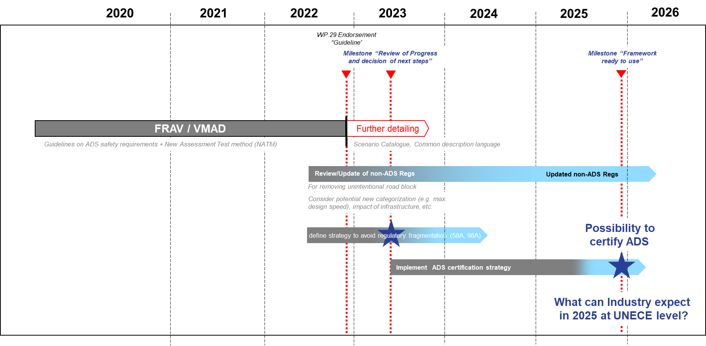
Our Target and motivation… (Reminder from GRVA-13)
Industry readies for market introduction of ADS
Need for harmonization
Need for legal certainty
Industry is in preparation for all relevant regulatory topics to support activities under UNECE, e.g.:
Review and amendment of non-ADS Regulations (“make existing Regulations work for AV’s”)
Categorization of Automated Vehicles
Strong involvement in all AD-related working groups (FRAV, VMAD, DSSAD, WP.1-IGEAD, ITS, …)
Vision Industry Roadmap 2025: GRVA-13-18e & WP.29-187-21

Slide 3
Need for new vehicle categories for AV’s?
Since the applicability of Regulations is defined by the vehicle categories the question came up if existing vehicle categories are still appropriate to be used for Automated Vehicles
The large variety of new use cases and vehicle designs will require to link the respective requirements to such concepts. This could be done either by creating new vehicle categories or by considering the different use cases in the individual system regulations. A balanced approach seems to be most appropriate.
It is identified that Automated Driving will have a fundamental impact on how such vehicles will be used and operated. This will require a number of adaptations to existing requirements (as well as in some cases maybe generating new ones) and, as a logical consequence, drive a new categorization of vehicles . Basic use cases to be differentiated include:
Furthermore, it can be expected that the more the categorization is aligned with the existing boundaries (e.g. GVM limits), the easier the existing requirements in the existing non-ADS Regulations can be applied.
Vehicles which can be operated with or without driver (dual mode vehicles)
Vehicles which can not be driven manually under nominal conditions and - which are designed to carry occupants - which are designed to carry no occupants (freight only)
Low speed driverless vehicles

Slide 4
Status of non ADS-Regulation review
Industry is contributing to the Task Forces / Informal Working Groups in charge of reviewing the non-ADS Regulations in view of Automated Driving already established under the GR’s
Industry has set up groups of experts reviewing the non-ADS Regulations as per GR’s
Industry is preparing overview slides on the non-ADS Regulations and identifies the required amendments in view of the different vehicle use-cases/automated vehicle categories.
Important to agree on basic concept for system boundaries (e.g. which requirements to be covered by ADS Regulation, which requirements by non ADS Reg.)

Slide 5
Basic assumptions For non ADS-Regulation review
What has to be covered by which Regulation?
Demand generation
Demand execution
Actuating
Transmission
(ECU/) Actuator
Driver
Control
(Control) Transmission
ADS
ECU
Transmission
Actuator
ADS Reg
Non-ADS Reg

Slide 6
Basic assumptions For non ADS-Regulation Review
Warning and response in case of failure
Warning generation
Response to signal
System
Warning signal
Driver
Signal
ADS
ADS Reg
Adequate response to system failure
„Control tower“ (if applicable)
Vehicle occupants (if applicable, e.g. passengers in a shuttle)
Non-ADS Reg (Steering, braking, etc.)

Slide 7
Industry is prepared to support and to Contribute…
Thank you for your attention!

