Slide 1
Proposal for V2V data interaction
Submitted by the expert from China
Informal document GRVA-14-20
14th GRVA, 26-30 September 2022
Provisional agenda item 5 (c)
For the 14th meeting of WP.29/GRVA
Submitted by the experts from China
2022/09/27

Slide 2
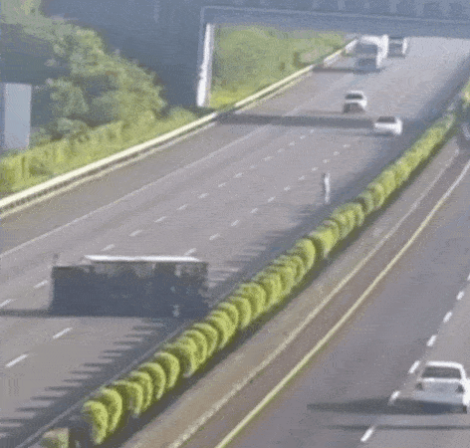
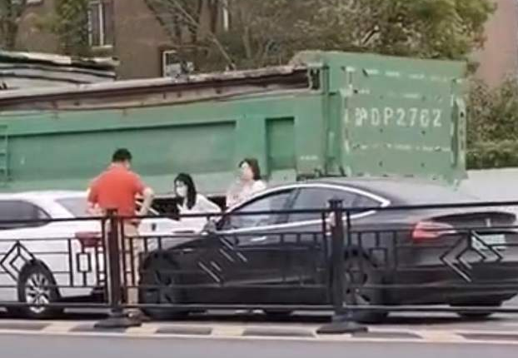
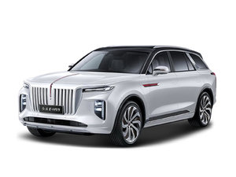
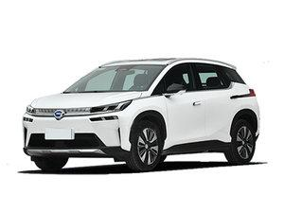
Data interaction improves driving safety
Promote the connectivity of vehicles. Whether a vehicle can send and receive data accurately is an important factor for the vehicle to realize connection function.
Improve traffic safety. Based on the V2V data interaction, vehicles can realize functions such as vehicle fault warning, forward collision warning, emergency braking warning, to improve traffic safety.
Language, grammar and truth-telling
Achieve effective communication
similar
data content
data format
data rules
reminder of secondary accident
vehicle interconnection
forward collision warning

Slide 3
V2V data interaction has a broad practice for standards and regulations
1.ISO
2.ITU
3.IEC
ISO/TC22/SC31
WG6 Extended vehicle/Remote diagnostics
ITU has developed standards related to connected vehicles, such as H.550, H.560, Y.4119, etc
IEC has formulated relevant standards for communication interface between vehicle and grid
4.SAE
5.Europe
6.Japan
SAE has formulated SAE J2735, SAE J2945 and SAE J3161 series standards.
European ETSI has formulated four types of networked vehicle standards, including active road safety, cooperative traffic efficiency, cooperative local service and global Internet service, covering V2V, V2I, V2N,etc
The ITS Connect Promotion Association of Japan has promoted the formulation of message sets, communication specifications, communication security, testing and other standards.

Slide 4
Proposal for carrying out preliminary research on V2V data interaction
China proposes to carry out preliminary research on V2V data interaction at the WP.29 level, so as to promote vehicle connectivity and improve driving safety around the world.
Standardize the content and format of V2V data interaction, and do not restrict the communication technology route.
D
S
R
C
OR
C-
V
2
X
C
o
n
n
e
c
t
i
o
n
F
u
n
c
t
i
o
n
Data Consistency Requirements
Data Content
Data Format
Data Broadcast Rules
Unified Data Elements
Definition
Data Meaning
Unified
Data Precision
Definition
Data Filling
Broadcast Frequency
Optional or Mandatory
Vehicle level
Communication Performance Requirements
Antenna Performance
Radiated Power
Receiving Sensitivity

Slide 5
How to carry out V2V data interaction
Is the object of V2V data interaction regulation a system or a whole vehicle?
If V2V data interaction regulations are formulated, at what level should this work be carried out? A dedicated Task Force or other Task Force?
How to coordinate the formulation of standards/regulations on the communication level of V2V data interaction?

