Slide 1
Open issues for Automated Driving Assessment &Test and Suggestions
Submitted by the expert from China
Informal document GRVA-14-20
14th GRVA, 26-30 September 2022
Provisional agenda item 5 (c)
For the 14th meeting of WP.29/GRVA
Submitted by the experts from China
2022/09/27

Slide 2
01 Problems with Automated Driving Assessment & Test in Practical Level
02 Questions & Answers
03 Exploration in Chinese National Intelligent Connected Vehicles Standard
04 Suggestions from China

Slide 3
01Problems with Automated Driving Assessment & Test in Practical Level
UN regulations
VMAD：New Assessment/Test Method for Automated Driving (NATM) Guidelines
FRAV：Guidelines and Recommendations concerning Safety Requirements for Automated Driving Systems
Reference and exploration
Problems found by the industry
Question 1: How to assess the robustness of the Validation & Verification? How to assess the boundary of the three test pillars?
Question 2: Is it necessary to define proving ground scenarios and concrete test cases to ensure the bottom line of safety? At present, the testing and certification scheme is negotiated between the manufacturer and the certification authority

Slide 4
01 Problems with Automated Driving Assessment & Test in Practical Level
02 Questions & Answers
03 Exploration in Chinese National Intelligent Connected Vehicles Standard
04 Suggestions from China

Slide 5
02Questions & Answers
Questions 1: Answers from NATM Guideline
Questions | Answers from NATM Guideline
Questions 1: How to assess the robustness of the Validation & Verification? How to assess the boundary of the three test pillars? | Assessment of the Verification strategy (e.g. verification plan and matrix) that describe the validation strategy and the integrated use of the pillars to achieve adequate coverage. Produce an efficient, comprehensive, and cohesive process, considering their strengths and limitations. The methods should complement one another, avoiding excessive overlaps or redundancy to ensure an efficient and effective validation strategy. Track tests: Assess the performance of an ADS in a discrete number of physical tests. It can also be used as additional data to validate the virtual tests. Real-world testing: Scenarios may not be precisely represented virtually or on a track test. It can be used for virtual validation and/or track tests. Virtual testing: A large number of tests for different parameters can be carried out.

Slide 6
02Questions & Answers
Questions 1: Answers from UN R157.01
Questions | Answers from UN R157.01
Questions 1: How to assess the robustness of the Validation & Verification? How to assess the boundary of the three test pillars? | Results of validation and verification may be assessed by analyzing coverage of the different tests and setting coverage minimal thresholds for various metrics. Verifying functions of "The System" under non-failure conditions by testing on a track and real-world testing. Simulation tool and mathematical models for verification of the safety concept.(checked under the influence of faults) Simulation shall not be a substitute for physical tests in Annex 5 and Annex 6 of this UN Regulation. Verify the accuracy of simulation tools used by means of results from track and/or real-world testing.
6

Slide 7
02Questions & Answers
Questions 2: Answers from NATM Guideline
Questions | Answers from NATM Guideline
Questions 2：Is it necessary to define proving ground scenarios and concrete test cases to ensure the bottom line of safety? | Annex II Functional Scenarios for divided highway application. It is recommended that sampling techniques be used when selecting parameters to be used in creating logical and concrete scenarios for ADS validation for a particular ADS and its ODD.
7

Slide 8
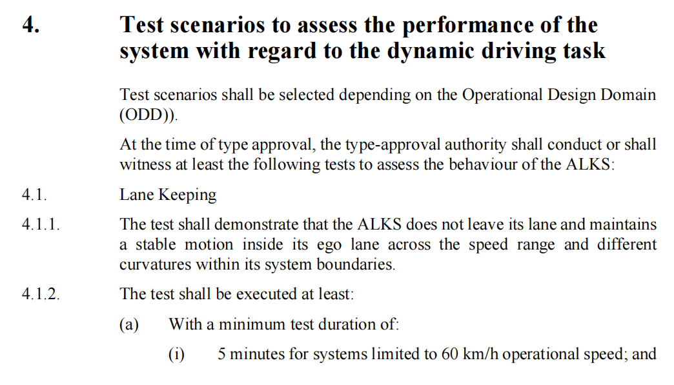
02Questions & Answers
Questions 2: Answers from UN R157.01
Questions | Answers from UN R157.01
Is it necessary to define proving ground scenarios and concrete test cases to ensure the bottom line of safety? | R157 Appendix V is about the third-party proving ground test. The third-party proving ground test is carried out from seven items: lane keeping, avoiding collision with road users or obstacles, following the vehicle in front, cutting in the vehicle in front, encountering static obstacles after the vehicle in front cutting out, FOV test, lane change, and avoiding emergency operation. However, the scenarios to be tested for each project are not given directly, but rather the scenario elements to be considered. The current understanding of the scheme is that this part of scenarios and test cases are determined by the certification authority and testing agency through joint consultation according to the product function of the enterprise.

Slide 9
01 Problems with Automated Driving Assessment & Test in Practical Level
02 Questions & Answers
03 Exploration in Chinese National Intelligent Connected Vehicles Standard
04 Suggestions from China

Slide 10
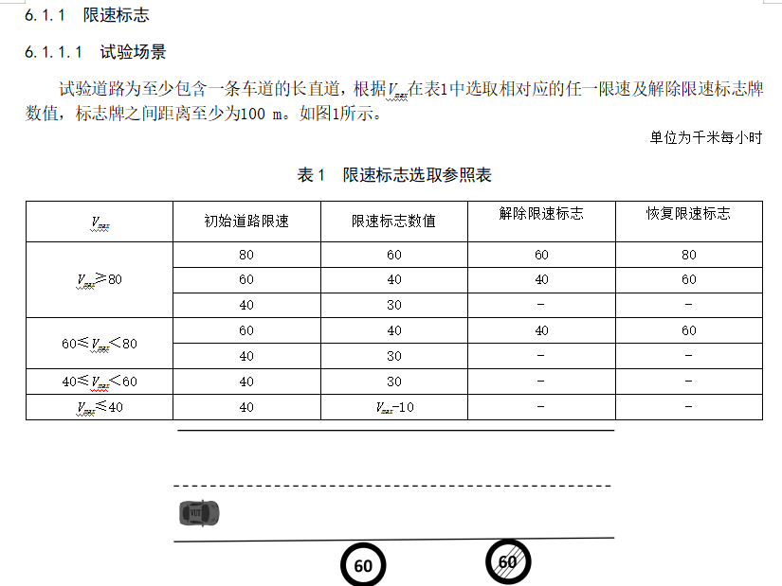
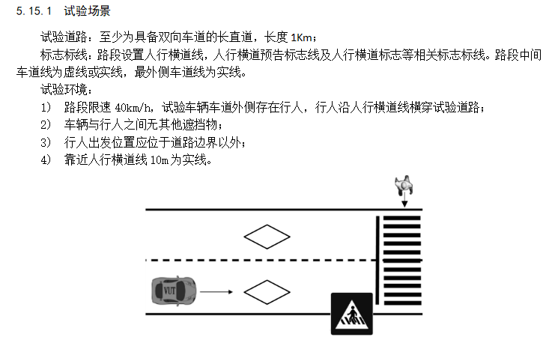
03Exploration in Chinese National Intelligent Connected Vehicles Standard
China has explored the allocation of ADS assessment & test methods in relevant standards. For the ADS general technical requirements, by consideration of the complementarity of simulation tests, track tests, road tests, audits, and other pillars, the assignment recommendation of pillars for relevant safety requirements is given. Concrete test cases for specific scenarios in the track & simulation test standard are listed as not exhausted. In the future, we will also actively contribute to the work of GRVA-related IWGs.
GB/T General technical requirements for automat driving systems
GB/T Field test methods and requirements for automated driving function
GB/T Automated driving function simulation test methods and requirements

Slide 11
01 Problems with Automated Driving Assessment & Test in Practical Level
02 Questions & Answers
03 Exploration in Chinese National Intelligent Connected Vehicles Standard
04 Suggestions from China

Slide 12
04Suggestions from China
During the following activities of FRAV & VMAD, two deliverables are suggested as supplements for guideline documents.
（1） Assessment for Verification strategy including the methodology of integrated use of the pillars to achieve adequate coverage and the method to define coverage thresholds.
（2）Examples of Verification strategy
（3）Concrete test case catalog ( necessary bottom line of safety)

