Slide 1
Report of the TF on ADAS for the 14th GRVA Session
Submitted by the TF on ADAS Co-Chairs
Informal document GRVA-14-18
14th GRVA session 26-30 September 2022
Provisional agenda item 6(a)

Slide 2
Status after the 13th GRVA session
Two online meetings (1 June, 30 August)
Four online meetings of the Drafting Group
Two proposals for UN R 79 are kept on hold
One new proposal for UN R 79 had been considered by the TF
Link to the TF documents: https://wiki.unece.org/display/trans/ADAS

Slide 3
Outcome on the pending proposals for UN R 79
Document | System | Objective of the proposal | Status
GRVA/2021/09 | ACSF C | Introduce a tolerance of 10% to the critical distance. | Pending a revised proposal. No change in the status. The request is to keep the working document in the GRVA agenda.
GRVA/2021/10 | ACSF C | Extend allowed time to start a LCM to 7 s (or more). | Pending a revised proposal. No change in the status. The request is to keep the working document in the GRVA agenda.
GRVA-14-XX New proposal | ACSF C | Additional clarification regarding activation of ACSF C | The proposal had been considered by the TF and the comments had been provided to OICA+CLEPA.

Slide 4
Progress with drafting the DCAS UN Regulation
The Small Drafting Group (SDG) was set up at the 11th ADAS TF session
The SDG participants: RUS, EC/JRC, NL, UK, AVERE, OICA, CLEPA, AAPC
The SDG:
Developed and agreed DCAS key principles, which were further agreed by the ADAS TF at the 12th session
Developed the method of reviewing the Master Document (The latest version ADAS-13-02 was prepared by the TF Secretary and circulated within the SDG)
Started the consideration and revision and restructuring of the Master Document (starting point ADAS-13-02)
The resulting Master Document ADAS-14-02 was presented to the TF with the invitation to the stakeholders to provide comments and proposals

Slide 5
DCAS Master Document Review Process Stages & Timing
16/17 GRVA
May/Sep. ‘23
Draft 3
(final)
14 GRVA
Sep. ‘22
Draft 1
15/16 GRVA
Jan./May ‘23
Draft 2
15 ADAS TF
Nov. ‘22
Draft 2 = ADAS-15-02
Interim
14 ADAS TF
30 Aug. ‘22
Draft 1 = ADAS-14-02
10 DG
Oct. ‘22
11 DG
Oct. ‘22
We are here
Stage 1
Stage 2
Stage 3
Stage 1
overview and restructuring
identify issues (redundancies, contradiction with principles, interpretation…) to be solved on the Stage 2
Stage 2
detailed review
agree on content of the requirements
Stage 3
fine tuning
finalize wording and definitions

Slide 6
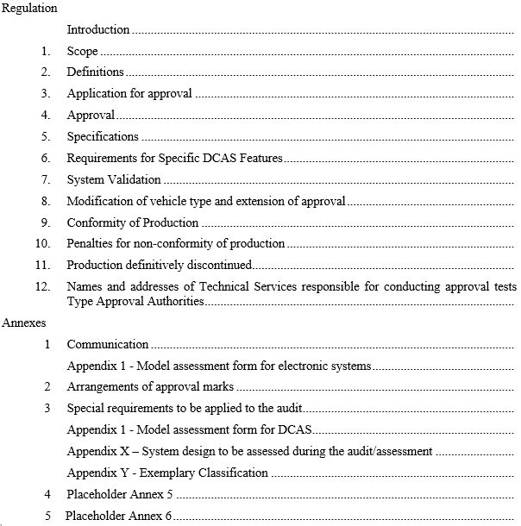
The Results of Restructuring (1)
MD ADAS-14-02
5. Specifications
5.1. General Requirements
5.1.1. General operational principles
5.1.2. DCAS interaction with other vehicle assistance systems
5.1.3 Functional requirements
5.1.3.1. General OEDR requirements
5.1.3.2. System boundaries
5.1.3.3. Vehicle dynamic behaviour / system dynamic control assistance
5.1.3.3.1. Lane Keeping
5.1.3.3.2. Lane Change
5.1.3.3.2.1. General Requirements
5.1.3.3.2.2. Specific Requirements for driver initiated lane change assistance [Placeholder]
5.1.3.3.4. Deceleration
5.1.4. System safety response to detected failures
5.1.5. DCAS and driver interactions (two directions)
5.1.5.1. Driver operation of the system (what the driver does with the system)
5.1.5.1.1. DCAS modes of operation (off / stand-by / active)
5.1.5.1.2. System activation and deactivation
5.1.5.1.2.x. Preconditions for DCAS activation
5.1.5.1.3. System status information
5.1.5.1.4. System deactivation
5.1.5.1.5. Driver override
5.1.5.2. System assurance of driver engagement (what the system does with the driver)
5.1.5.2.1. Driver monitoring strategy/mechanism
5.1.5.2.1.1. Monitoring Requirements
5.1.5.2.1.2. Criteria for proper driver engagement
5.1.5.2.2. Driver disengagement
5.1.5.2.3. Warning Cascade
5.1.5.3. Driver Information Material [education]/[instruction] with regard to DCAS

Slide 7
The Results of Restructuring (2)
MD ADAS-14-02
Still under development
6. Requirements for specific DCAS features
6.1. Specific requirements for advanced driver initiated maneuvers
6.1.1. Advanced driver initiated lane change
6.1.2. Advanced assistance for other driver initiated maneuvers [Placeholder]
6.1.3. [Low speed manoeuvring] [Placeholder]
6.2. System initiated manoeuvers
6.2.1. General requirements for system initated manoeuvres
6.2.1.1. Functional requirements
6.2.1.2. HMI
6.2.2. Specific requirements for system initiated lane change
6.2.2.1. Functional requirements
6.2.3. Specific requirements for maneuvers to transition from one phase of lane keeping to another
6.2.3.1. Functional requirements
6.2.3.2. Special provisions for dedicated maneuvers
6.2.3.2.1 Special provisions when forming an access corridor for emergency and enforcement vehicles
6.3. Specific requirements for hands-free driving [Placeholder] (VDA ongoing study)

Slide 8
Segregating Vehicle Control Assistance Systems between UN Regulation No.79 and DCAS UN Regulation (to be confirmed by the ADAS TF)
UN Regulation No. 79 presently covers:
ACSF A, ACSF B1, ACSF C, CSF, ESF, RMF
DCAS UN Regulation to cover:
Any other vehicle control assistance systems (see use cases in ADAS-08-04)
DCAS is considered as a combination of different vehicle control assistance systems/functions, which could be type-approved at once
For each system/function included into the combination the manufacturer shall provide necessary documentation as it would require by the DCAS UN Regulation.
The combination may include systems presently covered by UN Regulation No. 79.
[It should be up to the manufacturer whether to apply for approval of these systems pursuant to UN Regulation No. 79 or pursuant to the new UN Regulation.]

Slide 9
Next steps
Start of stage 2 with detailed review of the requirements
Section Modes of Operation
Section Driver Engagement Monitoring
Review of the existing requirements
Assessment of DCAS → elaborating on the annexes
Introduction and definitions could be checked after finalizing the requirements in stage 3
The DG meetings:
1st week of October 2022 (TBC)
3rd of 4th week of October (TBC)
15th ADAS TF session → 1st or 2nd week of November 2022

Slide 10
Thank you for your attention!

Slide 11
Back-up

Slide 12
Background
GRVA adopted at its 9th session in February 2021 the terms of reference for the Task Force on Advanced Driver Assistance Systems (ADAS).
The Task Force (TF) focuses on Advanced Driver Assistance Systems (ADAS), and shall address the simplification of UN Regulation No. 79 and if needed, develop a new ADAS UN Regulation with a focus on ADAS systems up to of level 2 (as defined in ECE/TRANS/WP.29/1140).
The TF on ADAS agreed to start developing a new UN Regulation

Slide 13
Two Parallel Workstreams of the TF
Development of the provisions for the new ADAS use cases
Analysis of ADAS use cases and associated requirements
Development of the definitions, classification and scope of regulatory activities
Development of the high-level regulatory items for ADAS
New UN Regulation on longitudinal + lateral control on a sustained basis
Working on the pending proposals for UN R 79
Finding open issues hindering to adopt the proposals
Proposals on how to resolve open issues
Drafting the amended proposals to UN R 79

Slide 14
Agreed DCAS Key Principles
1. “Driver” refers to a human being driving a vehicle.
1.1. A DCAS does not replace the driver (ADS); a DCAS assists the driver (ADAS).
1.2. A DCAS does not change the driver’s responsibilities for control of the vehicle.
2. A DCAS is a driver-operated vehicle system.
2.1. A DCAS must prevent reasonably foreseeable risks of driver misuse or abuse.
2.2. A DCAS must have means to evaluate continuous driver involvement in and supervision of the vehicle operation.
2.3. A DCAS do not aim to permit driver activities other than driving in addition to those permitted for manual driving.
2.4. A DCAS must provide sufficient information to enable the driver to supervise its motion-control assistance.
3. A DCAS assists the driver via sustained lateral and longitudinal motion-control support.
3.1. The DCAS support must not adversely impact road safety.
3.2. The DCAS support must not adversely impact driver control over the vehicle behavior.
4. The availability of a DCAS to the driver is constrained by defined system boundaries.
4.1. The manufacturer must describe the system boundaries.

Slide 15
Procedure of SDG for the review (Stage 1)
Guiding questions:
Does each requirement comply with key principles?
Is each requirement applicable to all types of DCAS?
Does it need to be moved in another place?
Is side comment/discussion point relevant for this headline/sub-headline?
Should additional paragraph(s) be introduced to address such side comment/discussion point?
Derived tasks
Check if the existing requirements are in line with the principles and in the right place
Add missing requirements, where necessary
Clustering of the several DCAS features (what is specific, what in common?)
Establishment of a new structure to address the clustering approach

