Slide 1
Proposal to start discussion of Acceleration Control for Pedal Error (ACPE)
Submitted by the expert from Japan
Informal document GRVA-14-14
14th GRVA, 26-30 September 2022
Provisional agenda item 6 (c)
♯14 GRVA
26-30th September 2022
Japan

Slide 2
Purpose and Contents of this presentation
Japan would like to propose to start discussion of making new UNR regarding Acceleration Control for Pedal Error (ACPE).
In this presentation, we explain the following contents;
1. What is ACPE?
2. Japanese situation of ACPE
3. Benefit for future traffic safety in the world
4. Plan for the discussion

Slide 3
1. What is ACPE?
2. Japanese situation of ACPE
3. Benefit for future traffic in the world
4. Plan for the discussion

Slide 4
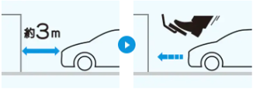
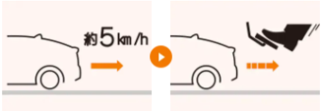
1. What is ACPE?
ACPE stands for Acceleration Control for Pedal Error.
Drivers sometimes mis-use acceleration pedal instead of brake pedals by mistake, in the case of unusual situation, such as collision cases, going back cases.
Especially, elderly drivers tends to make a error more than young drivers.(See later slide)
If the vehicle accelerate in such error situation, it may cause terrible accidents.
Examples of ACPE
Ex1 detecting object in front vehicle
Ex2 detecting object backward of vehicle
Approx. 3m
Approx. 5km/h
Ex1 and 2) By detecting object, the system determines that the driver has stepped on the wrong pedal.

Slide 5
1. What is ACPE?(Effect by ACPE)
ACPE can prevent accidents caused by error of pedals.
In some analysis, ACPE has a big effect to be able to prevent 63% of all relevant accidents.
Without ACPE
With ACPE
※The number of accidents in this survey:195

Slide 6
1. What is ACPE?
2. Japanese situation of ACPE
3. Benefit for future traffic in the world
4. Plan for the discussion

Slide 7
2. Japanese situation of ACPE (Background data of accidents in Japan)
Number of fatalities in traffic accidents is decreasing in Japan.
However, the number of elderly driver is increasing, we need to have some counter measurements to prevent the accident caused by elderly drivers.
Casualties （persons）
Fatalities（persons）
2,636 persons
（2021）

Slide 8
2. Japanese situation (the number of elderly drivers)
The number of license holders over 75 years old will continue to increase in Japan.
Trend of number of license holder (total and elderly driver)
Number of license holders aged 75 and over
(Thousands)
免許保有者数
（千人）
75歳以上免許保有者数
（千人）
Number of license holders
(Thousands of persons)
Estimated
実績
推計
track record
75 years old and over
Percentage of license holders 9.2
75歳以上の
免許保有率 9.2%
Number of license holders (left axis)
Number of license holders over 75 years old (right axis)
75歳以上の
免許保有率 4.0%
75 years old and over Percentage
of license holders 4.0
2009
(Year)
※ R2～6年の75歳以上免許保有者数推計は警察庁資料より
R7年の運転免許保有者数推計は（公財）交通事故総合分析センター平成24年第15回 交通事故・調査分析研究発表会より
R7年の75歳以上免許保有者数及びR2～R6年の免許保有者数は上記数値より自動車局推計
（年）
Estimates of the number of license holders aged 75 and over in R2-6 are from the National Police Agency.
Estimates of the number of driver's license holders in R7 are from the 15th Traffic Accident and Investigation Analysis Research Presentation in 2012 by the Traffic Accident Analysis Center.
The number of license holders aged 75 and over in R7 and the number of license holders in R2 to R6 are estimated by the National Bureau of Motor Vehicles based on the above figures.Translated with www.DeepL.com/Translator (free version)

Slide 9
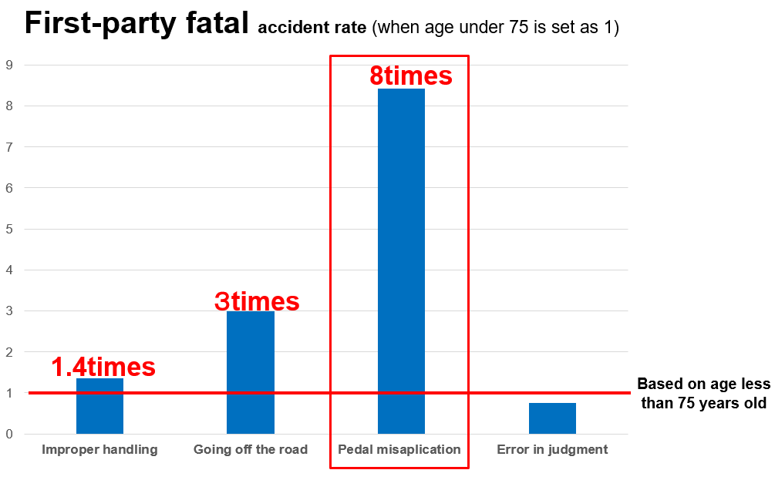
2. Japanese situation (reason of pedal misapplication)
When we see only fatal accidents, 47 fatal accidents occurred in one year. And around 4,000 accidents happened in total per year.
Such accidents are expected to increase according to the increase of elderly drivers.
Elderly drivers are more likely to pedal incorrectly and cause accidents than drivers of other generations (8 times of other generation).
Types of accidents which elderly drivers tend to cause comparing with other generation’s driver

Slide 10
2. Japanese situation (an actual accident in Japan)
A serious accident involving 2 fatalities and 8 injuries happened in central Tokyo in 3 years ago.
This accident caused big social discussion for such accident.

Slide 11
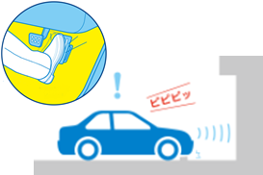
2. Japanese situation (promotion of ACPE)
MLIT has promoted ACPE strongly after the serious accident, together with AEBS.
The ratio of new vehicle with ACPE is increasing up to over 90% by a subsidiary and certification.
MLIT has started NCAP as well.
１．Promotion of ACPE, “sapo-car campain”
２．Certification and subsidiary
Purchase of Vehicles | ①＋② | ①
registered vehicle | 100,000 yen | 60,000 yen
車両購入 | ①＋②の場合 | ①のみの場合
登録車 | 10万円 | 6万円
①AEBS
②ACPE
２５３型式認定
253 type approved
３２５型式認定
325 type approved
※PMPD=ACPE
90％ of new vehicles have ACPE in Japan. But levels of prevention are different

Slide 12
1. What is ACPE?
2. Japanese situation of ACPE
3. Benefit for future traffic in the world
4. Plan for the discussion

Slide 13
3. Benefit for the future traffic in the world
ACPE is beneficial, only for Japan or not?
We do believe ACPE is clearly beneficial for the world including Europe.
The reasons of this are;
- Expectation of increasing total population of elderly people
- Expectation of increase of other types of pedals
- Increase of Automatic Transmission
- This data shows that aging society will come soon in all over the world.
- That means that the number of elderly driver will increase as Japan.

Slide 14
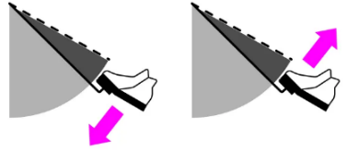
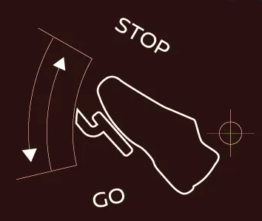
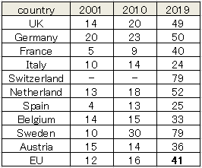
3. Benefit for the future traffic in the world (other types of pedals)
In addition to elderly driver, Other types of pedals may have another potential risk of relevant accidents.
EV dose not have a manual transmission, so automatic transmissions will increase. And other types of pedaling, such as one pedal system, may be another factor.
The number of EV is expected to increase in near future.
EV sales in the global market
Sales volume will be approximately 6.6 million
ON
STOP
Percentage of new car registrations and sales of passenger cars with automatic transmissions in European countries
Global Sales and Sales Market Share of Electric Cars, 2010-2021, IEA
Japan is over 99%AT
Materials : ICCT

Slide 15
3. Benefit for the future traffic in the world (actual accident)
In Sep 2020, a female driver, 39 years old, made a collision to a school gate with high speed, and caused 11 injuries including 7 kids, when she tried to pick up her kids. This accident seems to be caused by pedal error, in UK.
We need to do an effort prevent to repeat such accident. ACPE is one of the important measures to prevent them.

Slide 16
1. What is ACPE?
2. Japanese situation of ACPE
3. Benefit for future traffic in the world
4. Plan for the discussion

Slide 17
4. Plan for the discussion
Considering the situation explained in this presentation, Japan proposes the start of the discussion of ACPE.
Tentative plan of this discussion is as follows.
We hope GRVA members consider to this issue positively.
Idea of schedule (optimistic situation)
Within 2022 kick off for TOR
2023/2 GRVA#15 adoption of TOR and starting IWG
2023/3 start IWG
2024/2 informal doc to GRVA
2024/5 formal doc to GRVA
2024/11 formal doc to WP29

Slide 18
Thank you for your attention.

