Slide 1
Informal document GRVA-14-03
14th GRVA, 26-30 September 2022
Agenda item 2
Note by the secretariat
General information and highlights from the
June 2022 (Hybrid) sessions
of WP.29 / AC.1 / AC.2 / AC.3 / AC.4

Slide 2
General information
Next sessions of GRVA
-15th GRVA: 23-27 January 2023 (These date might change if China’s request can be implemented)
Deadline for official working documents: 31 October 2022
-16th GRVA: 22-26 May 2023 Deadline for official working documents: 27 February 2023
-17th GRVA: 25-29 September 2023 Deadline for official working documents: 3 July 2023

Slide 3
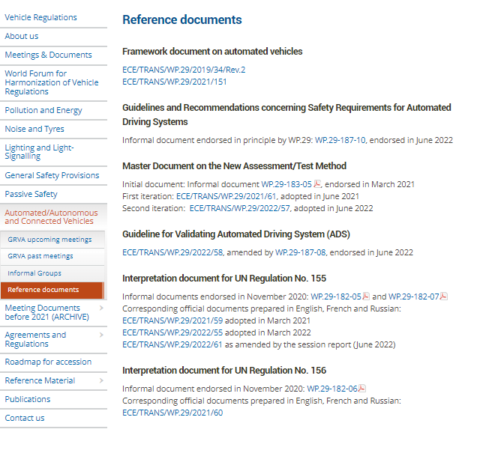
General information
The usual deliverables produced within the framework of WP.29 and its GRs are available online here:
UN GTRs:
https://unece.org/transport/standards/transport/vehicle-regulations-wp29/global-technical-regulations-gtrs
UN Rules: https://unece.org/rules
UN Regulations: https://unece.org/un-regulations-addenda-1958-agreement
**New**:
Deliverables under the Framework Document (FDAV)
https://unece.org/reference-documents-0

Slide 4
General information
Request from the secretariat for documents:
-Official documents shall be prepared according to the instructions in WP.29-157-24 (see ECE/TRANS/WP.29/1097, para. 12)
-For facilitating the translation of documents, please provide to the secretariat the drawings and pictures that include text in an editable format so that the text can be translated.
In addition, for IPR related reasons:
-The submitter of any document (including a presentation) may be invited to confirm that publication of this document on the UNECE website and further use does not violate any copyright/intellectual property rights and that the submitter agrees to hold UNECE harmless of any copyright/intellectual property claims concerning this document.
-If a document contains materials of third parties, permission of these parties may be required.

Slide 5
Highlights of the June 2022 sessions: (see ECE/TRANS/WP.29/1166 for more details)
AC.2 - resume consideration of a proposal for an IPR policy applicable to WP.29 and AC.2
- invited the GRs to prepare the list of priorities for 2023
- offered to provide guidance in case there would be no consensus on the election of officers
- supported the idea of organizing a GRVA meeting outside of Geneva in 2023 or 2024
- invited GRVA to develop an update to the Framework Document
- discussed the format, content and deliverables of a cooperation with WP.1
- recommended to use the template prepared by OICA for the review of UN GTRs and Regulations with regards to ADS

Slide 6
Highlights of the June 2022 sessions: (see ECE/TRANS/WP.29/1166 for more details)
WP.29 -received opening remarks from Director General Notsu (MIIT/Japan) and Director General Park (MOLIT/Korea) - both highlighted the importance of GRVA for their domestic activities
-invited the GRs to implement the guidelines prepared by the Secretary concerning the election of officers
-discussed new ideas for the collaboration with WP.1 related to ADS proposed by the representative of Canada, to go beyond a communication exercise
-recommended GRVA to reflect on the suggest of the Netherlands to amend the title of UN Regulation No. 157 to reflect the content of the 01 series of amendments.
-discussed the need to introduce UI provisions in relevant UN Regulations to support a uniform implementation of UI in the marketplace
-endorsed the: - 2nd iteration of the NATM Master document, NATM guidelines - FRAV guidelines and recommendations on ADS safety
-adopted the Recommendation on uniform provisions concerning Cyber and software updates
- incl. last minute correction by the GRVA secretariat to properly quote to paras. 7.3.1 and 7.3.4. of UN Regulation No. 155, which were very recently amended

Slide 7
Highlights of the June 2022 sessions: (see ECE/TRANS/WP.29/1166 for more details)
AC.3 -authorized GRVA to discuss Italy’s proposal to amendments to UN GTR No. 3 (Motorcycle brakes)
-noted that GRVA was seeking consensus on potential amendments to UN GTR No. 8 (ESC)
AC.4 -did not convene

