Slide 1
Informal document GRBP-76-29
(76th GRB, 5-7 September 2022,
agenda item 2)
Research on Measurement Methods for
LDV & HDV in Multiple Driving Mode Conditions
- CATC Data Study and Measurement Methods Research -
5-7th September 2022, GRBP 76th Session
Dongming Xie, Yanning Chang, Yu Liu, Xi Hu, Hanzhengnan Yu
China Automotive Technology and Research Center Co., Ltd.
1
Notes:
1

Slide 2
Review
January, 2018, the project GB/T “Measurement Methods for Noise Emitted by Light-duty Vehicles in Multiple Driving Mode Conditions” launched.
June, 2020, China introduced “Measurement Methods for Noise Emitted by Light-duty Vehicles in Multiple Driving Mode Conditions” in the 16th ASEP IWG meeting.
August, 2021, the project GB/T “Measurement Methods for Noise Emitted by Heavy-duty Vehicles in Multiple Driving Mode Conditions” launched.
October, 2021, GB/T 40578-2021 “Measurement Methods for Noise Emitted by Light-duty Vehicles in Multiple Driving Mode Conditions” published.
September, 2022, HDV working condition survey for the measurement methods based on CATC data.
2

Slide 3
GB/T 40578-2021 for LDV (Two questions are still remained)
Acceleration noise
cruise noise
Cruise noise
Test speeds (km/h) | V_{PP'}=30±1 | V_{PP'}=50±1 | V_{PP'}=70±2
Engine speeds (r/min) | n_{BB'}=Idle to 80%S
Acceleration (m/s²) | 0.5≤a_{test}≤3.5 | 0.5≤a_{test}≤3.0 | 0.3≤a_{test}≤2.5
Test Gears | (1+X/2)/2+1 | (1+X/2) | (X+X/2)/2+1
 | D for unlockable
Accelerator Position | POT or WOT (Both are possible)
Noise Tested | L_{max} per run for left side and right side separately
No. of Runs* | 2
Intermediate Result | Average of per side
Final result | Higher of averages
*M₁ (PMR≥90 kW/t), 2 runs can add at different acceleration.
Test speeds (km/h) | V_{PP'}=80±2 | V_{PP’}=110±2 for M₁ V_{PP’}=90±2 for others
Engine speeds (r/min) | n_{BB'}=Idle to 80%S
Acceleration (m/s²) | a_{test}≤0.15
Test Gears | Highest lockable gear or D for unlockable
Accelerator Position | POT (Cruise)
Noise Tested (dB(A)) | L_{max} per run for left side and right side separately
No. of Runs | 2
Intermediate Result | Average of per side
Final result | Higher of averages

Slide 4
Data Survey for HDV
Established a fleet composed of 76 heavy-duty vehicles, covering typical vehicle types, vocations and cities all over China.
Collected 1hz real-time data including vehicle speed, engine speed and other parameters by free driving operation.
Collected about 1.5 million kilometer’s real-road data by 3-6 months of stable driving.
 | Bus | Coach | Heavy Truck | Light Truck | Dumper | Tractor
Fleet Size | 13 | 12 | 15 | 12 | 10 | 14
Distance (10000 km) | 43.74 | 28.14 | 23.22 | 13.23 | 13.46 | 29.63
City | 16 cities covered (Harbin, Changchun, Hangzhou, Changsha, Guiyang, Fuzhou, Kunming, Nanning, Shuangliao, Xining, Linfen, Xiangyang, Huzhou, Nanchang, Xiamen)
Vocation | Intercity Long Haul 、Local Delivery、City Construction、Passenger Transportion…
Based on collected data, determine typical scenes that are prone to generate noise. Establish corresponding test projects in the standard system.
Based on scene information, calculate statistical characteristics to design specific test methods and conditions.
Notes:
Distance解释：城市客车公交车，固定路线Time跑，比较规范，Distance较长；普通客车，牵引车长途的客运货运，比较稳定；重型货车，城内物流，城间长途运输
轻型货车，自卸车，主要在城市内，功能性的，城市建设，环卫，Distance较短。
数据频率：1hz，GPS终端，
其他参数：扭矩、负荷、踏板也有采集
牵引 5.5吨，2.5吨 10L
货车：0.8 1.2 8 10 13L
自卸：1.6 2.5 4 6L

Slide 5
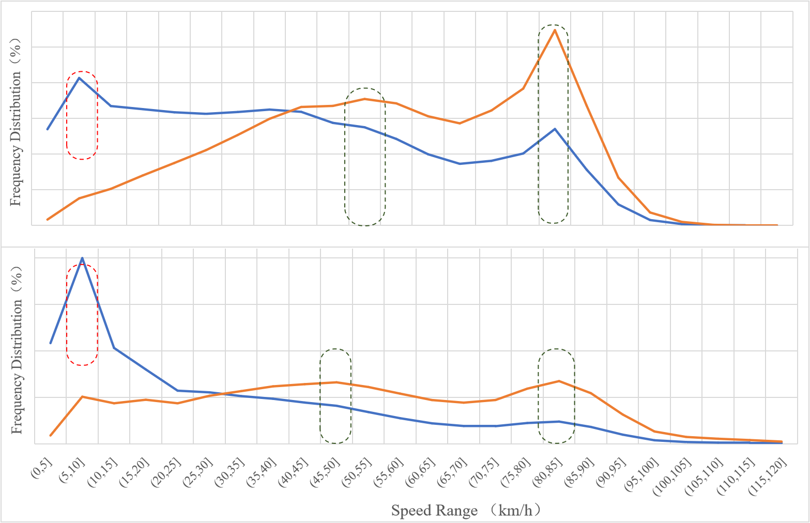
Data Survey for HDV (Speed)
For defferent vehicle types, locate high frequency speed distribution zones based on drive time and distance.
Heavy Truck
Drive Time
Distance
Light Truck
Notes:
Time统计：常出现的行驶情景
Distance的统计：因为噪声关注对于外界环境的影响，Distance代表车辆通过的距离，所影响到的范围。城市客车，Time峰值25-30，城市街道上行驶，Distance峰值35-40，在道路上开起来之后的速度，影响周围的小区；
普通客车：50-55,85-95；上了比较通畅的城郊、快速路，会选择的速度范围；在高速路上会选择的速度范围
低速受交通流影响较大

Slide 6
Data Survey for HDV (Speed)
Dumper
Tractor
Bus
Coach
Notes:
起步工况很重要，起步频繁，也是产生噪声的典型情景
从车辆起步到从一档转到二挡，是发动机转速较高，产生噪声较大的典型场景，提取该过程集合，统计加速度、转速的%数作为边界条件设定的参考。
自由行驶的条件下，选择的车速，和普通客车相比，稍微低一些，跟货车的性能有关
有必要在工况体系中设计加速行驶条件下的测量工况，实现对该场景车辆噪声的管控。我国车速分布较分散，有必要设定多个试验车速进行测量。
车辆在市区快速路上高速匀速行驶是产生市区交通噪声的典型场景，有必要在工况体系中设计匀速行驶条件下的测量工况，实现对该场景车辆噪声的管控。

Slide 7
Data Survey for HDV (Speed)
Vehicle Type | Speed Range | LOW | MID | HIGH
Bus | Time | 25-35 | —— | ——
 | Distance | 30-40 | —— | ——
Coach | Time | —— | 50-55 | 90-95
 | Distance | —— | 50-55 | 90-95
Heavy Truck | Time | 5-10 | —— | 80-85
 | Distance | —— | 50-55 | 80-85
Light Truck | Time | 5-10 | —— | 80-85
 | Distance | —— | 45-50 | 80-85
Dumper | Time | 5-10 25-30 | —— | ——
 | Distance | 25-30 | 50-60 | ——
Tractor | Time | 5-10 | 45-50 | ——
 | Distance | —— | 50-55 | 80-85
Test Speed Point |  | Starting + 30 | 50 | 80
Notes:
Time统计：常出现的行驶情景
Distance的统计：因为噪声关注对于外界环境的影响，Distance代表车辆通过的距离，所影响到的范围。城市客车，Time峰值25-30，城市街道上行驶，Distance峰值35-40，在道路上开起来之后的速度，影响周围的小区；
普通客车：50-55,85-95；上了比较通畅的城郊、快速路，会选择的速度范围；在高速路上会选择的速度范围
低速受交通流影响较大

Slide 8
Data Survey for HDV (Engine speed + Accelaration)
Calculate typical percentile values of engine speed and acceleration within± 5km/h range of test speed point.
Heavy-Truck
Engine Speed Percentile( Rated：2500rpm）
Speed | 50% | 80% | 90% | 95% | 99%
50 | 1449 | 1918 | 2019 | 2098 | 2236
80 | 1698 | 1781 | 2100 | 2169 | 2263
Acceleration Percentile(m/s2)
50 | 0.08 | 0.19 | 0.28 | 0.36 | 0.67
80 | 0.08 | 0.14 | 0.19 | 0.22 | 0.39
integrated noise
test results
[25-35]
[45-55]
[75-85]
test condition for certain vehicle type
Light Truck
Dumper
Engine Speed Percentile( Rated：2200rpm）
Speed | 50% | 80% | 90% | 95% | 99%
50 | 1259 | 1488 | 1560 | 1614 | 1863
80 | 1765 | 1783 | 1791.3 | 1801 | 1814
Acceleration Percentile(m/s2)
50 | 0.08 | 0.17 | 0.22 | 0.31 | 0.61
80 | 0.08 | 0.14 | 0.17 | 0.19 | 0.28
Engine Speed Percentile( Rated：3200rpm）
Speed | 50% | 80% | 90% | 95% | 99%
50 | 1748 | 2107 | 2293 | 2408 | 2976
80 | 2116 | 2650 | 2736 | 2799 | 2875
Acceleration Percentile（m/s2)
50 | 0.22 | 0.39 | 0.50 | 0.61 | 0.89
80 | 0.17 | 0.33 | 0.42 | 0.50 | 0.75
Engine Speed Percentile( Rated：2500rpm）
Speed | 50% | 80% | 90% | 95% | 99%
30 | 1382 | 1927 | 2014 | 2075 | 2199
50 | 1329 | 1454 | 1513 | 1557 | 1997
Acceleration Percentile(m/s2)
30 | 0.22 | 0.53 | 0.75 | 0.97 | 1.78
50 | 0.22 | 0.39 | 0.50 | 0.58 | 0.92
Notes:
从车辆实际行驶数据中定位并建立场景信息库，挖掘归纳典型运行特征，确定测量工况的具体试验方法和性能条件。
为测量工况的试验方法设计提供理论指导；归纳典型运行特征，为测量时的性能要求标定提供数据支持；最终确定测量工况的具体性能要求及试验方法。
单车的数据统计，今后完成对

Slide 9
Data Anylasis for HDV
Tractor
Bus
Coach
Engine Speed Percentile( Rated：1900rpm）
Speed | 50% | 80% | 90% | 95% | 99%
50 | 1142 | 1300 | 1355 | 1397 | 1470
80 | 1519 | 1575 | 1615 | 1637 | 1683
Acceleration Percentile(m/s2)
50 | 0.14 | 0.25 | 0.33 | 0.42 | 0.61
80 | 0.08 | 0.14 | 0.19 | 0.25 | 0.44
Engine Speed Percentile( Rated：2500rpm）
Speed | 50% | 80% | 90% | 95% | 99%
Overall | 1014 | 1425 | 1607 | 1778 | 2147
30 | 1154 | 1670 | 1793 | 1905 | 2051
Acceleration Percentile（m/s2)
Overall | 0.28 | 0.64 | 0.92 | 1.17 | 1.89
30 | 0.28 | 0.64 | 0.89 | 1.14 | 1.81
Engine Speed Percentile( Rated：2200rpm）
Speed | 50% | 80% | 90% | 95% | 99%
50 | 1339 | 1478 | 1551 | 1975 | 2188
80 | 1213 | 1469 | 1553 | 1605 | 1651
Acceleration Percentile(m/s2)
50 | 0.33 | 0.64 | 0.83 | 1.08 | 1.61
80 | 0.17 | 0.33 | 0.46 | 0.61 | 0.97
Engine Speed Percentile( Rated：1900rpm）
Speed | 50% | 80% | 90% | 95% | 99%
50 | 1057 | 1127 | 1160 | 1377 | 1497
80 | 1649 | 1703 | 1728.2 | 1743 | 1769
Acceleration Percentile(m/s2)
50 | 0.14 | 0.28 | 0.36 | 0.47 | 0.78
80 | 0.08 | 0.17 | 0.22 | 0.25 | 0.42
Engine Speed Percentile( Rated：2200rpm）
Speed | 50% | 80% | 90% | 95% | 99%
Overall | 1053 | 1195 | 1276 | 1349 | 1509
30 | 1112 | 1215 | 1309 | 1359 | 1434
Acceleration Percentile（m/s2)
Overall | 0.39 | 0.78 | 1.06 | 1.36 | 2.03
30 | 0.33 | 0.67 | 0.94 | 1.19 | 1.83
Engine Speed Percentile( Rated：2300rpm）
Speed | 50% | 80% | 90% | 95% | 99%
50 | 1213 | 1334 | 1380 | 1419 | 1872
80 | 1155 | 1192 | 1203 | 1211 | 1478
Acceleration Percentile(m/s2)
50 | 0.28 | 0.50 | 0.67 | 0.88 | 1.44
80 | 0.17 | 0.31 | 0.44 | 0.58 | 0.69
Notes:
从车辆实际行驶数据中定位并建立场景信息库，挖掘归纳典型运行特征，确定测量工况的具体试验方法和性能条件。
为测量工况的试验方法设计提供理论指导；归纳典型运行特征，为测量时的性能要求标定提供数据支持；最终确定测量工况的具体性能要求及试验方法。
单车的数据统计，今后完成对

Slide 10
Conclusions
Consider low- speed conditions for LDV (mixed with active sound, muffler and leisure noise problem, below 30km/h).
More accurate acceleration range is needed.
Emission Model and Evaluation Model for LDV are expected to be established (powertrain including engine and transmission system).
Testing speed 25-45 km/h and engine speed range (85-89% S) in UN R51-03 reflect the real-world working conditions well.
30±5km/h, 50±5km/h, 80±5km/h could be the propriate test speeds for HDV, but depends on the utilities and sub-categories of HDV.
Other conditions like the test mass need to study, and the work of HDV measurement methods will be finished next year.
10

Slide 11
Thanks for your attention!
China Automotive Technology and Research Center Co., Ltd.

