Slide 1
Transmitted by the IWG on DETA Informal document WP.29-187-27 187th WP.29, agenda item 4.5. (document DETA-44-07e rev1)
Report to 187th WP.29 session from the 44th IWG on DETA meeting
DETA: The secure internet database for exchanging approval documentation between the Contracting Parties of the 1958 Agreement, as required to be established by the UNECE, according to Revision 3 of this Agreement.

Slide 2
DETA - State of play
DETA is still under development but since May 2019 ready to be used for it base purpose:
34 Contracting Parties have notified their DETA Focal Point
App. 22600 approvals uploaded (+5000) by 15 TAA
App. 5600 manufacturers are uploaded and could be selected by TAA
13 manufacturers have access to DETA (only to their own approvals) (manufacturer’s access is to be requested via their approval authority and to be forwarded to the DETA Administrator)

Slide 3
DETA - State of play – Developments
Contracting and implementation Unique Identifier → contract for financial participation of industry is ready for signature → last fine tuning of specification is ongoing → awaiting the offer from the software supplier
Mass Upload Functionality → starting of test phase estimated in August TAA’s will be informed in due time
Q & A catalogue on the UI → first draft will be issued at the next IWG DETA

Slide 4
State of play – Extension of scope
Extension of scope DETA following WP.29/AC.2 assignment
→ Access to CS related information by the CPs of the 1998 Agreement → GRVA is addressing China’s request (GRVA-13-31) via a workshop
→ Access in the course of PTI (1997 Agreement) → IWG initiated a discussion to identify needs related to PTI, tbc. → IWG will report to WP.29 in November 2022 on results and possible solutions for addressing the needs → IWG will propose measures assuring necessary confidentiality

Slide 5
State of play – Presentations to GRs
Feedback from GRs with regard to the UI → The GRs received input on UI and responded
→ Ongoing, new presentation will be finalised after confirmation by WP.29 that: Schedule 4 of the 1958 Agreement (Rev.3) sets the basis conditions for use of UI.
The IWG is uncertain whether “practicalities” have to be defined in UN Regulations to support the use of UI.
Practicalities would secure uniform implementation and practices in the market.

Slide 6
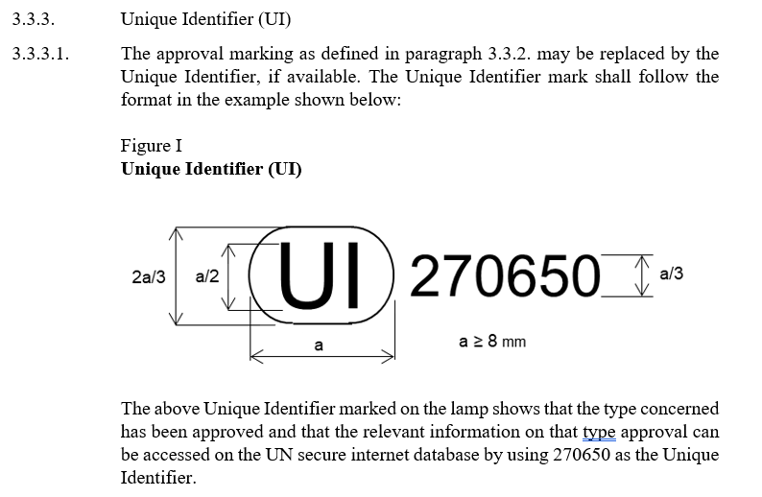
State of play – Presentations to GRs
Some cases where provisions in UN Regulations could be useful:
→ Standard text related to UI e.g.
→ Specification of the content of the summary document
See example from GRE
Amendment proposal to UN Regulation No. 148 tabled for adoption this week
(ECE/TRANS/WP.29/2022/92)

Slide 7
Questions to WP.29
UI implementation Should GRs be requested to include UI provisions in UN Regulations for which UI can be used in place of E mark (like in UN R148?)? YES / NO
→ If NO, can UI be used by Type Approval Applicants once the UI feature in DETA is ready?
WP.29 is requested to consider the position of IWG: That Contracting Parties may allow Technical Services to access DETA in case these Technical Services are performing an authoritative task under governmental control while other Technical Services being commercial economic operators, shall not be allowed access.

