Slide 1
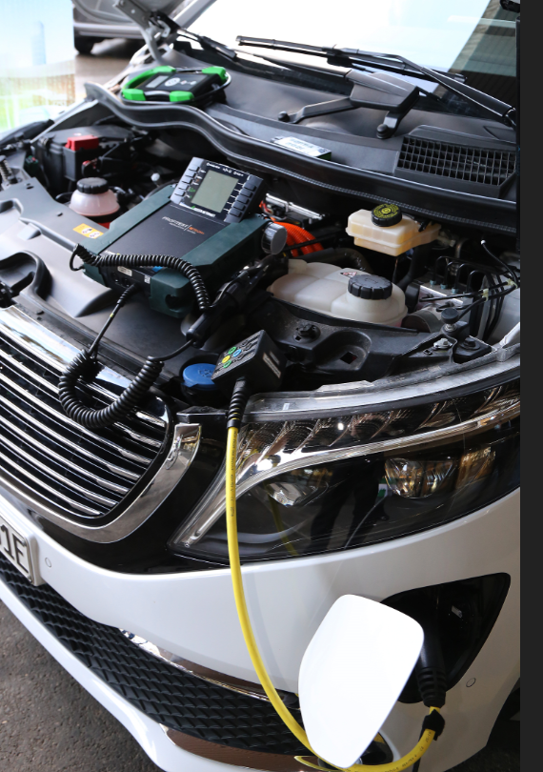
Working Party on Pollution and Energy (GRPE) Updates from latest ITC/WP.29 sessions, other UNECE activities
Note by the secretariat
Informal document GRPE-86-04
86th GRPE, 30 May-2 Jun3 2022
Agenda item 2
February 2022 ITC
Demo of Dekra’s battery health testers
Side event on Automation, connectivity and electrification (Film to introduce the topic)
New ITC Chair for 2023 and 2024 : Hannie Meesters, from the Netherlands
New Vice Chair : Antonio Erario (of 4 vice chairs)
WP.5 (trends and economics) tasked to develop two papers by Oct 2022
Climate change mitigation
ITC “invited its Working Parties to submit to the secretariat until 14 October 2022 their ongoing contributions, future plans, and suggestions in support of climate change mitigation.”
EV recharging infrastructure / Grid integration
“WP.5 to take into consideration the new trend towards electric charging infrastructure and, in coordination with the chairs of the relevant working parties, to prepare a first assessment of issues that need addressing in the realm of the ITC to be presented at the 85th session of the ITC”
First drafts available early July; time windows to react Sept / Nov => GRPE consultation group ?

Slide 2
Working Party on Pollution and Energy (GRPE) Updates from latest ITC/WP.29 sessions, other UNECE activities
Note by the secretariat
Informal document GRPE-86-04
86th GRPE, 30 May-2 Jun3 2022
Agenda item 2
March 2022 WP.29
AC.1 / AC.3 adopted all proposals from GRPE
AC.4 did not convene
requested all GR’s to perform a screening of UN Regulations, GTRs and Rules with regards to their fitness for Automated Driving Systems (ADS), incl. for driverless systems.
Further guidance expected by GRVA
Held the first meeting requested of the IWG on Safer and Cleaner Used and New Vehicles (SCUNV) that is hosted under WP.29
Main objective to agree on minimum requirements for used (in a first step) and new vehicle for economies in transition
More info:
https://wiki.unece.org/pages/viewpage.action?pageId=164397099
Next meeting on last day of June WP.29

Slide 3
Working Party on Pollution and Energy (GRPE) Updates from latest ITC/WP.29 sessions, other UNECE activities
Note by the secretariat
Informal document GRPE-86-04
86th GRPE, 30 May-2 Jun3 2022
Agenda item 2
Other activities
1- WP.6 (transport statistics) paper on
“Electric vehicle charging: analysis of CO2 emissions”
Raise interest from WP.6 to collect data on emissions and EV recharging infrastructure
2- Circular mobility podcast
Part of a series of 6 podcasts on circular economy; other circular economy podcasts on:
Measuring the Circular Economy, Energy, Forest, Food, Textile, Cities
To be released gradually over the summer in your favorite streaming platforms
World Economic Forum (Circular Car Initiative), GRPE Vice Chair, and UNECE secretariat have contributed to the circular mobility podcast

