Slide 1
The Regional Environmental Centre for Central Asia
Seventeenth meeting of the UNECE Steering Committee on Education for Sustainable Development
30 - 31 May 2022, Geneva, Switzerland
“Youth of Central Asia on the way of adapting to climate change and carbon neutrality”
Introduction to the agenda of the 10th Anniversary CALP
and OSCE “Regional training course on water diplomacy
with a special focus on gender-sensitive negotiation and mediation skills”
Almaty, Kazakhstan
16-25 September 2019
Tatyana Shakirova, Manager, Education for Sustainable Development Programme, CAREC
www.carececo.org
www.carececo.org

Slide 2
Strengthening synergies with other organizations and processes
The Regional Environmental Centre for Central Asia
Synergy with the UNECE Aarhus Convention: ACCESS TO ENVIRONMENTAL INFORMATION:
CACIP developed as a regional portal of climate and energy data https://centralasiaclimateportal.org/
Synergy with the UN FCCC:
the first Central Asian Pavilion at the UNFCCC’s Conference of Parties (COP-26) in Glasgow, Scotland, UK
Synergy with UNESCO and UNECE ESD and Youth strategies:
“13th CALP: Youth of Central Asia on the way of adapting to climate change and carbon neutrality”
Introduction to the agenda of the 10th Anniversary CALP
and OSCE “Regional training course on water diplomacy
with a special focus on gender-sensitive negotiation and mediation skills”
Almaty, Kazakhstan
16-25 September 2019
www.carececo.org
www.carececo.org

Slide 3
1. Synergy with the UNECE Aarhus Convention:
The Regional Environmental Centre for Central Asia
Developed the Central Asia Climate Information Platform (CACIP). The contents of the CACIP covers all CA countries (Kazakhstan, Kyrgyzstan, Tajikistan, Turkmenistan, and Uzbekistan) and provides both regional, transboundary, and country-specific information
CACIP platform is a tool for hands-on training, and acts as a one-stop-shop (information platform) for up-to-date and comprehensive climate data, information and knowledge on the Central Asia
* https://centralasiaclimateportal.org/
Introduction to the agenda of the 10th Anniversary CALP
and OSCE “Regional training course on water diplomacy
with a special focus on gender-sensitive negotiation and mediation skills”
Almaty, Kazakhstan
16-25 September 2019
www.carececo.org
www.carececo.org

Slide 4
2. Synergy with the UN FCCC: the first Central Asian Pavilion at the UNFCCC’s Conference of Parties (COP-26) in Glasgow, Scotland, UK
The Regional Environmental Centre for Central Asia
the first Central Asian Pavilion at the UNFCCC’s Conference of Parties (COP-26) in Glasgow, Scotland, UK
the Pavilion’s slogan “5 countries, 1 region, 1 voice”, where governments and civil society of five countries in the region made two regional statements:
one of the governments, and
one of the Central Asian NGOs
*Report on the CA pavilion is available
Introduction to the agenda of the 10th Anniversary CALP
and OSCE “Regional training course on water diplomacy
with a special focus on gender-sensitive negotiation and mediation skills”
Almaty, Kazakhstan
16-25 September 2019
www.carececo.org
www.carececo.org

Slide 5
THE CENTRAL ASIAN PAVILION AT THE COP-26 in Glasgow:
The Regional Environmental Centre for Central Asia
Introduction to the agenda of the 10th Anniversary CALP
and OSCE “Regional training course on water diplomacy
with a special focus on gender-sensitive negotiation and mediation skills”
Almaty, Kazakhstan
16-25 September 2019
www.carececo.org
www.carececo.org

Slide 6
3. Synergy with UNESCO and UNECE ESD and Youth processes: “13th CALP: Youth of Central Asia on the way of adapting to climate change and carbon neutrality”
The Regional Environmental Centre for Central Asia
the Central Asian Leadership Programme on Environment for Sustainable Development (CALP)
CALP presents a unique opportunity for young people in improving capacity of “new generation” managers for strengthening regional cooperation
thematic focus of the 13th CALP will be adapting to climate change and a role of young people in transition to carbon neutrality
Joint Youth Regional Statement will be developed at the 13th CALP and presented at the COP-27 in Egypt this year
Introduction to the agenda of the 10th Anniversary CALP
and OSCE “Regional training course on water diplomacy
with a special focus on gender-sensitive negotiation and mediation skills”
Almaty, Kazakhstan
16-25 September 2019
www.carececo.org
www.carececo.org

Slide 7
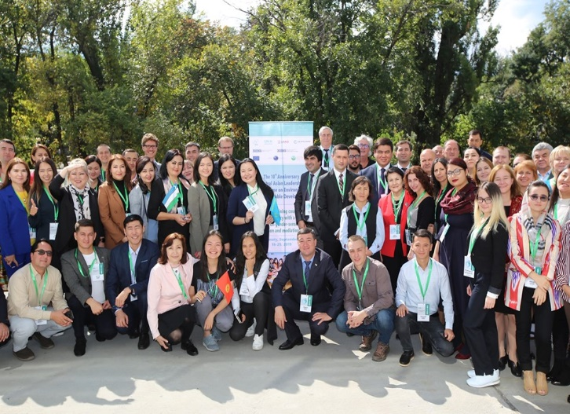
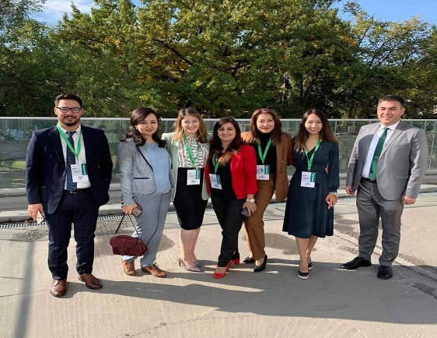
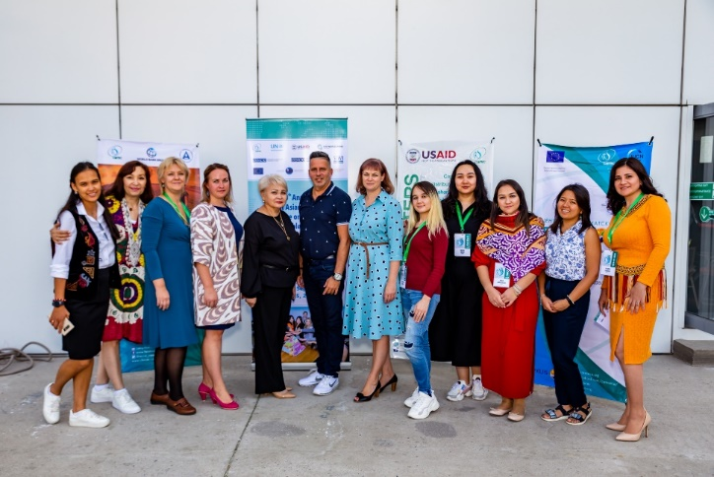
CALP alumni network and cooperation with CA governments
The Regional Environmental Centre for Central Asia
There is a trend of growing interest in participation in the CALP leaders from governments (by nominations)
In 2018 - 2021 – about 40-50% of graduates represented the state sector of the Central Asian countries and Afghanistan
About 370 alumni of the CALP (2010-2021)
Introduction to the agenda of the 10th Anniversary CALP
and OSCE “Regional training course on water diplomacy
with a special focus on gender-sensitive negotiation and mediation skills”
Almaty, Kazakhstan
16-25 September 2019
www.carececo.org
www.carececo.org

Slide 8
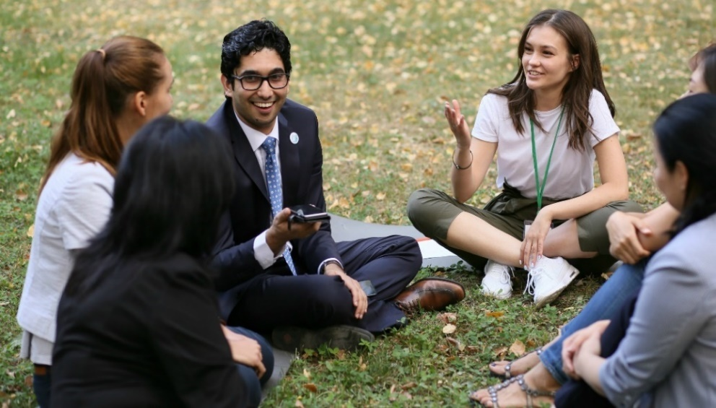
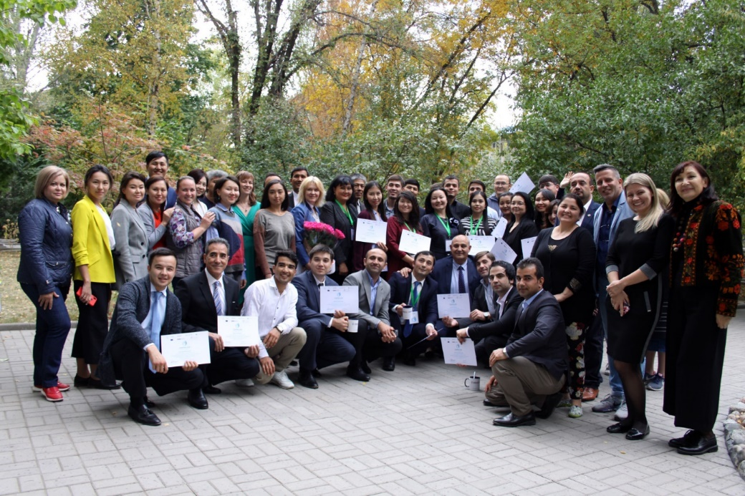
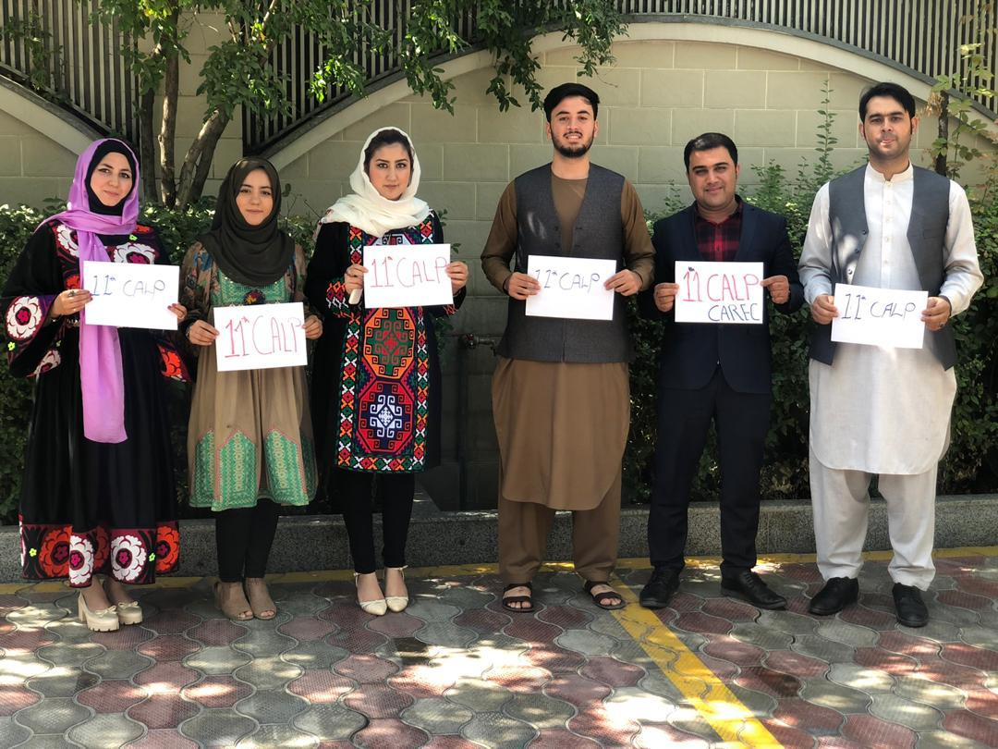
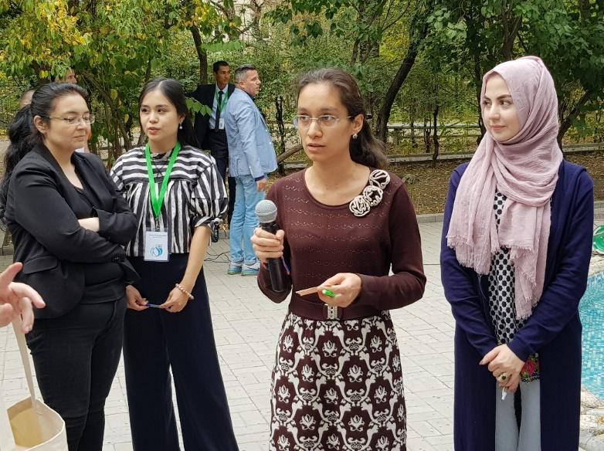
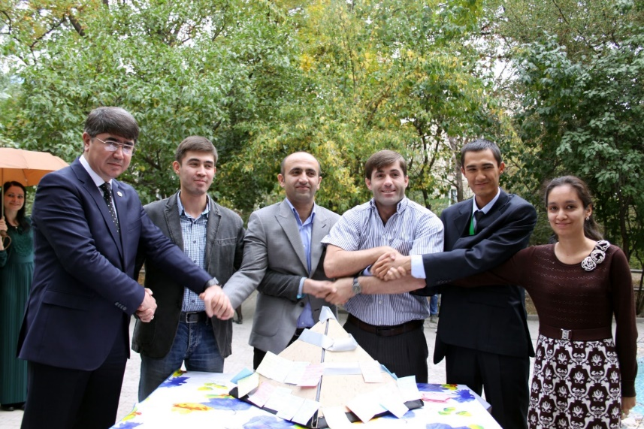
Our leaders of Central Asia and Afghanistan
www.carececo.org

Slide 9
The Regional Environmental Centre for Central Asia
We are opened for cooperation on the CALP-2022!
No borders for cooperation, partnership and friendship!
Thank you for your attention!
E: tshakirova@carececo.org
I: www.carececo.org
S: tatiana_Shakirova
CALP App.: http://calp.carececo.org/mobile/
www.carececo.org

