Slide 1
UN Regulations No. 13-H and 78 Stop Lamp Illumination
Submitted by the experts from OICA and CLEPA
Informal document GRVA-12-25 12th GRVA, 24–28 January 2022 Agenda item 8(c) and 9(b)
Seeking Clarification on the term “Deceleration Demand” used in documents
UN R13-H: ECE/TRANS/WP.29/GRVA/2020/31 adopted as ECE/TRANS/WP.29 WP29/2021/73
and
UN R13-H: ECE/TRANS/WP.29/GRVA/2022/10 (GRVA-11-39)

Slide 2
Current Status R13H.01 vs. Proposal
Slide 6 of doc GRVA-07-48
Inconsistent !
5.2.22.4.
NATURAL DRVING RESISTANCE
forbidden

Slide 3
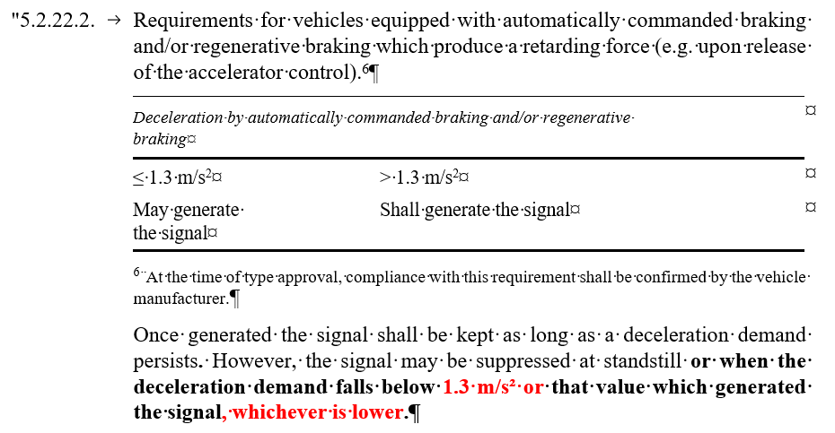
Clarification on the term „Deceleration Demand“
GRVA-11-39: clarification on the provisions introduced to paragraph 5.2.22.2. as part of document ECE/TRANS/WP.29/2021/73 endorsed by WP29 at its June 2021 session.
ECE/TRANS/WP.29/GRVA/2022/10:
Additions are indicated in red
Industry currently gets different interpretations from Technical Services on the question: When does a deceleration demand no longer persist? … and consequently when is the signal no longer to be kept acc. to Par 5.2.22.2

Slide 4
R13-H: GRVA/2020/31 adopted as ECE/TRANS/WP.29 /2021/73
Release Accelerator Control: Stop Lamp Illumination
Vehicle Speed [m/s] -----------------------------------------------
Supp.2: Deceleration [m/s²]
-----------------------------------------------
Supp.3: Deceleration Demand [m/s²]
With interpretation 1 of Suppl. 3 a design change would be required as part of an extension process of an existing approval.
The addition would clarify the intention and align the supplement with the rules of procedure of the UNECE 58 agreement.
accelerator pedal released
1.3
0.7
e.g. 0.5
t [s]
UN-R 13H/01 Suppl. 2
BL on
In all cases the signal shall be de-activated at the latest when the deceleration has fallen below 0.7 m/s²
BL off
5.2.22.2 Interpretation 1
Once generated the signal shall be kept as long as a deceleration demand persists. However, the signal may be suppressed at standstill.
UN-R 13H/01 Suppl. 3
BL on
BL off
5.2.22.2. Interpretation 2
Once generated the signal shall be kept as long as a deceleration demand persists. However, the signal may be suppressed at standstill or when the deceleration demand falls below that value which generated the signal.
UN-R 13H/01 Suppl. 3+
BL on
BL off

Slide 5
Clarification on the term „Deceleration Demand“
Industry view:
A “Deceleration” in the sense of paragraph 5.2.22.2 is a request from an automatically commanded braking function or regenerative braking system to decelerate the vehicle => Deceleration Demand
Not at all the retardation effects as described in Paragraph 5.2.22.4 are to be considered a braking demand.
This understanding matches with the Stop Lamp definition from R48:
2.5.4. "Stop lamp" means a lamp used to indicate to other road users to the rear of the vehicle that the longitudinal movement of the vehicle is intentionally retarded.
Resulting Deceleration
Natural Deceleration
Deceleration Demand
Resulting Deceleration
Natural Deceleration
The addition in GRVA-11-39 would avoid different interpretations and align the supplement with the rules of procedure of the UNECE 58 agreement.

