Slide 1
Report of the TF on ADAS to the 12th GRVA Session
Submitted by the TF on ADAS Co-Chairs
Informal document GRVA-12-18
12th GRVA session 24-28 Jan. 2022
Provisional agenda item 6(a)

Slide 2
Status after the 11th GRVA session
3 online meetings (October, November 2021 and January 2022)
A number of side meetings between TF meetings
Relatively low progress in drafting of the new UN Regulation:
The leadership carries on drafting by its own;
Other leadership and stakeholder commitments restrain the drafting process
Reduced number of participants from 80+ to 50+ (loss of the interest perhaps due to relatively low progress in drafting)
The current version of the Master Document is ADAS-10-02
Link to the TF documents: https://wiki.unece.org/display/trans/ADAS

Slide 3
Outcome on the pending proposals for UN R 79
Document | System | Objective of the proposal | Status
GRVA/2021/11 | ACSF C for HCV | Adapt ACSF C to enable the function on HCVs to address the truck-trailer combination in lane change provisions. | Proposal from ADAS TF ready for GRVA adoption. GRVA-12-19
GRVA/2021/09 | ACSF C | Introduce a tolerance of 10% to the critical distance. | Put on hold. Pending a revised proposal.
GRVA/2021/10 | ACSF C | Extend allowed time to start a LCM to 7 s (or more). | No progress. Some additional discussions expected.

Slide 4
Progress with the development of a new UN Regulation
What we intend to regulate. The distinction between ADS and ADAS (DCAS) “Recognizing the animal and constructing the cage”.
The naming of the functionality to be addressed was specified as ‘Driver Control Assistance Systems (DCAS)’.
The stakeholders’ comments have been converted to the draft regulatory provisions, where possible.

Slide 5
The items from the current discussion (1)
With reference to the discussion regarding statistics and accidentology, to introduce requirements on the manufacturer to report on the amount of driving under the system, the number of accidents that have occurred, crash-related events etc. → Perhaps, this cannot be done at the point of type approval, but relevant for the lifetime operation monitoring.
To propose a driver’s license for assistance systems; whether we have any knowledge on the actual driver competence when the system is being used. → Forward the proposal to WP.1.
The systems as outlined in the use case document (ADAS-08-06) should be considered as DCAS provided that appropriate driver engagement is maintained.
The safeguard clause is that the system should be deactivated if it is not capable of operating in a given environment. → The system boundaries will need to be defined properly.
Whether a system is considered as ADS or assistance system depends on the system functionality. → We still need to outline criteria which would differentiate a DCAS from an ADS, noting that the main argument of industry is that a system is assisted if it requires continued engagement of the driver. The control strategy will need to be defined (how the system assists the driver).

Slide 6
The items from the current discussion (2)
As a way forward, to proceed with the listed ‘use cases’ and to subsequently discuss what would be needed to have stakeholders be comfortable in order to permit such systems, specifying what would be needed for OEDR, driver engagement and other elements. → Go ahead with this approach.
Not only driver’s visual engagement but also mental engagement may be required for safe operation. → It may not be appropriate to specify monitoring technologies but rather to specify how long the driver may be disengaged. There should be limits to disengagement from the driver task. The driver engagement could mean to include positive actions from the driver to the DCAS, steering or brake pedal as well as monitoring that the driver is looking at the road conditions. To outline what we mean by driver engagement and outline what is expected of the driver. How would industry ensure driver engagement for different use cases?
DCAS should be able to initiate maneuvers itself. → A control strategy may need to be described indicating that the driver and system work in conjunction, reducing workload from the driver. What requirements are necessary to ensure safety with system-initiated maneuvers. Clear notice in sufficient time will have to be provided by systems.

Slide 7
Thank you for your attention!

Slide 8
Back-up

Slide 9
Background
GRVA adopted at its 9th session in February 2021 the terms of reference for the Task Force on Advanced Driver Assistance Systems (ADAS).
The Task Force (TF) focuses on Advanced Driver Assistance Systems (ADAS), and shall address the simplification of UN Regulation No. 79 and if needed, develop a new ADAS UN Regulation with a focus on ADAS systems up to of level 2 (as defined in ECE/TRANS/WP.29/1140).
The TF on ADAS agreed to start developing a new UN Regulation

Slide 10
Two Parallel Workstreams of the TF
Development of the provisions for the new ADAS use cases
Analysis of ADAS use cases and associated requirements
Development of the definitions, classification and scope of regulatory activities
Development of the high-level regulatory items for ADAS
New UN Regulation on longitudinal + lateral control on a sustained basis
Working on the pending proposals for UN R 79
Finding open issues hindering to adopt the proposals
Proposals on how to resolve open issues
Drafting the amended proposals to UN R 79

Slide 11
What to be covered in a new UN Regulation?
To address ADAS in general with a focus on systems combining longitudinal and lateral support on a sustained basis:
To provide a safety net (minimum requirements) for any ADAS especially the ones currently not regulated today.
To consider combinations of ADAS.
To introduce a generic approach to the ADAS performance/assessment:
More generic performance requirements applying to any (combination of) ADAS whereas UN R 79 is focused on steering systems only. Strong emphasis on driver involvement and HMI.
More generic compliance assessment method compared to those in UN R 79 (where specific tests are developed for each use case).
Aligned with discussions in FRAV/VMAD on generic requirements/ assessment for ADS.
GRVA noted the large number of proposals aiming to amend UN R79 and tasked this group to find a solution. A new regulatory approach that ensures more use cases or function variations are addressed is an appropriate approach to resolve this issue
Without prejudice to possible more detailed requirements on some ADAS in other regulations such as the ones currently covered in UN R 79 (similar to what exists e.g. for braking with UN R 13-H and AEBS Reg)
ADAS already covered by the other UN Regulations will not fall in the scope of the new UN Regulation.
The TF on ADAS agreed to start developing a new UN Regulation on this basis

Slide 12
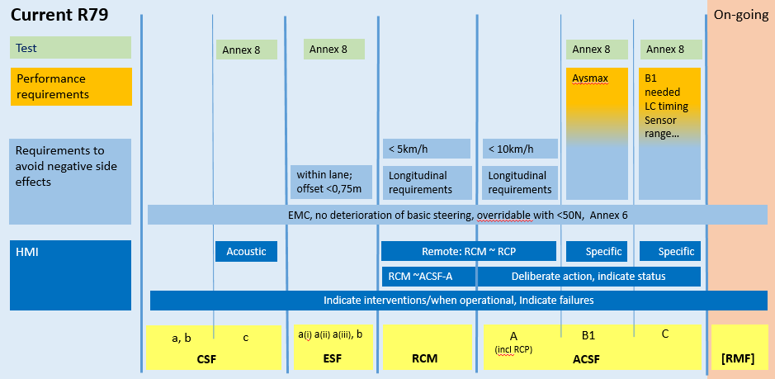
Annex: Scope of R79 vs future ADAS Regulation (doc ADAS-01-06)
ADAS regulation may only cover ADAS with both “lateral and longitudinal control”
The scope proposals here are addressing the main R79 limitations:
Longitudinal control does not fit in R79
A number of Use Cases are restricted / prohibited by R79 (i.e. definitions and ADAS scope in R79 are not general enough)
UN R79
ADAS Reg.
UN R79
ADAS Reg.
“Missing use cases” and “adjustments needed” could probably be handled under the current approach (i.e. be kept in R79)
ADAS regulation may as well cover continuous lateral control (which would then address more of the restricted / prohibited UCs by R79)

Slide 13
Development of a new UN Regulation – Composition
The structure of the draft is based on UN R 157 (ALKS).
The fulfilment of the provisions to be demonstrated by the manufacturer to the technical service during the inspection of the safety approach (audit) and according to the relevant physical (and virtual) tests (tbd).

