Slide 1
Informal document GRPE-85-31
85th GRPE, 11-14 January 2022
Agenda item 13
CITA-Applus+ Urea Emulator Emission Tampering
January 13th, 2022
Víctor Salvachúa, Topic Area Chairperson, R + D Vehicle Compliance
Eduard Fernández, Executive Director
Alejandro Checa, Technical Director

Slide 2
INDEX SLIDE
Ad Blue Emulators
Tests
Results
Conclusions

Slide 3
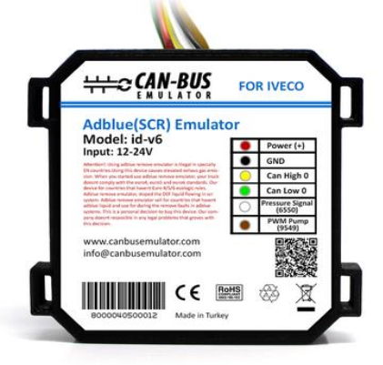
AD BLUE EMULATORS
https://www.canbusemulator.com/en/

Slide 4
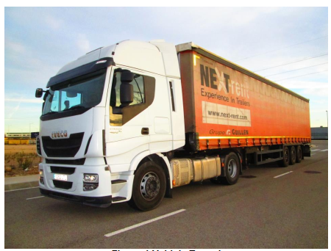
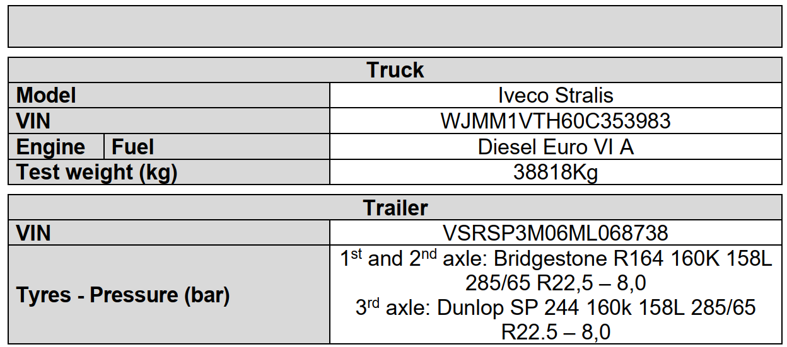
TEST VEHICLE
anti-tampering provisions on ECE R49.06 Annex 11 already applied to this vehicle

Slide 5
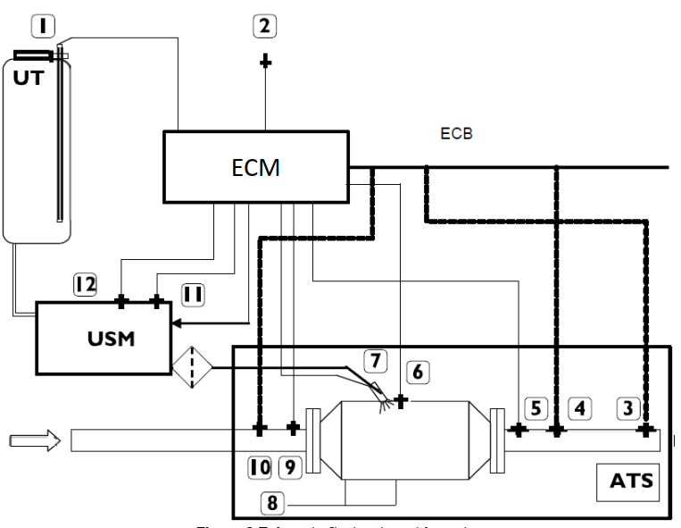
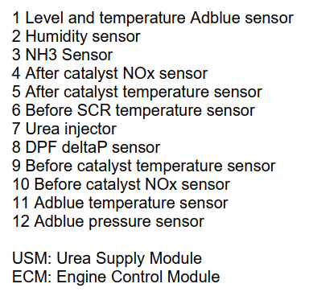
TEST VEHICLE

Slide 6
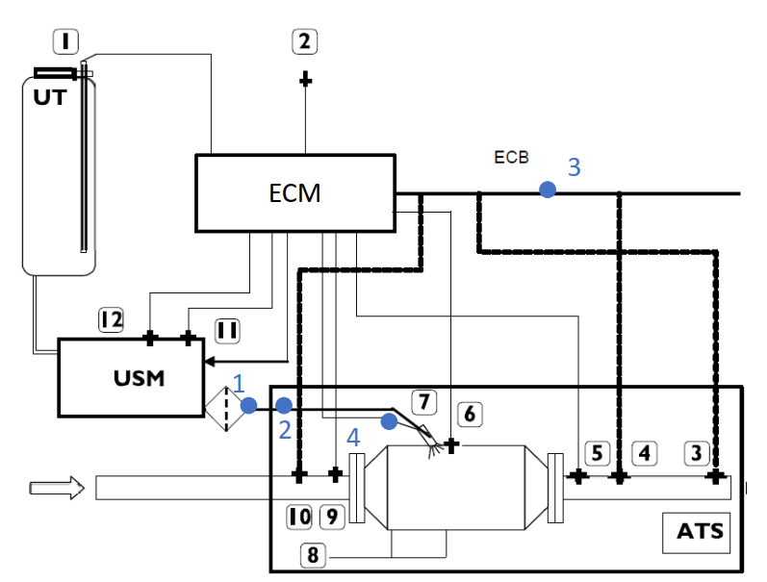
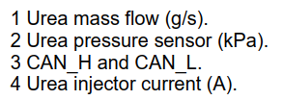
TEST INSTRUMENTATION

Slide 7
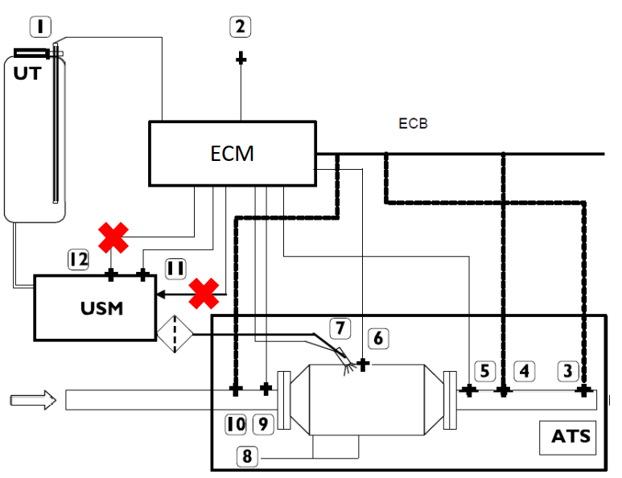
TEST OBD VALIDATION

Slide 8
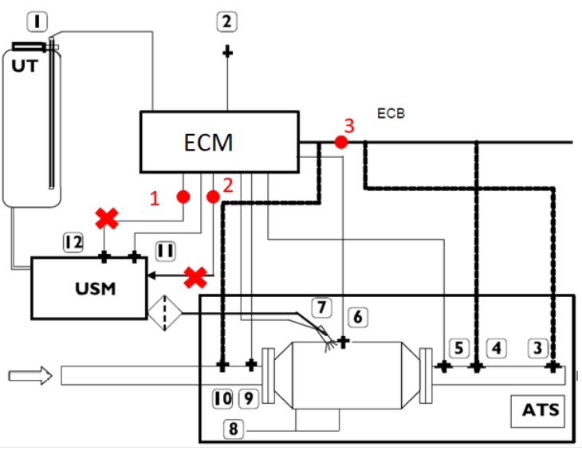
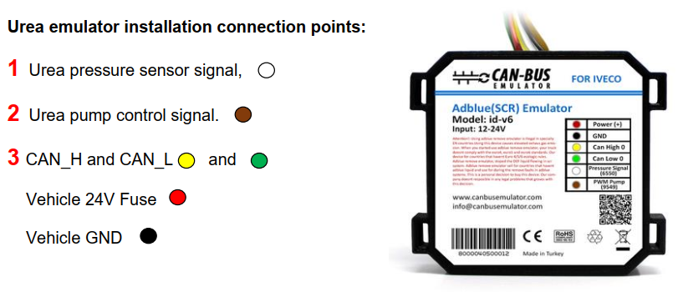
TEST AD BLUE EMULATOR

Slide 9
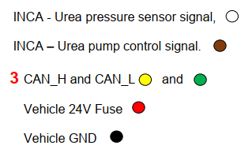
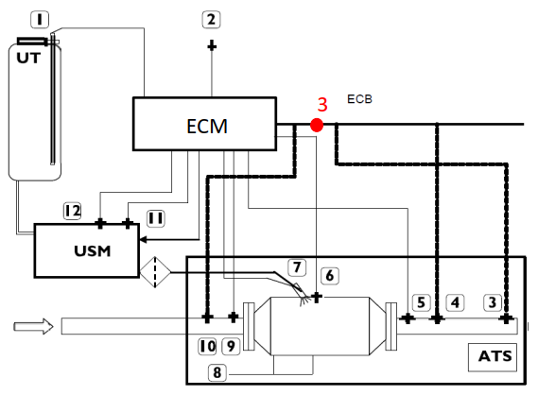
TEST AD BLUE PARALEL MODE

Slide 10
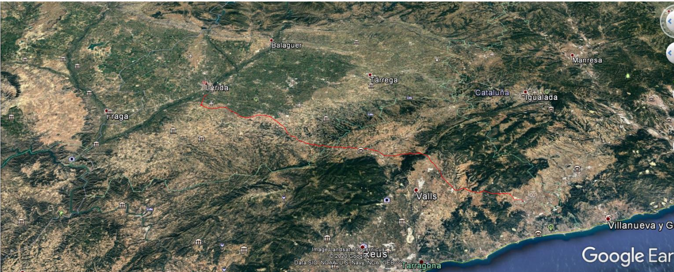
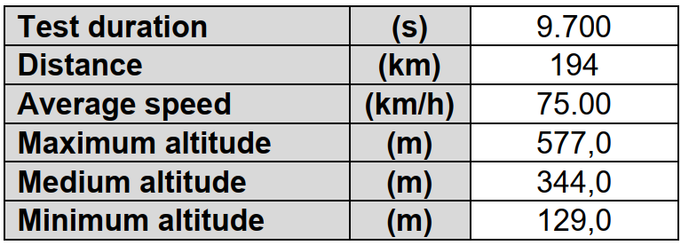
TEST ROUTE

Slide 11
RESULTS OBD VALIDATION
Mil ACTIVATED AND COUNTER INCREASES
TORQUE REDUCTION AFTER 10 HOURS
2 dtc PRESENT
DTC2012 = P208B Reductant Pump "A" Control Performance/Stuck Off
DTC2012 = P208A Reductant Pump "A" Control Circuit/Open
VEHICLE BEHAVES AS EXPECTED
Step | Date | Time | Emulator installed? (Y/N) | Driven mileage (km) | Driven hours (h) | Comments | Reagent quality counter (h) | Reagent consumption counter (h) | Dosing counter (h) | EGR valve counter (h) | Monitoring system counter (h) | NOx Warning System | Level One Inducement | Ad Blue ON? | Torque reduction? (Y/N) | MIL ON?
0 | 08/04/2021 | 8:00 | No | 0 | 0 | Original Conditions | 0h | 0h | 0h | 0h | 0h | Inactive | Inactive | YES | NO | NO
1 | 08/04/2021 | 13:52 | No | 239.12 | 3.52 | USM Isolated | 0h | 0h | 0-3h | 0h | 0h | Active | Inactive | NO | NO | NO
2 | 08/04/2021 | 18:19 | No | 271.58 | 4.56 | USM Isolated | 0h | 0h | 3-7h | 0h | 0h | Active | Inactive | NO | NO | NO
3 | 09/04/2021 | 13:03 | No | 134.64 | 2.28 | USM Isolated - Torque reduction 10h | 0h | 0h | 7-10h | 0h | 0h | Active | Active | NO | YES | YES
4 | 09/04/2021 | 17:26 | No | 101.2 | 1.71 | USM Isolated - Torque reduction | 0h | 0h | 10-12h | 0h | 0h | Active | Active | NO | YES | YES

Slide 12
RESULTS AD BLUE EMULATOR
No Mil ACTIVATED nor counters started
No TORQUE REDUCTION
Complete urea system override
No urea injected
On board Nox sensors detected emissions increase to close to the regulation limits

Slide 13
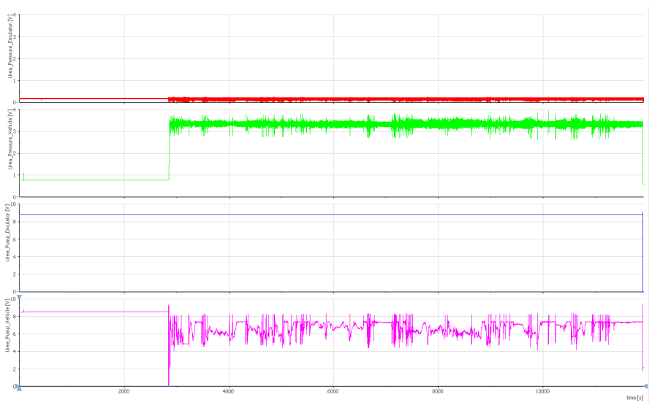
RESULTS PARALEL MODE
THE EMULATOR USES CAN MESSAGES TO DETECT VEHICLE IGNITION
Control and actuator signals are replaced by constant voltages
The usm is feed with fake MAX injection pressure
The pump is required not to inject

Slide 14
RESULTS DEVICE EVALUATION
THE SYSTEM completely AVOIDS THE UREA INJECTION
THE SYSTEM AVOIDS ANY DTC, MIL OR INDUCEMENT MODE ACTIVATION
Nox emissions increased around 400% in the test
Ad blue savings added to around 15€/200 km
Device payback is around 2 days for an international truck
Savings around 60€ per day

Slide 15
CONCLUSIONS
Experience shows that technology progress will challenge any tampering protection by design in few months
Current Anti-Tampering provisions should be improved
To prevent tampering, we need to improved tampering proof designs and to facilitate tampering detection
IWG on anti-tampering and whole life-cycle of the vehicle should be considered

Slide 16
Thank you for your attention!
www.citainsp.org
Rue du Commerce 123 - 1000 Brussels, Belgium
+32 (0)2 469 06 70
secretariat@citainsp.org

