Slide 1
Hydrogen in Austria
Mauricio Belaunde
Federal Ministry for Climate Action, Environment,
Energy, Mobility, Innovation and Technology
Directorate-General VI – Climate Action and Energy
Department VI/2 – Strategic Energy Policy
UNECE Workshop, 8 December 2021

Slide 2
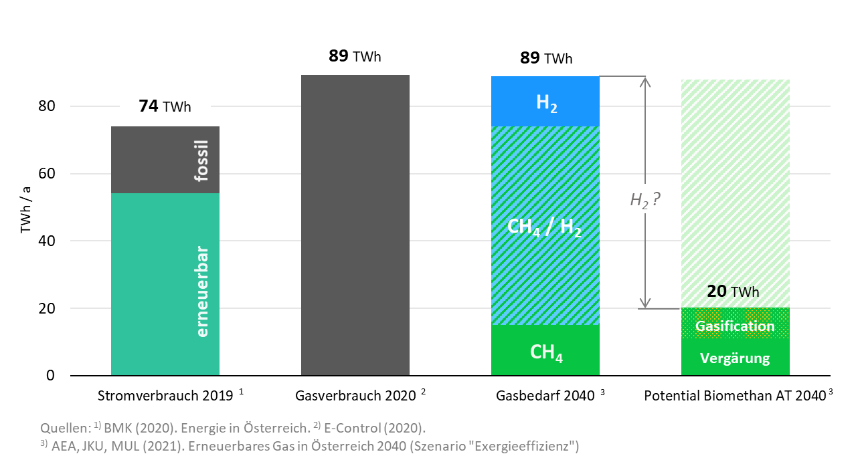
Gas demand in climate neutral Austria 2040
Electricity consumption 2019
Gas consumption 2020
Gas demand 2040
Biomethane potential AT 2040

Slide 3
Integration of hydrogen in the energy system
What role can hydrogen play in achieving Austria‘s target of climate neutrality 2040?
Which sectors are best suited and strategic priorities for hydrogen implementation?
How can sector coupling support Austria‘s target of 100% renewable electricity 2030?
Which segments of the hydrogen value chain are strategic priorities for Austria‘s R&D&I?
What regulations and policies are required to enable a targeted hydrogen economy?
What role will hydrogen imports play to fulfill domestic hydrogen demand?
H₂

Slide 4
Hydrogen Strategy for Austria
Accompanying Measures
Renewable Expansion Act
Steering Committee
WG 1: Generation, infrastructure and storage
WG 3: Hydrogen in industrial processes
Input
National Energy and Climate Plan
WG 2: „Greening the Gas“ (H2 and Bio-methane)
WG 4: Fuel cells and hydrogen in end use (4a Mobility, 4b Buildings)

Slide 5
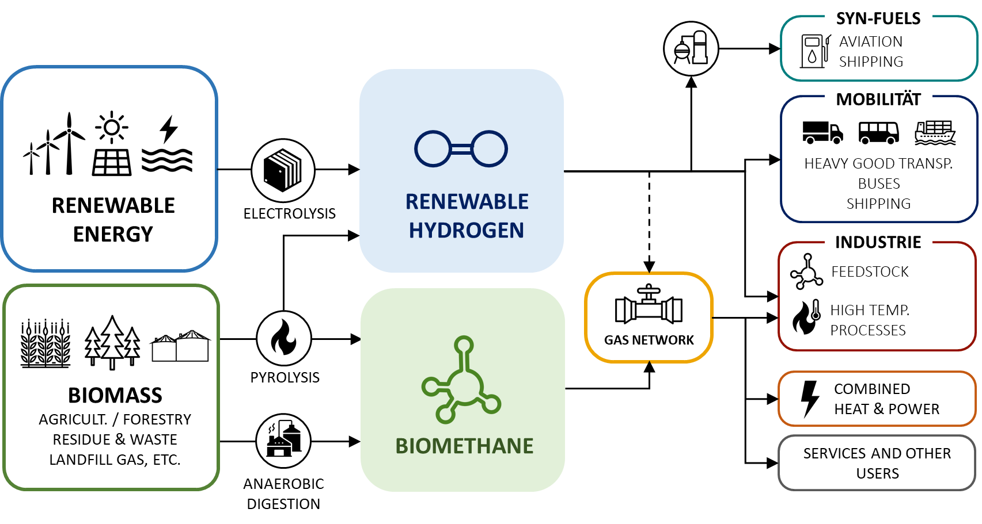
Strategic concept for renewable gases

Slide 6
Strategy targets
Installation of 1 GW electrolyser capacity by 2030
Assuming an annual full load factor of 5000 h/a and an efficiency of 75%: 1 GW Electrolysis ⇒ 3,75 TWh Hydrogen per year
Current consumption of (grey) hydrogen: ∼140.000 tonnes (4,6 TWh)¹
Hydrogen demand for full industrial decarbonisation highly exceeds AT installation targets ∼500.000 tonnes (16,7 TWh) of hydrogen would be required solely for the decarbonisation of the steel industry
→ Import of renewable hydrogen to fill the gap?
¹ Berechnungen BMK auf Basis Statistik Austria und Input der Arbeitsgruppen zur Wasserstoffstrategie

Slide 7
Hydrogen in the Renewables-Expansion-Act
€40M p.a.
Investment aid for renewable hydrogen production facilities (electrolysers)
Accompanying measures:
Waived network fees for electrolysers under specific circumstances
Waived renewable-energy-levies for renewable electrolyser operation
Definitions for renewable hydrogen and renewable gases

Slide 8
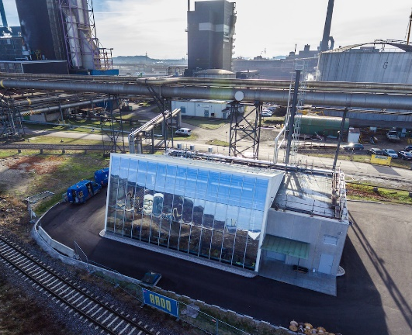
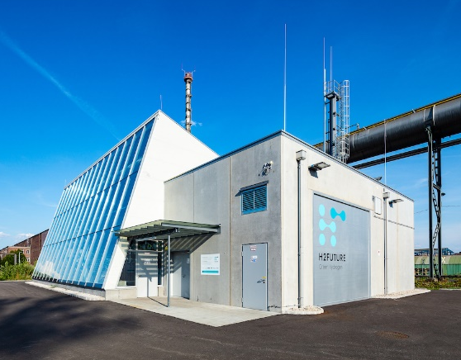
Flagship projects in Austria (1)
Source: www.h2future-project.eu
6 MW PEM electrolyser
Cooperation between utility Verbund, steel producer voestalpine, electrolyser manufacturer Siemens Energy, and TSO Austrian Power Grid
Notes:
H2FUTURE is a European flagship project for the generation of green hydrogen from electricity from renewable energy sources. Under the coordination of the utility VERBUND, the steel manufacturer voestalpine and Siemens Energy, a proton exchange membrane (PEM) electrolyser manufacturer, a large-scale 6 MW PEM electrolysis system will be installed and operated at the voestalpine Linz steel plant in Austria. The Austrian transmission system operator (TSO) Austrian Power Grid (APG) will support the prequalification of the electrolyser system for the provision of ancillary services.

Slide 9
Flagship projects in Austria (2)
European H2 value chains
Production and transport of renewable hydrogen
Regional cooperations

Slide 10
Thank you!
Federal Ministry for Climate Action, Environment, Energy, Mobility, Innovation and Technology
Directorate-General VI – Climate Action and Energy
Department VI/2 – General Issues of Energy Transition and Sector Coupling
vi-2@bmk.gv.at

