Slide 1
Update on the German National Hydrogen Strategy
UNECE project launch - How to jumpstart hydrogen production and export potential of CIS countries
08.12.2021
Dr. Cyriac Massué
Federal Ministry for Economic Affairs and Energy (BMWi)

Slide 2
Strategic objectives of the German H₂ strategy
Establishing H₂ as an alternative energy carrier (esp. industry, mobility)
Making “green” H₂ and related tech competitive
Develop a
domestic market
Transparent certification, guarantees of origin
Promoting R&D
Transport and distribution infrastructure
Establishing international markets and cooperation
Notes:
To make this happen, we have drafted a set of strategic objectives ….
As we believe in a market-driven approach, making hydrogen a competetive alternative is at the center of our efforts
But the future is not shaped by objectives or targets.
Real action is required.

Slide 3
Hydrogen in Germany: State of play
mainly used for ind. processes, e.g. production of ammonia, methanol, etc.
Total yearly production: approx. 55 TWh mainly „grey“ H₂
3,85 TWh of hydrogen are produced via electrolysis
H₂-infrastructure:
Private networks operated by Air Liquide (>250 km) and Linde (90 km)
Notes:
Hydrogen is nothing new
55 TWh current use, mainly in industry
also electrolyis, but not for environmental reasons, but beacause of purity or chlorine production
even distribution network exsist (NRW), althugh rather small scale
But given the new ambition reagrding climate change and the will to create new value chains things will have to change
more and bigger
climate friendly
a

Slide 4
Future of hydrogen in Germany
Total hydrogen demand in 2030
90 to 110 TWh
Growth in H₂ demand at first mainly in industry and transport
“Green” production capacity of
up to 5 GW added until 2030
and 5 GW more at least in 2040
Build-up of needed transport infrastructure

Slide 5
NWS-Action Plan: Necessary steps to success
9 bn € from German recovery plan (“Konjunkturpaket”)
Use where gap to profitability smallest or no other alternative
Regulation and state aid have to go hand-in-hand
Focus on integrated projects along whole value chain
Icons: Flaticon.com
Notes:
Therefore our strategy includes an action plan for the first phase of the hydrogen roll-out
Key guiding principles are:
As this is a new market, we have to adress the complete value chain (production, infrastructur, application) and we need a strong interaction with stakehodlers
focus on essential applications (chemical and heavy industry, transport), while not excluding future options
where possible encourrage a market-driven development of the hydrogen market
revise tax ans levy scheme, in particular to make the production of „green“ hydrogen more attractive
allow hydrogen to be an abatement option for companies -> RED II important to incentivese use of hydrogen in reffineries (hope 2GW)
Are aware that hydrogen is still very expensive and we need financial support (CAPEX and OPEX)
We can only succed with international cooperation…
…

Slide 6
Regulation: Improved framework conditions for H₂
Fair design of state induced price components for electricity (esp. EEG-surcharge)
Transitional regulatory framework for future H₂-infrastructure (EnWG revision + Directive on tariffs (H2 NEV))
Ambitious implementation of the EU Renewable Energies Directive (RED II)
OPEX: where needed, pilot programs (e.g. Contracts for Difference, CfD)
Transparency on CO₂-footprint of production (need for a European methodology)

Slide 7
State aid: Focus on IPCEI
Promotion of projects with a strong European spill-over character
Establishment of large-scale production plants
Current level of implementation
Approximately 230 projects submitted in the declaration of interest procedure
Preselection of 62 GER projects announced by Federal Minister Altmaier and Federal Minister Scheuer on May 28th
EU matchmaking, from end of May 2021 -> European networking
(Pre-) Notification EC, summer 2021 -> Aid Approval EC
Granting of funding decisions from 2022

Slide 8
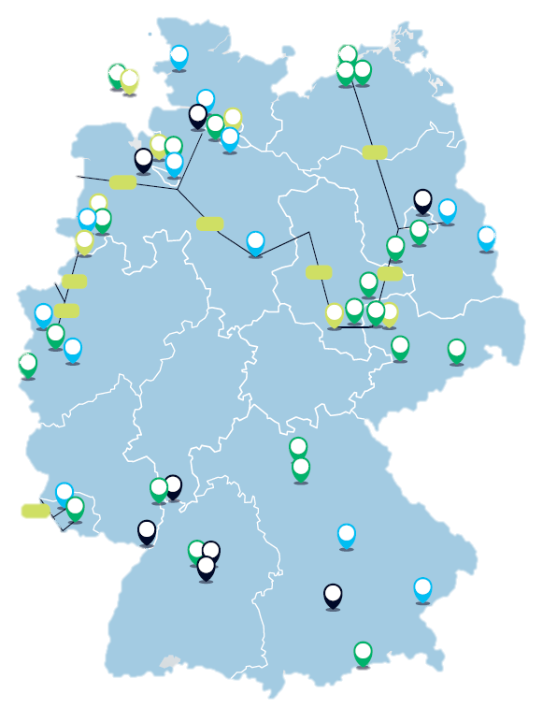
IPCEI: Pre-selection of 62 GER Projects
Production
Infrastructure
Use in industry
Use in mobility
Pipeline

Slide 9
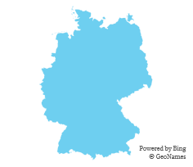
A large part of the hydrogen needed in Germany will have to be imported
Grey H₂ domestic production 2020
55 TWh
+
-
5 GW
14 TWh
90-110 TWh
XX TWh
Green H₂ production capacities planned for Germany 2030
Green H₂ domestic production 2030
H₂ demand expected 2030
H₂ demand not covered by domestic production 2030

Slide 10
International actions (with non-EU partners)
Funding tools
Funding guideline for PtX production facilities abroad
H2 Global - Auctions for purchase and sale of H2/ derivatives and compensation by government for difference in purchase and sale prices.
Individual subsidies:
Siemens Energy project funding notice in Chile handed over on 02.12.20
Grant decision for Thyssen Krupp project in Saudi Arabia handed over on 16.12.20
H2 Uppp - project to support smaller private sector projects through accompanying services

Slide 11
Outlook 2022
Revision of General Block Exemption Reg. and Climate, Energy and Environmental Aid Guidelines
a.o.: Definition “green / climate friendly hydrogen”
Gas Market Package
Certification of green and climate friendly gases
Integrated planning of energy infrastructure
State aid: Granting of OPEX
Germany: new government coalition contract: ambitious update of national H2 strategy (10 GW goal, etc.)

Slide 12
Thank you for your attention !

Slide 13
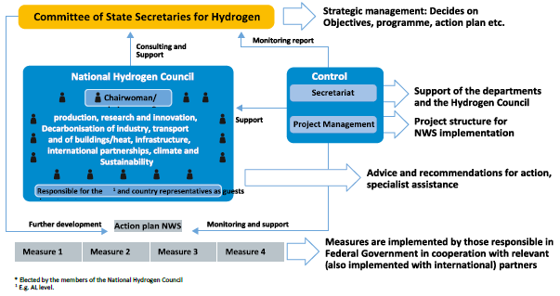
Governance of the H₂ strategy
Committee of State Secretaries for Hydrogen
Strategic management: Decides on
Objectives, programme, action plan etc.
Consulting and
Monitoring report
Support
National H₂ Council
H₂ office
Support of the departments
Secretariat
and the Hydrogen Council
Coordination
Experts from industry, science and society
Support
Project structure
Project Management
Advice and recommendations for action,
specialist assistance
Further development
Action plan NWS
Monitoring and support
Measures are implemented by those responsible in Federal Government in cooperation with relevant partners
Measure 1
Measure 2
Measure 3
Measure 4
Simplified visualization

