Slide 1
The European Hydrogen Strategy UNECE webinar: How to jumpstart hydrogen production and export potential of CIS countries? 8 December 2021, 10:00 – 13:00 CET
Mr. Alessandro Polito
Policy Officer
DG Energy, European Commission

Slide 2
Notes:
In short: ESI is about moving from the left to the right.
On the left: vertical value chains, separated from each other, with very little interactions.
On the right: a single, joined-up energy system, linking production and consumption through a variety of energy carriers, through more complex, multidirectional flows.

Slide 3
Towards a climate-neutral energy system
Energy system integration Strategy
A more circular and energy efficient energy system
A deep electrification of consumption, based on renewable electricity
The use of renewable and low carbon fuels (incl. hydrogen) in hard-to-abate sectors
1
Hydrogen Strategy
A full value chain approach
to upscale hydrogen
+
Clean Hydrogen Alliance
2
2
1
3
3

Slide 4
The EU hydrogen strategy
- 6 GW of renewable hydrogen electrolysers - Replace existing hydrogen production - Regulation for liquid hydrogen markets - Planning of hydrogen infrastructure
- Scale-up to all hard-to-decarbonise sectors - Expansion of hydrogen-derived synthetic fuels - EU-wide infrastructure network - An open international market with € as benchmark
- 40 GW of renewable hydrogen electrolysers - New applications in steel and transport - Hydrogen for electricity balancing purposes - Creation of “Hydrogen Valleys” - Cross-border logistical infrastructure
2024
2030
2
1
2050
3

Slide 5
Hydrogen – an investment agenda
Next Generation EU, Invest EU, Cohesion Policy, CEF-E, CEF-T
ETS Innovation Fund, Horizon Europe
Renewable electricity production
€220-340 BLN
Transport (HDV)
€13 BLN
Hydrogen transport,
distribution,
and storage
€65 BLN
Renewable hydrogen
€24-43 BLN
Steel
€8 BLN
European Clean Hydrogen Alliance
Notes:
Investment costs of renewable hydrogen based on 6 GW by 2024, and 30 GW by 2030.
Based on our ASSET study, average investment costs for a 100 MW electrolyser in the period up to 2024 are already in the range of 944-1565 EUR/kW_{h2}, and 599-1022 EUR/kW_{h2} for the period after 2024.
Investment costs for renewable power production assume sufficient renewable electricity to produce 10 Mt of renewable hydrogen by 2030.
Investment costs for transport, distribution and storage assume that 10 Mt requires additional infrastructure to new applications, mostly through repurposing.
The investment costs for repurposing gas pipelines compared to new hydrogen pipelines is 90% cheaper, the costs of transport H2 in repurposed pipelines is 4x cheaper.
Comparison of investment costs:
Investment costs new hydrogen pipelines (€2-5 mln /km)
Investment costs refurbished gas pipelines (€0,37 mln/km)
Investment costs in heavy duty vehicles assumes 1,1 Mt of renewable hydrogen for transport applications (including trucks, buses, trains and vessels).
Investment costs in steel assume 1 Mt of renewable hydrogen used to produce 20 Mt of green steel (20% of current production of 159.4 Mt of steel annually).
Comparison of transport costs:
Levelised costs of hydrogen transport in dedicated H2 transmission infrastructure (€12-16/mhw/600km)
Levelised costs of hydrogen transport in repurposed gas infrastructure (€4/mwh/600km)

Slide 6
H2

Slide 7
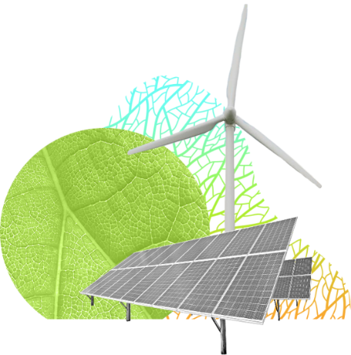
Renewable Energy Directive
specific sub-targets for the consumption of renewable H2 for hard-to-decarbonise applications in:
the industry: 50% of hydrogen consumption by 2030
transport sector: 2,6% of energy consumption by 2030
changes the framework for accounting renewable hydrogen towards the national contribution by Member State
extends the certification framework to all renewable fuels, including renewable hydrogen

Slide 8
2. A closer look to renewable hydrogen sub-targets
Hydrogen Strategy target
40 GW electrolysers
Cost-optimal sectoral allocation (modelling)
15,7 Mtoe of renewable hydrogen
4,5 Mtoe for energy
3,1 Mtoe in non-energy
1,5 Mtoe in refineries*
6,6 Mtoe in transport
*RFNBOs used for transport fuels
14,5 Mtoe
industrial hydrogen consumption 2030
304 Mtoe
transport energy consumption 2030
52,6% ~ 50%
RED proposal sub-targets
2,6%

Slide 9
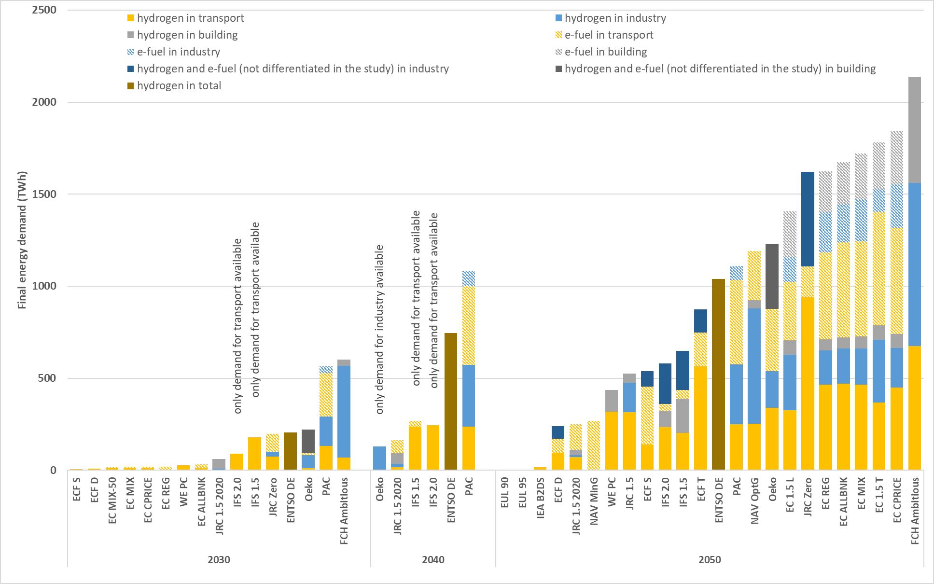
Future hydrogen demand
REDII proposal
186

Slide 10
Strengthening of EU ETS
Strengthening of existing ETS with an increase of 18 pp of emission reduction (from -43% to -61% by 2030)
Inclusion of all hydrogen production facilities (>25t/day)
Remove free allowances for aviation
Will now include maritime transport
New EU ETS extension for road transport and buildings, operational as of 2025

Slide 11
Policy measures on transport
Stronger CO2 emissions standards for cars and vans
Revision of Alternative Fuels Infrastructure Regulation: hydrogen refuelling stations across major transport corridors
ReFuelEU Aviation Initiative: Obligation on fuel suppliers to aircraft carriers
FuelEU Maritime Initiative: Greenhouse gas emission intensity thresholds for ships calling at European ports

Slide 12
Policy measures on taxation, trade and markets
Revision of the Energy Taxation Directive: Shifting tax incentives away from fossil fuels and towards clean technologies
New Carbon Border Adjustment Mechanism: Carbon price on imports of a targeted selection of products to prevent ‘carbon leakage’
Proposal for Gas and Hydrogen Markets Decarbonisation (due in December)

Slide 13
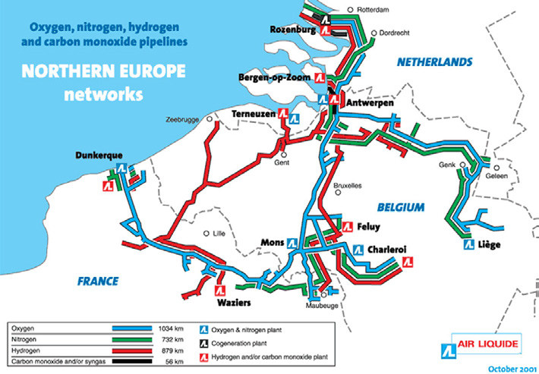
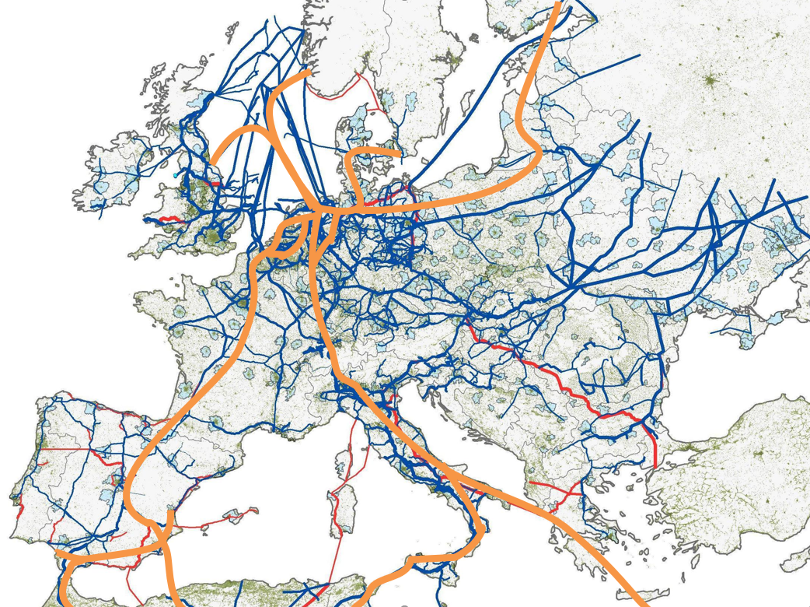
Hydrogen – infrastructure
Existing hydrogen infrastructure:
Belgium – 613 km
Germany – 376 km
France – 303 km
Netherlands – 237 km
Future hydrogen infrastructure:
Source: Hydrogen Europe, 2x 40 GW initiative

Slide 14
Hydrogen – the international dimension
Bilateral and regional cooperation
Clean hydrogen support under Neighbourhood Investment Platform
Multilateral fora
CEM and MI: Exchange of latest technological developments
International markets
Set common GHG emission reduction standards and sustainability criteria
Facilitate emergence of rules-based hydrogen market
Joint hydrogen research and development programmes through Association Agreements
Hydrogen collaboration under the Africa-Europe Green Initiative
Benchmark for euro denominated transactions in hydrogen
IEA, UNECE and IRENA: Role of hydrogen and hydrogen policies
Mainstream hydrogen in energy, diplomacy, climate, research, trade and international cooperation

Slide 15
Thank you alessandro.polito@ec.europa.eu

