Slide 1
Informal document GRE-85-37
(85th GRE, 26 to 29 October 2021,
agenda item 9)
How to reduce power consumption
in existing lighting functions
without reducing safety
Mr. Paul Henri MATHA
Chairman of GTB/WG Installation

Slide 2
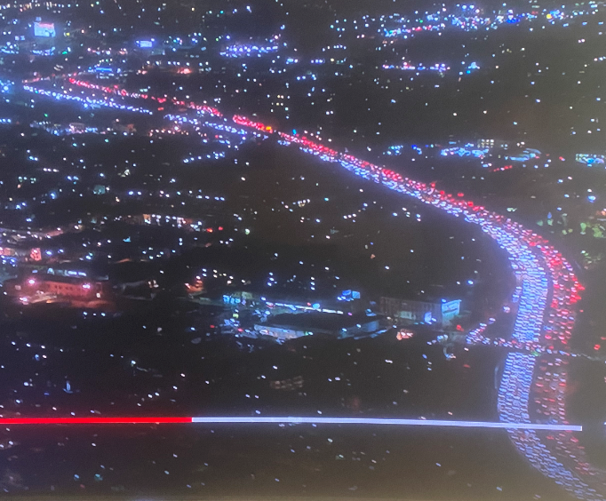
Background
… today’s waste of energy

Slide 3
Motivation
Power consumption has become in the last 2 years one of the main concerns due to:
New regulations about CO₂ emissions
The willingness of all the automotive industry to reduce the carbon footprint
Need to improve the efficiency of Electrical Vehicles
Lighting is one of the contributors to the power consumption

Slide 4
Limitations to the reduction of power consumption
Design Car makers wish to keep design flexibility, as lighting is one of the key factors that sells cars.
Technology LEDs are a very efficient light source (in lumen / watt terms) and enable a significant power reduction compared to incandescent light sources (with equal or better safety performance). The use of LED’s was a very good first step, however even more efficient solutions are necessary.
Regulation Amendments to the regulatory provisions will be necessary to allow new technical solutions and lamp activation conditions and to include them in the eco-innovations mechanism.
GTB would like to focus on the third topic and develop proposals for GRE in the coming years

Slide 5
Modification of lighting regulations
Potential areas to work on:
Function/lamp intensity versus exterior luminance
Photometric grid versus traffic conditions (e.g. traffic jam, platooning, road with streetlights)
Function activation
Some estimations suggest that it may be possible to save up to 20% of the exterior lighting average power consumption.
GTB intends to conduct independent research studies to assess the effective energy saving.

