Slide 1
Informal document GRE-85-36
85th GRE, 26-29 October 2021, Agenda item 8 (c)
UN Regulation No. 156
François Guichard
Secretary to GRVA
UNECE
INLAND TRANSPORT COMMITTEE

Slide 2
Content
Context
UN Regulation No. 156
SUMS
Type Approval requirements
Requirements for OTA
RxSWIN
Software updates and RxSWIN - Outlook

Slide 3
Context
Some vehicle manufacturers made already SW updates OTA for new ADAS functions
Necessity to update software on vehicles during the whole vehicle life
WP.29/AC.2 Proposal from the secretariat to address software updates
Decision to establish the Task Force on CS/OTA issues
Led y UK/DfT, Japan/NTSEL and US/NHTSA
Secretariat provided by OICA/Hyundai
Participants from CPs and NGOs
Profiles incl. Type Approval and CS experts.
UN Regulation No. 156:
Adoption by GRVA (in March 2020).
Adoption by WP.29/AC.1
EIF: January 2021

Slide 4
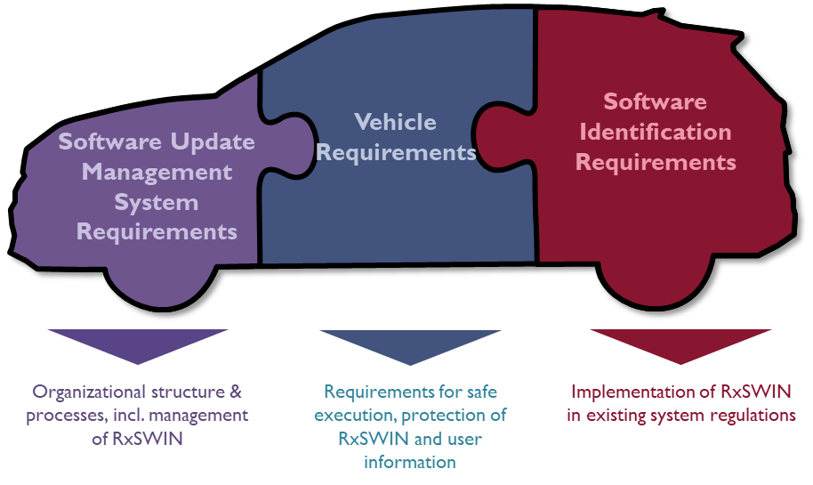
UN Regulation No. 156 - overview
Software Identification Requirements
Software Update Management System Requirements
Vehicle
Requirements
Organizational structure & processes, incl. management of RxSWIN
Requirements for safe execution, protection of RxSWIN and user information
Implementation of RxSWIN
in existing system regulations

Slide 5
Software Update Management System
This requires vehicle manufacturers to have, at an organisational level, the following:
Processes for configuration control for recording the hardware and software versions relevant to a vehicle type, including integrity validation data for the software
Processes for identifying the software and hardware on a vehicle relevant to a specific UN regulation and tracking if that software changes (the RxSWIN concept)
Processes for verifying the software on a vehicle component is what should be there
Processes for identifying interdependencies of systems, particularly with respect to software updates
Processes for identifying target vehicles and verifying their compatibility with an update
Processes to assess if a software update will affect type approvals or other legally defined parameters for a given target vehicle (including adding or removing functionality)
Processes to assess to assess if an update will affect the safety or safe driving of a vehicle
Processes to inform vehicle owners of updates
Processes to document all of the above and make it available for inspection at an audit
Processes to ensure the cyber security of software updates before they are sent to a vehicle
@Darren Handley

Slide 6
Type approval requirements
For every vehicle type that is declared, and approval sought, the following must be provided:
Evidence that the SUMS applies to the vehicle type
The software update delivery mechanism and process must be protected for the vehicle type to ensure authenticity and integrity of the software update
The RxSWIN must be protected on the vehicle type
Information regarding RxSWIN or type relevant software must be easily readable from the vehicle
@Darren Handley

Slide 7
Requirements for OTA
For over the air updates (non-wired), the vehicles of the vehicle type must:
Be able to restore systems if an update fails
Only execute updates when there is sufficient power
Ensure updates are executed safely, especially when the update may affect safety critical systems
Be able to inform users about each updates, incl. their successful execution (or otherwise)
Ensure the vehicle is capable of conducting the update
Be able to inform the user when a mechanic is needed
@Darren Handley

Slide 8
RxSWIN
Definition:
"RX Software Identification Number (RXSWIN)" means: - a dedicated identifier, - defined by the vehicle manufacturer, - representing information about the type approval relevant software of the Electronic Control System contributing to UN Regulation No. X type approval relevant characteristics of the vehicle
Note: alternatives to RxSWIN are allowed

Slide 9
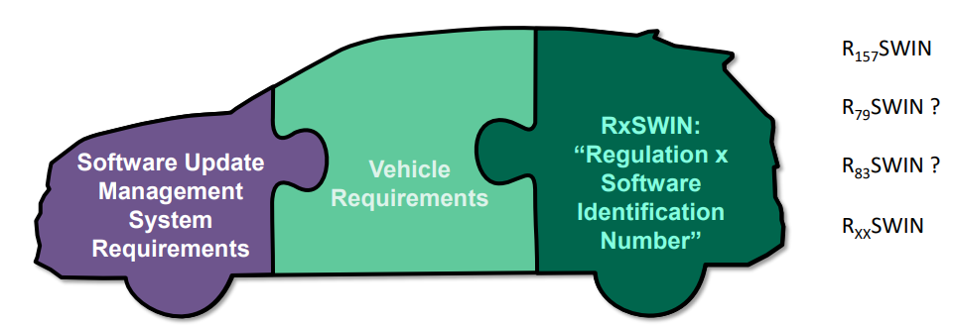
RxSWIN and other UN Regulations
If inserted in UN Regulations:
A template is provided in Annex 7 of the consolidated resolution R.E.3

Slide 10
RxSWIN - Outlook
UN R156 is in force.
RxSWIN and UN R156 are mentioned in UN R157.
Effective implementation and proper use of software updates / RxSWIN require harmonized rules for post registration approval updates

Slide 11
Thank you for your attention Text of the regulation https://unece.org/transport/documents/2021/03/standards/un-regulation-no-156-software-update-and-software-update Interpretation document https://unece.org/transport/documents/2020/12/working-documents/grva-proposals-interpretation-documents-un-regulation
Francois Guichard
Secretary to the Working Party on Automated/Autonomous and Connected Vehicles (GRVA)

