Slide 1
Informal document GRE-85-29
(85th GRE, 26–29 October 2021,
agenda item 4 (e))
Submitted by the expert from Poland
JUSTIFICATION
for GRE-85-19

Slide 2
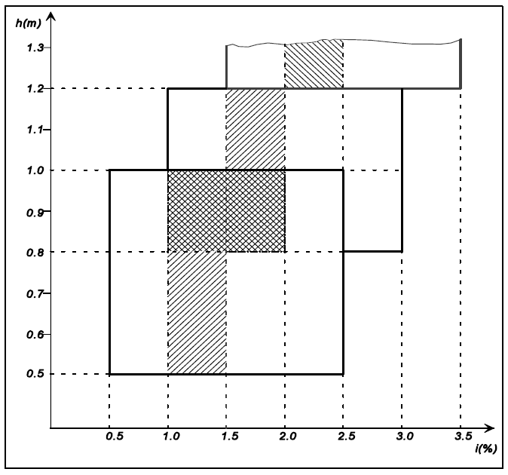
Reg. 48
Existing
situation

Slide 3
150m
75m
30m
At the moment, there are very wide load/ levelling tolerances

Slide 4
Necessity to use MANUAL LEVELING DEVICE

Slide 6
GLARE FOR IDEAL SITUTION
height of headlamp below 0.95 cm

Slide 7
100m
33m
GLARE FOR higher mounted headlamps
height of headlamp over 1.0 m

Slide 8
GLARE FOR REAL SITUTION – improper use of manual levelling device

Slide 9
INITIAL AIM ISSUE ANYWHERE INSIDE BOX
Poland proposed initial aim anywhere inside box for IWG-VGL
because of OICA request for prolonged use of manual levelling device
For today – automatic levelling only
Justification no longer valid - Poland withdraws proposal for initial aim anywhere inside box
Initial aim should be performance based – the same road illumination for each mounting height
MISTAKE
OF
GRE/2020/8/Rev.2

Slide 10
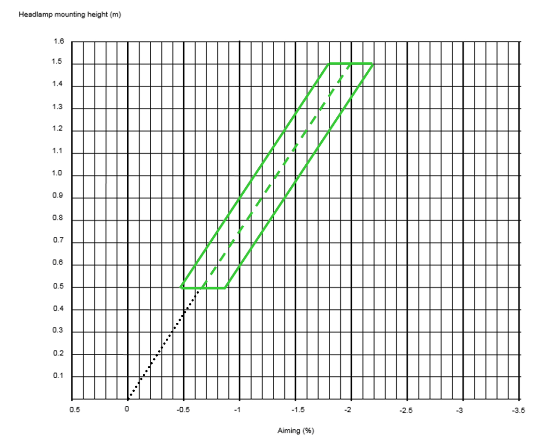
75m
PROPOSAL – standard height

Slide 11
75m
PROPOSAL - low mounted headlamp

Slide 12
75m
PROPOSAL - high mounted headlamp

Slide 13
Detection distance for different kind of headlamps
(20m – 100 m)
GTB
Glare and Visibility Forum, Geneva,
22 October 2018
J. Kobbert, K. Kosmas, T. Khanh

Slide 14
PEDESTRIAN FATALITIES IN RELATION TO
MONTH AND DAY HOUR
GTB
Glare and Visibility Forum, Geneva,
22 October 2018
M. J. Flannagan
UMTRI

Slide 15
DARKNESS HAS VERY DIFFERENT EFFECTS
BY CRASH TYPE
For fatal crashes, darkness increases risk by factors of:
- Two-vehicle 1.33
Road departure 0.99
Pedestrian 4.14
Animal 4.60
GTB
Glare and Visibility Forum, Geneva,
22 October 2018
M. J. Flannagan
UMTRI

Slide 16
Poland
FOR FATAL PEDESTRIAN CRASHES,
DARKNESS INCREASES RISK BY FACTORS OF 12

Slide 17
Proposal

Slide 18
Current technology of (static) automatic levelling devices is compatible with repeatability for any load distribution on the car better than possible to measure (better than ± 0.1%).
As general rule it is proposed to restrict “box” to ± 0.2% from initial aim value as the best choice.
Proposal

Slide 19
Proposal
Above requirements are optimal from safety and „technology neutral” point of view
However while it is impossible to meet above requirements because of design constraints of vehicle which are impossible to avoid
it is proposed to allow
values of levelling tolerances (”box shape”) as offered in GRE/2020/8/Rev.2

Slide 20
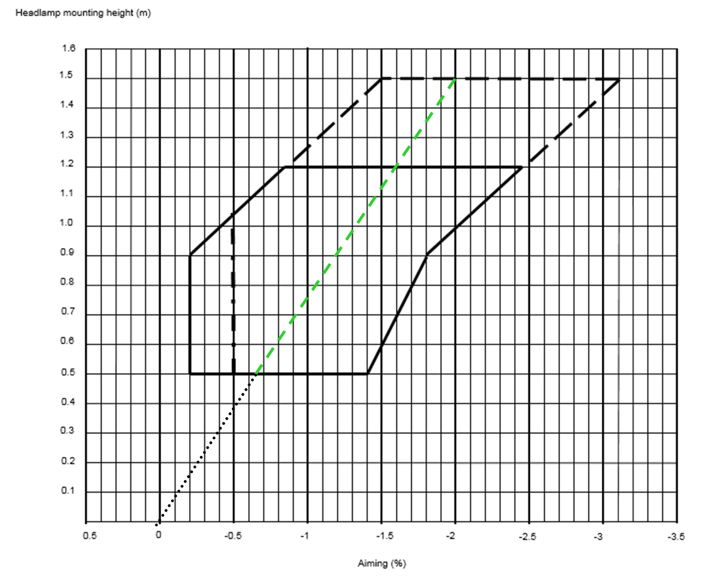
Proposal
ALTERNATIVE POSSIBILITY AS IN GRE/2020/8/Rev.2

Slide 21
FINALLY
Proposed solution IS OPTIMUM because allow TO AVIOD
AN UNSATISFACTORY COMPROMISE:
REQUIRE OPTIMAL BALANCE BETWEEN ROAD ILLUMINATION AND GLARE
ALLOWS EXCEPTIONS BUT ONLY WHEN REALLY NECESSARY
A similar solution was applied in many other paragraphs of Reg. No 48 (e.g. 6.5.4.3.; 6.7.4.2.1.; 6.9.4.2.; 6.10.4.2.; 6.14.4.2.; 6.15.4.2.; 6.17.4.2.; 6.17.4.3.; 6.18.4.2.; 6.18.4.3.; 6.19.7.3.; 6.21.1.2.3.; 6.21.7.1.; 6.21.1.2.3.; 6.21.7.1.)

Slide 22
Thank you for attention

