Slide 1
GRE
IWG
SLR
Transmitted by GRE-IWG SLR
Informal document GRE-85-18
(85th GRE, 26-29 October 2021,
agenda item 4 (a))
Simplification of the UN Lighting and Light-signalling Regulations
Progress report
to GRE-85

Slide 2
- Workload and meeting pace -
51 meetings in 7 years
11 September 2014 in Brussels (BE)
23 October 2014 in Geneva (CH)
14 January 2015 in Brussels (BE)
13 April 2015 in Geneva (CH)
13 October 2015 in Brussels (BE)
5-6 November 2015 in Brussels (BE)
15-16 December 2015 in Brussels (BE)
13-14 January 2016 in Brussels (BE)
29 February & 1 March 2016 in Brussels (BE)
14-15 April 2016 in Brussels (BE)
9-10 June 2016 in Brussels (BE)
5-7 September 2016 in Brussels (BE)
5-7 October 2016 in Brussels (BE)
5-7 December 2016 in Brussels (BE)
21-23 February 2017 in Brussels (BE)
22-24 March 2017 in Brussels (BE)
16-18 May 2017 in Tokyo (JP)
13-15 June 2017 in Brussels (BE)
12-14 July 2017 in Brussels (BE)
4-6 October 2017 in Brussels (BE)
18-21 December 2017 in Brussels (BE)
29 Jan / 1 Feb 2018 in Shenzhen (CN)
4-6 April 2018 in Brussels (BE)
30 May / 1 June 2018 in Brussels (BE)
3-5 July 2018 in Brussels (BE)
24-26 September 2018 in Brussels (BE)
10-12 December 2018 in Brussels (BE)
25-27 February 2019 in Brussels (BE)
27-29 March 2019 in Brussels (BE)
22-24 May 2019 in Brussels (BE)
3-5 July 2019 in Brussels (BE)
3-5 September 2019 in Tokyo (JP)
9-11 October 2019 in Brussels (BE)
4-6 November 2019 in Brussels (BE)
11-13 December 2019 in Brussels (BE)
8-10 January 2020 in Brussels (BE)
2-4 March 2020 in Brussels (BE)
27-29 May 2020 – WebEx
7-10 July 2020 – WebEx
26-28 August 2020 – WebEx
21-23 September 2020 – WebEx
3-5 November 2020 – WebEx
9-11 December 2020 – WebEx
12-14 January 2021 – WebEx
17-19 February 2021 – WebEx
24-26 March 2021 – WebEx
10-12 May 2021 – WebEx
16-18 June 2021 – WebEx
20-22 July 2021 – WebEx
9-10 September 2021 – WebEx
6-8 October 2021 – WebEx
Next meetings*:
SLR-52 on 15-17 Dec 2021
SLR-53 on 12-14 Jan 2022
* Hybrid, if possible…

Slide 3
SLR submission to GRE-85
Notes:
A complete package of 12 documents will be discussed at GRE-85 in October 2021. This will include:
a presentation of the main changes (3 informal documents)
a consolidated text for each of the draft 01 series of amendments to the new device Regulations No. 148, 149 and 150 (3 formal proposals)
all the installation Regulations (R48, R53, R74, R86) will be amended to introduce references to the headlamp Classes in the 01 series of amendments to Regulation No. 149 (6 formal proposals)
This has been a huge challenge for GTB and its WGs which have heavily contributed to this work since “Day #1”

Slide 4
Headlamp Levelling
GRE-IWG SLR submitted a Revised proposal to GRE-84
GRE/2020/8/Rev.2
Despite holding 3 special sessions since GRE-84, SLR has not yet converged on a revised proposal that can reconcile all the different positions.
The great majority of SLR members believe that the existing proposal (GRE/2020/8/Rev.2) may provide the best basis to find a compromise.
SLR might consider to continue the discussion in some additional special sessions, if so instructed by GRE. The activity, focussing mainly on Reg. 48, would fit with the Simplification Stage II / Step 2.
Removal of the manual levelling option,
except for off-road vehicles
(i.e. M₂G, M₃G, N₂G, N₃G)
New
aiming
diagram
“GRE noted diverging positions on the proposed aiming diagram and manual levelling for off-road vehicles only. GRE remained optimistic that a consensus could be reached and requested IWG SLR to convene 1-2 additional separate meetings with the aim to reconcile the different positions and to prepare a revised proposal for the next session”

Slide 5
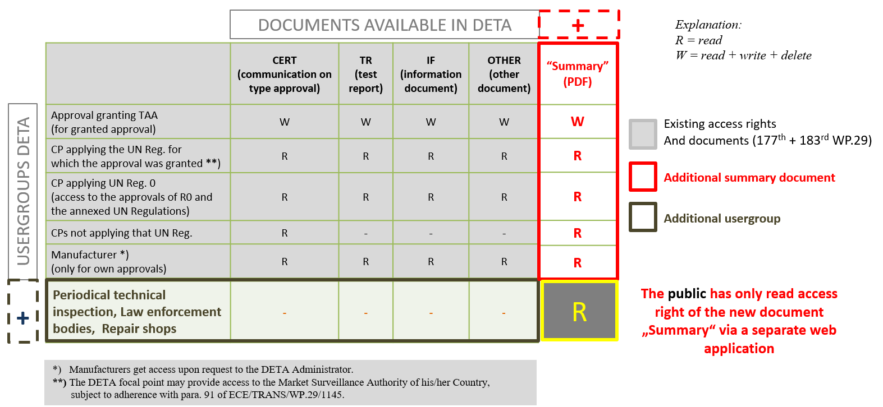
UNIQUE IDENTIFIER / DETA Database SLR approach endorsed by DETA
For further details see document: DETA-41-06/Rev.1

Slide 6
Justification for the proposed transitional period for Stage II / Step 1
Proposal:
“As from 1 September [2026] Contracting Parties applying this Regulation…”
Justification for the proposed transitional period:
Compared to the original versions of UN Regulations Nos. 148, 149 and 150, the proposals for the 01 series of amendments – with the aim of introducing performance-based provisions – lead to a lot of amended and more stringent requirements to different functions. In particular, revised photometric requirements are proposed for enhanced passing-beam, driving-beam and AFS distributions.
For future headlamp/signalling projects the new requirements will lead to the necessity to develop improved devices/functions and accordingly new light source modules for these functions.
Since the development of new projects usually needs at least 2 years and, additionally, manufacturers require 1 year for the introduction of new light source modules, a minimum transitional period of 3 years is proposed.
Assuming an entry into force in 2023, the year 2026 is proposed in square brackets. Identical Transitional Provisions are proposed for UN Regulations Nos. 148, 149 and 150 for consistency. Most importantly, this takes into account the need for simultaneous type approval of devices including multiple functions according to different Regulations.

Slide 7
“CPs moment”
Since the 41st SLR session, a “CPs moment” has been introduced on the agenda of SLR.
This is intended to present the SLR results, and to provide an overview, to those CPs that that did not have the chance to attend the complete session.
Although all CPs are always invited and encouraged to participate in SLR meetings, the “CPs moment” offered a good opportunity to be updated and ask questions.
The “CPs moment” will continue to be a permanent item on the agenda, foreseen on the last day of the meeting.

