Slide 1
GRE 85 – 16 Informal document Submitted by the experts from France and Germany* manufacturers logo Size versus visual acuity This informal document gives additional information to the proposal (working document ECE/TRANS/WP.29/GRE/2020/5/Rev.2 prepared by experts from France and Germany) allowing the use of manufacturer logos inside the illuminant surface of a signalling lamps.

Slide 2
Manufacturers logo ←→ size
The proposed size is 100 cm²
Within this area, there will be a luminosity distribution visible, which allows
to identify the brand of the car manufacturer
Smaller structures have to be detected by the human eye
inside the proposed area.
→ The visual acuity is important!

Slide 3
Manufacturers logo ←→ size
Proposed logo size 100 cm²
Logo of 100 cm² with a simple structure
Inside the field of 100 cm² there must be a structure.
The visual acuity determines the distance at which a logo is detected as such

Slide 4
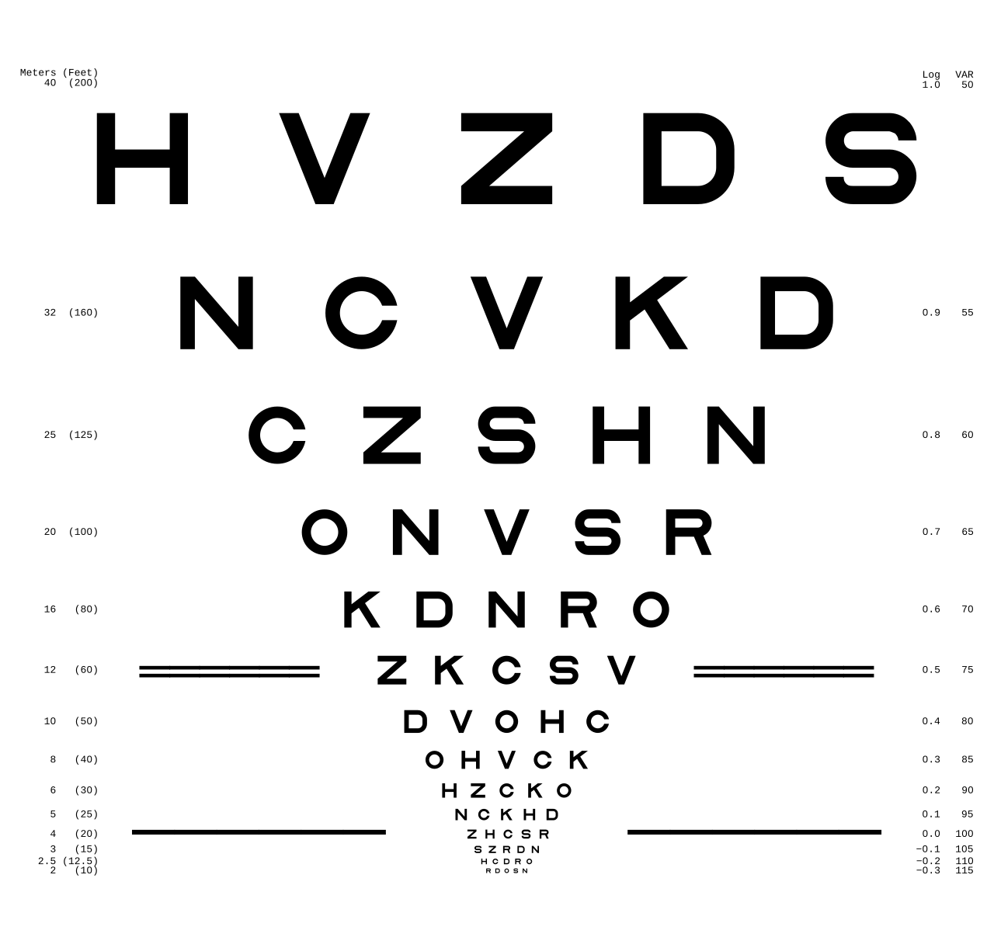
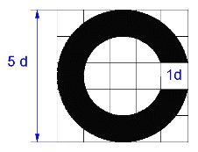
Manufacturers logo ←→ size
Some facts on visual acuity
It is highest for central vision (foveal)
It is lower for peripheral vision
It is measured as the spatial resolution of the visual processing system
It depends on the contrast to the surroundings and the adaptation of the eye
Landolt ring for measuring the visual acuity
Chart with letters

Slide 5
Manufacturers logo ←→ size
The visual acuity of a normal observer is defined as the ability to distinguish
two objects with a distance of 1’ (one arc minute)
1’, one arc minute
1,5 mm from a distance of 5 m
1,75 mm from a distance of 6 m (20 feet)
3 mm from a distance of 10 m
6 mm from a distance of 20 m
10 mm from a distance of 33 m
20 mm from a distance of 67 m

Slide 6
Manufacturers logo ←→ size
Those observation distances have to be compared with the safety distance
- in the city: distance passed in 1 s
- outside the city: distance passed in 2 s
Safety distance in m
(rel.) Speed in km/h | Inside the City | Outside the city or highway
30 | 8,3
50 | 14
60^{*)} | (17) | (34)
80 |  | 44
100 |  | 56
120 |  | 67
130 |  | 72
150 |  | 83
1’ one arc minute
1,5 mm from a distance of 5 m
1,75 mm from a distance of 6 m
3 mm from a distance of 10 m
6 mm from a distance of 20 m
10 mm from a distance of 33 m
20 mm from a distance of 67 m
*) Unusual speed for the specific zones

Slide 7
Manufacturers logo ←→ size
conclusion
For lower speed < 50 km/h you may distinguish two lines or areas as separated objects within a logo if their distance is larger than 3 mm
Remark: in the city, at lower speed, not self-luminous logos are already visible
For higher speed even 10 mm separation is not enough to identify a logo
By restricting the size to 100 cm², it is already very hard
to identify a logo in normal traffic situations outside the city.
In the city all logos, self-luminous or not, are visible anyway.

