Slide 1
Task Force on Electro-Magnetic Compatibility (TF-EMC) Status report to GRE-85 October 2021
Submitted by the expert of TF-EMC Informal document GRE-85-10 85th GRE, 26-29 October 2021
agenda item 7.(a)

Slide 2
TF-EMC Status Report - General
4 TF-EMC meetings took place since March 2021
Proposals from OICA EMC-TF and CPs have been issued and discussed.
As scheduled, an informal document has been prepared for the GRE-85 session with :
agreed proposals
and/or proposals still under discussion (but with detailed proposed wording)
April 2021
GRE session
October 2021
GRE session
R10 revision Informal document
Status report from TF-EMC

Slide 3
TF-EMC Status Report – Informal document
Proposals in informal document already agreed within TF-EMC (highlighted in green)
Suppression of FM band CISPR 25 measurement as alternative to vehicle CISPR 12 measurement for narrowband radiated emission
Suppression of 800 mm Stripline method for ESA immunity testing
Extension of possible use of simplified measurement for test performed by technical services to vehicle in charging mode test
Note to precise « link » between ECE R10 and ISO 26262
Addition of official definitions in regard to autonomous vehicles
Precision on ESA transient immunity test for charging mode configuration

Slide 4
TF-EMC Status Report - Informal document
Proposals in informal document still under discussion within TF-EMC (highlighted in yellow)
Addition of reverberation chamber method for ESA testing
Consideration of non-residential environment for emission of radiofrequency conducted disturbances on AC or DC power lines – Vehicle in charging mode
Precision for minimum charging current for vehicle and ESA in DC charging mode emission test
Precision in each concerned annex for vehicle in charging mode of the charging modes to be tested and of the charging cables to be used
Emission measurement (conducted and radiated) instrumentation – Potential use of FFT (Fast Fourier Transform)
Consideration of autonomous vehicles (ADAS functions) for radiated immunity test
Precision on e-call testing for vehicle radiated immunity
Precision on operating conditions and failure criteria for ESA in charging mode immunity test
Precisions for trolleybuses
Extension up to 6 GHz of radiated immunity test frequency range
Introduction of vehicle ESD test

Slide 5
TF-EMC Status Report – Informal document
Suppression of FM band CISPR 25 measurement as alternative to vehicle CISPR 12 measurement for narrowband radiated emission
Clause 6
Annex 5
Suppression of this alternative method (voltage at antenna terminal in FM band) because cannot be considered as representative of vehicle radiated emission in the 30 MHz – 1 GHz frequency band.

Slide 6
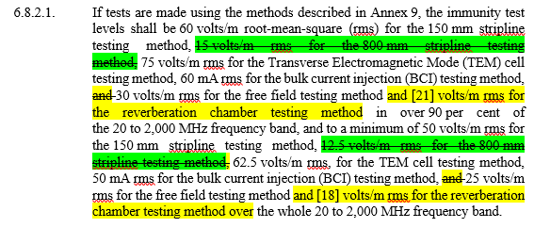
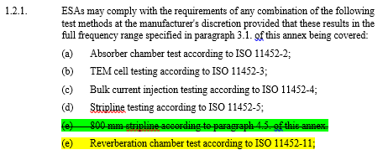
TF-EMC Status Report – Informal document
ESA immunity test methods : suppression of 800 mm Stripline + potential addition of Reverberation chamber method
Clause 6
Clause 7
Annex 9
Suppression of 800 mm Stripline test method because test method not standardized and not used anymore.
Potential addition of reverberating chamber test method because standardized (ISO 11452-11) and more representative / robust.

Slide 7
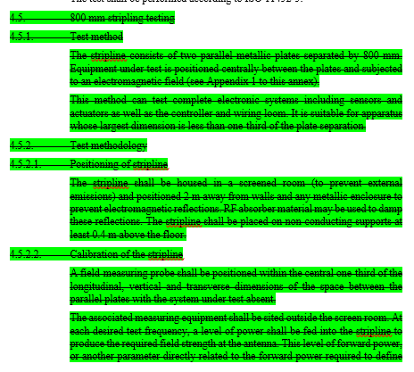
TF-EMC Status Report – Informal document
ESA immunity test methods : suppression of 800 mm Stripline + potential addition of Reverberation chamber method
Annex 9
Suppression of 800 mm Stripline test method because test method not standardized and not use anymore
Potential addition of reverberating chamber test method because standardized (ISO 11452-11) and more representative / robust

Slide 8
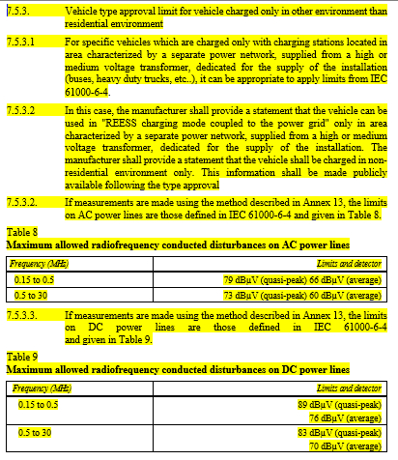
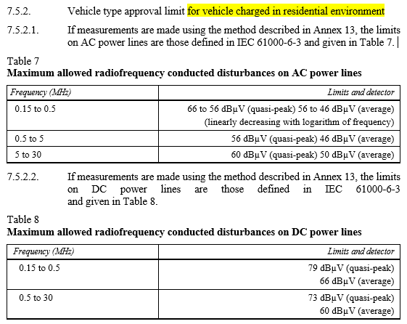
TF-EMC Status Report – Informal document
Emission of radiofrequency conducted disturbances on AC or DC power lines – Vehicle in charging mode
Clause 7
Distinction between residential and other environments (less stringent requirement for non-residential environment) in line with IEC 61000-6-3 and 61000-6-4 with associated statement that vehicle can be charged only in non-residential environment.

Slide 9
TF-EMC Status Report – Informal document
Emission of radiofrequency conducted disturbances on AC or DC power lines – Vehicle in charging mode
Annex 2A
Annex 3A
Clause 7
Distinction between residential and other environments (less stringent requirement for non-residential environment) in line with IEC 61000-6-3 and 61000-6-4 with associated statement that vehicle can be charged only in non-residential environment.

Slide 10
TF-EMC Status Report – Informal document
Precision for minimum charging current for vehicle and ESA in charging mode emission test
Annex 4
Annex 7
Annex 13
Annex 14
Annex 19
Annex 20
Editorial change for « nominal »
Potential technical modification for minimum charging current value in DC charging mode (test facility limitation, no proven impact)

Slide 11
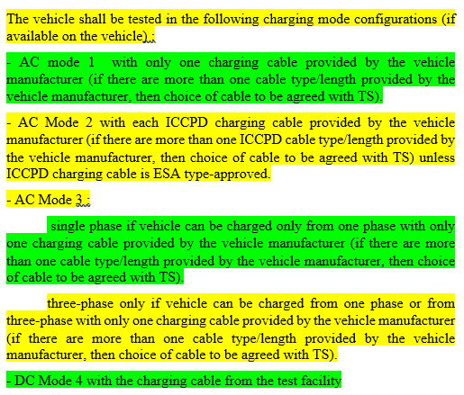
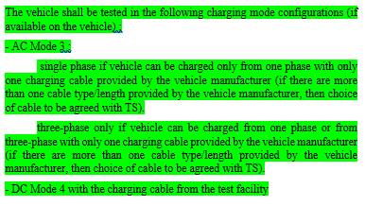
TF-EMC Status Report – Informal document
Precision in each concerned annex for vehicle in charging mode of the charging modes to be tested and of the charging cables to be used
Annex 4
Annex 6
Annex 11
Annex 12
Annex 13
Annex 14
Annex 15
Annex 16
ECE R10.06 does not states explicitly which charging modes should be tested and with which charging cables in emission and immunity annexes concerning vehicle in charging mode

Slide 12
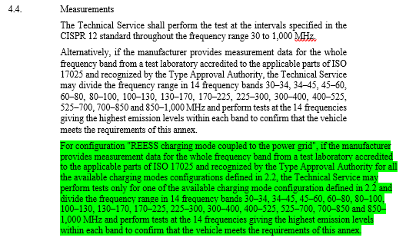
TF-EMC Status Report – Informal document
Extension of possible use of simplified measurement for test performed by technical services on vehicle in charging mode test
Annex 4
Annex 6
Annex 13
Annex 14
Annex 15
Annex 16
Use of simplified test method by technical services (under certain conditions) already included in previous R10 versions for vehicle not in charging mode.

Slide 13
TF-EMC Status Report – Informal document
Emission measurement (conducted and radiated) instrumentation – Potential use of FFT (Fast Fourier Transform)
Annex 4
Annex 5
Annex 7
Annex 8
Annex 13
Annex 14
Annex 19
Annex 20
Last reference standard CISPR 16-1-1 allows to use FFT for emission measurement. On-going revision of CISPR 12 and CISPR 25 have also included possible use of FFT.

Slide 14
TF-EMC Status Report – Informal document
Consideration of autonomous vehicles (ADAS functions) for radiated immunity test
Annex 6
Autonomous vehicle functions shall be considered for R10 radiated immunity test. Operating conditions still under discussion.

Slide 15
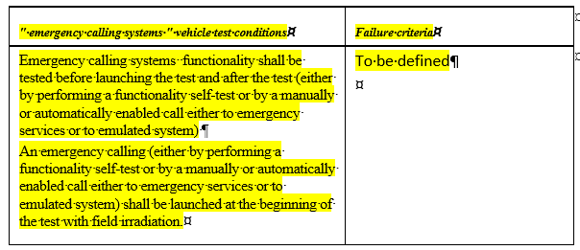
TF-EMC Status Report – Informal document
Precision on e-call testing for vehicle radiated immunity
Annex 6
E-call test during immunity to be precise (operating conditions and failure criteria); testing in EMC laboratory to be precised; test level to be confirmed.

Slide 16
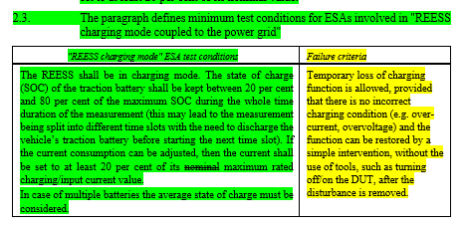
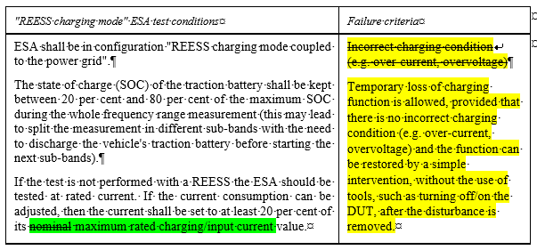
TF-EMC Status Report – Informal document
Precision on operating conditions and failure criteria for ESA in charging mode immunity test
Annex 9
Annex 21
Annex 22
No technical change for operating conditions
Potential change of failure criteria.

Slide 17
TF-EMC Status Report – Informal document
Extension of frequency range up to 6 GHz
6.4.2.1
6.9.2.1
7.7.2.1
7.18.2.1
Need to consider new services above 2 GHz (e.g 4G, 5G) for immunity to external sources.
Conditions for testing long vehicle shall be precised, test level above 2 GHz to be precised.

Slide 18
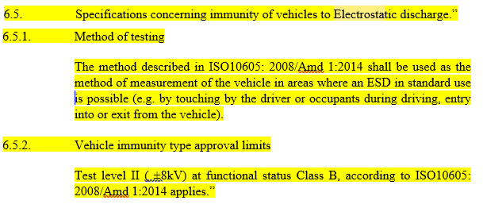
TF-EMC Status Report – Informal document
Introduction of vehicle ESD test
6.5
Topic under discussion.

Slide 19
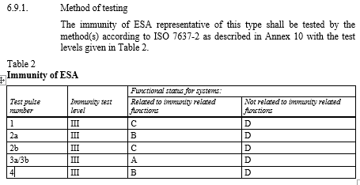
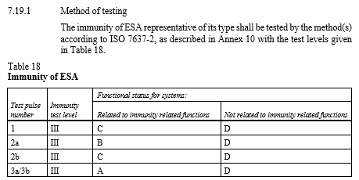
TF-EMC Status Report – Informal document
Precision on ESA transient immunity test for charging mode configuration
Annex 10
Annex 10 wording is not fully consistent with requirement described in clauses 6 and 7

Slide 20
TF-EMC Status Report – Informal document
Miscellaneous
Scope
Note to precise « link » between ECE R10 and ISO 26262
Definitions
Addition of official definitions in regard to autonomous vehicles

Slide 21
TF-EMC Status Report – Informal document
Miscellaneous
Clause 6
Precision for trolleybuses

Slide 22
TF-EMC Status Report - Revision of R10
Proposals still under consideration within TF-EMC (not included in informal document)
Improvement of test set-up figures and descriptions for vehicle in configuration "REESS charging mode coupled to the power grid"
Improvement of test set-up figures and descriptions for ESA in configuration "REESS charging mode coupled to the power grid"
Update of standards normative references to more recent editions

Slide 23
TF-EMC Status Report - Revision of R10
Next steps for R10 revision
As proposed and agreed during GRE 84th session the next steps will be to propose formal working documents for R10 revision at the 2 next GRE sessions
April 2021
GRE session
October 2021
GRE session
April 2022
GRE session
October 2022
GRE session
Status report from TF-EMC
R10 revision Informal document
R10 revision Formal working document
R10 revision Final formal working document

