Slide 1
GRE-85-02
UI
270650
Proposal for extension of DETA to improve the use of the
UNIQUE IDENTIFIER for UN Regulations
As introduced and accepted by WP.29 IWG on DETA
DETA-41-06e Rev.1
Based on SLR-48-15
1

Slide 2
UNIQUE IDENTIFIER / DETA Database
Legal Basis / Motivation
Legal Basis: 1958 Agreement Revision 3 Schedule 5:
“… the approval markings required by UN Regulations may be replaced by a Unique Identifier (UI) preceded
by the symbol , unless specified otherwise in the UN Regulations.”
UI
Device markings (depending on Regulation text)
Approval marking
Other marking
….
Marking example for lighting & light-signalling Regulations
R1 S1 2aY F1 AR
P21W
P21/5W
PY21W
MD E4 3349
E1
3169
3170
12V
148R00
Light sources / modules used in the device
Trademark / Logo of manufacturer
Approval marking
Rated voltage

Slide 3
UNIQUE IDENTIFIER / DETA Database
Motivation / Text of the Regulation (R148, R149, R150)
The (traditional) Approval Marking specifies (Example R148):
The number of the type approval
The contracting party (country) who is responsible for the type approval
The Regulation Number the device was type approved to
The status of the Regulation at the time of type approval
The different functions that are included in the device
Any possible restrictions in mounting height
Any possible restrictions in mounting position
Any possible restriction to the number of devices necessary (D or Y)
IMPORTANT:
ALL these markings must be visible after the installation of the device on the vehicle
3170
E1
148R
(series) 00
R1 S1 2aY F1 AR
(2a)Y
R1 S1 2aY F1 AR
E1
3170
148R00
MAY BE REPLACED BY
The (new) Unique Identifier Marking specifies:
The unique number for accessing the DETA
IMPORTANT:
ALL these markings must be visible after the installation of the device on the vehicle
UI
270650
270650
With UI currently required information becomes invisible, unless you are one of the existing user groups in DETA

Slide 4
UNIQUE IDENTIFIER / DETA Database
Motivation / Possible solutions
Solution A
Solution B
Redefine the approval marking
Amend DETA
R1 S1 2aY F1 AR
UI
270650
E1
3169
3170
+
148R00
R1 S1 2aY F1 AR
E1
3169
3170
OR
Electronic database (DETA)
Information
Information
Information
148R00
+
New usergroup
E1
3169
3170
OR
UI
270650
Result: All the necessary information is available
as it is not replaced by the UI
Result: All the necessary information is available
but part of DETA

Slide 5
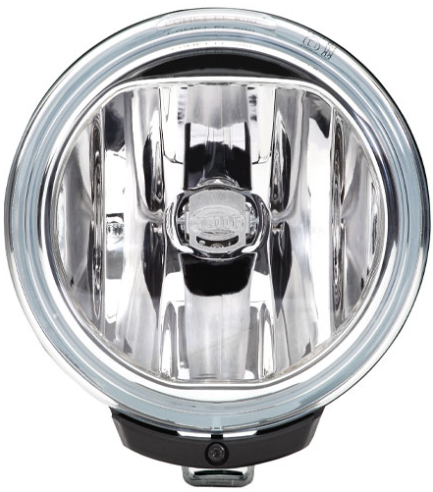
UNIQUE IDENTIFIER / DETA Database
Motivation / Reason for the chosen solution
Example: Device used as a beam contributor for different AFS systems
Approval marking
Unique Identifier
(On any fixed part visible after installation i.e. lens)
(On any fixed part visible after installation i.e. lens)
60+ mm
F3 K PL
00 XEWR 11111 22222 33333 44444
00 XCV 55555 66666 77777
00 XCWT 88888 99999
00 XCVR 121210 112211
00 XCWR 14441 14442
00 XCWR 552200 552201
Marking
Database
20 mm
35+ mm
E6
9 mm
UI
+
Electronic database (DETA)
Information
Information
Information
1234567
R14900
1122
The presence of the marking in front of the optics could have an influence on the quality of the optical system
5

Slide 6
UNIQUE IDENTIFIER / DETA Database
Details of the amendment to DETA
Proposal - Make the relevant information available to those dependent on the content
Part A: Document management
Create a new „Summary“ document in DETA (PDF)
showing for example, depending on GRs decisions for each Regulation:
Part B: Usergroup management
Create a new usergroup in DETA
Usergroup level: Public (e.g. law enforcement, repair shops, etc.)
Usergroup rights: Read only the „Summary“ document
Description
Traditional markings / Explaining text
If they exist, limitations to the installation and/or use
The public has only access to the „Summary“ document stored in DETA via a separate web application.

Slide 7
UNIQUE IDENTIFIER / DETA Database
Details of the amendment to DETA – Part A
Part A – „Summary“ document managment
Summary
HEADLINE
UI
270650
UNIQUE IDENTIFIER as on the device
R1 S1 2aY F1 AR
E1
3169
3170
TRADITIONAL MARKING The alternative marking as in the Regulation / Explaining text for the device.
148R00
Depending on GR‘s decision
EXPLAINING / ADDITIONAL TEXT
Explaining text to the symbols / markings /device if necessary.
The intention is to provide equivalent information to the existing marking
Information text
The above information, except for the alternative marking, is available somewhere in the existing documents in DETA. According to the currently proposed usergroups matrix, this information could be found by authorised experts only, but not by anyone else. The existing documents also contain a lot of information that is not for public view in any case!

Slide 8
UNIQUE IDENTIFIER / DETA Database
Details of the amendment to DETA – Part A
YES (“… may be replaced by a UI…” e.g. R148, R149, R150)
UI marking allowed by the Regulation?
NO (“…unless specified otherwise in the UN Regulations…” e.g. R44, R129)
R1 S1 2aY F1 AR
R1 S1 2aY F1 AR
UI
YES
E1
E1
3170
OR
270650
3170
148R
148R
Summary document necessary?
NO
Summary
Information
Information
Information
YES
Summary
Information
Information
Information
Content?
All decisions to be made by each GR separately for each Regulation

Slide 9
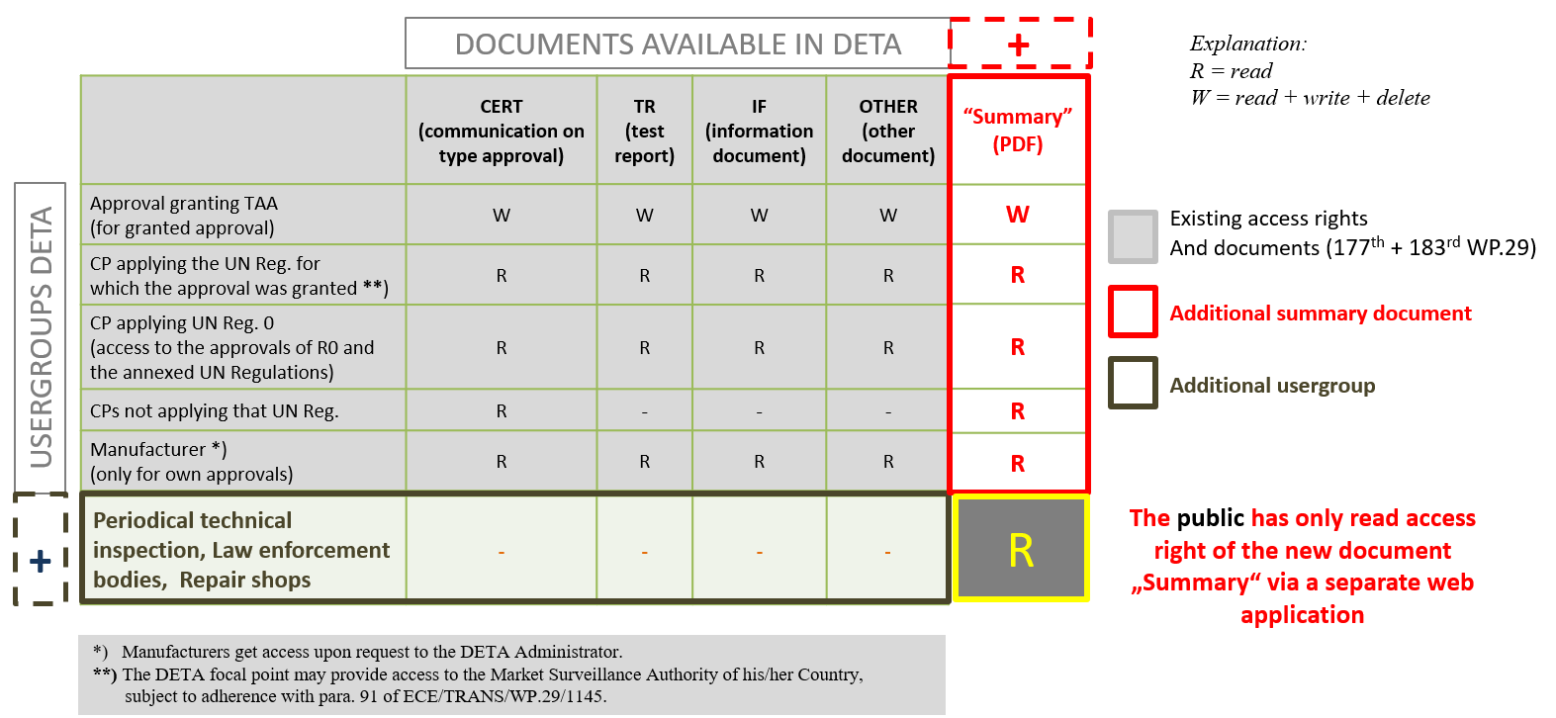
UNIQUE IDENTIFIER / DETA Database
Details of the amendment to DETA – Part B
Part B – Usergroup managment

Slide 10
BACKUP

Slide 11
UNIQUE IDENTIFIER / DETA Database
Explanation to „approval mark“ / „approval marking“ / „approval number“ ……
The explanation below is based on the text of Regulation No. 148, draft series 01
E1
3.3.2.1.1. „Approval mark“
3.3.2. „Approval Marking“
ALTERNATIVES
0170
3.3.2.1.2. „four to six digit sequential number“
R1 S1 2aY F1 AR
R1 S1 2a F1 AR
3.3.2.1.3. „Symbols“
E1
0170
148R00
3.3.2.1.4. „Regulation Number + „R“ + Series“
148R00
Y
3.3.2.1.5. „Additional symbols“
UI
270650
3.3.3. „Unique Identifier“
3.3.4. „Other marking“
12V
P21W
3.3.4.x. Trademark, Modulemarking, Voltage,(Substitute) light source category ….
E1*148R00/00*0170*00
„Approval number“ acc. to schedule 4 of the 1958 agreement

