Slide 1
2020 CPI Manual
June 10, 2021
Group of Experts on Consumer Price Indices
Brian Graf, Senior Economist
Real Sector Division

Slide 2
Outline
Why update the Manual?
Background
Key milestones and progress
Key changes
Going Forward

Slide 3
Why update the Manual?

Slide 4
Background
2014 UNECE-ILO CPI Group of Experts Meeting http://www.unece.org/stats/documents/2014.05.cpi.html
2014 IWGPS endorsement for updating the CPI manual
IMF as the lead agency
World Bank current chair
Multiple layers of review
Two publications
Consumer Price Index Manual: Concepts and Practices (Manual)
Consumer Price Index: Theory

Slide 5
Review
Initial chapter review – experts and compilers
Compilers and data users – 6 months
IWGPS review
Formal consultation of countries
Outside review

Slide 6
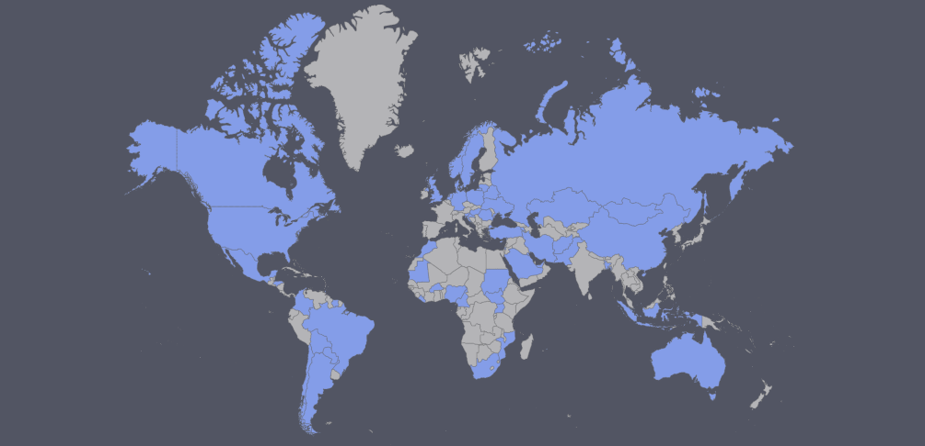
Feedback received from 57 countries…
Includes consultation of compilers and the formal consultation

Slide 7
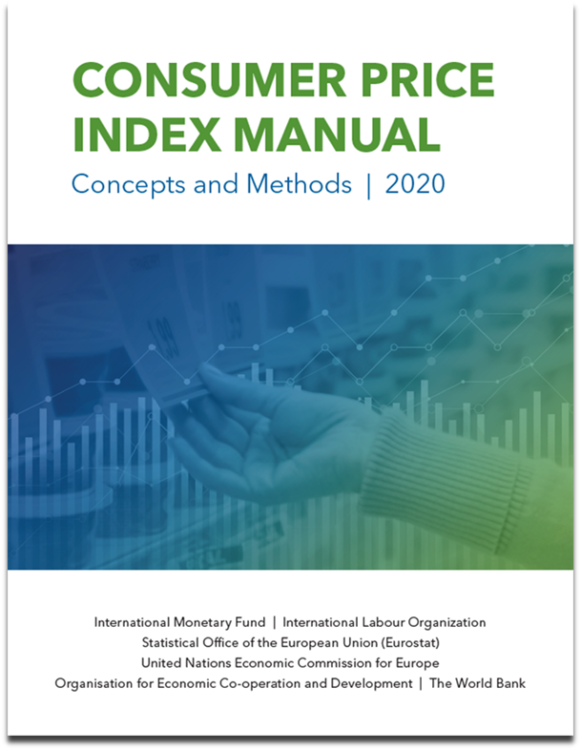
Endorsed
51st Meeting of the United Nations Statistical Commission
March 2020

Slide 8
Publication
Release – November 19, 2020
Print version – December 2020
Translation – Ongoing

Slide 9
Key updates
More prescriptive:
Wherever possible, the Manual provides more prescriptive advice.
Second-, and in some cases, third-best options
Reflect advances in technology that have given rise to e-commerce and the digital economy.
Reflect improvements made to the concepts and methods used to compile CPIs.
New data sources
Reflect evolving data user needs.

Slide 10
Key updates
Ensure broader consistency with the System of National Accounts 2008.
Eliminate repetition and ensure consistency between chapters.
Feedback and experiences with 2004 Manual.
Incorporate the Practical Guide to Compiling Consumer Price Indices into the Manual.
The CPI Guide replaced by the Manual and discontinued.
Most chapters now conclude with overview of key recommendations.

Slide 11
Key updates
Standardizing terminology – create more uniformity and consistency across countries:
Product, item, and variety
Variety -- The individual product for which prices are collected during the collection period. It includes the detailed specification of the product or item observed.
Elementary aggregate has been defined more clearly to mean the lowest level of groups of goods and services for which expenditure weights are assigned and held constant for a period of time.
This change was made in response to the use of alternative sources, such as scanner data, to develop detailed weights below the elementary aggregate level.
There is need to ensure consistency across countries when referring to elementary aggregates.

Slide 12
Key Changes/Updates
Three new chapters
Overview of compiling CPIs
Scanner data
Updating weights and linking index series
Rewrites
Sampling
Focus on multi-stage sampling process in practice
Practical realities faced by compilers and availability of sampling frames
Missing prices and quality adjustment
More detailed examples and clearer guidance

Slide 13
Key Changes/Updates
Treatment of internet purchases and collection of online prices
Innovations in the collection of prices
Web scraping
Hand-held computers/tablets
Data editing
Theory and concepts
Treatment of scanner data in the calculation of elementary aggregates
Quality adjustment methods to deal with scanner data

Slide 14
Manual – Going forward
“Snapshot” of recommendations and best practice at time of endorsement
Challenge: dynamic nature of compilation methods
Guidance Notes to be issued as needed to ensure Manual remains current
Recognize that methods continue to evolve
Research drives development of new best practices
Guidance Notes issued to update relevant chapter in the Manual

Slide 15
Manual – Going forward
Research Agenda
Identifies topics for further research and discussion
Foster the development of new methodologies
Encourage collaboration and guide the agendas for upcoming meetings
UNECE-ILO Group of Experts on Consumer Price Indices
Ottawa Group

Slide 16
Outreach
Presentation and introduction of updated Manual
Webinars
Regional seminars on CPI Manual
Introduce and discuss changes and updates made to the Consumer Price Index (CPI) Manual;
Identify and reinforce key recommendations through discussion and practical exercises; and
Demonstrate the link between producing accurate, reliable CPI data, developing sound policy decisions based on these data, and the importance of disseminating data fit for surveillance
Digital Manual

Slide 17
Theory publication
Draft chapters available – September 2020
Review by main reviewers – Ongoing
Incorporate comments from reviewers – Ongoing
Chapters 1, 9, and 11 – Ongoing (target – mid-summer 2021)
Compiler review
Review by IWGPS
IWGPS discussion on final version
Formal editing
Theory publication will not be endorsed by the UNSC

Slide 18
https://www.imf.org/en/Data/Statistics/cpi-manual

Slide 19
Thank you!
Comments welcome
bgraf@imf.org

