Slide 1
Draft guide on CPI during lockdown
Chris Jenkins – Office for National Statistics
Group of Experts on Consumer Price Indices, June 2021

Slide 2
Introduction
The outbreak of the Covid-19 pandemic in early 2020 and the resultant restrictions led to challenges in the compilation of CPI
Main issues encountered for CPI:
Closure of outlets and/or sectors of the economy
Restricted access to outlets to collect price data
Missing prices
Changes in quality due to Covid-19

Slide 3
Introduction
International statistical community came together to provide guidance and support – this is still evolving
The world is still in the hold of the pandemic, but most NSOs have a better grasp of how to deal with CPI during such a period
However, there is an opportunity to provide guidance material to support CPI compilation

Slide 4
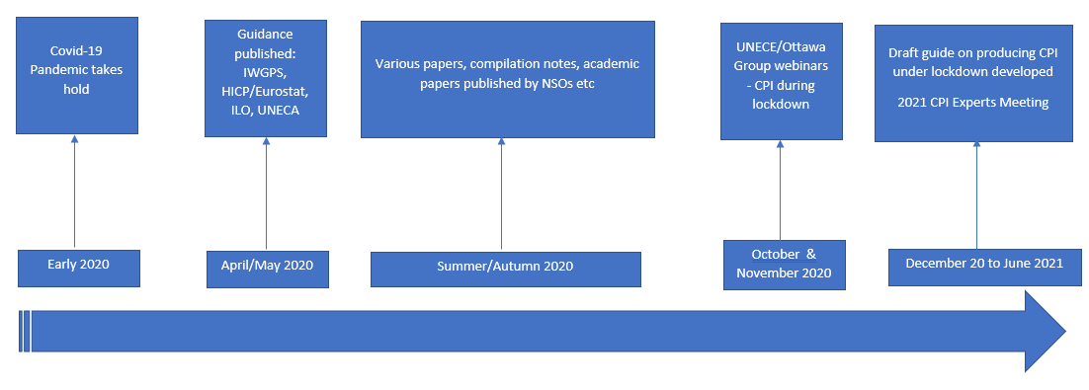
Covid-19 timeline

Slide 5
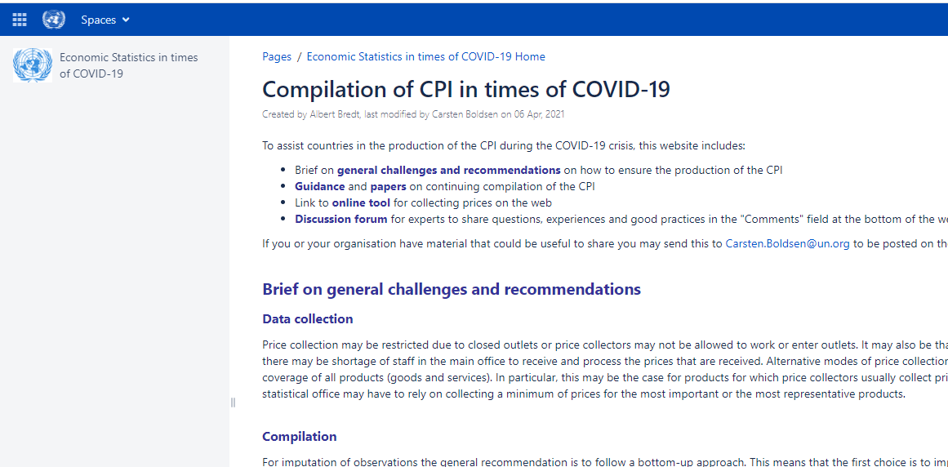
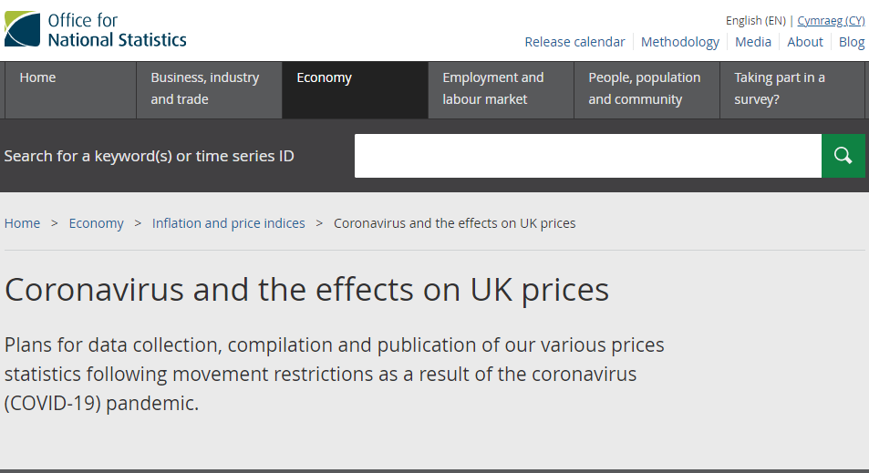
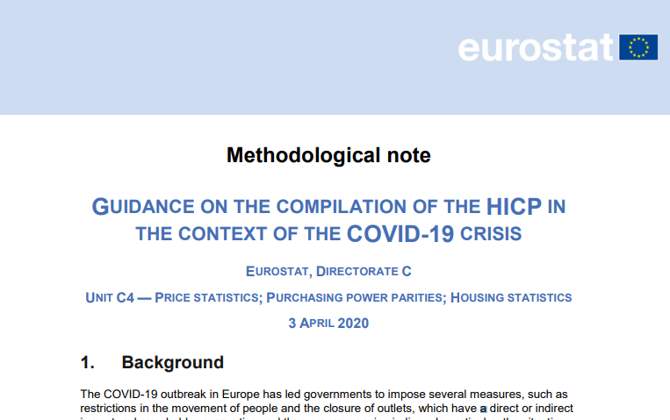
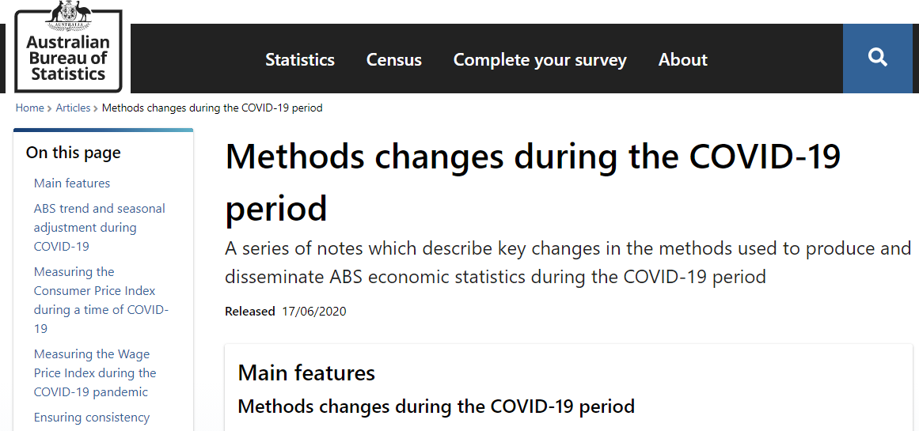
CPI during lockdown - resources

Slide 6
Draft Guide – CPI During Lockdown
October/November 2020: CPI during lockdown – webinars:
Webinar 1 - Theoretical considerations
Webinar 2 - Data collection
Webinar 3 – Imputation for missing observations
Webinar 4 – Communication
Conference of European Statisticians requested the development of reference document to summarise the main findings, best practice etc.

Slide 7
Draft – CPI During Lockdown Guide
Draft guide developed between December 2020 to April 2021 through the CPI Expert Meeting Steering group, but main authors as follows:
Giorgi Tetrauli (National Statistics Office of Georgia)
Federico Polidoro (National Institute of Statistics of Italy)
Rob Cage (Bureau of Labor Statistics, United States)
Claude Lamboray (Eurostat)
Carsten Boldsen (UNECE)
Chris Jenkins (Office for National Statistics, United Kingdom)
Purpose of this Guide: provide recommendations and examples of good practices for producing the CPI under lockdown and other exceptional circumstances.

Slide 8
Draft Guide – CPI During Lockdown
Guide contains five chapters (first chapter is the introduction):
Chapter 2 – Data collection
Chapter 3 – Imputation and index calculation
Chapter 4 – Expenditure weights
Chapter 5 – Communication
The guide is not prescriptive - the key points and examples of the Guide are based on countries’ experience with producing the CPI under the Covid-19 pandemic in 2020-2021
The key points of the Guide are in line with the CPI Manual and the IWGPS Business Continuity Guidance for CPI

Slide 9
Draft – CPI During Lockdown Guide – Chapter 2 – key points
Clear definition of ‘available’ and ‘unavailable’ products needed
Health and safety of staff and personnel highest priority
Attempt to collect as many actual prices as possible using various modes, but;
Do not switch between outlets in the field
‘Covid-19’ charges in general should be included
Contingency planning key outcome from Pandemic
In long-term – NSOs to consider mixed mode collection to become more resilient

Slide 10
Draft – CPI During Lockdown Guide – Chapter 3 – key points
Imputation strategy for available products should follow a ‘bottom up’ approach
Specific imputation methods to be considered for products that are not transacted during a lockdown: Impute with a comparable EA, nearest higher level index or the overall CPI
Important that imputation methods are self-correcting
NSOs should develop consistent metrics to monitor the extent of imputations in the CPI
NSOs should develop and communicate a comprehensive imputation policy

Slide 11
Draft – CPI During Lockdown Guide – Chapter 4 – key points
NSOs should avoid making instantaneous changes to aggregation formula/weights updates
If weight update involves ‘unrepresentative’ spending for the lockdown period, NSOs may consider modification of the weight update
For annually updated CPIs, there is more scope to derive weights based on recent expenditure data
NSOs should produce ex-post analysis to compare and contrast any impact on CPI using lagged weights

Slide 12
Draft – CPI During Lockdown Guide – Chapter 5 – key points
NSOs should continue dissemination of CPI at the common level of disaggregation and to agreed timetable wherever possible
Proactive communication is necessary to maintain transparency and credibility of CPI during such shocks
Where data quality is impacted, it is advised to disseminate auxiliary information to assist users
Analytical, supplementary indicators can be produced to accompany headline CPI to support user understanding

Slide 13
Discussion and next steps
Draft guide available for comment: https://unece.org/statistics/documents/2021/05/working-documents/guide-producing-cpi-under-lockdown-draft
We would welcome feedback by end June 2021: economic.stats@un.org
Any additional case studies to be included?
Errors or significant omissions?
Pandemic and the response still evolving – so guide may need to be adapted (i.e. expenditure weights)
Thanks to the authors !

