Slide 1
Hedonic Quality Adjustment-methods compared to bilateral price index numbers: preliminary results
Kristiina Nieminen
UNECE CPI Expert Group, 4th June 2021

Slide 2
Content
Project group
Background
Objectives of the studies
Study 1
  Testdata: alcoholic beverages
  Results
  Conclusions
Study 2
  Testdata: clothes and shoes
  Results
  Conclusions

Slide 3
Project group
Antti Suoperä, methodologist
Hannele Markkanen, economist
Satu Montonen, mathematician
Kristiina Nieminen, project leader
EU-grant aggreement no 885851, 2019-FI-B4469-PRICE – New methodologies for HICP

Slide 4
Background
introduced several scanner-dataset to CPI since 2017
Identified challenges in scanner-data:
  Lifecycle of products varies
    Some products ”age” faster due to changes in fashion or season
  Consumption changes within a year
    Customer habits (Christmas, Easter…), Availability of products (seasonality, problems with imports, COVID19 pandemia…)
  Product quality changes in time due to technical development
So we investigated applicable solution for commodity groups having
  High attrition rate
  High changes in consumed quantities within a year

Slide 5
Studies 2020 and 2021
Study 1 -- 2020
Data: Alcoholic beverages
Report: Comparing Basic Averages, Index Numbers and Hedonic Methods as Price Change Statistic
Study 2 -- 2021
Data: Clothes, shoes and bags
Report: Price Index for Clothes, Shoes and Bags in Finland: Solving the Life-Cycle Bias in Scanner-data

Slide 6
Objectives of the study 1
To test alternative methods for calculating pure price change
  The basic averages (arithmetic/geom/harmonised, weights/no weights)
  The basic index numbers (Laspeyreys, Paasche…)
  The excellent index numbers (Törnqvist, Fisher, Montgomery-Vartia…)
  A hedonic method (quality or quantity adjusted)
Present all methods by their logarithmic presentations of averages
  Easier to compare different formulas in pairs by calculating deviations between them
Use base strategy and previous year normalised as average month in price comparison
Compare the results

Slide 7
Study 1: Alcoholic beverages-data

Slide 8
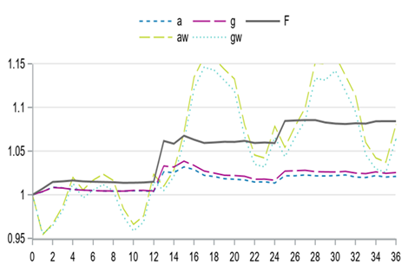
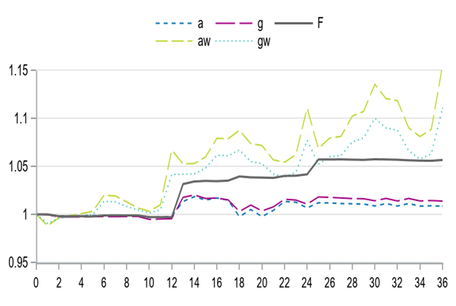
Basic averages
Index series for averages and Fisher for commodity group Rosé from 2016.0 to 2019.12
Index series for averages and Fisher for commodity group Dark Rum from 2016.0 to 2019.12

Slide 9
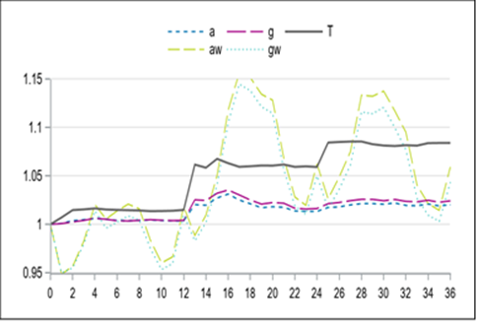
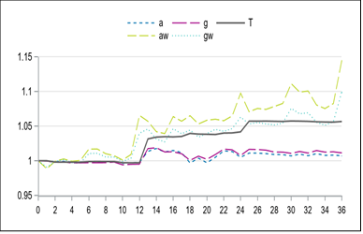
A hedonic method – panel data
Quality adjusted ‘index series’ for averages and Törnqvist for commodity group Rosé from 2016.0 to 2019.12.
Quality adjusted ‘index series’ for averages and Törnqvist for commodity group Dark Rum from 2016.0 to 2019.12.

Slide 10
Conclusion, study 1
Alcoholic beverages
Matching-pairs (by EAN) is best solution for this data
  It captures well increases of tax rates as prices change minimally in a year
The basic index numbers are contingently biased
  – also in this case
The basic averages are good for measuring price change only if quantities have not changed or have changed proportionally
A hedonic method is good only if quantities consumed are linearly related

Slide 11
Objectives of the study 2
Test hedonic solution for the problem of overlap
  commodities having high attrition rate; new products enter the markets while others disappear
Hedonic solution
  semilogarithmic price model
  Quality characteristic:
    a life cycle of commodities
    (how many months commodity has been on the markets)
    the quality of commodities does not change
Robust solution
  Homogenous product = detail commodity group broken down by age
  aggregate prices of each age group into unit prices

Slide 12
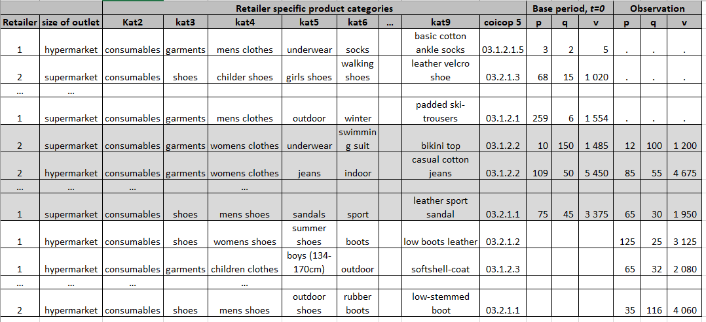
Study 2: Clothes and shoes-data

Slide 13
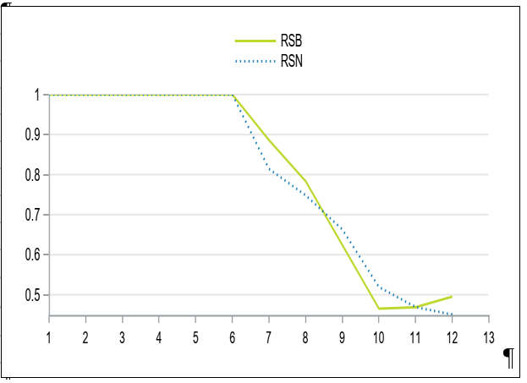
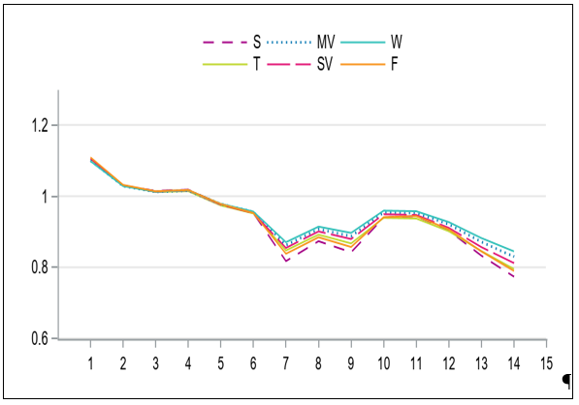
Bilateral index numbers
Decline of consumption values (RSB) and number of commodities (RSN) in NUTS2 region West-Finland in year 2020
Declining prices by the excellent index numbers. Index series are 2020=1 and NUTS2 region ‘West-Finland’ for clothes

Slide 14
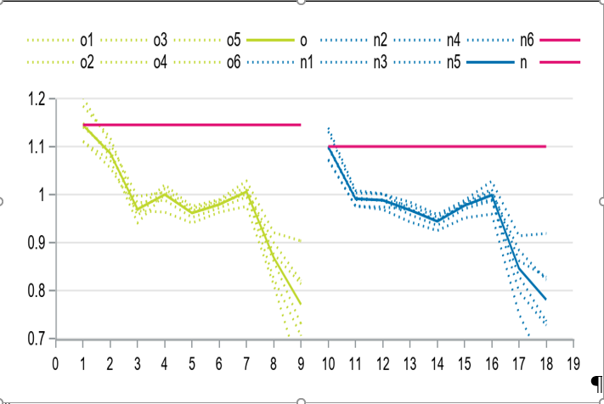
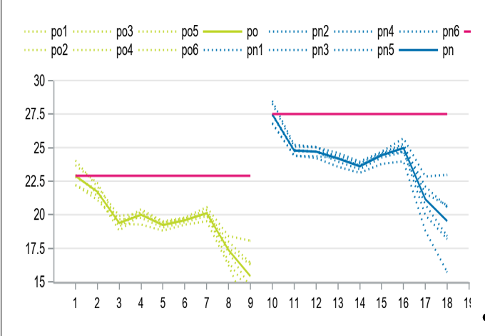
Basic averages by category (KAT9)
Index series for old (yellow) and new (blue) selection of T-shirts. Solid lines are aggregates Törnqvist for old and new selection of T-shirts. The red line one is quality adjusted Törnqvist
The same by commodity prices. The solid yellow and blue lines represent price profiles for true average prices and red line profile for quality adjusted prices.

Slide 15
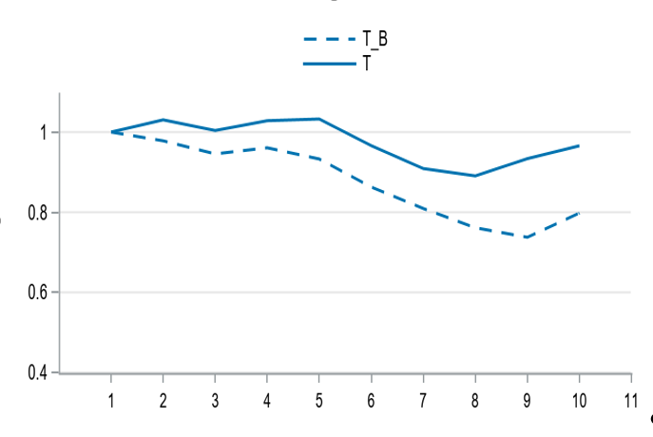
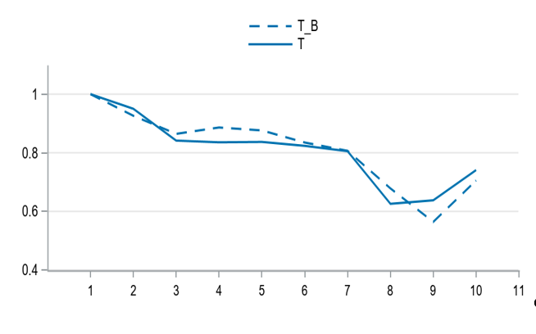
Robust vs Bilateral Analysis: Preliminary Results
Index series for bilateral (doted lines) and robust method (solid lines) in ‘West-Finland’ for
clothes
Index series for bilateral (doted lines) and robust method (solid lines) in ‘West-Finland’ for
shoes and bags

Slide 16
Conclusion, study 2
Clothes and shoes
Matching-pairs (by EAN) fails and does not catch the price development correctly
Retailer specific product categories may be used as homogenous products
  if it is sufficiently detailed
  If it remain unchanged in time
Quantities and prices changes nearly hand-in-hand
  The basic averages are good for measuring price
  Hedonic methods might be useful
Fashion-dependent products age at faster rate while quality remains the same
  differences in quality are mainly due to the aging of product >> product is no longer of interest to customer

Slide 17
Conclusion, study 2
Clothes and shoes
we propose two different method based on a price model
quality adjustment and hedonic index or
a robust compilation strategy based on actual weighted average prices (unit values)
Both methods gives equal results
We select a robust compilation strategy because
This method totally removes the price effects of ages of ranges between base and observation period
this method is extremely simple and efficient for commodities having short life cycle.

Slide 18
Thank you
Kristiina.nieminen@stat.fi

