Slide 1
Measuring human capital in UK official statistics: now and into the future
Presented by Gueorguie Vassilev
Head of Economic Well-being and Human Capital, ONS
economic.wellbeing@ons.gov.uk

Slide 2
Agenda
Recent experience measuring and developing human capital statistics
Intentions of future statistical production and analysis
UK focus

Slide 3
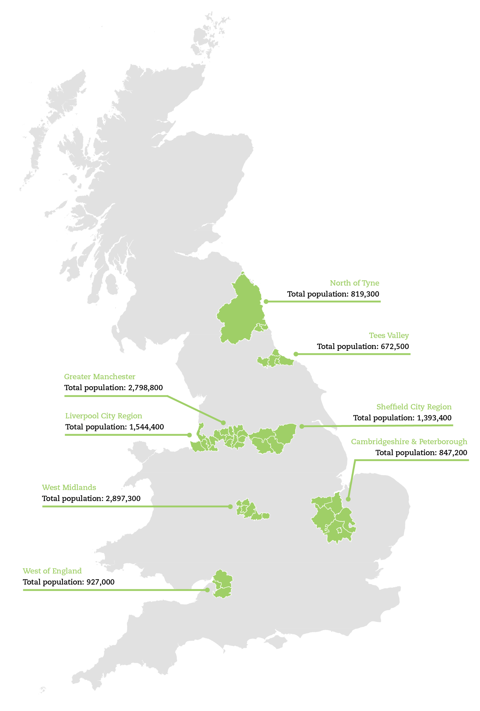
Motivating factors
Devolved political policy-setting
Considering investment in the
UK’s workforce
Interaction between human capital
and other policies
Notes:
Other economic policies include childcare, health, housing and inequality

Slide 4
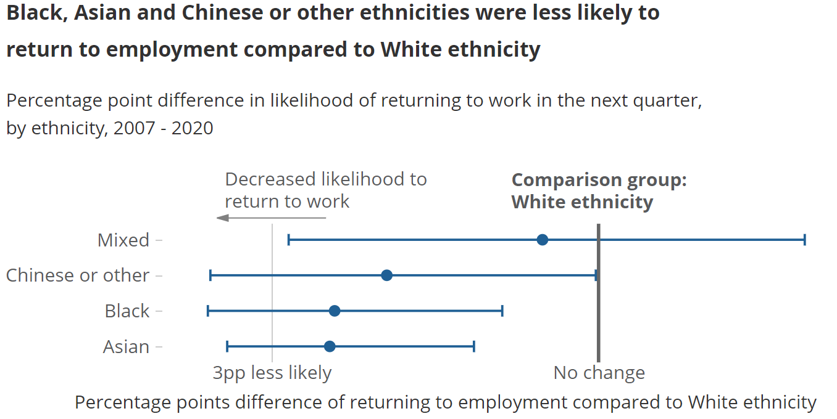
Recent experience
Notes:
For the master’s premium chart: Average premium in lifetime earnings for those with a Master's or PhD degree and those with an undergraduate degree or equivalent, compared with people with A levels, UK, 2004 to 2018
For the ethnicity chart: metadata is on the chart
For the training at work chart: Wage benefit for employees who participated in job-related training or education in the last three months, by occupation group, UK, average between 2014 and 2017
Keep referring to how this has been informed by domestic policy needs.
Links to recent articles: https://www.ons.gov.uk/peoplepopulationandcommunity/wellbeing/articles/humancapitalestimates/2004to2018
https://www.ons.gov.uk/employmentandlabourmarket/peoplenotinwork/unemployment/articles/whichgroupsfindithardesttofindajobfollowingaperiodoutofwork/2021-03-30

Slide 5
Producing human capital stocks
Sources: Labour Force Survey (s) , life expectancy tables
Methods: Fraumeni framework – discounted adult lifetime earnings
Data requirements – earnings (all employee jobs) and education transitions by age, sex, qualifications (others for developments)
Main assumptions:
Lifetime earnings at age X calculated based on current earnings fort those at age above X, up to age 65
Earnings measure one year’s marginal product
Future earnings discounted at 3.5%, annual nominal growth of 2%
Real stocks calculated with Tornqvist index
Notes:
For point 2 – make it clear we assume this is also true for the self-employed, and even for the unemployed by age sex and highest qualification split
For points 1 on retirement age and 3 on the fixed proportion assumptions – can discuss sensitivity analysis as shown in our articles eg https://www.ons.gov.uk/peoplepopulationandcommunity/wellbeing/articles/humancapitalestimates/2004to2017#methodology

Slide 6
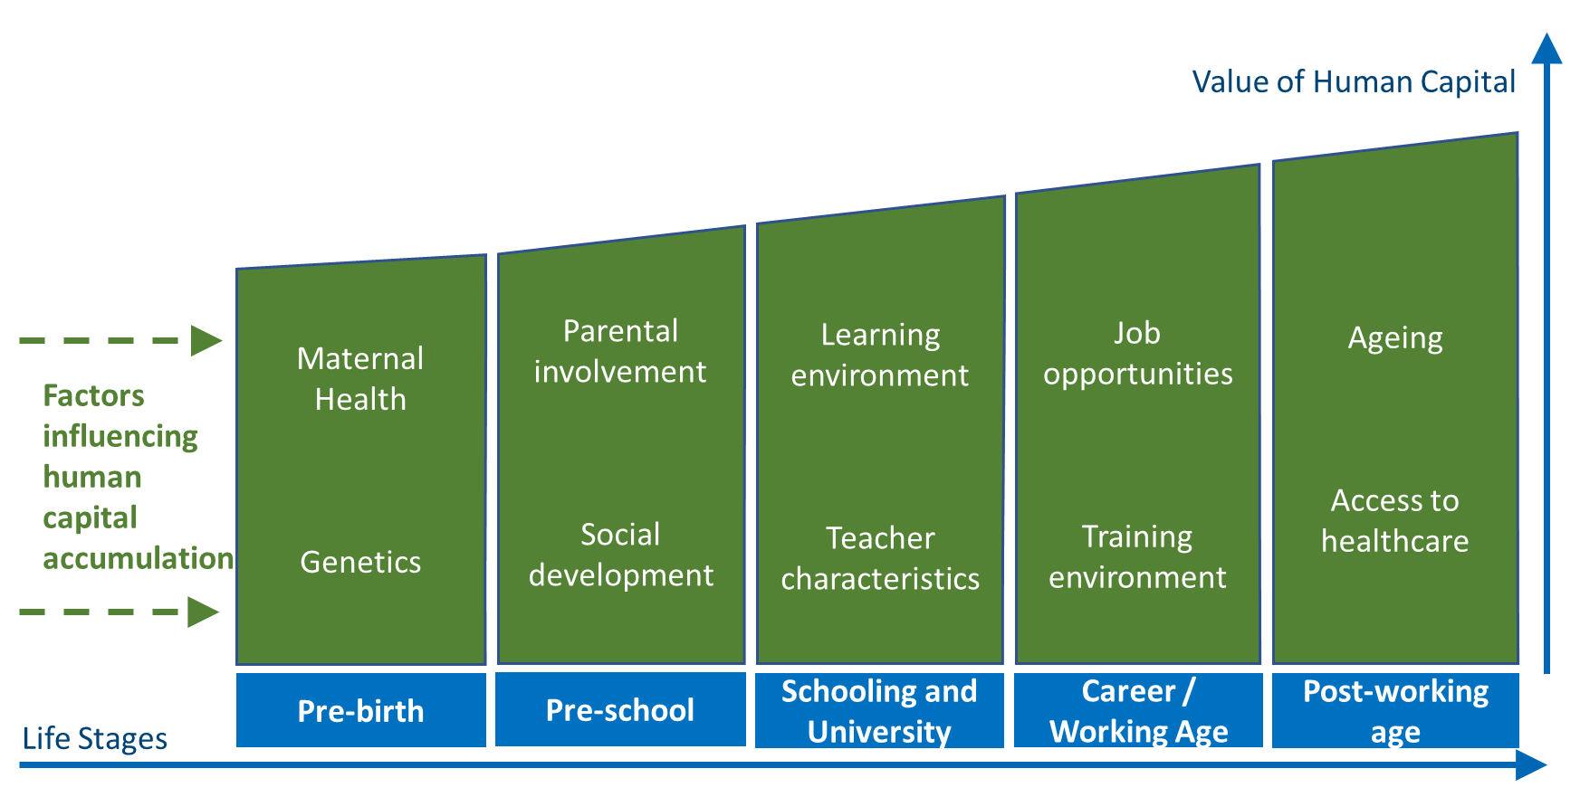
Future statistical needs
Lifetime acquisition model of human capital
Consider wider scope of human capital factors
New data requirements e.g. commercial job adverts
Links to National Accounts
Notes:
Links to future planned work:
https://www.ons.gov.uk/peoplepopulationandcommunity/wellbeing/articles/humancapitalworkplan/2018
https://consultations.ons.gov.uk/well-being-inequalities-sustainability-and-environment/indicator-based-approach-to-measuring-human-capita/
intentions of future statistical production and analysis
use of existing data sources
wider use of administrative data
commercial data like online job adverts
targeted data collection

Slide 7
Bringing back to a coherent framework - questions
If human capital is an asset, what is investment? Are some elements current spending?
What would be the scope?
If there is investment, what are the products?
If there’s an asset, who owns it?
Where is the new production boundary?
What is the price/deflator?
Notes:
ONS intentions for experimental accounts of consolidated missing capital
Focus on HK – scope, sector allocation, questions of valuation, assigning flows between investment, change in volume/price + knock-on impacts to the rest of the sector accounts.

Slide 8
Bringing back to a coherent framework – answers?
Investment = increase in skills or knowledge; Valuation? current spending = ‘maintenance’ of human capital
Scope = Education, Family, Health, Work, Life experience
Products = skills + knowledge, not education levels
Ownership = All + further distributive transactions?
Boundary = unpaid work, independent learning
Deflators = marginal skills prices
Notes:
ONS intentions for experimental accounts of consolidated missing capital
Focus on HK – scope, sector allocation, questions of valuation, assigning flows between investment, change in volume/price + knock-on impacts to the rest of the sector accounts.
Unpaid work – but with a different valuation. Investment values + PIM model, rather than just lifetime earnings. Investment values at
On the boundary – mention that we also need to consider the international boundaries e.g. lots of online course attendance from international university providers.

Slide 9
Questions
Contact: economic.wellbeing@ons.gov.uk

