Slide 1
Area Group on Labour, Education and Human Capital
Group of Experts on National Accounts
UNECE
May 2021

Slide 2
Area Group
Michael Smedes (Australian Bureau of Statistics), Ann Lisbet Brathaug (Statistics Norway), Barbara Fraumeni (Central University for Finance and Economics, Beijing), Wulong Gu (Statistics Canada), Patrick O’Hagan (consultant, former Statistics Canada), Paolo Passerini (Eurostat), Tihomira Dimova (UNECE), Alessandra Righi (ISTAT), Gueorguie Vassilev (UK ONS), Richard Wild (IMF) and Peter van de Ven (OECD)

Slide 3
Why is this area important?
Crucial policy questions that hinge on a better understanding of the links between the labour market, human capital, production and income include:
Human capital as a driver of innovation and economic development
Measurement of productivity and the ability to deliver real income growth to households
Issues of inclusive growth, equity and the distribution of income
Impacts on the labour market and the changing nature of ‘work’ from changes in production arrangements, including those changes caused by digitalisation and globalisation

Slide 4
Current Situation
Labour is at the heart of production, forming a primary input alongside capital, but, unlike capital, is recognized only indirectly in the SNA through compensation of employees, mixed income and informal production. The SNA references that labour statistics form an important adjunct to the accounts in brief [2008 SNA, paras 2.156-2.158], and some of the linkages to population and productivity are set out in Chapter 19.
The SNA 2008 sets out its position to exclude human capital from production in Chapter 1. The central premise is that it is not consumption of education and training services in and of themselves that may form human capital assets, but rather the assembly of these inputs by the persons consuming them into productive knowledge, skills, competencies and attributes.

Slide 5
Labour, Education and Human Capital
Stylized Relationship
Education and Training
Human Capital
Labour
SNA
Production Account
Contributes to
Underpins
Input to

Slide 6
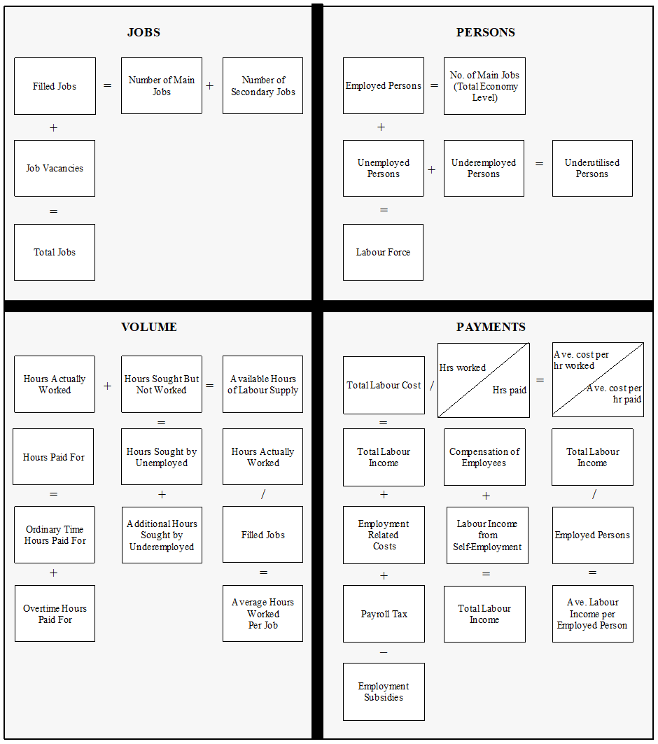
Labour Accounts

Slide 7
Labour Accounts: Existing material & practice
Many NSOs currently produce, or are now establishing, labour accounts (some have been producing these accounts for decades): Netherlands, Norway, Denmark, Switzerland, Australia, Iran, Malaysia + more
A range of other NSOs use some form of labour accounting to support their productivity estimates: USA, Canada +
ILO have considered the topic at two Conference of Labour Statistician meetings

Slide 8
Labour Accounts Recommendations
1. Labour accounts should be included within the central framework in the update to the 2008 SNA. This places labour in the same position as other inputs into the production process, and supports extensions to the accounts for valuing human capital
2. These accounts would be described in a new additional chapter of the SNA, placed between current chapter 9 “The use of income accounts” and chapter 10 “The capital accounts”. This would replace some elements currently covered in chapter 19.
3. The labour accounts will be based on the SNA production boundary and would, at a minimum, cover the labour domains of jobs, people, volume (hours), and payments. They should also include demographic breakdowns by gender, age and educational attainment

Slide 9
Education Accounts
The goal of the account is to compile the total expenditure on education and training consistent with the framework of the national accounts in a set of tables: the supply and use tables and the financing/cost tables by education and training purpose
The account would also include educational attainment of the resident population and the number of students and graduates and participation in vocational training and lifelong learning
And extended to provide additional demographic and labour detail related to education and training that can be used to show the distribution of investment across groups of individuals (gender & age)

Slide 10
Education: Existing material & practice
Substantial guidance material already developed:
  UNESCO Methodology of national education accounts
  UNESCO-OECD-Eurostat Manual for data collection on formal education
  UNECE Satellite account for education and training
  SNA, OECD, Eurostat guidance on measuring volumes of output
Many NSOs have produced some version of an education account, many of them as part of initiatives organised by international agencies
A number of education accounts have been produced in conjunction with estimates of human capital

Slide 11
Education and Training Recommendations
1. Extended accounts for education and training should be developed. These accounts would build on existing material, particularly the Satellite Accounts for Education and Training (SAET)
2. The Education and Training Account would be an extension on the central framework in that it includes (i) both monetary and non-monetary data; (ii) own account (in-house) training; and demographic breakdowns by gender & age
3. Consider values for unpaid household educations services (in conjunction with other task teams)

Slide 12
Human Capital
The idea of viewing human knowledge and abilities as an asset – as human capital - and to estimate its value is not new, but has gained more prominence in recent years, especially in the context of sustainable development
Policymakers are calling for ways to understand and quantify human capital, in order to better understand what drives economic growth and the functioning of labour markets, to assess the long-term sustainability of a country’s development path
Devising a robust methodology for the monetary valuation of the stock of human capital is especially crucial as studies suggest that human capital is the most important component of the total capital stock in advanced economies

Slide 13
Human Capital: Existing material & practice
UNECE Guide on Measuring Human Capital
There are six major measures of human capital, each of which covers at least 130 countries. Of these, two are monetary measures, one by United Nations Environment Programme (UNEP) and Kyushu University Urban Institute, and the other by the World Bank
A number of NSOs have produced experimental estimates of Human Capital

Slide 14
Human Capital – Initial Steps
Human Capital represents a major new field of study and research for national statistical organisations
It is a critical area of economic measurement that needs to be addressed. We need to start engaging with the topic
What are the sensible first steps we can take on what will be a lengthy development path?

Slide 15
Human Capital Recommendations
That pragmatic and achievable steps are taken in developing extended accounts for human capital outside of the core SNA. These first steps would consist of:
    Developing cost-based education measures, in accordance with the recommendations under Education and Training above
    Produce income-based monetary stock measures with gender, age, and education detail (consistent with the labour accounts structure)
2. It is expected that some countries will feel they lack the capacity to produce human capital estimates. However, the critical importance of human capital to economic development and progress means it is essential that we begin to engage on the topic. And this proposal would appear to be a sensible starting point.

Slide 16
Questions
Do AEG members support the specific recommendations made in the paper?
Are the recommendations ambitious enough for this important topic, or should we be more ambitious?
Are there countries with existing practice they would like to share? Or plans for future developments on this topic?
If interested in this work, please contact michael.Smedes@abs.gov.au

