Slide 1
Guidance Note: Carbon Pricing
UNECE May, 2021
James Tebrake and Emmanuel Manolikakis
IMF STA Real Sector Division

Slide 2
Background
As part of the SNA update process, an ISWGNA Subgroup on Well-being & Sustainability was formed to lead the research on issues related to:
Environmental-Economic Accounting
Defining a broader framework for capturing economic activities
Treatment & recording of carbon pricing scheme
Extending the asset boundary (including ecosystem assets)
Unpaid household work
Distribution of household income, expenditure & wealth
Education and human capital
Health and social conditions

Slide 3
Overview
Economic activity is having an increasingly negative impact on the environment.
To slow the increase in GHG emissions or eliminate them altogether, countries around the world have introduced or are introducing various polices aimed at reducing GHG emissions. Two of the more popular policy instruments include:
Carbon taxes
Emission trading schemes (ETS) (e.g., Cap and trade)
These policies apply a price to a broad set of emission sources that are aimed at encouraging businesses and individuals to innovate and change their behavior and therefore reduce the level of GHG emissions.
It is important that the associated transactions (non-financial and financial) across all sectors are properly accounted for and transparently presented in the System of National Accounts (SNA) and are harmonized and consistent with GFS, BOP and SEEA.

Slide 4
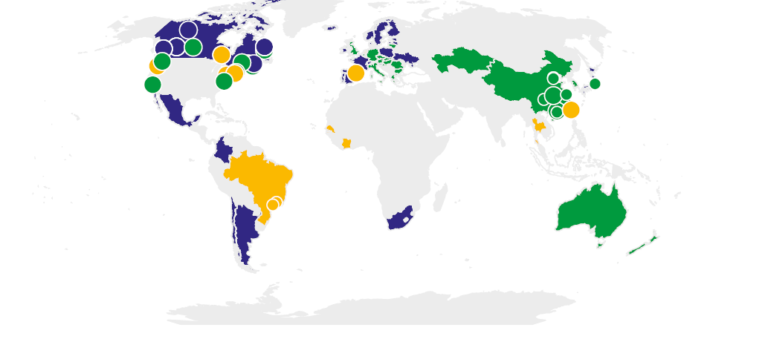
Emission Permits – Global Carbon Pricing Initiatives
Source: https://carbonpricingdashboard.worldbank.org/map_data

Slide 5
Emissions Permits – Current State of Play
While ETS schemes, and carbon pricing schemes generally exist, presently they are not very significant.
That said, we know that over the next number of years there will be a large focus on climate change mitigation
Perhaps other countries (such as, India) may introduce ETS schemes, and it is therefore important to re-examine our treatment.

Slide 6
Treatment of Emission Permits
in the National Accounts

Slide 7
Emission Trading Schemes (Cap and Trade schemes)
An emissions permit (cap-and-trade) system is a flexible market mechanism and establishes a maximum level of pollution - a cap.
Companies must have a permit to cover each unit of pollution they produce. Each permit stipulates the amount of GHG emissions that can be emitted (quota). Companies must have a permit with a sufficient quota of units of pollution to cover their polluting needs (emissions).
Government decides on a limit that is applied to the emission with a specific period and issues a quantity to reflect the limit. Issued in the primary market through auctions or are distributed free of charge.
Auction processes are not restricting participants, permits can be purchased by any market participant - individuals, investors, governments, nonprofit institutes, financial and non-financial companies.
It is presumed that only non-financial corporations will incur emissions liabilities and will need to offset these liabilities with emission permits. If companies exceed their quota for emissions, they can purchase unused permits from others, adjust their production or in the longer-term install technology that reduces emissions. Emission Permits have an active market, so prices fluctuate over time as demand/supply change.
Firms must surrender the permits (corresponding to the emission used) after emissions made or expired.
From CO2 emitting firms’ perspective, an emission permit looks to be similar to a carbon tax at the point where the permit is surrendered to government to “pay for” carbon emissions. However, prior to this point emission permits are tradeable assets, whose value is not directly established by government but by market conditions.

Slide 8
Treatment & Recording
Current Treatment in 2008 SNA
Considered as “ D29 other taxes on production” since emission permits (EP) do not involve the use of a natural “asset”.
Tax revenue = Sales of EP at time of surrender.
Recognizing that the proposed treatment in the 2008 SNA does not fully articulate all the dimensions of tradeable emission permits, further guidance was requested by the ISWGNA.
The TF reviewed how emission permits could be recorded in the national accounts; considered and provided numerical examples of various options ranging from non-produced non-financial assets, financial assets, split assets which embody two distinct assets - a non-produced non-financial asset and a financial asset. The TF even explored the possibility of a super national body where a distinction between national type programs and international ones were discussed.
ISWGNA Recommendation
In following the consideration of the Task Force the ISWGNA chose to recommend the split asset approach. A recommendation which was described in SNA News and Notes numbers 30/31 and 32/33.

Slide 9
Recognition – Split Asset Approach
Payments for EP taxes on production, recorded on an accrual basis (at time of emission)
GG debt is unaffected by change in value of permits.
GG accounts is unaffected by secondary market trading.
Tax revenue is determined by value of permit surrendered at issuance.
Variability in GG Net Lending/ Debt can arise from indifference of firms to surrendered permit.
NPNFA – may have a negative value.
Issue
Financial asset (accounts receivable, pre-paid tax) valued at purchase price created for firm
Corresponding financial liability (accounts payable, pre-paid tax) recorded for GG
Subsequent periods
NPNFA ➔ Purchase Price – Market Price
Surrender
NPNFA is removed from balance sheet of firm via (OCVA)
Financial asset surrendered to GG (valued at purchase price ) in lieu of taxes
Liability of GG remains the same
Increased asset via (OCVA) for firm

Slide 10
Treatment & Recording
There are several practical challenges that countries have experienced when trying to implement the split-asset approach. Key amongst these are:
Is the classification of a prepaid tax consistent with permit holders other than non-financial corporations?
How to deal with cross-border trading of permits and the resultant discrepancy between government revenue from auctions and the subsequent surrender of permits?
How to treat permits which are freely given away by governments?
What is the value (tax) of the EP – at original issuance or surrender value?

Slide 11
Treatment & Recording
“Taxes are compulsory unrequited payments, in cash or in kind made by institutional units to the general government exercising its sovereign powers. Taxes are described as unrequited because, in most cases, the government provides nothing commensurate in exchange to the individual unit making the payment.” (Paragraph 22.88).
Emission permits are required by firms whose production processes generate pollution; the emission permit will not determine the optimum output the firm would like to achieve. A firm will consider the current market price that exists for emission permits and decide the optimal production function that will minimize costs, maximize profits and comply with the pollution regulations.
In the case where emission permits are auctioned, the purchaser acquires an asset which can be used to either minimize GHG costs, or as an investment or for humanitarian reasons.
For example, a non-profit institute may acquire as many permits as possible they can afford and not ever redeem them in the hope to force entities to adopt greener production processes sooner. Are EP unrequited payments?
Is the classification of a prepaid tax consistent with permit holders other than non-financial corporations? How could we interpret a negative valuation for the NPNFA in the event where the market price falls below the issuance price? How to treat permits that are given by government freely, capital transfers or as subsidies?

Slide 12
Split Asset Approach – Cross Broder Transactions
There are international emission trading schemes where corporations may purchase emission permits from one country and surrender them to another country. These cross-border transactions may imply that a country will be receiving tax revenue from production activities that occurred in another jurisdiction and consequently there will be a misalignment in both countries institutional sector accounts.
International schemes pose additional data requirements, in addition to information regarding the number of emissions issued, outstanding, tax revenue received, compilers need to be able to identify the debtor and/or creditor and their respective jurisdictions.
The split-asset approach cannot accommodate the complexities and interpretability of international schemes.

Slide 13
Emission Permits – Right to Use Assets
According to the SNA (paragraph 17.3630) “These permits do not involve the use of a natural asset (there is no value placed on the atmosphere so it cannot be an economic asset).
The atmosphere is not owned or controlled by any economic unit and therefore should not be part of the SNA asset boundary.
What is being proposed, is the creation of an asset that reflects the right to use the climate regulating services of the atmosphere as part of specific production activities.
Governments issue EP implying that they are exercising ownership rights over the atmosphere and restricting/regulating its use.
The right to use the asset, as embodied in the EP provides a benefit to the economic owner, either in terms of being able to continue to operate or as a potential financial investment.
EP are marketable, can be readily sold and for which market prices can be established. They are designed to have a finite time period but will exist for longer than a year, the holder of the permit bears all the risks and rewards and they are transferable.
What type of macroeconomic assets are EP?

Slide 14
Emission Permits – Right to Use Assets
Emissions permits differ from some other types of permits issued by Government such as casino permits or taxi permits.
These permits are issued in order to limit supply and in effect provide monopoly profits to the approved operators.
The primary purpose of emissions permits is not to limit the supply of goods or services, nor provide monopoly profits to the permit holder. EPs are intended to limit emissions and alter the behavior of firms to adopt environmental technologies and processes.
According to the SNA (p 10.158), “the category other natural resources currently includes radio spectra. Given the increasing move to carry out environmental policy by means of market instruments, it may be that other natural resources will come to be recognized as economic assets. If so, this is the category to which they should be allocated.”
One of the key differences in the case of the electromagnetic spectrum, fishing and other quotas is that in these cases, a natural resource is being used by an institutional unit to derive economic benefit (supply cell phone services, or catch fish), whereas in the case of emission permits the natural resource is not being directly exploited to provide economic benefit, but rather is being degraded by the activities being undertaken to provide economic benefit.

Slide 15
Emission Permits – Right to Use Assets
A new sub-category could be created to accommodate assets that involve the use of nature/ecosystems such as wetlands, forest etc. Contract, Licenses, Permits and Right to Use Natural Assets.
Issue
an appearance of an asset (emissions permit) in the government sector through a volume change in the OCVA account.
Subsequent periods
Any change in market price will be shown in the revaluation account for all institutional sectors who acquired the NPNF asset
Surrender
NPNFA is removed from balance sheet of acquirers via (OCVA)
No impact on GG
Acquisition less disposal of non-produced asset (valued at time of sale, and depreciates to zero over its useful life)
GG records cash for disposal of asset
GG debt is unaffected by change in value of permits.
GG Net Lending/ borrowing impacted by disposal of NPNF asset.
GG accounts is unaffected by secondary market trading.

Slide 16
Emission Permits – Resource Lease
The notion of a right to use assets as mentioned above presupposes that the use of the atmosphere (as a CO2 sink) is restricted to a one-off application and does not take into consideration two key elements - time or quantity.
The issuance of permits could be considered as a pre-paid resource rent, where the payment grants the acquirer with the right to emit a pre-specified quantity of CO2 sometime in the future.
To bridge the difference between the issue price with the price at the time the permit is surrendered, one way to account for the change in price of EP is through the introduction of a Forward.

Slide 17
Recognition – Resource Rent – Prepaid rent approach
Payments for EP taxes on production, recorded on an accrual basis (at time of emission)
GG debt is unaffected by change in value of permits.
Variability in GG Net Lending/ borrowing will arise from changes in market prices at the time of surrender.
Tax revenue is determined by value of permit at time of surrender at market price.
Forward – may be an asset or liability -issuer/acquirer.
Issue
Financial asset (accounts receivable, pre-paid tax) valued at purchase price created for firm
Corresponding financial liability (accounts payable, pre-paid tax) recorded for GG
Subsequent periods
Simultaneously, a Forward is created with a zero value. Changes in market price of EP will lead to a financial asset or liability. However, the value is only recognized at the time of surrender.
Surrender
The Forward is required to match the surrender of the EP at the prevailing market price
Positive increases in the market price at the time of surrender will benefit holders and a decrease will lead to a benefit for the issuer.

Slide 18
Options for Way Forward
Continue with Split Approach endorsed by ISWGNA but modify to:
Ensure that NPNFA do not go negative.
Alternative treatment for permits purchased for other than emission objectives and by non-residents.
Recognize the atmosphere as an asset that reflects the right to use the climate regulating services of the atmosphere as part of specific production activities – new category.
Extend the asset boundary to include the atmosphere and treat permits as a resource lease – rent approach.

Slide 19
“Testing” Guidance
As part of the SNA update process, we would like to test the proposed recommendation to see if it can be consistently implemented across countries. Notably we are interested in determining”
Data required for compilation: issue price of permits, market price of permits, issue countries, purchasers, sectors.
International comparability in the treatment.
Consistency with other sections of the SNA, BPM and the GFSM.

Slide 20
Thank You!
Questions/Comments/Suggestions?

