Slide 1

Digital Supply and Use Tables
Ziad Ghanem
Statistics Canada
May 2021

Slide 2
Overview
1
Framework for Digital Supply and Use Tables
1
Digitally-ordered products
2
Data sources
2
Digitally-delivered products
3
Measurement methods
3
Review of results, 2017-2019
4
Classification of products
4
Looking forward

Slide 3
Digital SUTs framework

Slide 4
Publication of experimental digital Supply and Use Tables (SUTs)
Reference years: 2017-2019, published in April, 2021
Canada level SUTs but some provincial aggregates on GDP and jobs based on industry dimension.
Revisions: experimental product
  - Based on currently available source data
  - Refinement of methods, clarifying data gaps, feedback from users, and international comparisons
Revisions: advanced SUTs
  - Revisions due to benchmark 2018-2019 SUTs
Based on advanced Canadian SUTs (2018-2019)
  Nominal output and GDP by industry not fully integrated with other published industry volume measures.
  Some digital economy elements may differ from other measures in StatCan (some conceptual, some due to integration framework)

Slide 5
OECD framework for digital economy indicators: digital SUTs
Advantage of international comparability
Expanding current detail (in scope for Canadian digital SUTs)
  - Current industry and product classifications do not show relevant details or aggregates for digital economy
  - Requires a breakdown of information already in the SUTs
Additional information (out of scope for Canadian digital SUTs)
  - Beyond SNA 2008 (current production boundary): value of data and free digital services
  - Work continues on value of data independently of the digital SUTs
Risks: comparability with the myriad of other measures in the public domain
  - Does not perfectly align with previously released digital economy satellite account

Slide 6
Digital SUTs framework
Digital industries
  - New statistical unit: digital only firm
Digital products and products significantly affected by digitalization
  Mostly a reorganizing of product classification
  Some minor product splits
Digitally ordered and digitally delivered products
  - Splitting products, mostly based on e-commerce

Slide 7
Data sources

Slide 8
Surveys
Annual business surveys: e-commerce modules
Annual Survey of International Transactions in Commercial Services: digital delivery module
  - Large proportion of services exports are digitally delivered
Households: Canadian Internet Use Survey, 2018
Businesses: Survey of Digital Technology and Internet Use, 2019
  - $305 billion in e-commerce sales in a wide range of industries

Slide 9
Administrative data
Corporate income tax, internet sales forms
  Information on values but also proportion of online sales (online firms)
Income tax, unincorporated units
  Units dependent on intermediary platforms
Value added tax, remittances by non-resident firms
  Address data gap of online imports of services
Customs merchandise imports, low-valued courier shipments
  Exponential growth
  Assume e-commerce related

Slide 10
Measurement mehtods

Slide 11
General approach to estimation
An allocation not a recompilation approach
Incorporate information where available and use simplifying assumptions for the remainder
In general output information is available
  Split inputs based on output (digital units)
  Proportionally allocate outputs to uses (digitally ordered)

Slide 12
Digital industries
Digitally enabling industries
  Information and Communication Technology industries
  Largest component; mostly a simple mapping from current SUTs industries with some minor industry splits based on survey data
Digital intermediary platforms charging a fee
  Mainly in taxi, delivery and short-term accommodation but some unexpected industries (e.g., restaurants, only takeout)
  Micro records and tax data
Firms dependent on intermediary platforms
  Incorporated and unincorporated units
  Mostly tax data
Data and advertising driven digital platforms
  In Canada, small values. Mostly advertising with very little data-driven platforms.
E-Tailers
  Online retailers and wholesalers, mostly available from current surveys under current classifications.
  Some possible misclassifications of online distributors to traditional industries
Digital only firms providing finance and insurance services
  Difficulties in distinguishing “purely” digital units.
  Statistics Canada working on a Fintech frame that may prove useful
Other producers only operating digitally
  Gambling, dating sites etc.
  Excludes goods producers in Canadian tables. Perceived as not essential for their activity.

Slide 13
Digital industries – intermediary platforms
Split each impacted industry (output and input tables) into:
  Traditional units
  Intermediary platforms (resident)
  Incorporated units dependent on: i) resident platforms ii) non-resident platforms
  Unincorporated units dependent on: i) resident platforms ii) non-resident platforms
In the product dimension, delineate detail on platform fees
  Paid by producers and often consumers as well
Payments to non-resident platforms based on output by dependent units

Slide 14
Digital industries
Focus is on splitting main industry outputs
In general, inputs and GVA components are derived based on average industry coefficients. Refining production functions for future iterations.

Slide 15
Classification of products

Slide 16
Classification of digital products and significantly impacted
Mostly a reordering based on current classifications
Cloud computing splits
  Split output of software and data processing and hosting into cloud vs non-cloud based on review of annual reports of largest firms. Not in current classification.
Digital intermediary services splits
  Based on the approach explained previously under the digital industries

Slide 17
Digitally-ordered products

Slide 18
Digitally ordered products
In the Canadian digital SUTs, goods digitally ordered through domestic distributors are shown as digitally ordered by consumers and their output and imports are shown as digitally ordered through distributors. As distinct from the OECD framework, a new digitally ordered category (a4) is added to identity these products.
A | Digitally ordered
a1 | Direct from a counterparty
a2 | Via a resident digital intermediary
a3 | Via a non-resident digital intermediary
a4 | Via a resident retailer or wholesaler
B | Not digitally ordered
Much simpler to measure the distribution margin only. But analytically limiting.

Slide 19
Digitally ordered – excluding domestic retailers
Output based on ecommerce modules from annual business surveys.
Imports based on customs imports for large non-resident ecommerce sites and a proportion of small-valued courier shipments.
Proportionally allocate outputs and imports to uses. Outputs are apportioned based on class of customer modules from annual business surveys.

Slide 20
Digitally ordered – domestic retailers
Margin output based on ecommerce modules from business surveys.
Allocate margin output to uses based on valuation tables. Outputs are apportioned based on class of customer modules from business surveys.
From margin uses derive consumption expenditures based on survey sales / margin ratios.
Consumption expenditures are allocated to imports and domestic production where deemed missing

Slide 21
Digitally ordered – difficulties
Survey modules on e-commerce sales or micro records of online units do not provide information on use categories.

Slide 22
Digitally-delivered products

Slide 23
Digitally delivered products
No data sources except for module on the survey of commercial services exports
Based on the characteristics of the products in the SUTs
  Some splits: books, newspapers, …
  Missing education (important in 2020), government services (e.g., StatCan)

Slide 24
Results

Slide 25
Digital supply table, 2019
Digital industries accounted for 5.0% ($205 billion) of total output. Digitally-ordered products represented 6.8% ($336 billion) of total supply and digitally delivered services represented 2.3% ($116 billion) of total supply.
Most digitally ordered products (71%) were sourced directly from the supplier, whereas 27% were purchased through domestic retailers and wholesalers.
Approximately 7.2% of imports ($52 billion) were digitally ordered which slightly exceeded the share of digitally ordered from domestic producers, 6.8% ($278 billion).
The share of digitally delivered products in domestic production (2.4%) was higher than its share in imports (1.8%).

Slide 26
Digital use table, 2019
Households accounted for approximately 30% of digitally ordered products
The digital industries had the highest proportion of digitally ordered purchases at 14%; for other industries, households, and exports this proportion hovered around 8%.
Digital delivery covered 2.3% ($17 billion) of total exports.

Slide 27
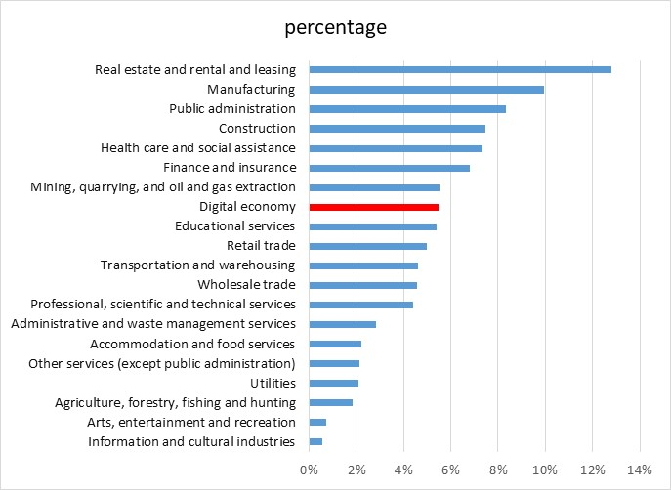
Industry shares of total gross value added, 2019
At 5.5% ($118 billion) of Canadian GDP in 2019, the digital economy ranked slightly below mining, quarrying and oil and gas extraction ($119 billion) in relative size.

Slide 28
Digital industries GDP and jobs, 2017-2019
The contribution of the digital economy to total GDP trended up from 5.2% ($103 billion) in 2017 to 5.4% ($111 billion) in 2018, and 5.5% ($118 billion) in 2019.
The share of the sector in overall jobs also followed a similar trend increasing from 4.3% (772,000) of total jobs in 2017 to 4.8% (882,000) in 2019.
The digitally-enabling industries, traditionally referred to as the information and communication technology sector, dominated production in the digital industries.
The contributions to jobs differed from the contribution to GDP. Digitally-enabling industries contributed 88.5% of the GDP in the digital sector but 76.7% of jobs in 2019. This was driven mainly by the telecommunications industry

Slide 29
Looking forward
Differentiating industry production functions: digital vs non-digital
Refine allocation of digitally-ordered by use category
Likely some increase to the online activity as ongoing research expands the frame
Currently focused on business sector market activities.
  Missing measures of digitalization in public administration, education and health.
  Missing a conceptual measurement framework and data sources
Extending the time series back in time may be difficult due to lack of source data and small, diminishing values in some areas. Under experimentation

Slide 30
References
Statistic Canada (2021). “Digital Supply and Use Tables, 2017 to 2019”. The Daily. https://www150.statcan.gc.ca/n1/daily-quotidien/210420/dq210420a-eng.htm
OECD. (2019). “Guidelines for Supply-Use Tables for the Digital Economy”, paper presented at Working Party on National Accounts, Paris, 1-2 July 2019.
Ghanem, Ziad (2021). “Measuring the digital economy: The Canadian digital supply and use tables 2017-2019”, paper presented at the meeting of the Eurostat-OECD-UNECE Group of Experts on National Accounts 2021, 17-25 May 2021.
OECD, WTO and IMF. (2020). Handbook on Measuring Digital Trade, OECD, Paris.
Statistics Canada. (2020). “Canada’s service exports through the lens of digital trade”, Latest Developments in the Canadian Economic Accounts, Statistics Canada catalogue number 13‑605‑X.

