Slide 1
Incongruous expenditure and index reference periods
BLS perspective
Anya Stockburger
Chief, Branch of Revision Methodology
Division of Consumer Prices and Price Indexes
Bureau of Labor Statistics
UNECE CPI Expert Group Meeting
June 10, 2021

Slide 2
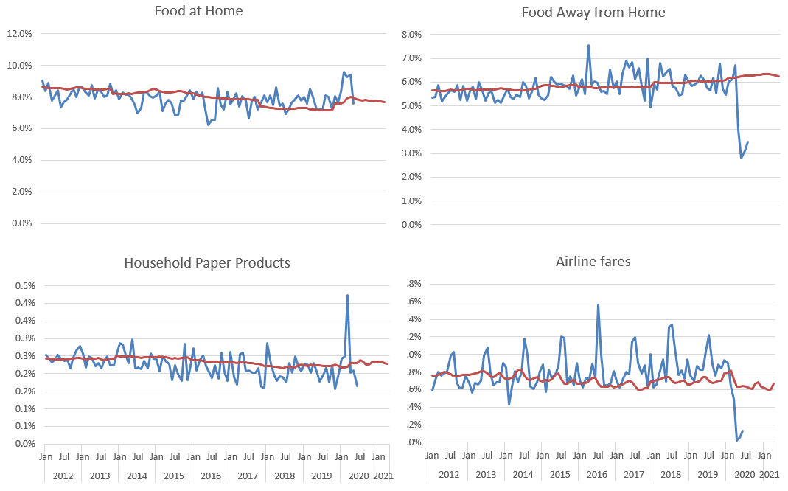
Expenditure Shifts
Source: BLS internal data
Notes:
Large shifts in expenditure data in 2020
Biennial expenditure weights reflect spending 2-3 years earlier
Next weight update is in 2022 using 2019 and 2020 expenditures. Will those be relevant in 2022 and 2023?

Slide 3
Impact of reducing the lag between expenditure and index reference periods
Source: Josh Klick, BLS Senior Economist, internal calculations
Notes:
Can measure relevance in terms of substitution bias
Goal = no lag between expenditure and index reference periods, Superlative index best estimates CPI’s measurement objective (Final C-CPI-U)
Improvements in Lowe index (CPI-U) when the lag goes from current production (2-3 years) to the hypothetical 0 years (“crystal ball” expenditures)
In April/May/June 2020, the measure of substitution bias (difference in 12-month percent change of CPI-U minus C-CPI-U indexes) would have been cut in half using 2019 expenditures rather than 2017/2018
Even in situation with structural shifts, minimizing the lag between expenditure and index reference periods (even if not zero) was still an improvement

Slide 4
Weight update options
Questions:
How many quarters of data to use (8 or 4)?
Which quarters to use (most recent or most relevant)?
Frequency of updates (biennial or annual)?
Index Reference Period | Expenditure Reference Periods Available
2022 | 2019 2020 1st quarter 2021?
2023 | 2019 2020 2021 1st quarter 2022?
Notes:
2022:
In the past, using most recent data is the best
However 2020 is such an anomalous year, averaging with 2019 will mitigate outliers like April 2020 spending on paper products
It might be possible to get the first quarter of 2021 data processed in time to use
Current plan is to forge ahead with 2019/2020 weights
2023:
Typically would continue using 2019/2020 weights
Considering an update in 2023 with 2021 weights
If possible, we might be more inclined (than we were to use 2021 data in 2022) to include first quarter of 2022 data in the 2023 update

Slide 5
Anya Stockburger
Chief, Branch of Revision Methodology
Division of Consumer Prices and Price Indexes
Bureau of Labor Statistics
www.bls.gov/cpi
stockburger.anya@bls.gov

