Slide 1
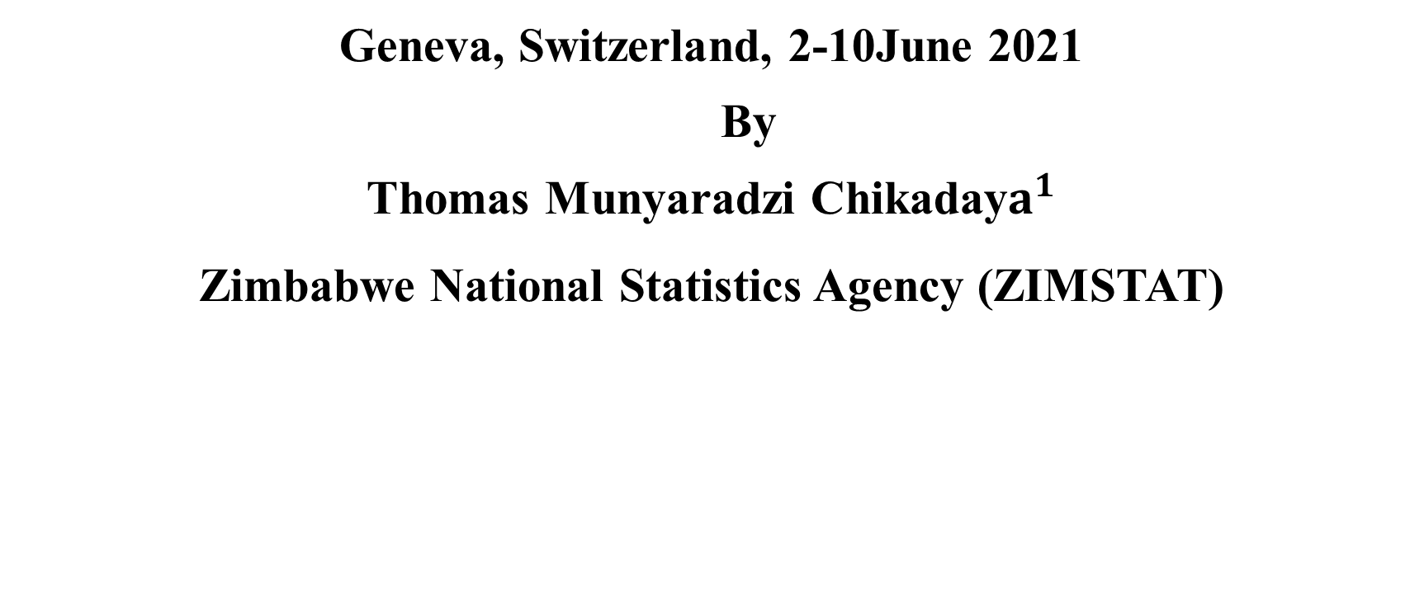
THE EFFECTS OF CHANGING CURRENCY ON THE ZIMBABWE CONSUMER PRICE INDEX (CPI)
Geneva, Switzerland, 2-10June 2021
By
Thomas Munyaradzi Chikaday$a^{1}$
Zimbabwe National Statistics Agency (ZIMSTAT)

Slide 2
Pricing system during multiple currency in Zimbabwe and its effects
There were five pricing system which operated are still operating in Zimbabwe from 2009 to date.
Erosion of workers 'salaries and wages.
Cash shortages
Multi-currency period in Zimbabwe:
The period started in February 2009.
Officially ended in February 2019.

Slide 3
Cash shortages in Zimbabwe and the effects
As from mid 2014, there was cash shortages in Zimbabwe.
Prices increased
CPI gradually increased

Slide 4
The behaviour of CPI due to cash shortages in 2017

Slide 5
The behaviour of CPI due to cash shortages in 2018

Slide 6
Exchange Rates from Jan 2018 to Feb 2019 (Exchange rates between the US dollar and the bond note on the parallel market)

Slide 7
Treatment of multiple currencies prices during the period on CPI
Since the beginning of 2009, Zimbabwe introduced a basket of multi-currencies with the United States dollar as the official currency.
From that period, ZIMSTAT converted prices denominated in any other currencies using local prevailing exchange rates on the particular day of data collection into the United States dollars.
Hence the index computed was based on the US dollar prices. This was done from 2009 until February 2019.

Slide 8
Rebasing of the CPI
In January 2013, ZIMSTAT was producing a CPI with new weights based on the 2011/12 PICES and the index reference period was December 2012 =100.Older indices up to January 2009 were rebased accordingly.
In March 2019, ZIMSTAT revised again CPI weight using the 2017 PICES results and February 2019 = 100 was the index reference period.
Another new series was created, that is, indices computed from ZWL. Rebasing of older indices was impossible because of differences in currencies.
ZIMSTAT started converting all US dollar prices into RTGS$ using the local prevailing exchange rates in creating a new series of ZWL indices.

Slide 9
Users’ Needs and Challenges
Users wanted a CPI which measures the cost of living when consumers are buying using five pricing systems.
Since users wanted five separate CPIs according to the mode of payment; Challenges were;
Sampling of outlets and representativeness of the selected samples
Would the resources be enough for the exercise?
Also are the demands not violating international standards?

Slide 10
Challenges faced in communicating with users
Most of the public users do not understand the CPI and how it is measured.
Some users do not have emails.
Educating the public on CPI computation proves to be costly.

Slide 11
Reaction of the general public users in Zimbabwe
When the CPI figures are released, independent compilers publishes their own numbers in independent papers. The methodologies of the independent compilers are not known to ZIMSTAT and the nation. They are always hidden to the public.
Some critics of ZIMSTAT tend to trust estimates published by IMF and World Bank more than the actual figures published by ZIMSTAT.

Slide 12
END
Thank you.

