Slide 1
Options for Publishing Timely,
Nearly Superlative Indexes
BLS working paper by
Trevor Bergqvist, Rob Cage, Blake Hoarty, Sara Stanley, Jeff Wilson
Rob Cage
U.S. Bureau of Labor Statistics
Meeting of the Group of Experts on Consumer Price Indexes
United Nations Economic Commission for Europe
June 9, 2021

Slide 2
Agenda
Current publication solution for Tornqvist index
Options for an improved solution
  C.E.S. with modeled substitution elasticity – new modeling approaches
  Tornqvist with forecasted weights
Results
Future direction
Any opinions expressed in this presentation are those of the author and do not constitute policy of the Bureau of Labor Statistics.

Slide 3
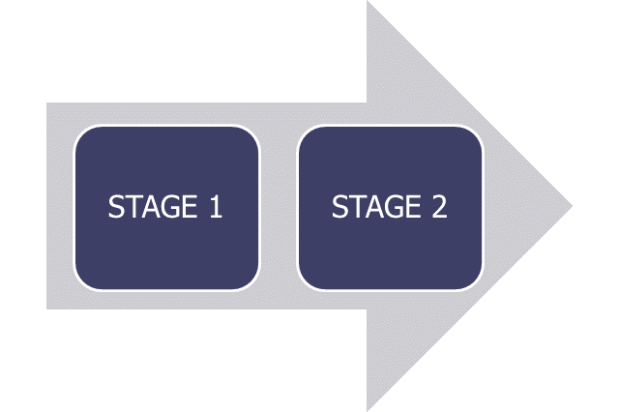

U.S. CPI estimation methodology
Aggregate 100,000+ sampled items into component indexes
243 items x 32 areas = 7,776 component indexes
Urban population only
Hybrid use of Laspeyres and Geometric Mean formula
  Either fixed-quantity or fixed-share weights assumed
  Most samples rotate every 4 years
Aggregate elementary indexes into products
Lowe formula used for CPI-U, CPI-W, R-CPI-E
  Leontief (fixed-quantity) utility preferences assumed
  Annualized weights updated every 2 years
Tornqvist formula used for Chained CPI-U (but published with roughly one year lag)
  Monthly weights!
  Consumer substitution response observed

Slide 4
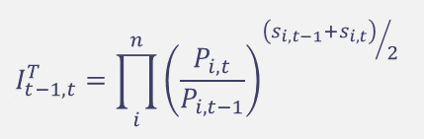

Lagged weight problem
Chained CPI-U:
$$I_{t−1,t}^{T}=\prod_{i}^{n}{{\left(\frac{P_{i,t}}{P_{i,t−1}}\right)}^{{\left(s_{i,t−1}+s_{i,t}\right)}/2}}$$
Requires t-1 and t monthly weights
Not available until following year
SOLUTION:
  Publish in month (t+1) a preliminary index for month (t) that predicts the Tornqvist
  Revise and publish Tornqvist approximately 1-year later
Current Prediction Model:
  C.E.S. (Lloyd-Moulton) formula
  Modeled elasticity of substitution parameter, σ = 0.6
  Same lagged weights as CPI (36 month lag)

Slide 5
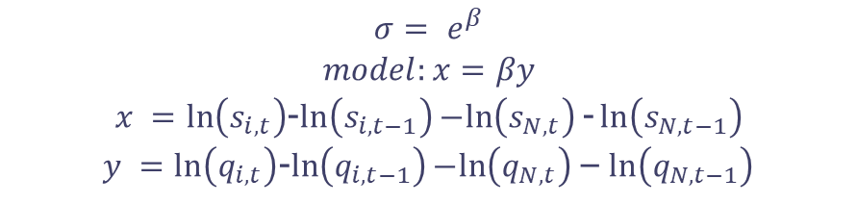
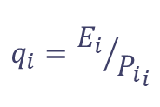
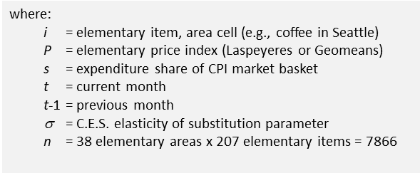
Improved prediction: C.E.S. options
C.E.S
Tornqvist
Method 1
Brute Force
Use s_{y-1, t-1} as proxy for s_{t-1} in C.E.S. to simulate production lag
Iteratively find value of σ within -1.0 to 4.0 range that minimizes absolute difference from Tornqvist, each month from January 2000 to December 2017
Method 2
Diewert-Feenstra
Double Differencing
Use largest i as N (Owner’s equivalent rent, in the South)
Iterate over all i as N, over all months, January 2000 to December 2017

Slide 6
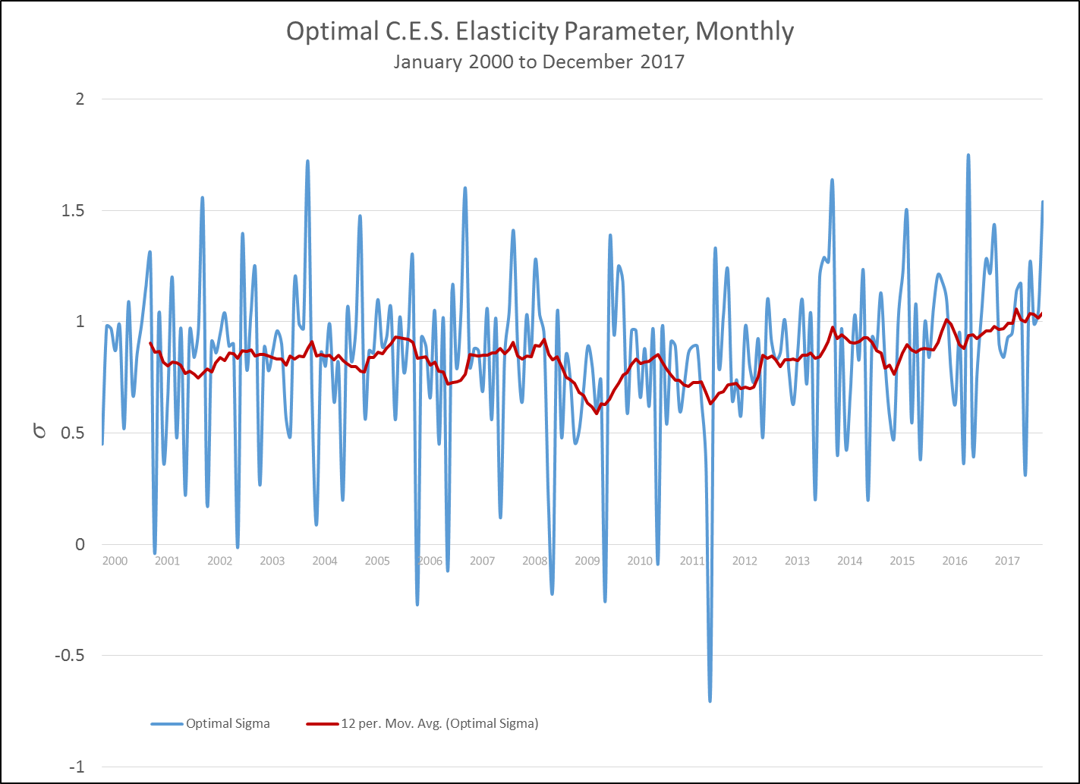
Method 1: optimal elasticity parameter
MONTHLY

Slide 7
Method 1: optimal elasticity parameter
MONTHLY
sorted by Month, then Year

Slide 8
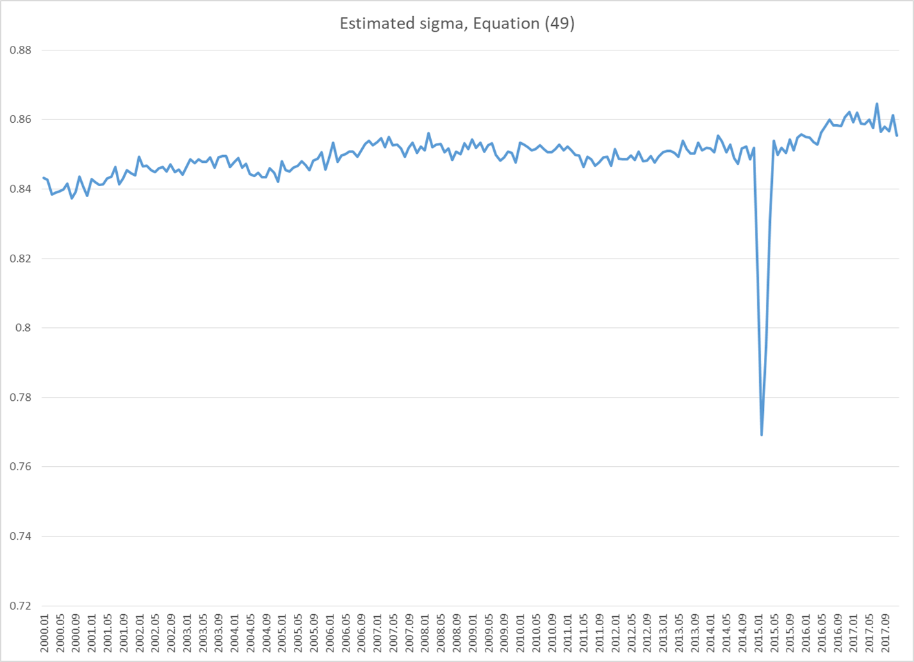
Method 2: optimal elasticity parameter
Numeraire = HC01 (Owners equivalent rent ) in X300 (Large metropolitan areas in the South)

Slide 9
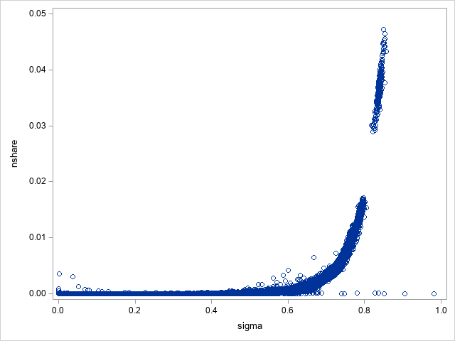
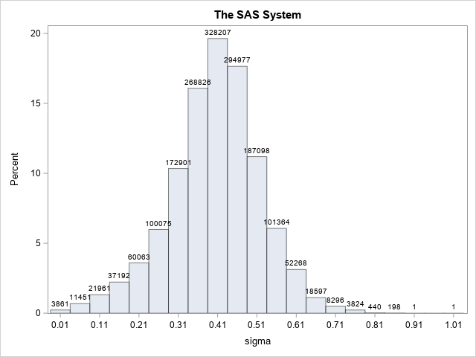
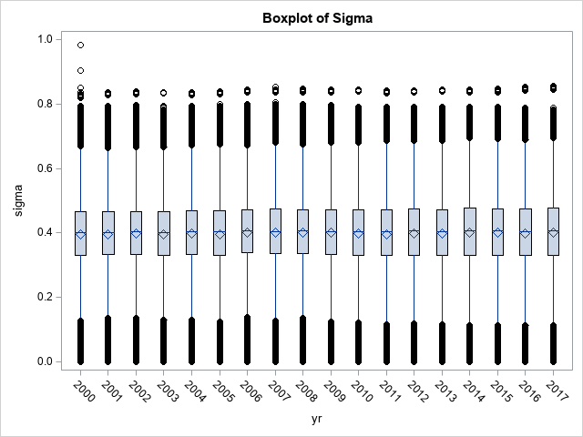
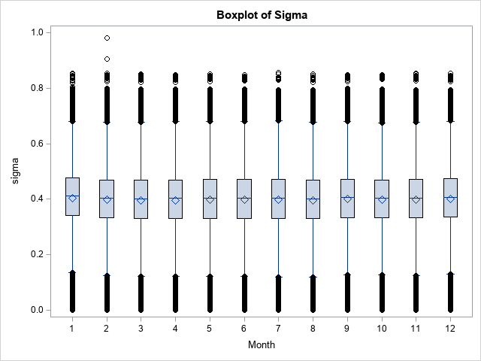
Method 2: optimal elasticity parameter, all iterations

Slide 10
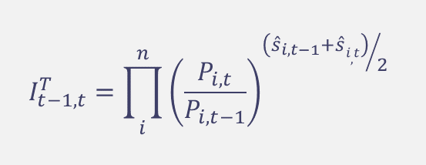
Improved prediction: Tornqvist with forecasted monthly weights
$$I_{t−1,t}^{T}=\prod_{i}^{n}{{\left(\frac{P_{i,t}}{P_{i,t−1}}\right)}^{{\left({\hat{s}}_{i,t−1}+\hat{s}i,t\right)}/2}}$$
ARIMA model (0 1 1)(0 1 1) fitted for all monthly elementary item budget share time series
Time span of December 1999 to December 2016
Generate forecasts for January 2017 to December 2017
Stable seasonal pattern assumed
Forecasting equation:
Ŷ_{t} = Y_{t-12} + Y_{t-1} – Y_{t-13} - θ₁e_{t-1} – Θ₁e_{t-12} + θ₁Θ₁e_{t-13}

Slide 11
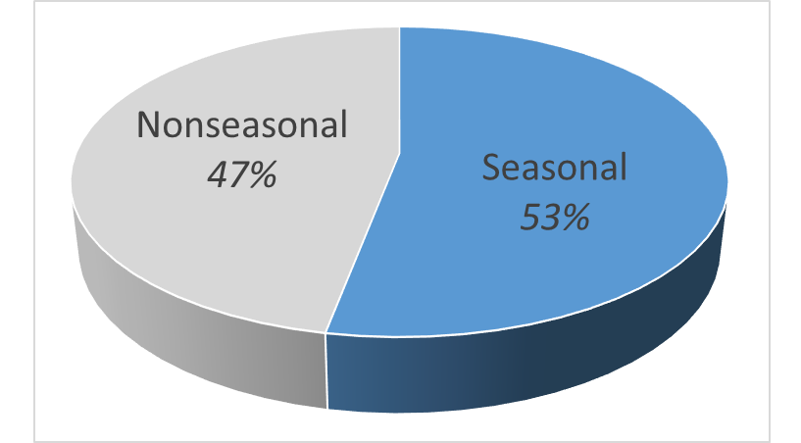
Forecasts: seasonal items
HF02 = Natural Gas
Highly seasonal items:
HF02 - Natural gas
EE01 – College tuition
FT01 - Soup
AB01 - Boys outerwear
HB02 - Lodging away from home (hotels)

Slide 12
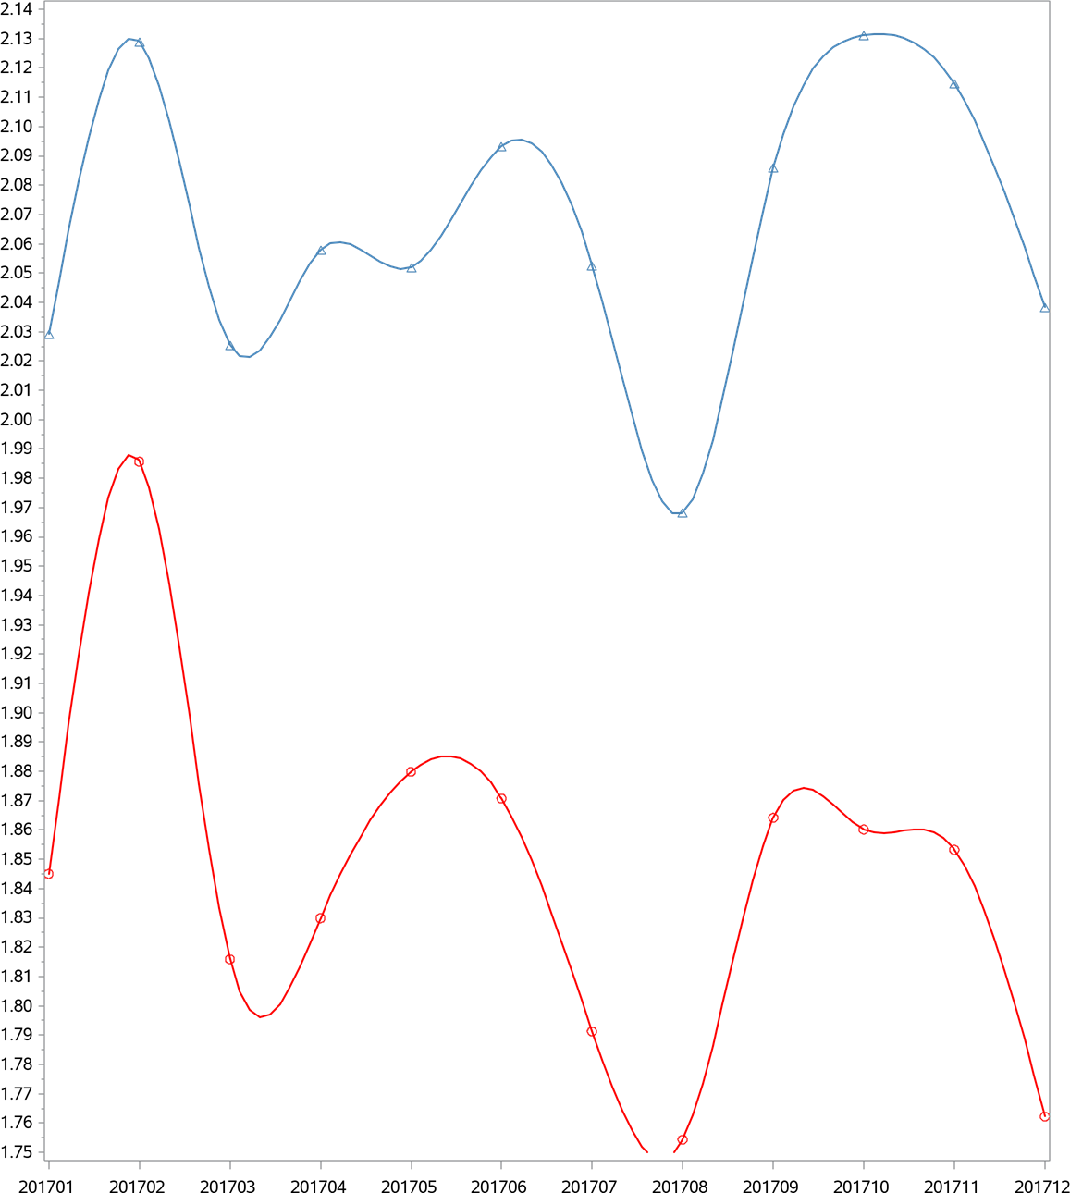
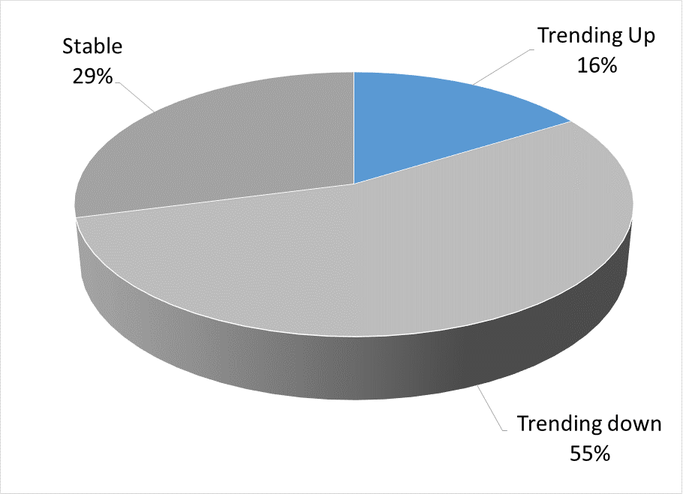
Forecasts: upward trending
ED03 – Cellular phone service
Notable upward trending items:
HA01 - Rent
ED03 – Cellular phone service
MD01 – Hospital services
RB01 – Pets and pet supplies
FT06 – Prepared salads

Slide 13
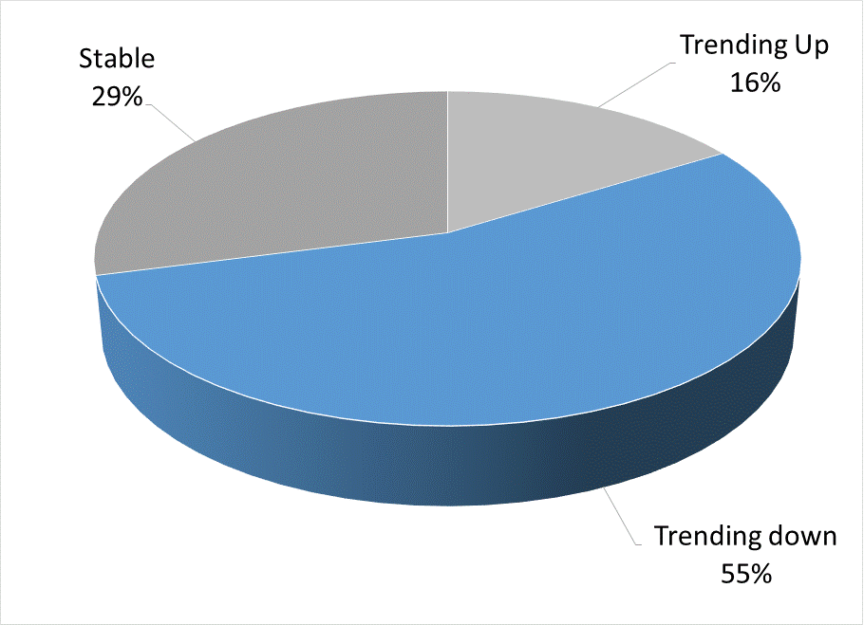
Forecasts: downward trending
RG01 = Newspapers and magazines
Notable downward trending items:
RG01- Newspapers and magazines
RC02– Sports equipment
FP02 - Tea
GD01 – Legal services
AF01 – Infants apparel

Slide 14
Index Results

Slide 15
Conclusions
Tornqvist with forecasted weights and monthly chained C.E.S. models with y-1 weights are improvement over current methodology
Tornqvist with forecasted weights and C.E.S. σ=0.85 both predict actual Tornqvist within |0.07| percent per annum
Improvement of item monthly budget share models could decrease prediction error for Tornqvist w\ forecasted weights
  Opportunity to include intervention adjustments for alternative spending data acquired for forecast period in real-time

Slide 16
Future directions
Fine tune budget share forecast models
Test model performance for an extended time period
Compare and contrast CES approach (with modeled elasticity) against Tornqvist approach (with modeled budget shares) during COVID lockdown period (2020)
Revise preliminary Chained CPI-U methodology if evidence suggests prediction error can be reliably reduced

Slide 17
Contact Information
Rob Cage
Assistant Commissioner, CPI
U.S. Department of Labor | Bureau of Labor Statistics
2 Massachusetts Ave, N.E. | Washington, DC
www.bls.gov/cpi
202-691-6959
cage.rob@bls.gov

