Slide 1
First Steps for Introducing New Weights in the CPI
Paul A. Armknecht
IMF Price Statistics Expert

Slide 2
Background
New CPI weights must be introduced periodically to keep the index accurate and relevant
The source of new weights is most often a HES (but could also be HFCE)
The weight period (b) precedes the price reference period (0)
NSOs must decide which index formula to use
Target formulas recommended in the CPI Manual are: Fisher, Törnqvist, or Walsh
In practice a fixed basket formula is used

Slide 3
Background
Fixed basket index with fixed quantity weights is biased
Items with larger relative price changes gain in relative shares
An Example: Table 1. Expenditure Shares for CPI Tubers
 | HES Quantity in Kg | Avg. Price | HES Weight | Share (percent) | Avg. Price | Cost Weight | Share (percent) | Avg. Price | Cost Weight | Share (percent)
Tuber Items | 2017 | 2017 | 2017 | 2017 | 2018 | 2018 | 2018 | 2019 | 2019 | 2019
Potatoes | 32.5 | 3.08 | 100 | 50.0 | 6.16 | 200 | 64.7 | 9.24 | 300 | 69.9
Yams | 32.5 | 2.05 | 50 | 25.0 | 2.18 | 53 | 17.2 | 2.75 | 67 | 15.6
Taro | 9.1 | 2.75 | 25 | 12.5 | 3.06 | 28 | 9.0 | 3.17 | 29 | 6.8
Plantains | 6.5 | 3.86 | 25 | 12.5 | 4.31 | 28 | 9.0 | 5.10 | 33 | 7.7
Total |  |  | 200 |  |  | 309 |  |  | 429

Slide 4
Options for introducing new weights
Use expenditure shares directly from weight reference period (b)
By using this approach, the NSO assumes that the expenditure shares between the weight reference period (b) and the price reference period (0) have remained fixed
With fixed expenditure shares, prices and quantities can shift but the expenditure share will remain constant
This approach mimics more realistically normal consumer behavior with respect to product substitution
The index formula with fixed expenditure shares is a Young price index:
(1) $I_{Y,i}^{t}=\sum_{i}^{n}{s_{i}^{b}{p_{i}^{t}}/{p_{i}^{0}}}$ where
(2) $s_{i}^{b}=p_{i}^{b}{q_{i}^{b}}/{\sum_{i}^{n}{p_{i}^{b}}}q_{i}^{b}$

Slide 5
Options for introducing new weights
Price updating weights from b to 0
If the NSO assumes the quantities would remain fixed through time (Laspeyres-type index), they will update the weights for the change in prices between weight reference period (b) and the price reference period (0)
Price updating the weights results in the expenditure shares shifting
As shown in table 1, items with largest relative price change have an increased relative share.
The index formula with updated share weights is a Lowe price index:
(3) $I_{Lo,i}^{t}=\sum_{i}^{n}{ s_{i}^{b0}\left({p_{i}^{t}}/{p_{i}^{0}}\right)}$ where
(4) $s_{i}^{b0}=s_{i}^{b}{\left({p_{i}^{0}}/{p_{i}^{b}}\right)}/{\sum_{i}^{n}{s_{i}^{b}}}\left({p_{i}^{0}}/{p_{i}^{b}}\right)$

Slide 6
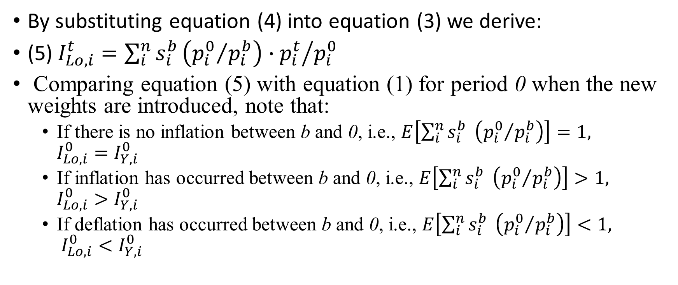
Comparing the Lowe and Young Formulas
By substituting equation (4) into equation (3) we derive:
(5) $I_{Lo,i}^{t}=\sum_{i}^{n}{s_{i}^{b}{{\left({p_{i}^{0}}/{p_{i}^{b}}\right)∙p}_{i}^{t}}/{p_{i}^{0}}}$
Comparing equation (5) with equation (1) for period 0 when the new weights are introduced, note that:
If there is no inflation between b and 0, i.e., $E\left[\sum_{i}^{n}{s_{i}^{b}} \left({p_{i}^{0}}/{p_{i}^{b}}\right)\right]=1,$ ${I_{Lo,i}^{0}=I}_{Y,i}^{0}$
If inflation has occurred between b and 0, i.e., $E\left[\sum_{i}^{n}{s_{i}^{b}} \left({p_{i}^{0}}/{p_{i}^{b}}\right)\right]>1,$ ${I_{Lo,i}^{0}>I}_{Y,i}^{0}$
If deflation has occurred between b and 0, i.e., $E\left[\sum_{i}^{n}{s_{i}^{b}} \left({p_{i}^{0}}/{p_{i}^{b}}\right)\right]<1,$ ${I_{Lo,i}^{0}<I}_{Y,i}^{0}$

Slide 7
Comparing the Lowe and Young Formulas
Assuming normal consumer substitution behavior, if inflation occurs between 0 and t, the Lowe will continue to exceed the Young
If deflation occurs between 0 and t, the Young will exceed the Lowe
The choice of which these two formulas to use thus depends on whether there has been inflation between b and 0, and whether inflation is expected between 0 and t.
In cases where there has been continuous inflation, the Young will be preferred.
In case where there has been continuous deflation, the Lowe may be preferred.

Slide 8
Comparing the Lowe and Young Formulas
We also know the following ordering of our price indices from both theory and practice:
Lowe > Laspeyres > Fisher > Paasche
In the case where there has been inflation between b and 0, the Lowe will also exceed the Young and, given normal consumer substitution behavior, the Young > Fisher.
The NSO, therefore, should probably use the Young vs. the Lowe

Slide 9
Additional considerations
Is it reasonable to assume that:
Consumer substitution occurs in response to price change
No substitution occurs and the same quantities are typically purchase
This question is answerable empirically by measuring the elasticity of substitution—the percent change in quantity divided by the precent change in price
If there is no substitution, the elasticity is zero
If there is equal substitution, the elasticity is one
Elasticity near zero is consistent with the Lowe fixed quantity index
Elasticity near one is consistent with the Young fixed shares index.

Slide 10
Additional considerations
It may be possible for the NSO to estimate the elasticity using the shift in shares between previous and current weights.]
Feenstra and Reinsdorf (2007) suggest estimating the elasticity (η) using a linear regression of the changes in the ln of the shares on changes in the ln of the price changes:
$$Δ\ln{s_{it}} = α_{t}− (η−1)Δ\ln{p_{it}} + ε_{it}$$
The coefficient from the regression models is used to estimate the value of the elasticity (η)

Slide 11
Additional considerations
The Appendix to the paper provides an example of the calculations required to estimate the elasticity
While other research methods can be used to estimate the elasticity, the approach presented here may have more direct application for NSOs

Slide 12
Conclusion
The preferred index formulas are Fisher, Törnqvist, and Walsh
These usually cannot be produced in the time constraints demanded for the CPI, although retrospective indices may be possible
When choosing between using the Young or Lowe index for real time calculations, the Young index may be preferrable if long-term inflation conditions prevail.

