Slide 1
Twenty-one years of adjustments for quality change in the U.S. Consumer Price Index
Brendan Williams
Senior economist, Branch of Consumer Prices
Consumer Price Index Division
Prepared for the Group of Experts on Consumer Price Indices
UNECE Online Meeting
4 June 2021

Slide 2
Overview
Quality adjustments had a -0.04% impact annually
External previous estimates suggest a larger amount of quality bias
Item replacements have strong, positive effects
Broader understanding of the item replacement process helps explain this discrepancy

Slide 3
Item replacement
Motivation for quality adjustment
Discontinued good replaced with new replacement
Item replacements can be compared, adjusted, or imputed
Class-mean imputation: Imputation by other item replacements
Cell-relative imputation: Imputation by other items in basic index (deletion method)

Slide 4
Item replacement objectives
Price change associated with product updates
Usual justification for item replacement
Product cycle effects
Quality change
Benefit not capture by match-model
Change in consumer surplus from product entry/exit

Slide 5
Hedonic adjustments
Hedonic indexes should approximate matched model behavior
BLS has lacked timely weighting information for hedonic estimation
Certain forms of hedonic adjust/indexes do not capture staggered price change/product cycle effects

Slide 6
Counterfactual indexes
Strict matched model (no item replacement)
No class-mean imputation
Use class-mean for all imputations
No quality adjustment
Convert quality adjustments to comparable or non-comparable based on threshold
All quality adjustments converted to comparable

Slide 7
Summary of major findings
Effect | Annual impact (Dec 1998 – Dec 2019)
Quality adjustment | -0.04%
Item replacement | 0.63%
Class-mean imputation | 0.17%

Slide 8
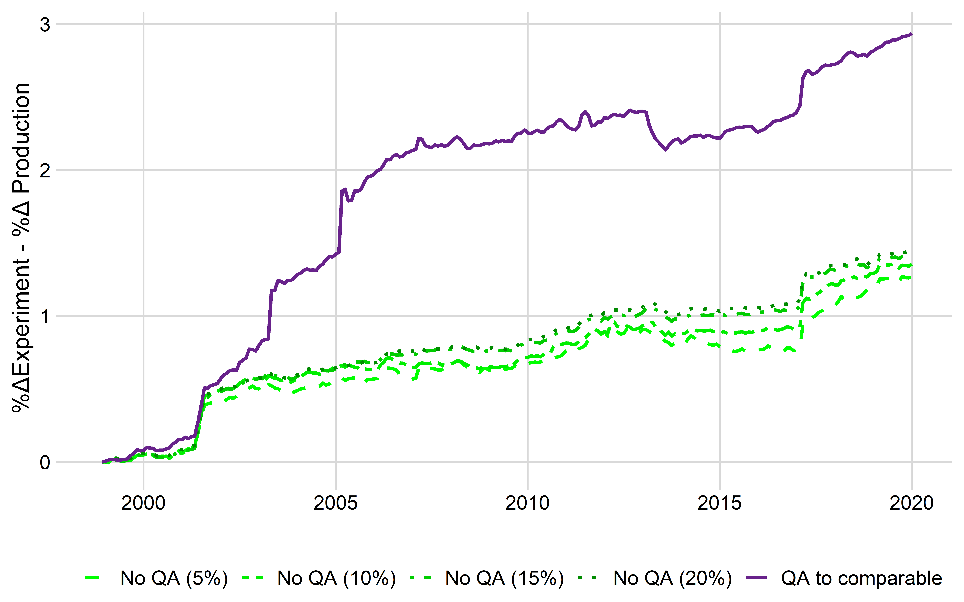
Difference between QA counterfactuals and production (All)

Slide 9
Upper limit to quality adjustment impact
The difference between production and the “QA to comparable” index was -0.09%
Assuming quality differences are fully represented in price, this is an upper bound on the amount of quality bias that could be removed by item replacement adjustments

Slide 10
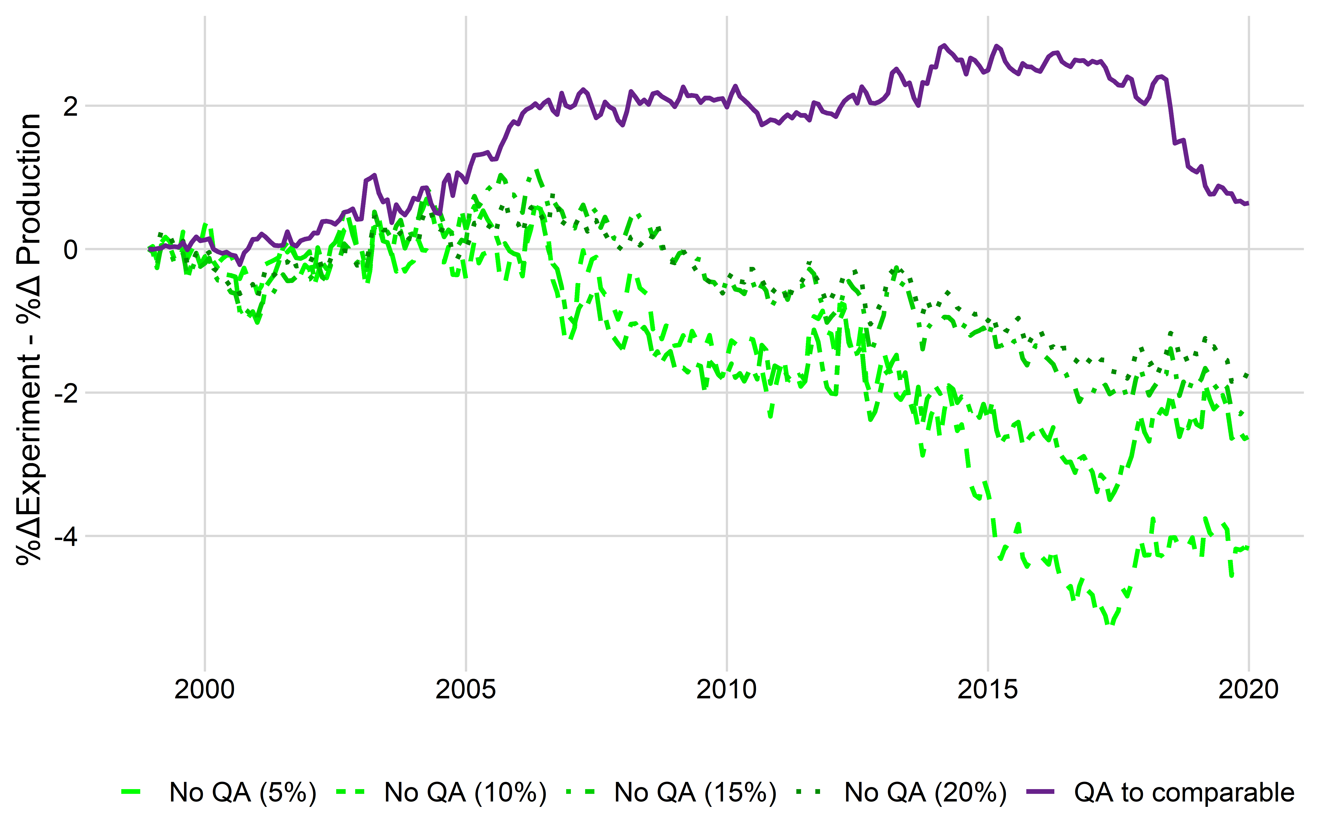
Difference between QA counterfactuals and production (Apparel)

Slide 11
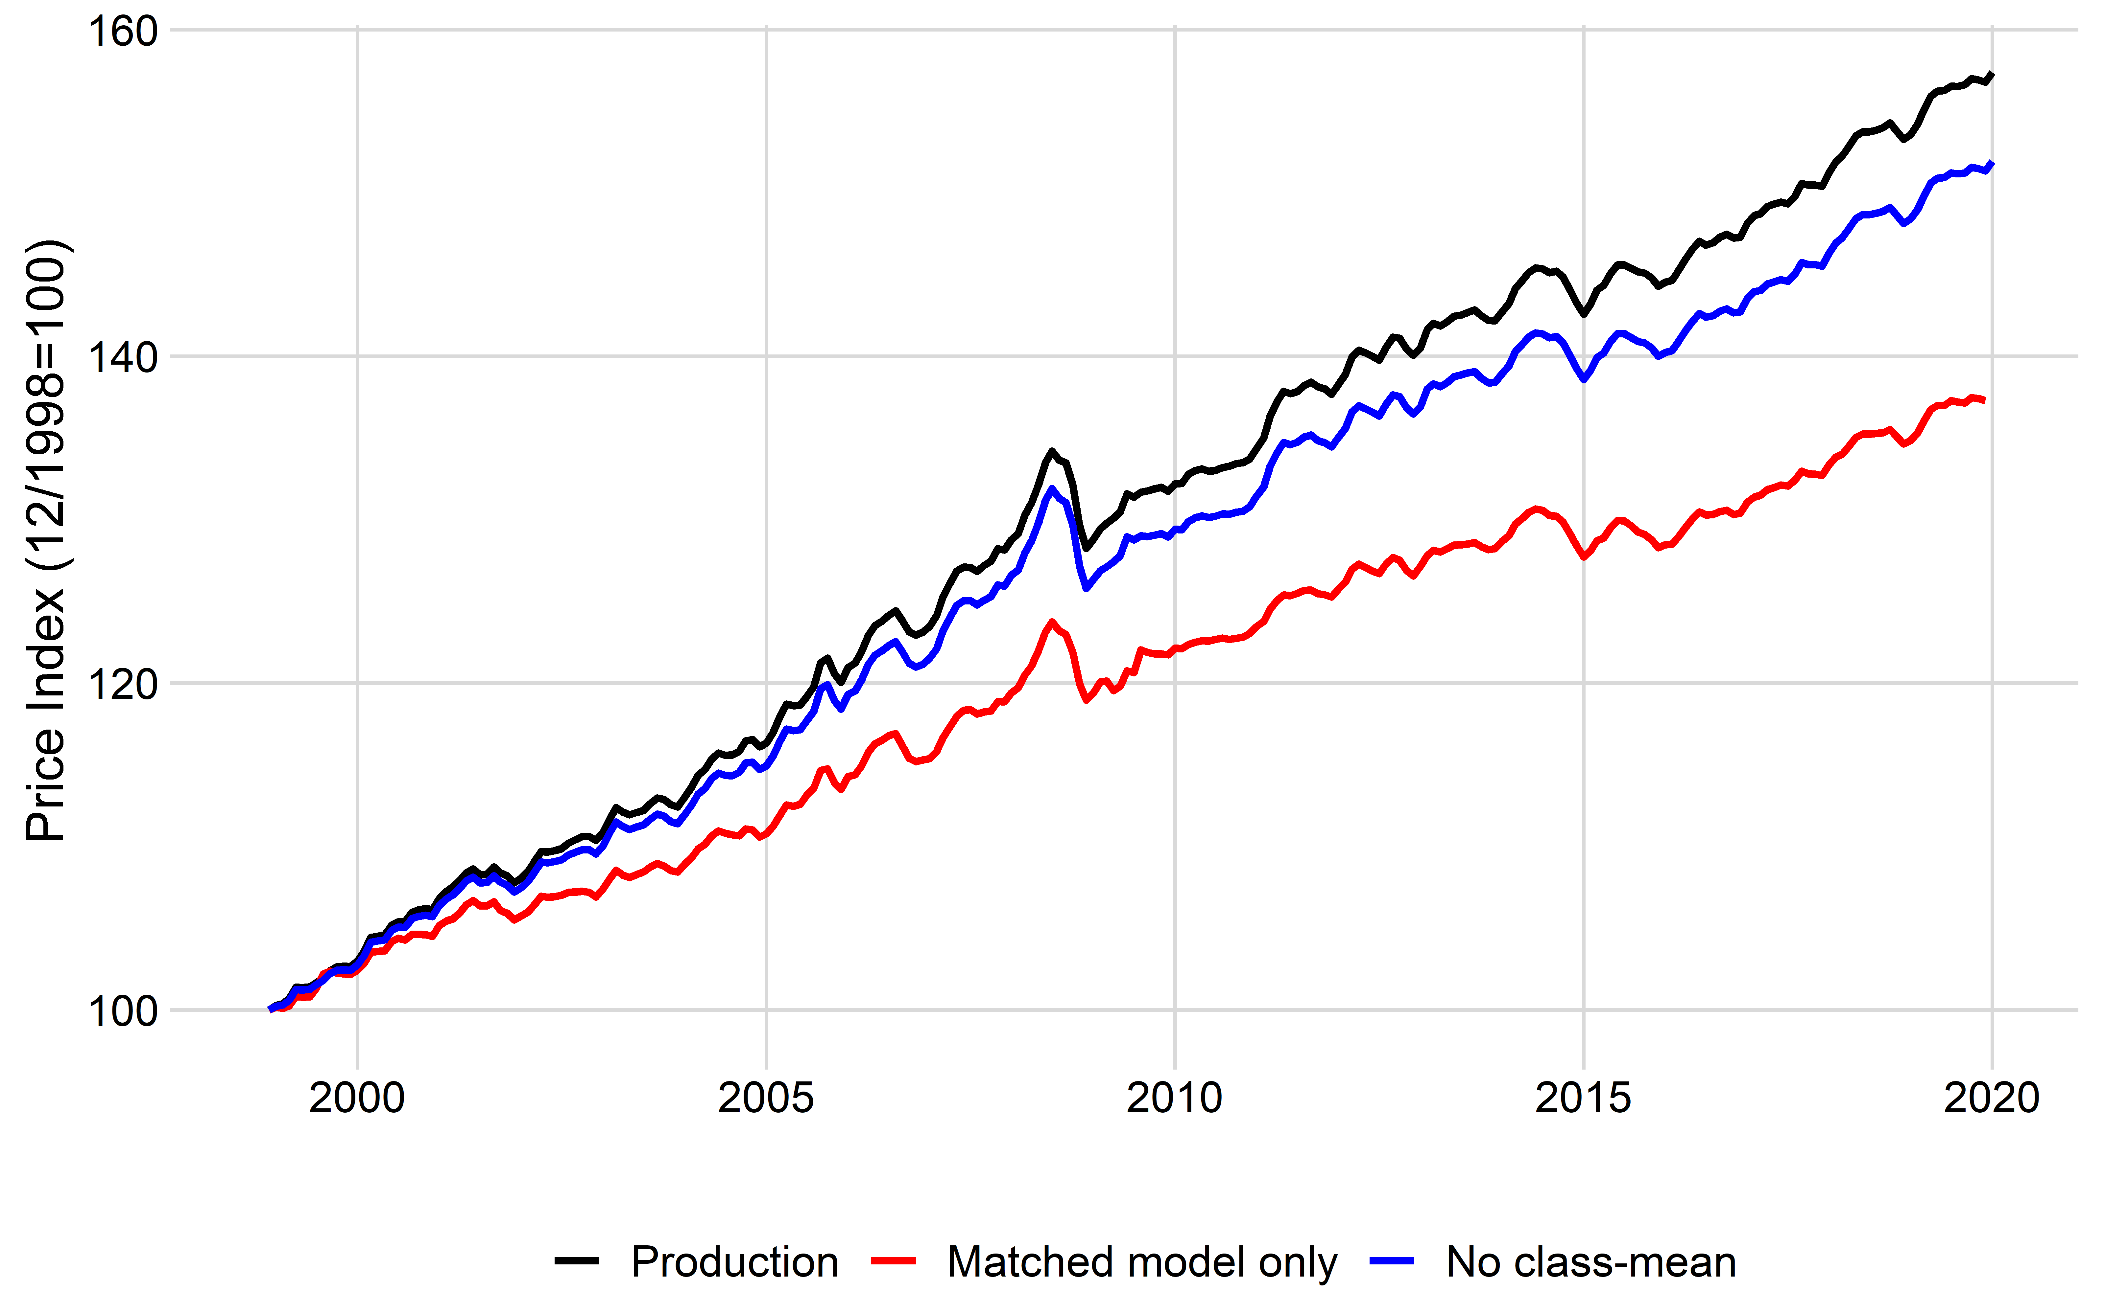
Item Replacement Counterfactuals (All)

Slide 12
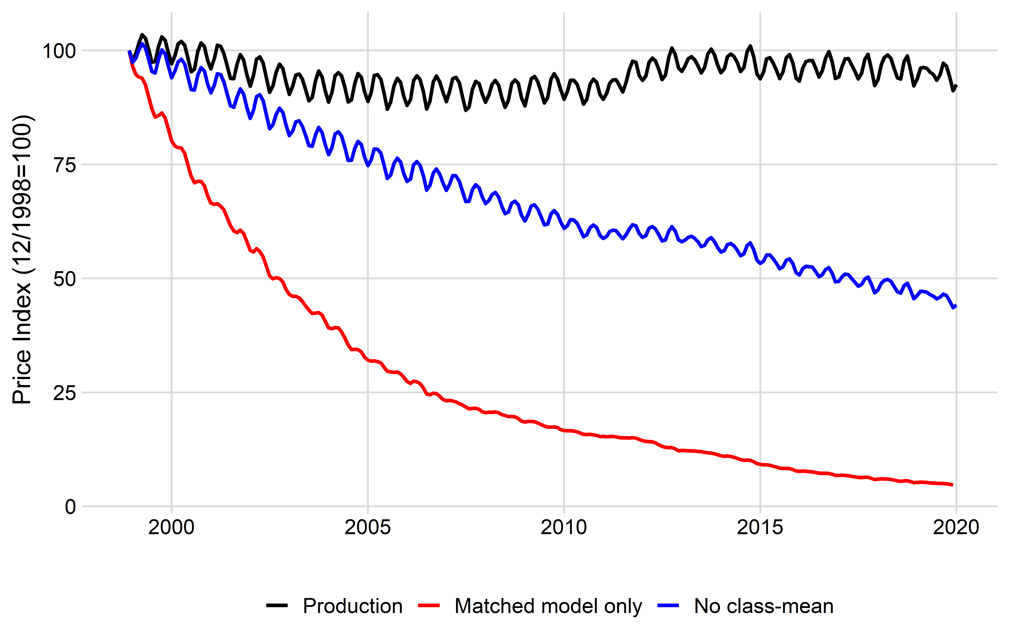
Item Replacement Counterfactuals (Apparel)

Slide 13
Class-mean imputation candidates
Rank | Title | Item Replacement Impact
1 | Baby food | 12.48%
2 | Motor vehicle insurance | 9.46%
3 | Other miscellaneous foods | 7.28%
4 | Breakfast cereal | 7.11%
5 | College tuition and fees | 6.92%
6 | Candy and chewing gum | 5.80%
7 | Frozen noncarbonated juices | 5.42%
8 | Cakes, cupcakes, and cookies | 5.32%
9 | Water and sewerage maintenance | 5.28%
10 | Coffee | 5.19%

Slide 14
Summary
BLS quality adjustments have a modest impact
Item replacement and class-mean effects are large
Items with large item replacement effects should use class-mean imputation
Items with small effects item replacement effects can use simplified methodologies
Evidence for product cycles over staggered price-setting

Slide 15
Brendan Williams
Williams.Brendan@bls.gov

