Slide 1
Classification progress in the UK CPI
Liam Greenhough
Senior Statistical Officer

Slide 2
“An elementary aggregate should consist of a relatively homogeneous set of goods or services, with similar end uses and similar expected price movements”
IMF Consumer Price Index Manual
Notes:
https://www.imf.org/en/Data/Statistics/cpi-manual

Slide 3
Homogeneity
Product | Classification: 1 | Classification: 2 | Classification: 3
Boys’ t-shirt | Boys’ clothing | Boys’ tops | Boys’ t-shirt
Boys’ polo 1 | Boys’ clothing | Boys’ tops | Boys’ polo
Boys’ polo 2 | Boys’ clothing | Boys’ tops | Boys’ polo
Boys’ coat | Boys’ clothing | Boys’ outerwear | Boys’ coat
Boys’ jacket | Boys’ clothing | Boys’ outerwear | Boys’ jacket
Women’s coat | Women’s clothing | Women’s outerwear | Women’s coat
Men’s jacket | Men’s clothing | Men’s outerwear | Men’s jacket
More homogeneous
More complex classification task

Slide 4
Clothing dataset characteristics
Web scraped
“Moderately big” (500k unique products, daily scraping, ~12GB per month)
Approximately 30% product churn (~160k new unique products per month)

Slide 5
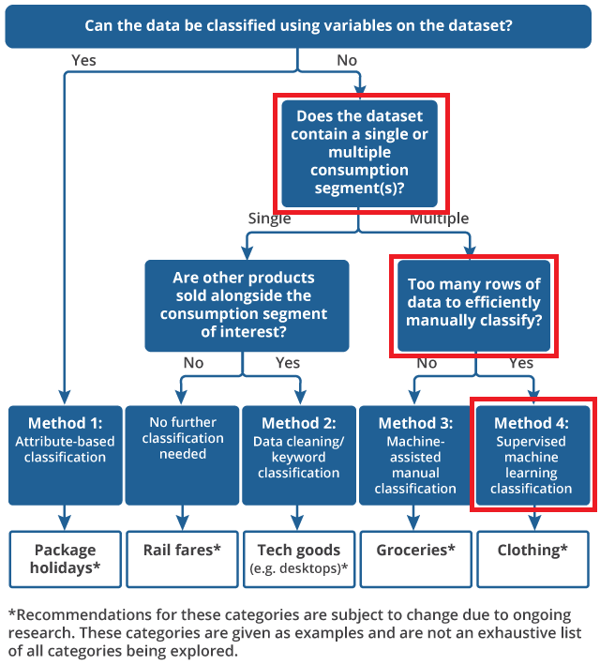
Strategy used
Need to adapt classification method to the type of dataset being classified.
Given characteristics of clothing dataset, use method 4.

Slide 6
date webscraped: implicit
retailer: implicit
Product location
Product name
Price variables
Size
Image
Other variables: style, material, colour, brand, etc.
Description
Web scraping
Kids / Baby / Multiple piece outfit sets
2-piece blue Panda Outfit (0-3 years)
£16.30 £18.00
Size selected: 3-6M
0-3M 3-6M 6-9M 9-12M
12-18M 18-24M 2-3Y
This cute two-piece outfit set with emblazoned panda will surely liven up their day

Slide 7
Supervised machine learning
Use data to train machine in how to classify products
Like regression, learns relationship between predictor variables (features) and response variable (label) to minimise a loss variable.

Slide 8
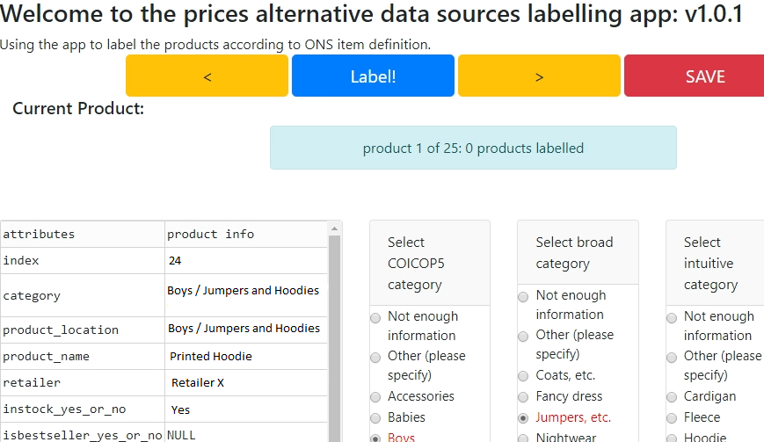
Creating labels
Custom app (in Python, Dash)
Crowd-sourced labelling by Prices division
Approximately 130k labels

Slide 9
Features: FastText
“black spotty dress (10-11y)”
“retailer X”
“Home / Girls / Dresses”

Slide 10
Features: FastText
“black spotty dress (10-11y)”
“retailer X”
“Home / Girls / Dresses”
pre-processing
“spotty dress”
“girls dresses”

Slide 11
Features: FastText
“black spotty dress (10-11y)”
“retailer X”
“Home / Girls / Dresses”
pre-processing
“spotty dress”
“girls dresses”
FastText embedding
[0.551, -0.256, …, 0.221, 1, 0, 0, 0, 0, 0, 0, 0, 0, 0, 0, 1, …, 0, -0.571, 0.326, …, 0.121]
[0.241, -0.053, …, 0.443, 0, 0, 1, 0, 0, 0, 0, 1, 0, 0, 0, 0, …, 0, 0.351, -0.952, …, 0.562]
[0.221, 0.521, …, -0.615, 0, 0, 0, 0, 0, 1, 0, 0, 0, 0, 0, 0, …, 0, 0.662, -0.116, …, 0.922]
[0.101, -0.221, …, 0.292, 1, 0, 0, 0, 0, 0, 0, 0, 1, 0, 0, 0, …, 0, -0.258, 0.952, …, 0.625]
[0.551, 0.428, …, -0.525, 0, 1, 0, 0, 0, 0, 0, 0, 0, 0, 0, 0, …, 0, 0.225, -0.311, …, 0.925]
[0.825, -0.335, …, 0.192, 0, 0, 1, 0, 0, 0, 0, 0, 0, 1, 0, 0, …, 0, 0.425, -0.441, …, 0.271]
$$X=$$
Product name
(FastText)
Age-gender
(text mining)
Retailer
Product location
(FastText)

Slide 12
Features: text mining
“black spotty dress (10-11y)”
“retailer X”
“Home / Girls / Dresses”
[0.551, -0.256, …, 0.221, 1, 0, 0, 0, 0, 0, 0, 0, 0, 0, 0, 1, …, 0, -0.571, 0.326, …, 0.121]
[0.241, -0.053, …, 0.443, 0, 0, 1, 0, 0, 0, 0, 1, 0, 0, 0, 0, …, 0, 0.351, -0.952, …, 0.562]
[0.221, 0.521, …, -0.615, 0, 0, 0, 0, 0, 1, 0, 0, 0, 0, 0, 0, …, 0, 0.662, -0.116, …, 0.922]
[0.101, -0.221, …, 0.292, 1, 0, 0, 0, 0, 0, 0, 0, 1, 0, 0, 0, …, 0, -0.258, 0.952, …, 0.625]
[0.551, 0.428, …, -0.525, 0, 1, 0, 0, 0, 0, 0, 0, 0, 0, 0, 0, …, 0, 0.225, -0.311, …, 0.925]
[0.825, -0.335, …, 0.192, 0, 0, 1, 0, 0, 0, 0, 0, 0, 1, 0, 0, …, 0, 0.425, -0.441, …, 0.271]
$$X=$$
Product name
(FastText)
Age-gender
(text mining)
Retailer
Product location
(FastText)

Slide 13
Features: retailer
“black spotty dress (10-11y)”
“retailer X”
“Home / Girls / Dresses”
[0.551, -0.256, …, 0.221, 1, 0, 0, 0, 0, 0, 0, 0, 0, 0, 0, 1, …, 0, -0.571, 0.326, …, 0.121]
[0.241, -0.053, …, 0.443, 0, 0, 1, 0, 0, 0, 0, 1, 0, 0, 0, 0, …, 0, 0.351, -0.952, …, 0.562]
[0.221, 0.521, …, -0.615, 0, 0, 0, 0, 0, 1, 0, 0, 0, 0, 0, 0, …, 0, 0.662, -0.116, …, 0.922]
[0.101, -0.221, …, 0.292, 1, 0, 0, 0, 0, 0, 0, 0, 1, 0, 0, 0, …, 0, -0.258, 0.952, …, 0.625]
[0.551, 0.428, …, -0.525, 0, 1, 0, 0, 0, 0, 0, 0, 0, 0, 0, 0, …, 0, 0.225, -0.311, …, 0.925]
[0.825, -0.335, …, 0.192, 0, 0, 1, 0, 0, 0, 0, 0, 0, 1, 0, 0, …, 0, 0.425, -0.441, …, 0.271]
$$X=$$
Product name
(FastText)
Age-gender
(text mining)
Retailer
Product location
(FastText)

Slide 14
Feature matrix
[0.551, -0.256, …, 0.221, 1, 0, 0, 0, 0, 0, 0, 0, 0, 0, 0, 1, …, 0, -0.571, 0.326, …, 0.121]
[0.241, -0.053, …, 0.443, 0, 0, 1, 0, 0, 0, 0, 1, 0, 0, 0, 0, …, 0, 0.351, -0.952, …, 0.562]
[0.221, 0.521, …, -0.615, 0, 0, 0, 0, 0, 1, 0, 0, 0, 0, 0, 0, …, 0, 0.662, -0.116, …, 0.922]
[0.101, -0.221, …, 0.292, 1, 0, 0, 0, 0, 0, 0, 0, 1, 0, 0, 0, …, 0, -0.258, 0.952, …, 0.625]
[0.551, 0.428, …, -0.525, 0, 1, 0, 0, 0, 0, 0, 0, 0, 0, 0, 0, …, 0, 0.225, -0.311, …, 0.925]
[0.825, -0.335, …, 0.192, 0, 0, 1, 0, 0, 0, 0, 0, 0, 1, 0, 0, …, 0, 0.425, -0.441, …, 0.271]
$$X=$$
Product name
(FastText)
Age-gender
(text mining)
Retailer
Product location
(FastText)

Slide 15
Classification performance
 | Feature vector
Algorithm | FastText (prod name) | Age-gender | Retailer | FastText (prod location) | Features | Macro F1
XGBoost | ✔ | ✖ | ✖ | ✖ | 300 | 0.66
XGBoost | ✔ | ✔ | ✖ | ✖ | 306 | 0.79
XGBoost | ✔ | ✔ | ✔ | ✔ | 628 | 0.81
Neural Network | ✔ | ✔ | ✔ | ✔ | 628 | 0.82
Earlier research tried: Decision Trees, Random Forests, Logistic Regression and Support Vector Machines
15
Notes:
Decision Tree – not suited to such a complex multiclassification task, found to have very low performance
Random Forests – lower performance than XGBoost
Logistic Regression and Support Vector Machine – slightly lower performance than XGBoost and longer run times. Support Vector Machines also lack out-the-box probabilities.
Neural Network – small improvement on XGBoost in performance but harder to fit and maintain, may not justify performance gain
XGBoost – lots of advantages: relatively easy to fit (compared to Neural Networks), strong performance, has probabilities and fast training times (with GPU support)

Slide 16
Other factors investigated
Pre-processing methods (POS, stemming, etc)
Augmentation technique (SMOTE)
Choice of classes
Algorithm hyperparameters

Slide 17
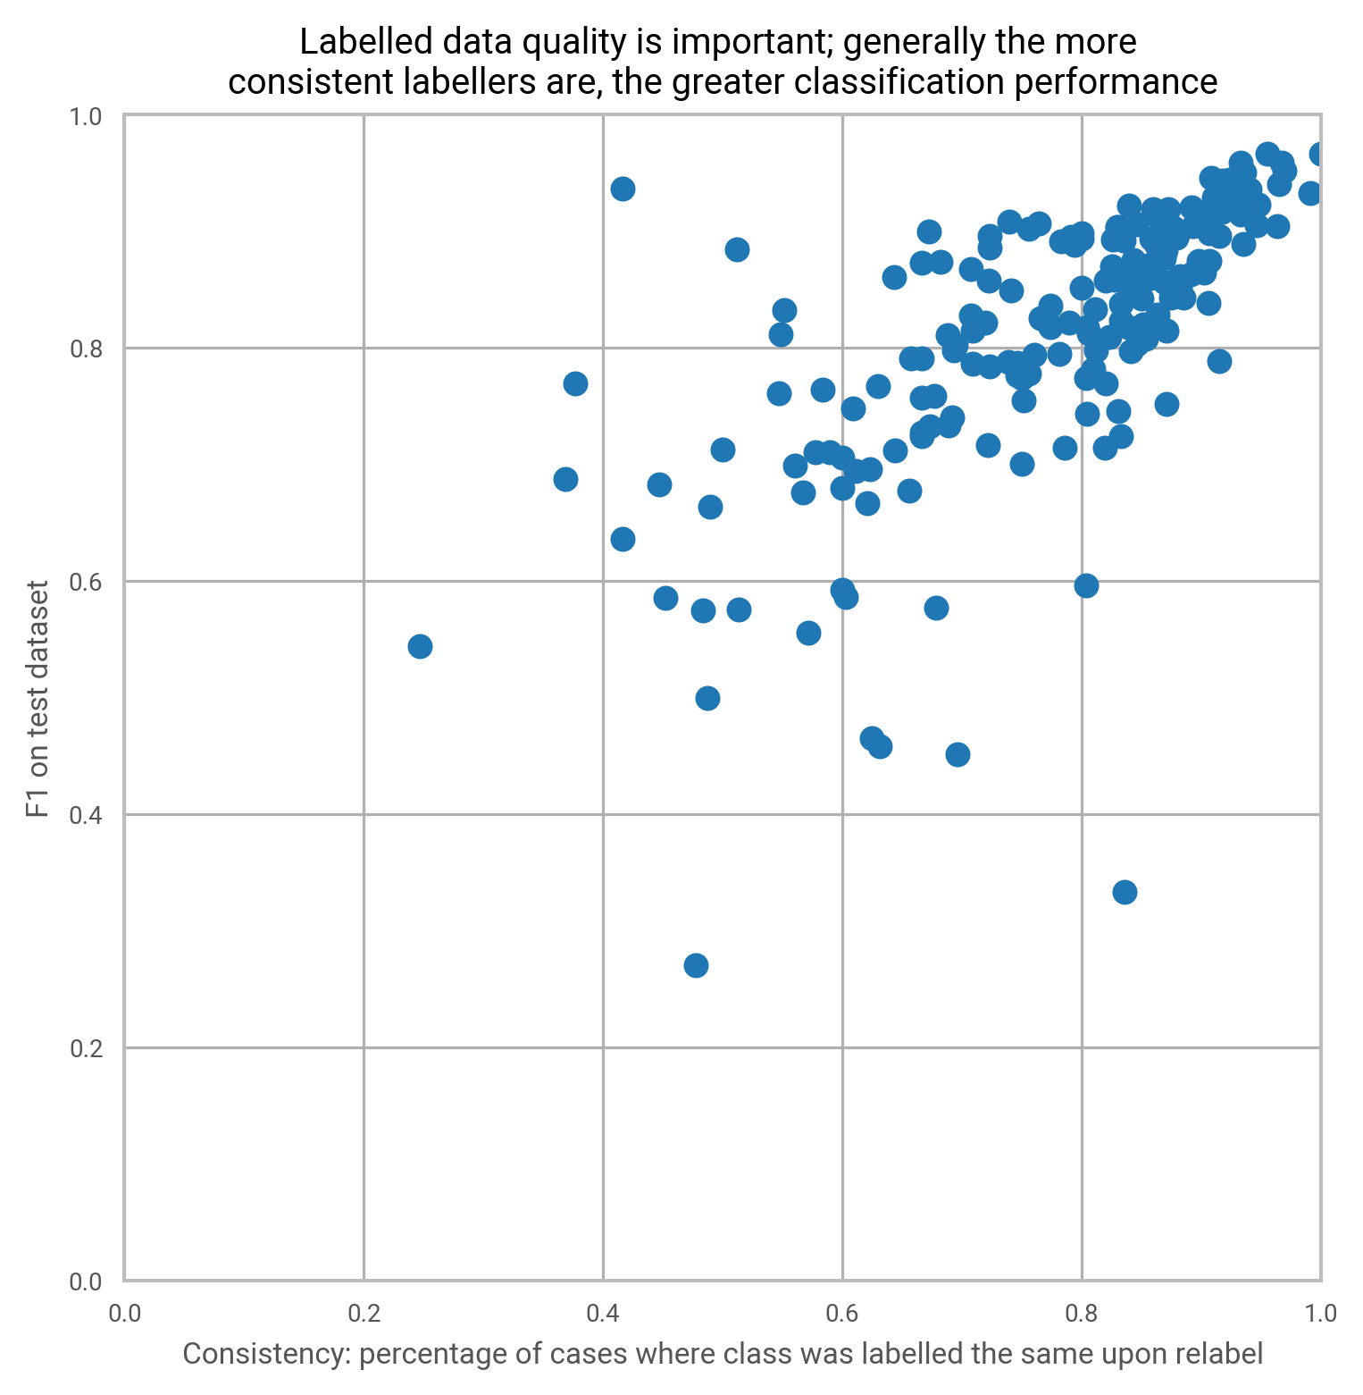
Inconsistency
Labelled 30,000 products twice
Measured consistency of labelling
Seems to be relationship with performance!

Slide 18
Inconsistency: errors
Product location: “Home / Men”
Product name: “Polo Shirt (10-11 Yrs)”
Labeller 1:
Men’s polo shirt
Labeller 2:
Boys’ polo shirt

Slide 19
Inconsistency: niche cases
Product location: “Girls / PE Kits”
Product name: “Black School Skort”
Labeller 1:
Girls’ sports shorts
Labeller 2:
Girls’ skirt

Slide 20
Inconsistency: lack of information
Product location: “Mens / Clothing”
Product name: “Roll neck sweater”
Labeller 1:
Men’s jumper
Labeller 2:
Men’s sweatshirt
Notes:
Note: in the UK context, a “sweater” is often used interchangeably to mean sweatshirts (tighter-knit) and jumpers (looser-knit)

Slide 21
Future work
Explore effect classification has on indices
Benchmark for “good enough” classification performance
Long-term: improvements to data quality
21

Slide 22
Thank you
Any questions?

