Slide 1
Machine learning in the Norwegian CPI
A classification tool
Kjersti Nyborg Hov
hkj@ssb.no

Slide 2
New data sources
Traditional data collection
  Sample of goods and services
Transaction data
  Complete coverage of goods, incl. turnover information
Challenge: unclassified

Slide 3
Division 01: Food and non-alcoholic beverages
Entirely made up by transaction data
Dynamic market – dynamic basket
  400-1200 new items entering the market each month
  Approx. 120 COICOP (un-official) level 6 groups
Product group codes not detailed enough for a simple mapping file
Solution: utilize machine learning to classify new items

Slide 4
Machine learning – pattern recognition
Unsupervised
  Algorithm learns patterns from untagged data, i.e. self-detect patterns based on all input data
Supervised
  A sample of correctly labelled data (training set)
  Algorithm finds mapping function between features (text) and labels (COICOP group)

Slide 5


The classification process
Training data
SVM classification model
Raw data
Structured data
Classified items, prediction
New items

Slide 6
Representing text as numbers (bag-of-words)
Matrix format
  Each unique word is a column
  Each item (by name and product group code) is a row
Frequency count for each word

Slide 7
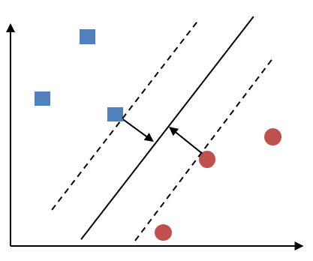
Support vector machine
Two-class problem:
  Separate blues from reds
Maximize distance to closest item of each class
New items on the left side are labelled as blue, and vice versa for red

Slide 8
Output

Slide 9
Output

Slide 11
Performance
Threshold control variable
  Relative probability between first and second choice of the model < 4
  Model-assigned likelihood of item belonging to a certain class < 2
Performance
  Approx. 95 per cent accuracy
  Approx. 15-20 per cent of items need manual one-by-one control
Increased thresholds means better accuracy, however also more manual labour

Slide 12
Conclusion
Substantial reduction in time spent on classification
  Focus on troublesome items
Probably better quality (humans make mistakes too)
Note however:
  Requires training
  Investment to implement
  Still need some manual interaction

Slide 13
Thank you

