Slide 1
Index Compilation Techniques for Scanner Data: An Overview
Claude LAMBORAY
Eurostat Unit C4
Group of Experts on Consumer Price Indices (online meeting)
June 2021

Slide 2
Introduction
Scanner data sets: timely weights and dynamic product assortments
Different approaches are possible for index compilation
Modernization of the legal framework of the Harmonised Index of Consumer Prices (HICP)
HICP Task Force Multilateral Methods
In this presentation:
Overview of methods
Country practices
Simulations

Slide 3
What is the individual product to be priced?
Field price collection: price observed at one point-in-time, in a specific outlet, for a specific product
Scanner data: average price of transactions
Three dimensions : time, outlet, product
Example: Individual product = transactions referring to the three first weeks of the month, for all outlets of a retail chain, for a specific item code.
The average prices and aggregated quantities of the individual products are the input of any index compilation method.

Slide 4
Fixed weights and static product universe
Jevons
Geometric
Laspeyres-type
Index
Annual update of the base period
December linking
Update and linking strategy
Sample
All data
All data or
sample
Ann. updated Jevons
Ann. updated geo. Lasp.-type
Method

Slide 5
Variable weights and dynamic product universe
GEKS, WTPD, GK
Index
Rolling/exp. time windows
Splicing method
Update and linking strategy
All data or
sample
All data
GEKS, WTPD, GK
methods
Method

Slide 6
Variable weights and dynamic product universe
GEKS, WTPD, GK
Törnqvist
Jevons
Index
Rolling/exp. time windows
Splicing method
Annual update of the base period
Dec. linking
Monthly update of the base period and chaining
Update and linking strategy
All data or
sample
All data
All data
Sample
GEKS, WTPD, GK
methods
Ann. updated Törnqvist
Dynamic basket
method
Method

Slide 7
Country overview
Fixed weights
Static product universe
Variable weights
Dynamic product universe
Ann. updated Jevons
Ann. updated geo. Lasp.-type
GEKS, WTPD, GK methods
Ann. updated Törnqvist
Dynamic basket
method
Denmark
Sweden
Iceland
Switzerland
France
Netherlands
Belgium
Luxembourg
Norway
Finland
Italy
Spain
Slovenia

Slide 8
Simulations
Dominick’s scanner dataset on 6 product categories for the period January 1990 to April 1997 (88 months)
Annually updated Törnqvist, Geometric Laspeyres, Laspeyres and Jevons index
Dynamic basket method and chained Törnqvist
75 variants of multilateral methods
Index formulas: GEKS, GK, WTPD
Time windows: 13 months, 19 months, 25 months, 88 months (full time window)
Splicing methods: movement splice, window splice, window splice on published indices, half splice, half splice on published indices, mean splice, mean splice on published indices, December splice
Link to access all the indices

Slide 9
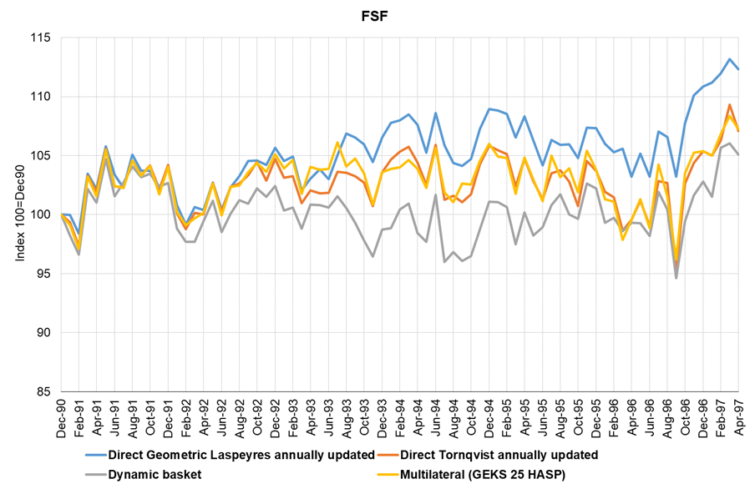
Simulations
Fabric Softeners

Slide 10
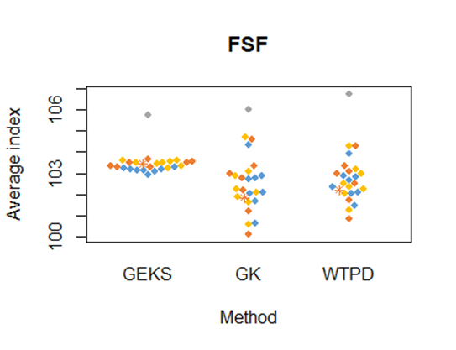
Simulations
Fabric Softeners
Average index
(Jan 1990 - April 1997)
100=Jan 1990

Slide 11
Conclusions
Fixed weights/static product universe versus variable weights/dynamic product universe
Multilateral methods: good compromise
Increased complexity in the methods: from fixed basket methods, to dynamic basket method, to multilateral methods
Will it be possible to identify good practices and formulate recommendations ?

Slide 12
Thank you
Notes:
Update/add/delete parts of the copy right notice where appropriate.
More information: https://myintracomm.ec.europa.eu/corp/intellectual-property/Documents/2019_Reuse-guidelines%28CC-BY%29.pdf

