Slide 1
FRAV Status Report to the 10th GRVA Session
Submitted by the IWG on FRAV
Informal document GRVA-10-31/Rev.1
10th GRVA, 25-28 May 2021
Provisional agenda item 4(a)
Web Conference
25 May 2021

Slide 2
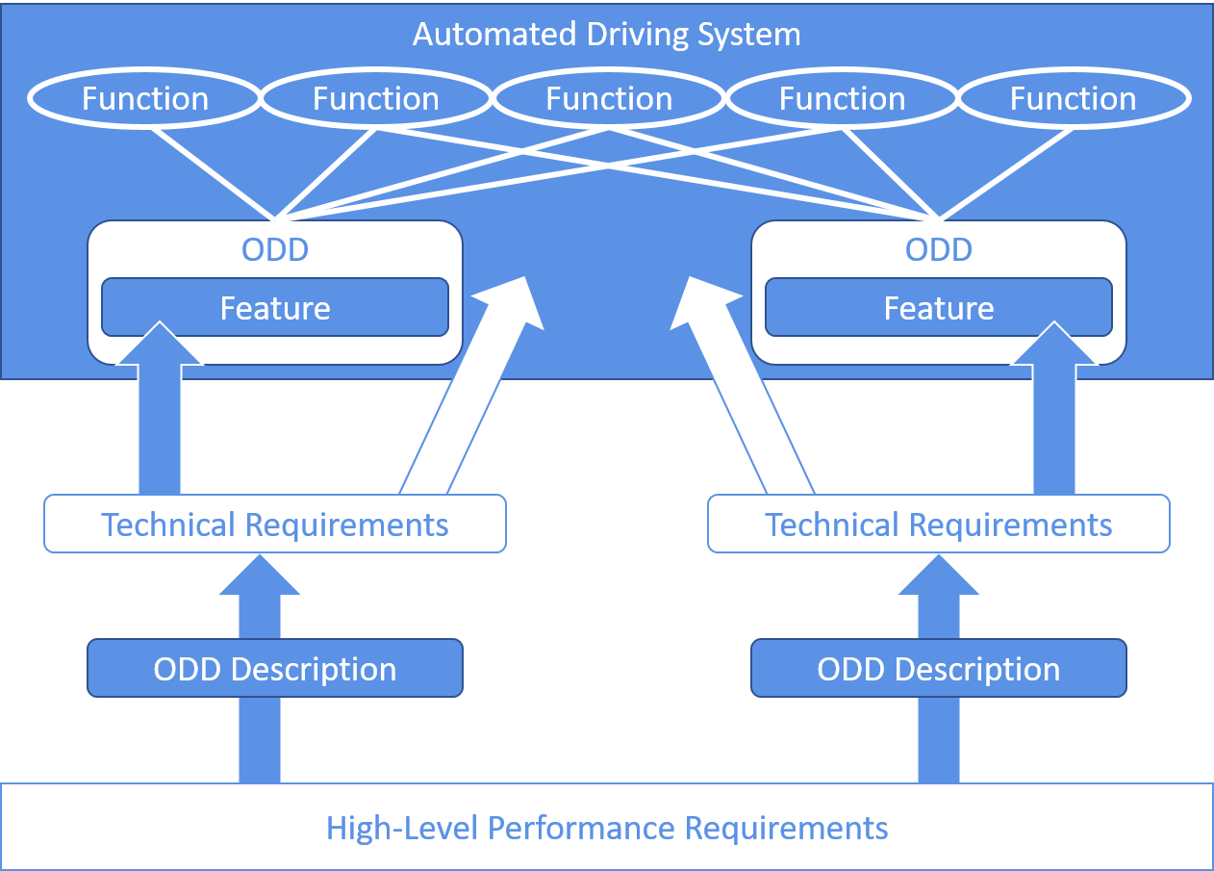
FRAV progression
Diversity of ADS and ODD
142 safety proposals
Five “Starting Points”
List of “Safety Topics”
ADS drives safely
ADS interacts safety with user(s)
ADS responds safely to critical events/conditions
ADS safely manages damage/malfunction
ADS maintains safe operational state
Originally, 40 topics related to safety needs and goals for ADS performance across the five dimensions covered by the starting points
FRAV initially addressed the diversity of ADS applications and developed a framework to enable the application of safety requirements to any ADS configuration.
FRAV gathered input from across all stakeholders, including national and regional guidelines to develop a framework covering the full range of anticipated safety needs.

Slide 3
FRAV progression
Safety topics review
Tasks/Objectives
Common Understanding
Safety Needs
19 pages of comments on interpretation and elaboration of safety topics, covering 43 topics (FRAV-12-08). Multiple references to “DDT”, “ADS user(s)”, and “other road users” indicated need to reach common understanding. Comments included concept for “guardrails approach” to ADS driving requirements.
Three workstreams:
Dynamic Driving Task
ADS users
Other road users
Three milestones:
Common understanding
Application to define safety needs
General requirements to address safety needs
DDT: FRAV-14-07/Rev.1
ADS users: Working on descriptions of user roles/ responsibilities
ORU: Definition of common and special physical, functional, and/or behavioral properties based on ORU cases
New task: Apply DDT understanding to relevant safety topics with aim to propose safety requirements
Identify safety needs relevant to the diverse roles human users may have across ADS configurations and to ORU based on the common and special properties, based on elaboration of safety topics.
Consensus on approach(es) to addressing safe ADS performance of the DDT (nominal and safety-critical conditions) building from safety topics.

Slide 4
FRAV status: Workstreams
DDT functions (FRAV-14-07/Rev.1)
Consensus understanding and framework based on Perception, Planning and Decision, and Control
ADS users (FRAV-14-08)
Different user roles depending upon ADS vehicle configuration and relationship to user(s)
Role of user may vary even during a single trip
Requirements to ensure correct use and prevent misuse
Other road users (FRAV-14-06)
ORU have different physical, functional, and behavioral properties
Safety needs and nature of interactions depend on these properties
Requirements to ensure safe interactions and ADS responses

Slide 5
DDT-related safety task
Derive general safety requirements from the safety topics
Based on the common understanding of the DDT
Consider “guardrails approach” to safety requirements
Guardrails Concept
Safe driving involves multiple options for responses under dynamic conditions. Criteria for ADS safety should not prescribe exact driving maneuvers but should provide parameters within which safety is achieved.
The requirements should provide manufacturers with flexibility to design systems that perform within this safety domain and meet the safety objectives.

Slide 6
FRAV forward plan
General Requirements
Specifications
ADS descriptions
Package Delivery
General safety requirements addressing safety needs based on starting points framework and elaboration of safety topics. “General safety requirements” means definition of what should be verified for what reasons. Specifications (e.g., criteria, limits, formulas) would follow.
FRAV has discussed several approaches to defining specifications, especially related to ADS performance of the DDT:
Careful & Competent Human Driver
State of the technologies
Mathematical formulas (e.g., “safety envelopes”)
Positive statistical risk balance
Specifications need to address traffic efficiency and safety (such as “string stability”) so combinations of methods are likely in finding optimal solutions.
Based on understanding of requirements, FRAV can return to its original framework to develop guidelines regarding documentation required to understand each ADS (e.g., configuration, intended uses, and limitations on use) and application of requirements.
Package consisting of guidelines for ADS documentation, safety requirements, and other guidance as needed to understand application of safety requirements to individual ADS applications.
(GRAV-11 September 2020)
(GRAV-12 February 2021)

Slide 7
FRAV input on EDR/DSSAD
EDR/DSSAD informal group request
Input on data collection requirements for ADS vehicles
Account for diversity of ADS configurations
ADS performance data
ADS user roles and interactions
Account for different purposes/uses of data
Crash event analysis and reconstruction
ADS performance data for research, NATM development (in-service pillar)
Account for technical aspects
Data locked on board vehicle
Data transmitted for analysis and reporting

Slide 8
Data Elements Matrix (Illustration purposes only)
Purpose of Data Collection | Applicability of Data | Data Set | General Description
Accident analysis/ reconstruction | All vehicles | A | Data on vehicle state/performance
 | Conventional vehicles (no ADS) | B | Data on actuation of manual driver controls
 | Vehicles equipped with an ADS | C1 | ADS data on DDT performance
 | Vehicles equipped with an ADS designed to interact with a user | C2 | Data on user behavior/interactions with ADS
Evaluation of system operations/research/ assistance with accident analysis ( L3-L5) | Vehicles equipped with an ADS | D1 | Non-crash ADS operational performance data
 | Vehicles equipped with an ADS designed to interact with a user | D2 | Non-crash user interactions with ADS
Elements in the data sets are mutually exclusive (i.e., no duplication) and may be combined depending upon the vehicle configuration, for example:
Conventional (manual only) vehicle → A + B
ADS with human driver controls → A + B + C1 + C2 + D1 + D2
Driverless passenger vehicle → A + C1 + C2 + D1+ D2
Driverless commercial vehicle (no occupants) → A + C1 + D1

Slide 9
Thank you for your attention.
FRAV welcomes questions,
comments, or suggestions.

