Slide 1
Submitted by the expert from the European Association of Automotive Suppliers CLEPA | Informal document GRVA-10-23 10th GRVA, 25-28 May 2021 agenda item 8(b)
UN R13 and Electro Mechanical Brakes

Slide 2
ECE-R13 and Electro Mechanical Brakes (EMB) Overview of changes made to Informal Document GRVA-09-05
With respect to GRVA-09-05, changes were made in the following paragraphs:
- 2.31.
- 2.51.
- Correction in Justification of paragraph 5.1.4.5.1.
- PTI paragraph 5.1.4.5.3. (with new Justification)
- 5.1.4.6.2.1.
- 5.1.4.6.2.1 & 5.1.4.6.2.2 & 5.1.4.6.2.3 (word “wheel” deleted)
- Proposal for deletion of paragraph 1.2.11. of Annex 4 withdrawn
- Note, that paragraph 2.4.1 of Annex 7, Part D is still under discussion

Slide 3
Explanation to Paragraph 2.51
EBS
Vehicles with pneumatic braking do have an ‘energy source’
(Layout Examples)
Diesel engine
Energy source
Energy transmission
Combustion engine
compressor
4 circuits protection valve
Air tank (FA)
BEV
Energy source
Energy transmission
Wheels
Motor/ gene-rator
600V
compressor
4 circuits protection valve
Air tank (FA)
2.49. "Energy source" means a device that both generates and provides energy required for the braking system.

Slide 4
Explanation to Paragraph 2.51
EMB
Vehicles with an EMB can have an ‘energy source’,
But it is called an ‘electrical supply device’
(Layout Examples)
Diesel engine
Energy transmission
Combustion engine
Generator
Circuits insulation
Electrical Storage Device (FA)
24V
Electrical Supply Device
M
BEV
Energy transmission
Wheels
Motor/ gene-rator
600V
DC/DC
Circuits insulation
Electrical Storage Device (FA)
24V
M
2.51. "Electrical supply device" means a device (e.g. battery, REESS, DC/DC converter, generator, fuel-cell or a combination of those components) that supplies electrical energy to the braking system's electrical energy storage device(s).

Slide 5
Explanation to Paragraph 2.51
EMB
Vehicles with an EMB can have an ‘energy source’,
But it is called an ‘electrical supply device’
(Layout Examples)
Diesel engine
Energy transmission
Combustion engine
Generator
Circuits insulation
Electrical Storage Device (FA)
Electrical Supply Device
M
BEV
Energy transmission
Wheels
Motor/ gene-rator
600V
DC/DC
Circuits insulation
Electrical Storage Device (FA)
M
2.51. "Electrical supply device" means a device (e.g. battery, REESS, DC/DC converter, generator, fuel-cell or a combination of those components) that supplies electrical energy to the braking system's electrical energy storage device(s).

Slide 6
PTI update

Slide 7
PTI update

Slide 8
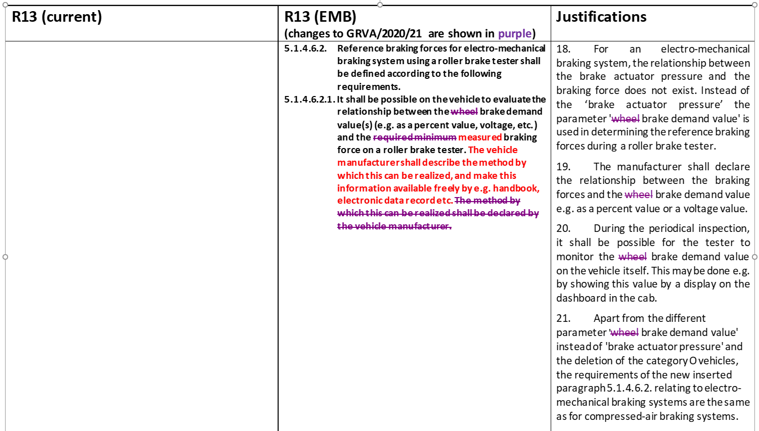
PTI update

