Slide 1
What can we do in the GRSP to get the same protection level for male and female occupants?
Submitted by the expert from Sweden | Informal document GRSP-69-42 (69th GRSP, 17-21 May 2021 agenda item 18)
Pernilla Bremer, Senior administrative officer, Sweden
Anna Carlsson PhD Chalmers Industriteknik
Mats Svensson, prof. Chalmers University
Anders Kullgren adjunct prof. Chalmers

Slide 2
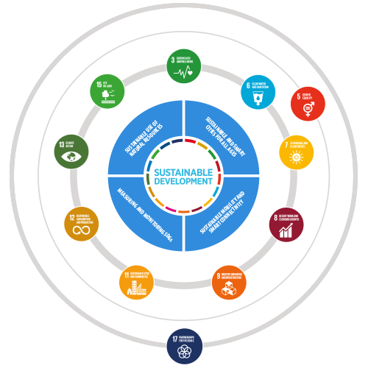
What should we do in the GRSP?
UNECE…
… supports cooperation for safer transport
(Target 3.6 – Improving road safety)
… promotes womens economic empowerment and mainstreaming of gender equality in all its activities
(Target 5.C – Adopt and strenghten policies and enforceable legislation for gender equality)
… supports countries to ensure that industry, innovation and infrastructure provide robust foundation for sustainable development
(Target 9.6 – Promoting gender responsive standards)
https://unece.org/sdg-priorities

Slide 3
Result from the study presented in Dec -20
People of different sizes and gender where studied and the conclusion were:
Female occupants have greater risk of crash related injuries than male occupants
Females: Greater risk of spine, thorax and extremity injuries (Welsh & Lenard 2001; Bose et al. 2011; Parenteau et al. 2013; Kahane 2013)
Males: Greater risk of head injuries (Parenteau et al. 2013; Welsh & Lenard 2001)
Risk is also affected by size
Gender is the factor that effects the risk the most

Slide 4
What can we do in the GRSP?
This is a topic with many different layers and that effects several ECE regulations
ECE R16, Seat belt test
ECE R17, Strenght of seats
ECE R 94 and 137 Frontal test
ECE R95 and 135 Side impact test

Slide 5
Potential collaboration within UNECE
WP.1 – Global forum for road trafik safety
WP.6 – Working party on regulatory cooperation and standardization policies.
EC
And of course the industry

Slide 6
Maybe the solution is inclusive testing and a new dummy….
…but, we cannot start in a solution,
First we need to understand the problem,

Slide 7
When one size doesn’t fit all – Ways forward
Form a task force to understand the problem and work out a suggestion for terms of reference for IWG adressing both men and women equally and diversity of occupants to be presented for the GRSP in december.
Form a ad hoc group in collaboration with interested CP, industries and invite WP.1 and WP.6 to join - if still lingering questions. To be presented in december.

