Slide 1
Submitted by the expert from Republic of Korea on behalf of IWG-DPPS
Informal document GRSP-69-20
68th GRSP, 17-21 May. 2021, agenda item 2(b)
Status of Informal Working Group
on Deployable Pedestrian Protection Systems
(IWG-DPPS)
Chair: Jin Seop PARK, Republic of Korea(KATRI)
Secretary: Irina Dausse, OICA(Renault)

Slide 2
Overview
Objective To develop the amendment of GTR No.9 & UN R127 w.r.t. Deployable Pedestrian Protection Systems (DPPS)
Activities - IWG: MAR., 2018 ~ JUN., 2021(TOR mandate)
Meetings - 9th Meeting (20th ~ 21st JAN., 2021 / Online) - 10th Meeting (9th ~ 10th MAR., 2021 / Online) - 11th Meeting (27th ~ 28th APR., 2021 / Online) - Subgroup online meetings
* Due to the Covid19 pandemic, the progress is slow
2p

Slide 3
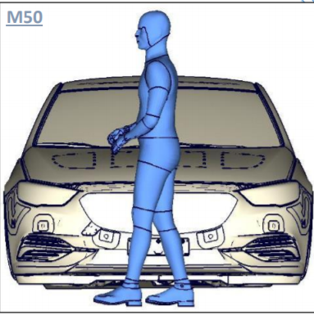
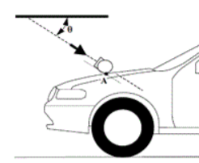
Summary of the amendment discussion
Must meet the regulation criteria
Static test in undeployed position
@LT x 0.9
Verification
of detection
Headform Test
(physical)
Static test in undeployed position
@ 9.7 m/s
Prerequisites
- System info
- HIT
Static test in deployed position
@ 9.7 m/s
Potential options
- Simulation
Physical testing
Generic Method
Dynamic test
@ 9.7 m/s
* HIT = Head Impact Time
LT = Lower Threshold (of speed)
3p

Slide 4
Major Issues
HIT determination: 3 possible options 1. simulation : considering the modification from Euro NCAP procedure (HBM, position, etc.) 2. physical testing : dummy testing based on SAE J2782 3. beginning to discuss generic method
still some challenges
※ IWG requests for GRSP confirmation regarding
(all Contracting Parties, especially the United States)
→ applying the numerical simulation method to the regulation
* HBM = Human Body Model
4p

Slide 5
Major Issues
Defining test area - undeployed condition : Korea, Germany, Japan, UK - deployed condition : Netherland, OICA
HIT vs WAD for dynamic test - regression : UK, Netherland, Germany, Spain - dot-to-dot : Japan, Korea
Detection/Sensing area - detection area definition : Germany, Netherlands, Korea, Spain, France, Italy - additional deployment condition of DPPS: Japan
Verification Impactor: Flex-PLI(decided)
* WAD = Wrap Around Distance
5p

Slide 6
Plan
Next Meeting - 29th ~ 30th JUN., 2021 - Online meeting
More meetings (t.b.d.)
Extension of mandate of IWG-DPPS
timeline
GTR9 drafting
Informal
GRSP
Dec 2021
Formal
GRSP
May 2022
WP29
Nov 2022
6p

Slide 7
Thank you for your attention
7p

