Slide 1
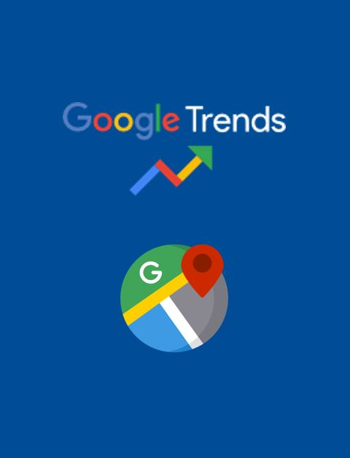
Developing High Frequency Economic Indicators using data from Google Platforms
May 26, 2021
Marco Marini, Alberto Sanchez, Jim Tebrake, Paul Austin, Chima Simpson-Bell
IMF Statistics Department
Disclaimer: The views expressed in this paper are those of the authors and do not necessarily represent the views of the IMF, its Executive Board, or IMF management.

Slide 2
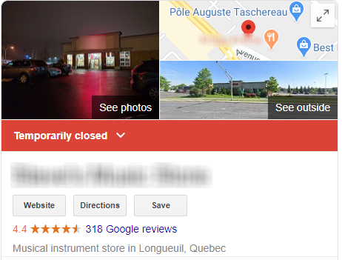
User Demand in the Age of COVID: Finer, Faster and more Frequent
Users are demanding more granular, high-frequency, and timely indicators to:
  Nowcast of traditional economic indicators
  Increase the frequency of traditional indicators (e.g., from quarterly to monthly GDP)
  Examine evolving structural changes in real-time (e.g., business opening, closing)
  Assess impact at a very granular level - by business types / geographic locations
Could these indicators be developed using information from Google?

Slide 3
Is it possible to produce timely, high frequency economic indicators consistent with international classifications and statistical methods using data extracted from the Google Places API and Google Trends Platform.

Slide 4
(1) Data Sources – Google Places API
The Google Places API provides access to information that aligns closely in content and concept to the type of information typically recorded on a business register.
For example, the name, activity, comments could be used to assign an activity code and the “review”, “rating”, “price level” information can be used to provide an indication of size.
Shortly after the start of the COVID-19 pandemic Google added an additional field (business operating status) to the Google Places API.

Slide 5
(1) Data Sources: Google Places API
Since the start of the COVID-19 Pandemic the IMF has been extracting data for a global sample of 90,000 “places”.
The first extraction was on April 24th, 2020. The IMF Statistics Department has taken at least two extractions per month since that time.
The database currently has over 3,000,000 observations and covers 21 of the largest cities in the world.

Slide 6
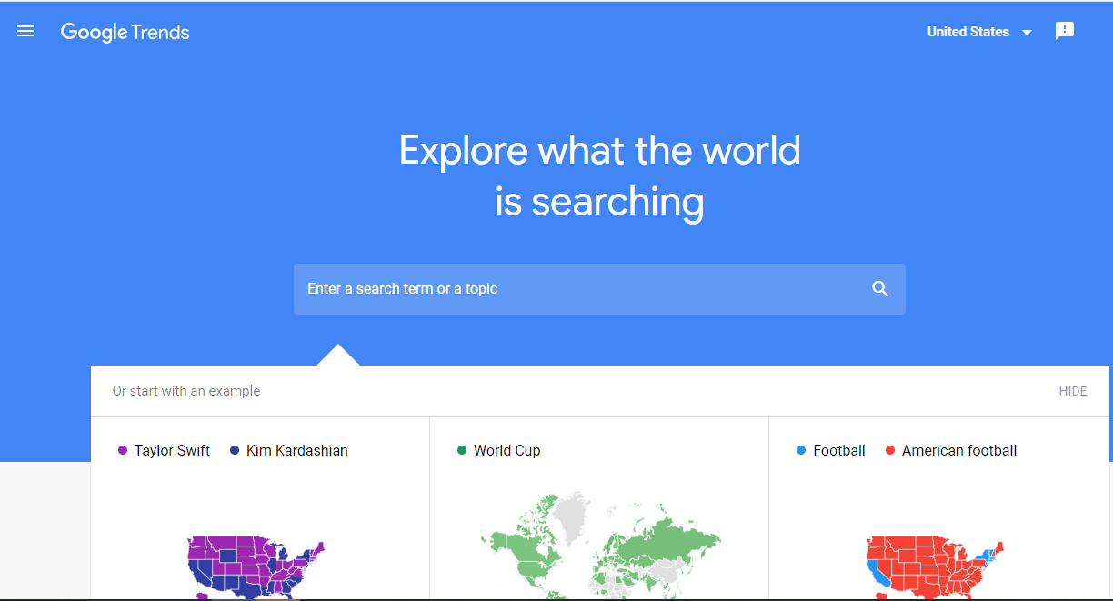
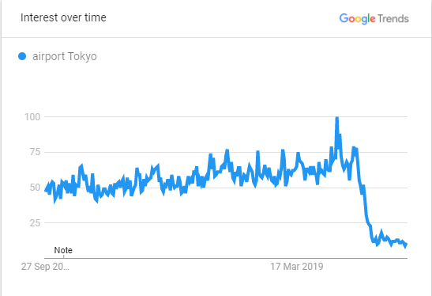
(2) Data Sources: Google Trends
Google Trends is a measure of the interest in a topic relative to all topics over time.
Google Trends provides access to anonymized, categorized and aggregated search requests.
Google classifies search queries into 27 categories (e.g. Transportation & Logistics) at the top level and 241 categories at the second level using an automated classification engine.
Recent OECD methodology uses Google Trends and machine learning to produce a weekly GDP tracker (Wolosko, 2020)

Slide 7
We are working with these data sources to deterime if ....
These data be used to develop a set of timely, high frequency economic indicators consistent with international statistical classifications and concepts.
These economic activity indicator be integrated with official statistics to improve their timeliness and frequency (e.g. be used to “nowcast” real GDP for a given country/region).

Slide 8
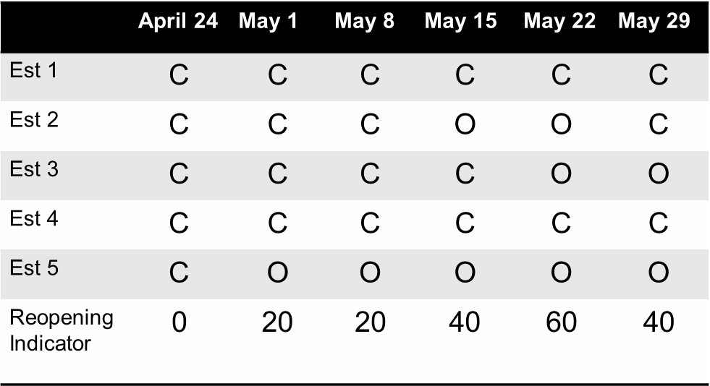
(1) Supply Indicators – Business Status
The reopening indicator measures the percentage of businesses temporarily closed on a baseline date that have since re-opened.
Start with an initial sample of businesses that temporarily closed due to COVID-19.
Track their “status” at each collection (bi-weekly)

Slide 9
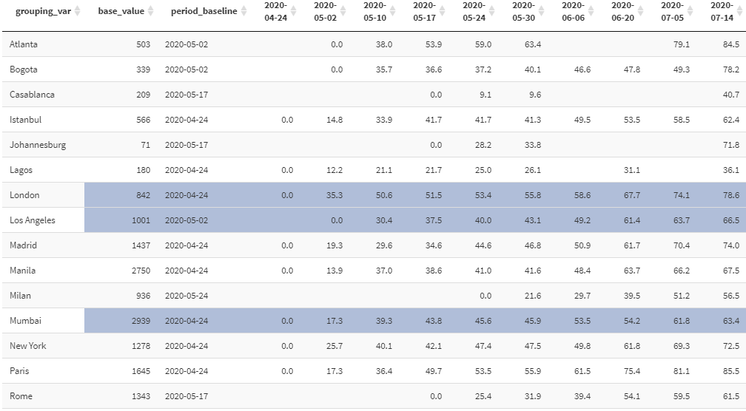
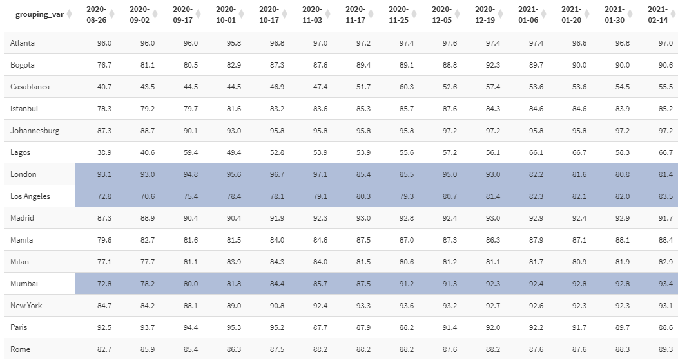
(1) Supply Indicators – Business Status
Share of “places” temporarily closed on April 24, 2020 that have since re-opened.

Slide 10
(1) Supply Indicators – Business Status
Toronto: Hair Care Temporarily Closed
Using the reviews as weights provides a different perspective on the potential severity of the closures.
Using the name and Google Activity code it is possible to assign an ISIC class.

Slide 11
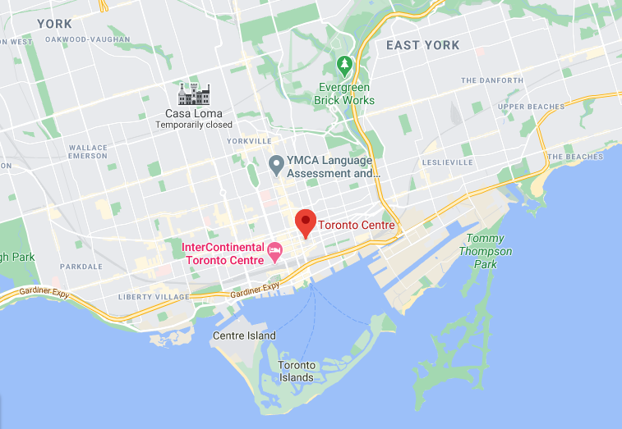
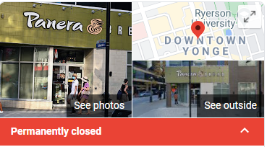
(1) Supply Indicators – Exits
Toronto Center
Toronto: Exits
It is also possible to measure entries and exits through the business status indicator. Using review information will provide an indication of the size of the exit.

Slide 12
(2) Demand Indicators – Google Interest by Industry
Given the infinite number of possible search terms - Google has developed an algorithm to aggregate searches into 1000+ “trend” categories.
For example, the category “Consumer Electronics” is an aggregation of search topics as indicated below (this is an example for Australia).

Slide 13
(2) Demand Indicators - Google Interest by Industry
We map the Google Trends categories to the International Standard Industrial Classification of All Economic Activities (ISIC) using Natural Language Processing methods (word2vec) that score the Google Trends category description against the ISIC description (at the 4-digit level).
We are currently testing various methods to aggregate the ISIC assigned Google Trends categories to derive an estimate of Google Trends by ISIC for a given country.

Slide 14
(2) Demand Indicator – Google Reviews
Los Angeles: Reviews indicator vs. California Unemployment claims (inverted)
The reviews indicator is an index based on the number of new customer reviews received by a fixed group of businesses, relative to a baseline date
Since customer reviews follow engagement with a business, the reviews indicator provides timely information on recent sales activity
The new reviews can also be weighted by their average rating (from 1 to 5) to give less weight to negative reviews

Slide 15
(2) Demand Indicator – Google Reviews by activity
Reviews can be summarized by activity, weighted by rating.
Indicators tracking the stock of reviews or the number of new reviews can be developed and used as a short-term indicator of change in demand.
These indicators are highly correlated with the supply side indicators.
Toronto: Stock of Reviews and Change in Reviews by activity

Slide 16
Application to Selected Countries: Nowcasting Quarterly GDP during COVID-19 using Google Based High Frequency Indicators by Economic Activity

Slide 17
Google Data Allow to Track in Real-Time the Impact of the Pandemic
Google Trends by Economic Activity and the Reopening Indicator track well the fall and recovery of those sectors particularly hit by the pandemic (e.g., transportation and storage in France)

Slide 18
Indicators Developed in this Study Prove to Be Powerful Predictors for Some Economic Activities…
Regression model for Quarterly Value Added of Transportation and Storage (Section H of ISIC rev. 4) in six countries
 |  | Google Trends by Economic Activity |  | Reopening Indicator
 | R² | Coeff | t-stat | Coeff | t-stat
Australia | 0.83 | 0.43 | 3.22** | 0.19 | 2.43**
Brazil | 0.91 | 0.10 | 2.21** | 0.30 | 13.20**
Canada | 0.88 | 0.89 | 5.57** | 0.38 | 6.44**
France | 0.92 | 0.25 | 2.15** | 0.48 | 7.28**
Philippines | 0.95 | 0.45 | 6.40** | 1.28 | 15.96**
South Africa | 0.92 | 0.25 | 2.47** | 0.34 | 8.90**
Estimation Period: 2015q4-2020q3
Model specification in logs, with constant. All data seasonally adjusted

Slide 19
… Producing Accurate (and Timely) Nowcasts of the Second and Third Quarter of 2020

Slide 20
Conclusions and Next Steps
Objective: Develop a repeatable and highly accessible methodology that can be used to produce high frequency indicators by economic activity based on Google data for real-time monitoring and nowcasting
Next Steps:
  We are refining our methodology to
    Improve weighting scheme for aggregation of categories (currently, a simple average is used)
    Develop activity indicators for selected businesses/industries by combining information from Google Places and Google Trends
  We are in the process of documenting the methodology and results in an IMF working paper and intend to include all the R scripts a compiler would require to stand-up these indicators for a given geographic region.

Slide 21
Google support to the Global Statistical System
1. Support for National Statistical Systems
Many National Statistical organizations are unable to pay the Google Places Access fee. Is there any way the credits provided by Google through the not-for-profit COVID-19 response efforts could be extended to National Statistical organizations?
2/ Historical “Start-up” Data
  For National Statistical Organizations interested in using the Google Places data as an input into their business register and business dynamics program is Google able to provide a “Start-up” time-series of 2-3 years?

Slide 22
Thank you!
  Marco Marini (mmarini@imf.org)
  Alberto Sanchez (asanchez3@imf.org)
  Jim Tebrake (jtebrake@imf.org)
  Paul Austin (paustin@imf.org)
  Chima Simpson-Bell (csimpson-bell@imf.org)
  IMF Statistics Department

Slide 23
Annex – Mapping Trends Categories to ISIC
Google search categories are selected automatically through text comparison with description of 4-digit level of the ISIC rev. 4
For example, the following categories are selected for Transportation and Storage (all within “Transportation & Logistics” Trends category)
Level 1 | Level 2 | Level 3
Business & Industrial: 12 | Transportation & Logistics: 50 | Aviation: 662
Business & Industrial: 12 | Transportation & Logistics: 50 | Distribution & Logistics: 664
Business & Industrial: 12 | Transportation & Logistics: 50 | Freight & Trucking: 289
Business & Industrial: 12 | Transportation & Logistics: 50 | Mail & Package Delivery: 1150
Business & Industrial: 12 | Transportation & Logistics: 50 | Maritime Transport: 665
Business & Industrial: 12 | Transportation & Logistics: 50 | Moving & Relocation: 291
Business & Industrial: 12 | Transportation & Logistics: 50 | Packaging: 290
Business & Industrial: 12 | Transportation & Logistics: 50 | Parking: 1306
Business & Industrial: 12 | Transportation & Logistics: 50 | Public Storage: 1347
Business & Industrial: 12 | Transportation & Logistics: 50 | Rail Transport: 666
Business & Industrial: 12 | Transportation & Logistics: 50 | Urban Transport: 667

