Slide 1
Improving timeliness of consumer expenditure estimates: Experimental methods using nowcasting and card data
Kyle Hood, Bureau of Economic Analysis

Slide 2
Introduction
This talk covers work from two projects at BEA
Project I: Measuring spending using card transaction data
  Coauthors: Abe Dunn, Andrea Batch, Alex Driessen
Project II: Nowcasting advance estimates of private consumption of services in the US National Accounts
  Coauthor: Baoline Chen

Slide 3
Measuring spending using card transaction data
The COVID-19 pandemic required an immediate response
  Pandemic declaration and policy responses caused large, rapid shifts in economic conditions
  High-frequency economic data (daily or weekly) are needed to trace the path of the economy
  Concerns about survey data quality (mostly unfounded) and indicators
We use card transactions to respond to this challenge
  Rapid (3-5 day delay)
  High frequency (daily)
  Granular (3-digit NAICS based on merchant category)

Slide 4
Overview
High-frequency estimates and initial response
  Overview of data source
  We develop a simple model to eliminate seasonal patterns and trends and to evaluate the daily patterns after the pandemic was declared
  We provide an overview of the daily estimates and discuss the timeline of how these estimates were released and updated
Lessons from comparisons with source data before and after the pandemic
  We compare card with official sources before and after the pandemic to show the data’s usefulness in more or less volatile periods
  We find that the card data series were more informative than some pre-pandemic estimates had suggested
  Interpretation of these results

Slide 5
Data/method overview
Fiserv card transaction data
  Fiserv is one of the world’s largest card transaction intermediaries: $2.6 trillion in annual card transactions worldwide
  Each observation is a card swipe (e.g., debit, credit or gift card) or online transaction, but aggregated to national level by 3-digit NAICS
  More details discussed by Dunn et al. (2020)
Data series constructed using FRB and Palantir methodology
  FRB Paper - Aladangady et al. (2019) – 13-month rolling panel methodology with benchmarking to 2012 Economic Census
  Produces a much more stable and informative series
The data have some limitations
  They may not be representative, variable coverage across categories, and unclear how well entry/exit are captured
Method: Regression on daily data eliminates some seasonality, long-term trends

Slide 6
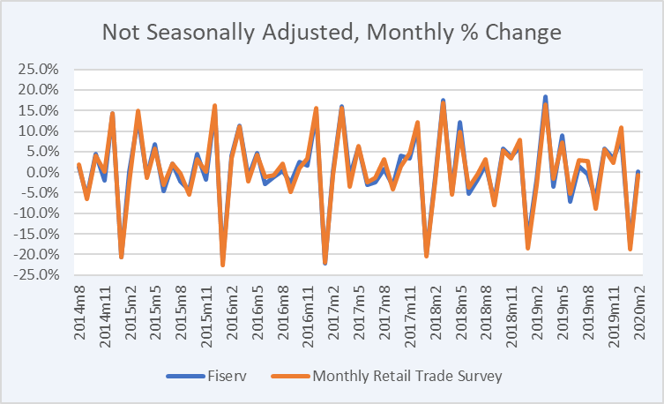
Comparison with MRTS

Slide 7
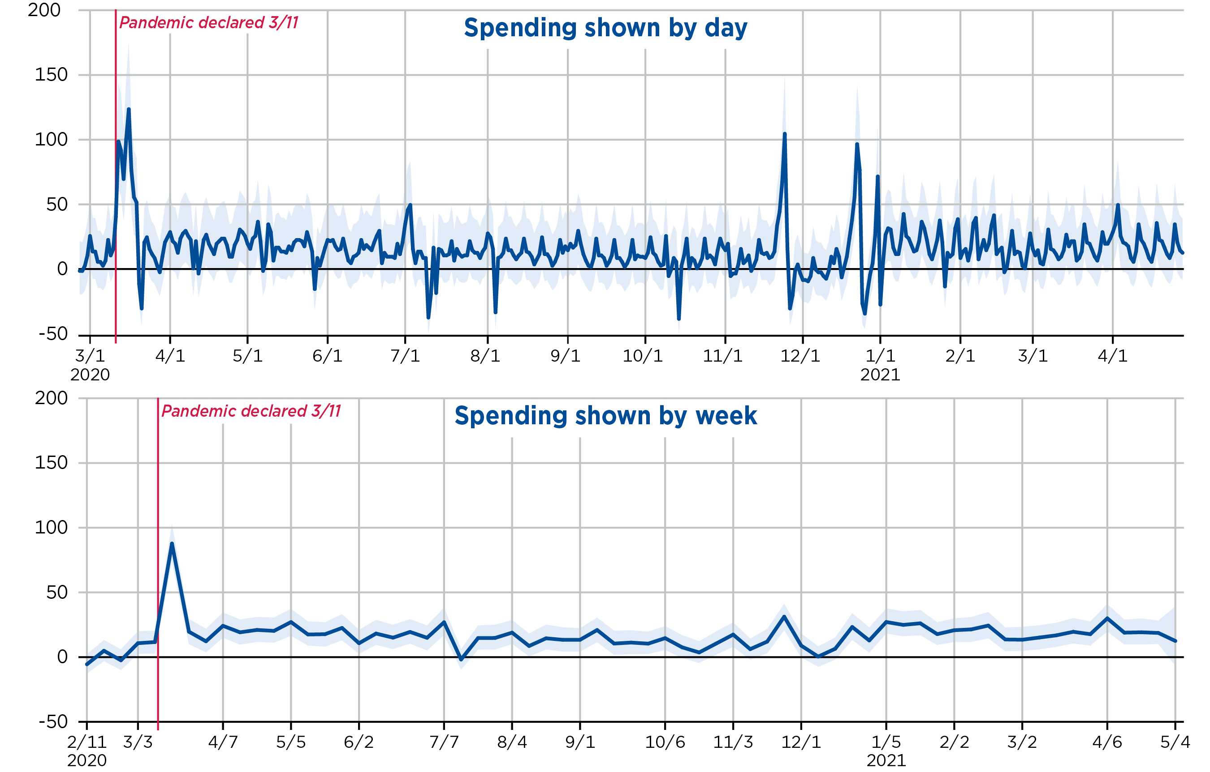
Food and beverage (445)

Slide 8
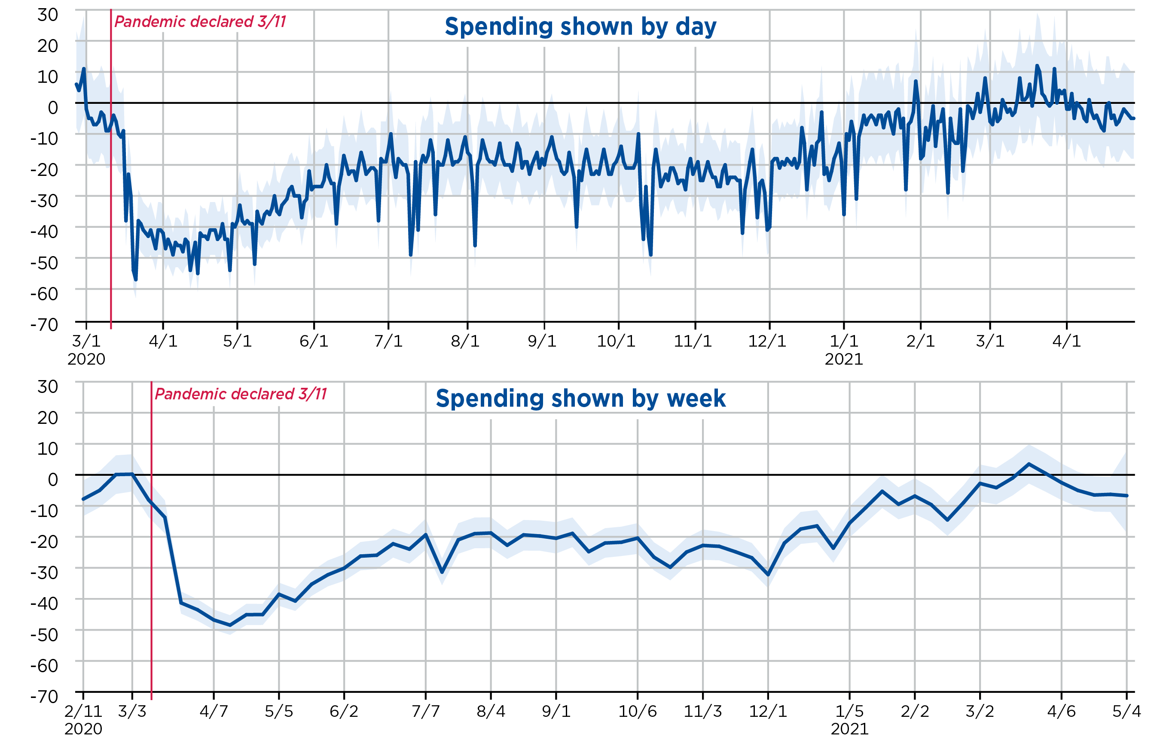
Gas stations (447)

Slide 9
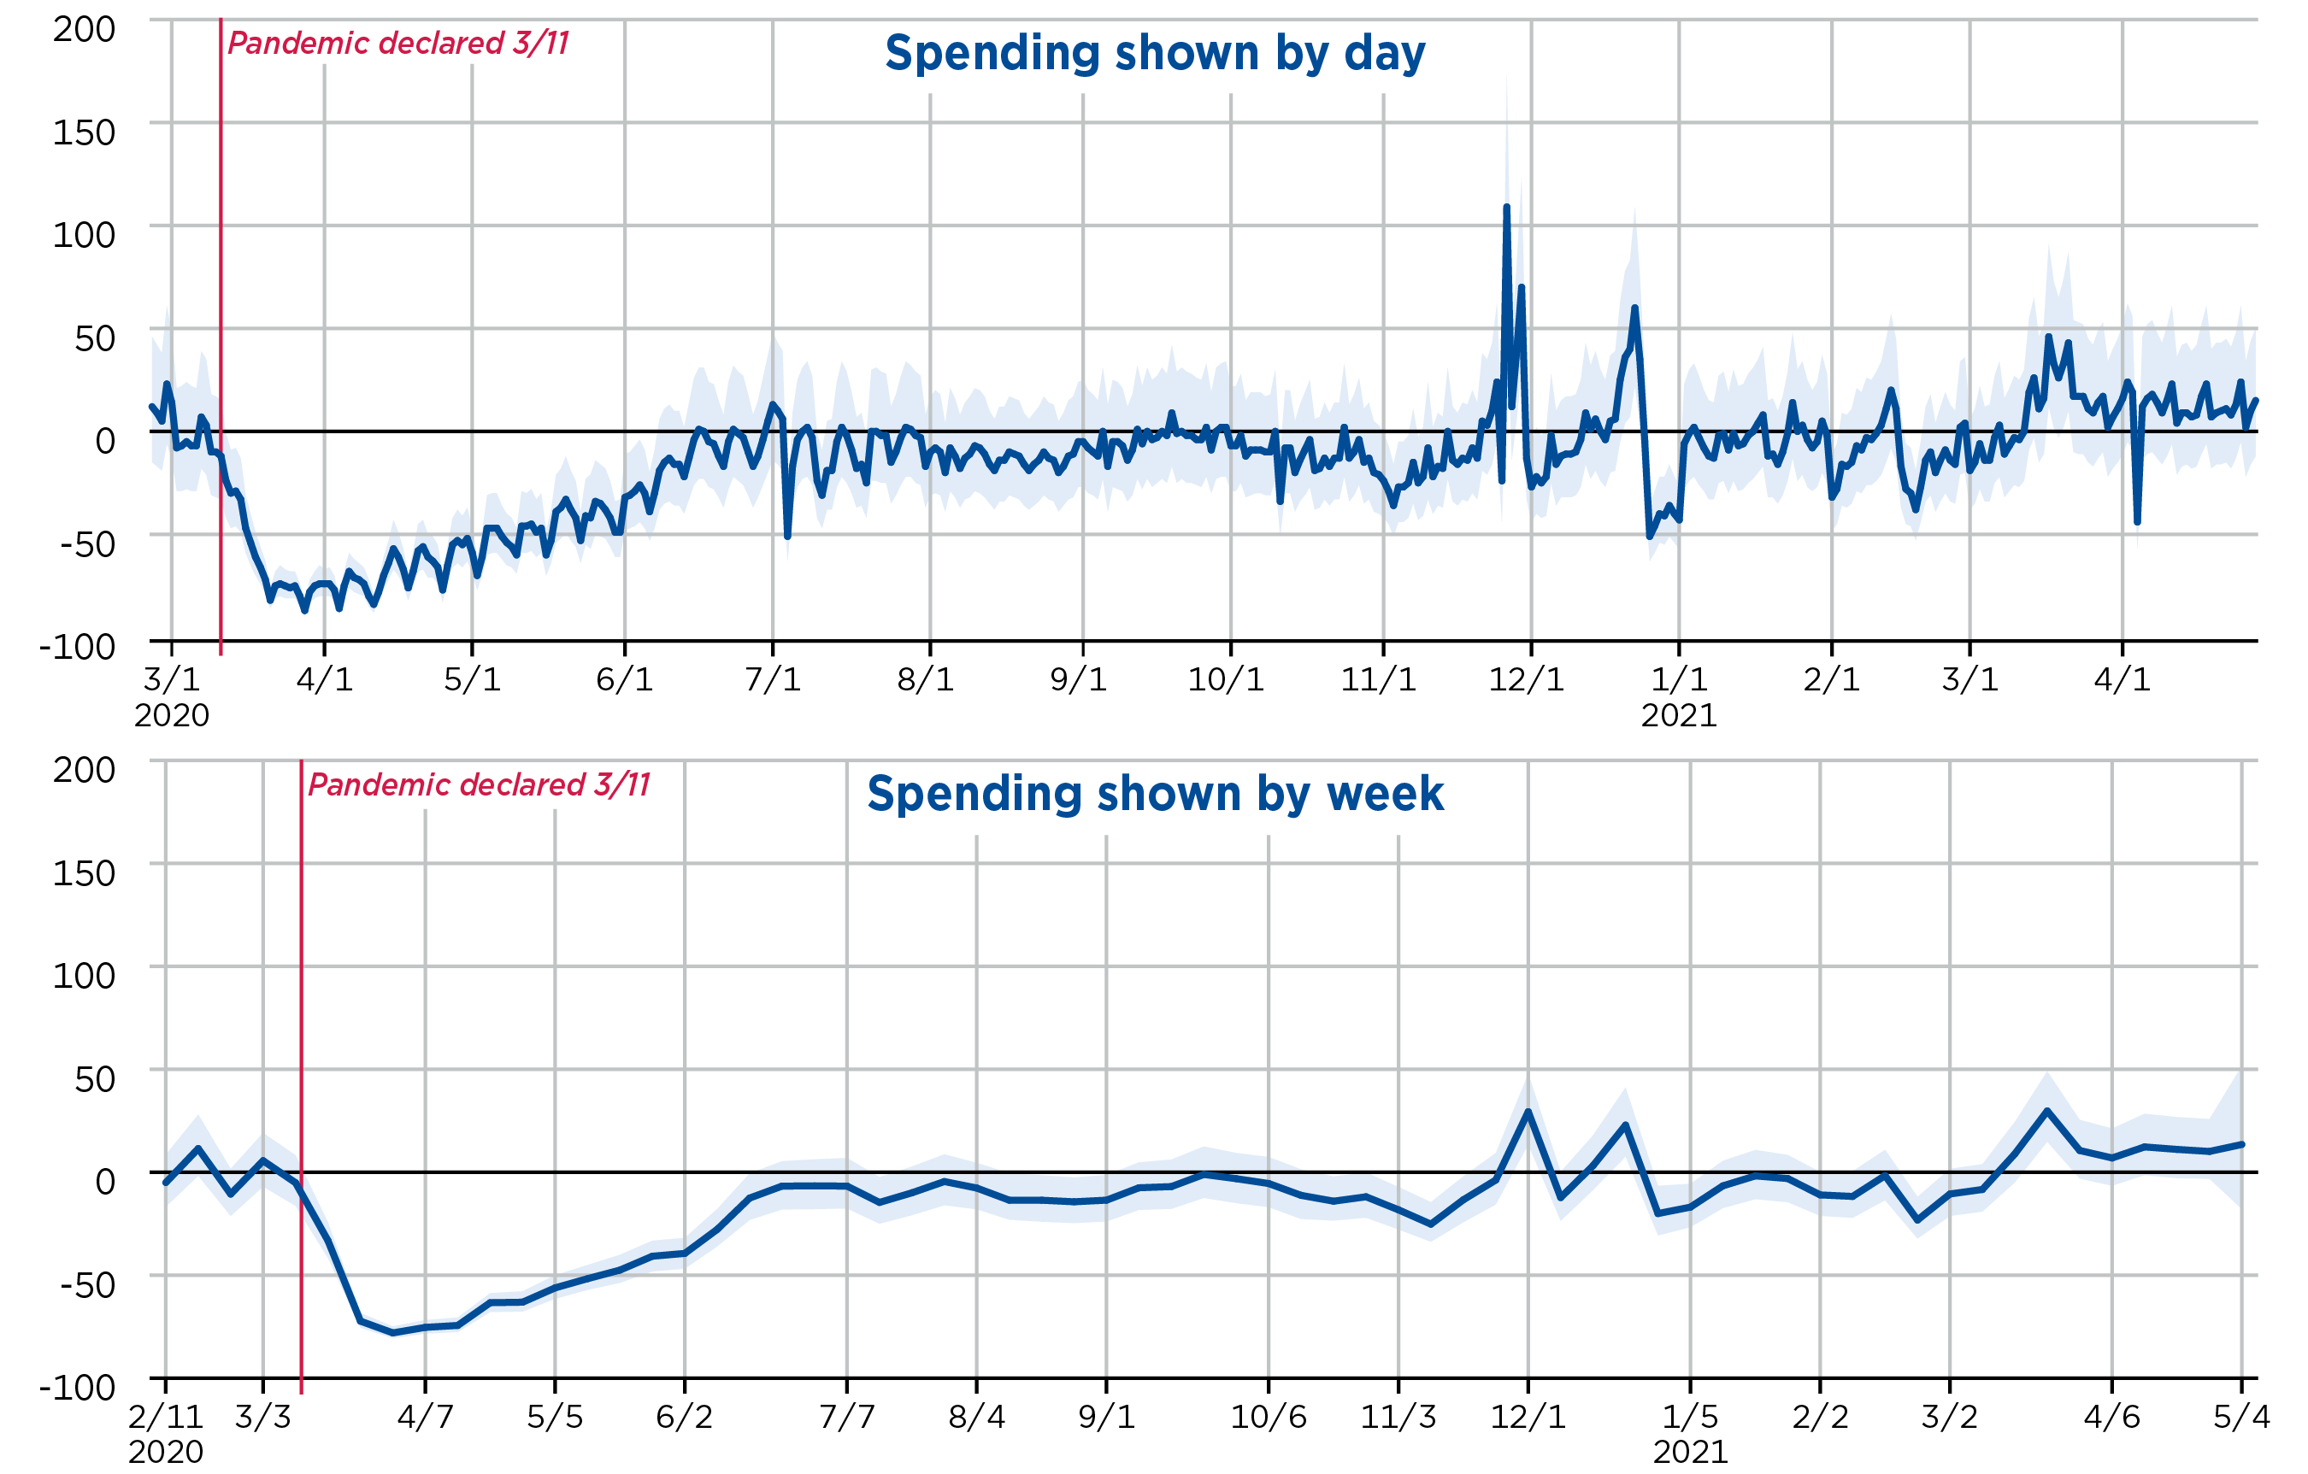
Clothing (448)

Slide 10
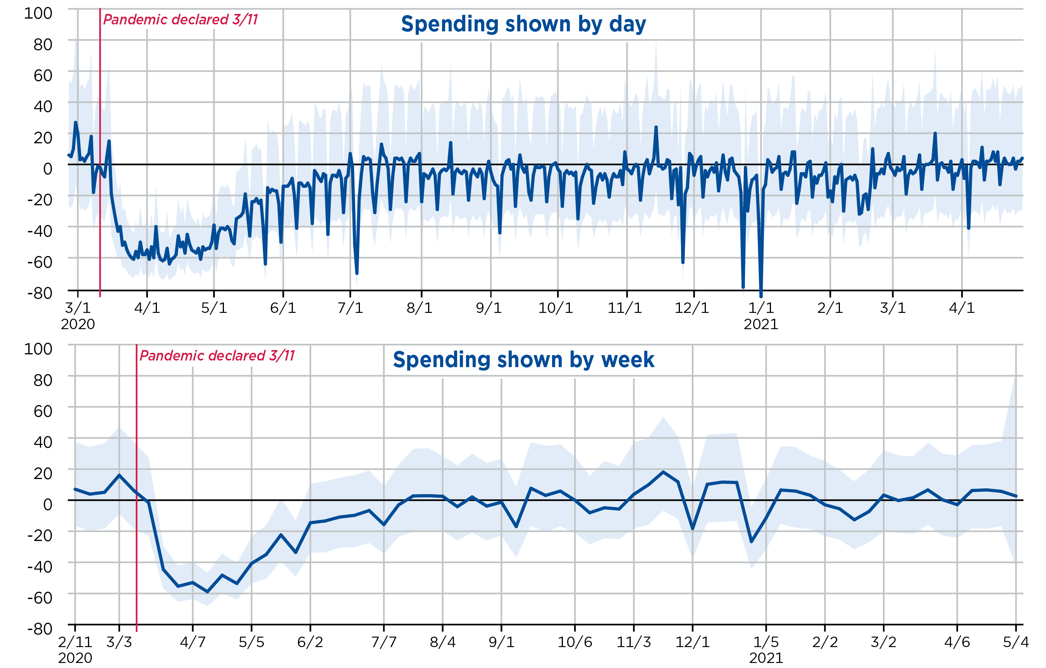
Ambulatory health care (621)

Slide 11
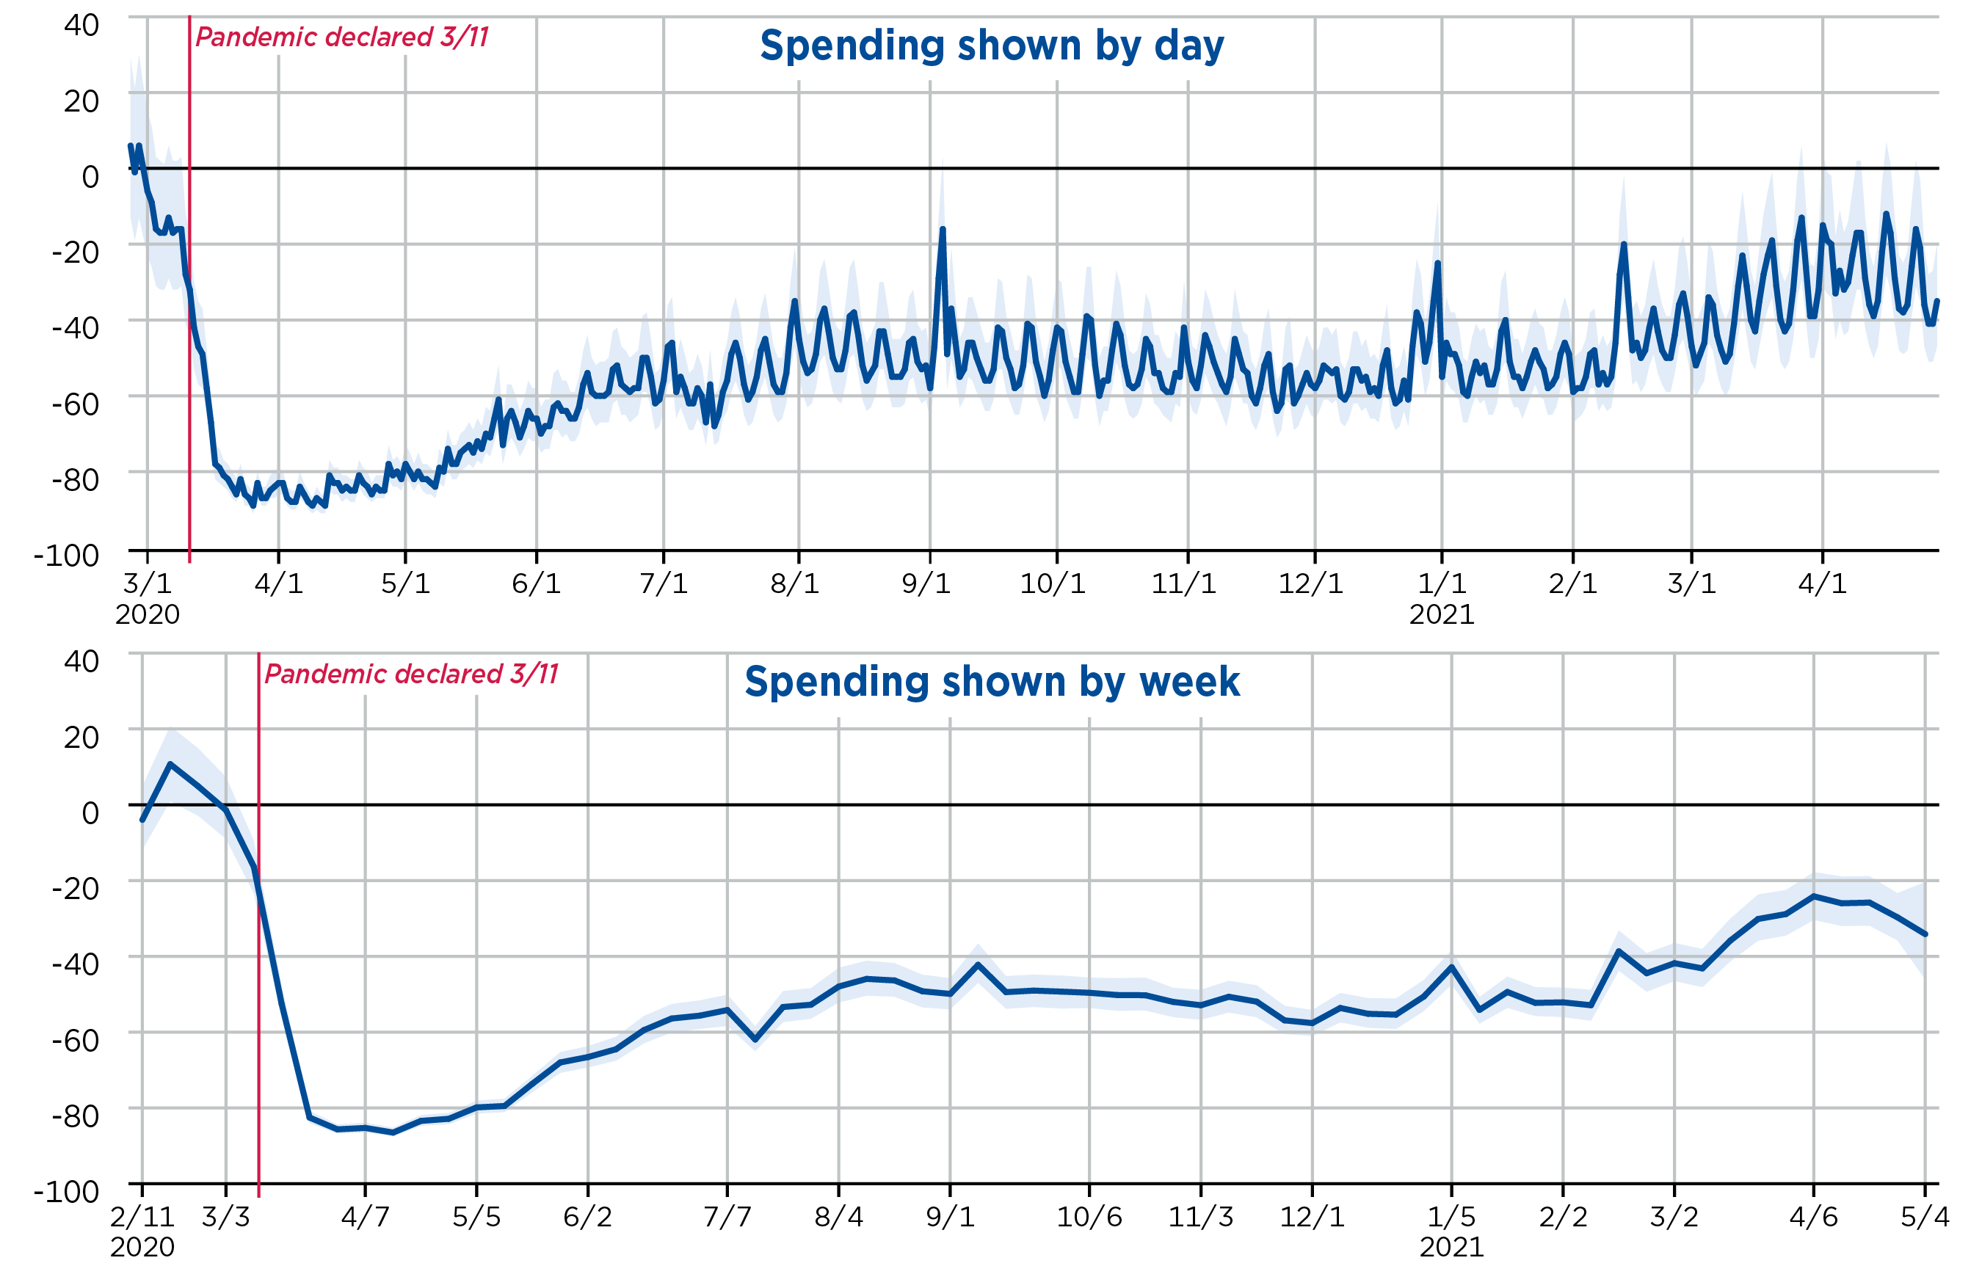
Accommodation (721)

Slide 12
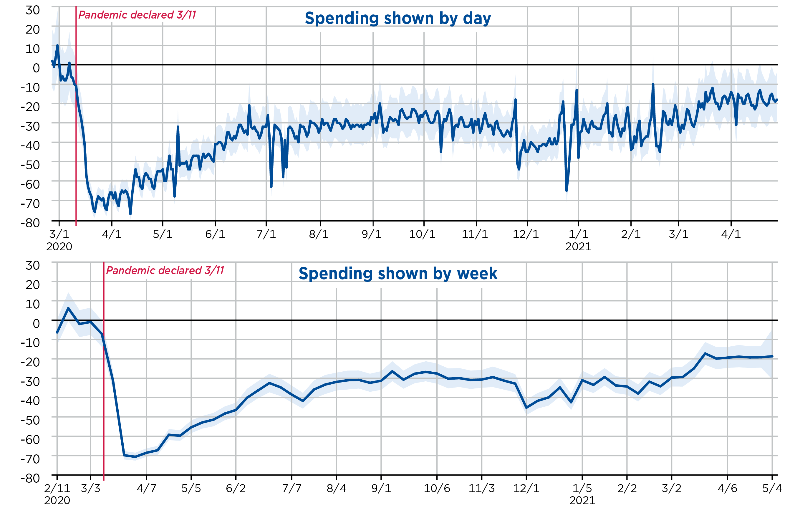
Restaurants (722)

Slide 13
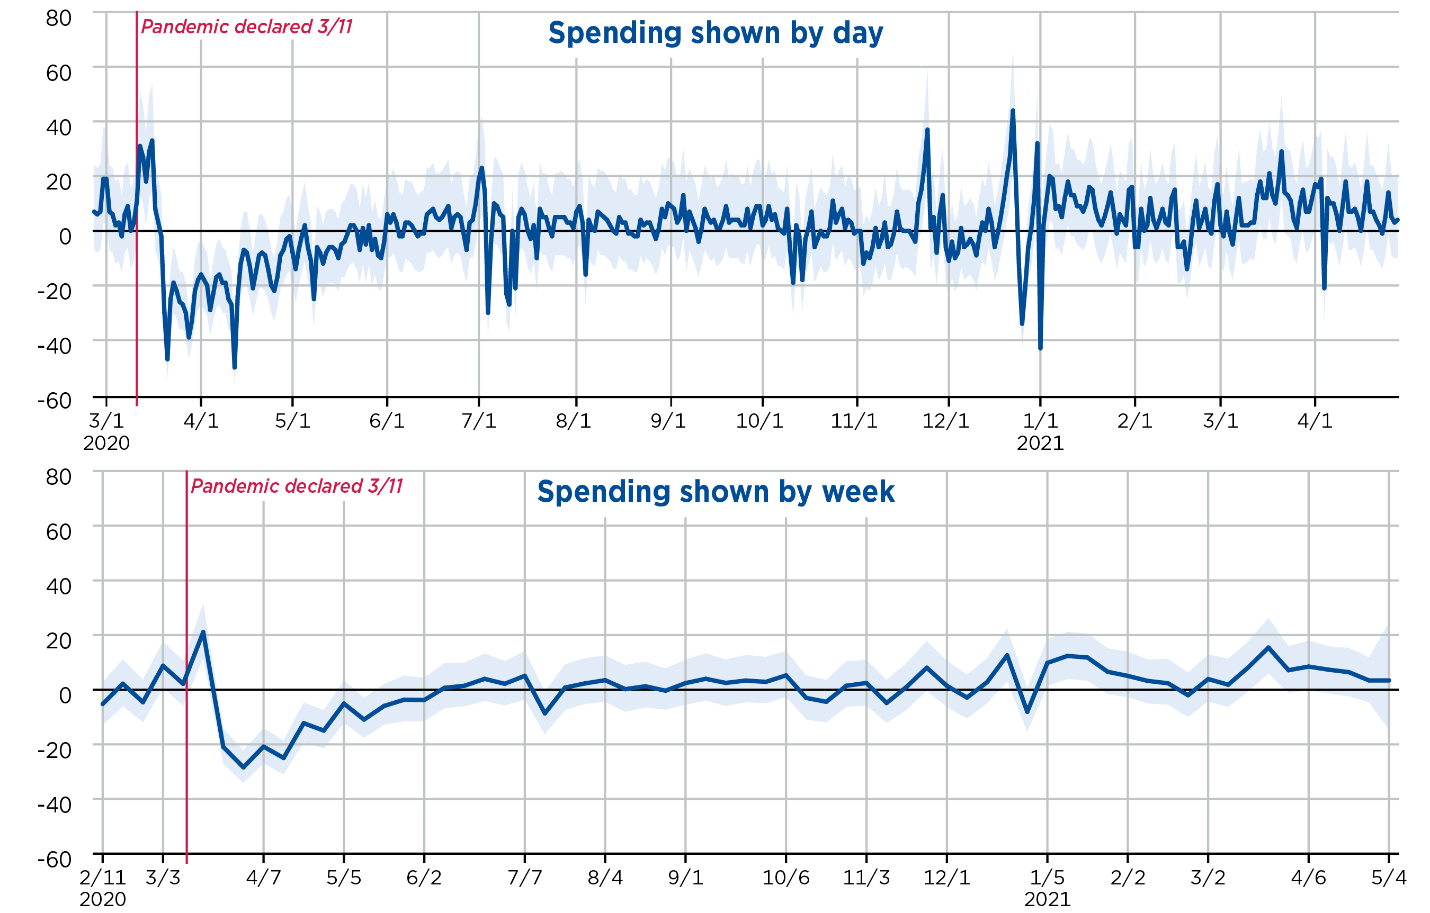
Aggregate retail and food services

Slide 14
Development of Card Transaction Estimates
After the initial pandemic declaration, we were able to release an event study within just over a month (see Dunn et al., 2020)
The data were used to inform estimates for some components of consumption expenditures
In June of 2020, we began releasing updates regularly (first bi-weekly, then weekly)
Familiarity with data sources enabled rapid deployment
  We have been working with these data for a few years
  Other forecasting projects (e.g., Chen et al., 2019) and data use cases
  We were able to anticipate for which categories Fiserv data would perform relatively well

Slide 15
Fiserv and QSS correlations: Services

Slide 16
Fiserv and MRTS correlations: Retail

Slide 17
Discussion
Summary
  Prior to the pandemic period, the Fiserv data exhibited high correlations in levels but low correlations in growth rates with official series
  We assumed that the correlations in levels were informative during the much more volatile pandemic period
  After the pandemic the correlations in growth rates were much higher across the board
Our interpretation of these results
  Statistical relationships break down in the face of structural changes
  Less volatile times: Idiosyncratic factors dominate
  More volatile times: Economic signal dominates

Slide 18
Nowcasting advance estimates of private consumption of services in the US National Accounts
Gross Domestic Produce (GDP) estimated three times each quarter with 1-month (“advance estimate”), 2-month (“2nd estimate”) and 3-month (“3rd estimate”) delays
Differences in source data availability can yield large revisions in components of GDP
Our project focuses on reducing revisions for detailed components of Personal Consumption Expenditures (PCE) on Services
We will employ a combination of traditional time series techniques and model averaging
Results show that model averaging can improve forecasts

Slide 19
More detail on PCE services and motivation
The category PCE Services makes up between 45% and 50% of GDP, and is composed of 122 detailed components
For many of these, the third estimate uses the Quarterly Services Survey (QSS), which is partially available for the 2nd estimate, but never for the first estimate
The alternative indicators used for the first estimate suffer some problems
  The problems are exemplified by a lack of correlation
  For example, for health care services, correlations between the indicator and third estimate are negative for 4 of 15 detailed components, and are above 0.5 in only 2 of 15 cases

Slide 20
Timing of estimates and data for PCE Services
End of reference quarter
First (“advance”) estimate
Second estimate
Third estimate
Months
No QSS data
Limited QSS data
Full QSS data
This is our prediction target
This is where we would like to have an improved estimate

Slide 21
Approach overview
Motivated by the performance of these indicators, we seek to use statistical techniques to improve the advance estimate, focusing on including information on
  Long-term trends
  Medium-term behavior
  Short-term/medium-term cross-sectional behavior
Problem: Short time-series (2009 Q3 – Present)
  Use “nowcasting” approaches
  Consider several model-averaging techniques
  Split sample to estimate and validate each approach
  Look for general trends across indicators

Slide 22
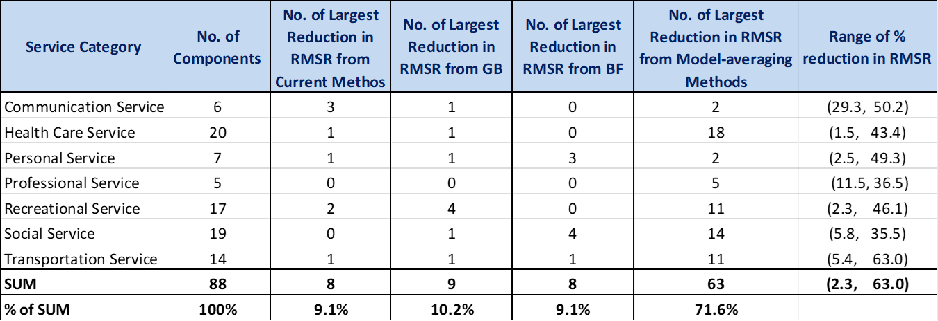
Summary table of results (reduction in RMSR)
No. of Largest Reduction in RMSR from Current Method

Slide 23
Conclusions
The BEA is exploring several avenues to increase timeliness and frequency of our statistics
Alternative data sources offer the potential to help produce high-frequency, timely estimates
  There were benefits to working with these data sources before the pandemic
  Card data performed better than what was suggested by pre-pandemic estimates
Nowcasting techniques can be used to improve timeliness, reducing potential revisions in early estimates
  Model averaging approaches show potential
  Revision reductions vary in detailed components up to more than 50%
Next steps
  Explore new alternative data sources
  Combine nowcasting techniques and other prediction techniques with alternate data

