Slide 1
DISTRIBUTIONAL NATIONAL ACCOUNTS IN COSTA RICA
Jose Pablo Valdes Martinez
Senior Economist
World Bank

Slide 2
Outline of the presentation
Introduction
Project development objectives
Outline of the methodology and data sources used
Proposed work plan
Main results
Difficulties found, lessons learned and next steps

Slide 3
1. Introduction
Growing inequality
Economic crisis
Economic policies increase inequality
Distributional measures are needed to assess the degree of inequality

Slide 4
1. Introduction
World Bank Poverty Commission
Recommendation 4
The World Bank should take the lead in a Joint Statistical Working Group for Household Consumption Statistics, mandated to establish guidelines for the measurement of household consumption, examine the relationship between consumption and income, and investigate the relationship between the household survey, national accounts and other data sources
Recommendation 7
The World Bank, together with national statistical institutes and other statistical agencies, should explore the construction of an annual indicator of the standard of living of households based on national accounts measured by consumption, defined in a way that matches the measure as possible with household surveys

Slide 5
2. Project development objectives
Develop distributive measures of national accounts
Estimates of household income and consumption distribution consistent with national accounts
Understand the differences between NA and survey
Provide a better understanding of national accounts and household surveys to help reconcile macro and micro sources
Improve quality
National accounts and household surveys will be improved as a result of estimating distributional measures

Slide 6
3. Outline of the methodology and data sources used
Initial assessment of NA and HH and adjustments to NA totals
Micro-macro linkage
Imputation and aligment
Cluster households
Elaborate inequality indicators
EG-DNA methodology was followed

Slide 7
3. Outline of the methodology and data sources used
Data sources
Source | Type of survey | Objective | Population under study | Domains | Frequency | Main topics covered
National Survey of Household Income and Expenditure (Enigh) | Survey to households and individuals | Produce statistical information on spending patterns and the structure of household income in Costa Rica, to update consumption and financial situation indicators. | Individual dwellings, the households that inhabit these dwellings and the habitual residents of the households. | 1. National level. | Five-year (2018) | Household final consumption expenditure, non-consumption expenditure, capital expenditure and household income and savings structures
 |  |  |  | 2. Zone: urban and rural.
 |  |  |  | 3. Planning region: Central, Chorotega, Central Pacific, Brunca, Huetar Caribe and Huetar Norte.
National Survey of Households' Microenterprises (Enameh) | Household survey (informal sector) | Provide society with statistical information related to the economic activity of businesses created in households, in order to generate and update statistics necessary for the formulation, monitoring and evaluation of public policies and private actions for the informal sector. | Micro-enterprises of households or productive activities of goods or services directed to the market, either in whole or in part. | 1. National level. | Annual | Characteristics of the activity, sales and services, institutional support, information and communication technologies, expenses of the activity, income of the activity, assets and inventories of the activity, financing, expectations and balance of income and expenses.
 |  |  |  | 2. Zone: urban and rural.
 |  |  |  | 3. Planning region: Central, Chorotega, Central Pacific, Brunca, Huetar Caribe and Huetar Norte.

Slide 8
4. Proposed work plan

Slide 9
5. Main results
Preliminary results up to household saving
Household groups:
  Income quintiles
  Gender
  Economic activity
Usual inequality indicators
Impact analysis

Slide 10
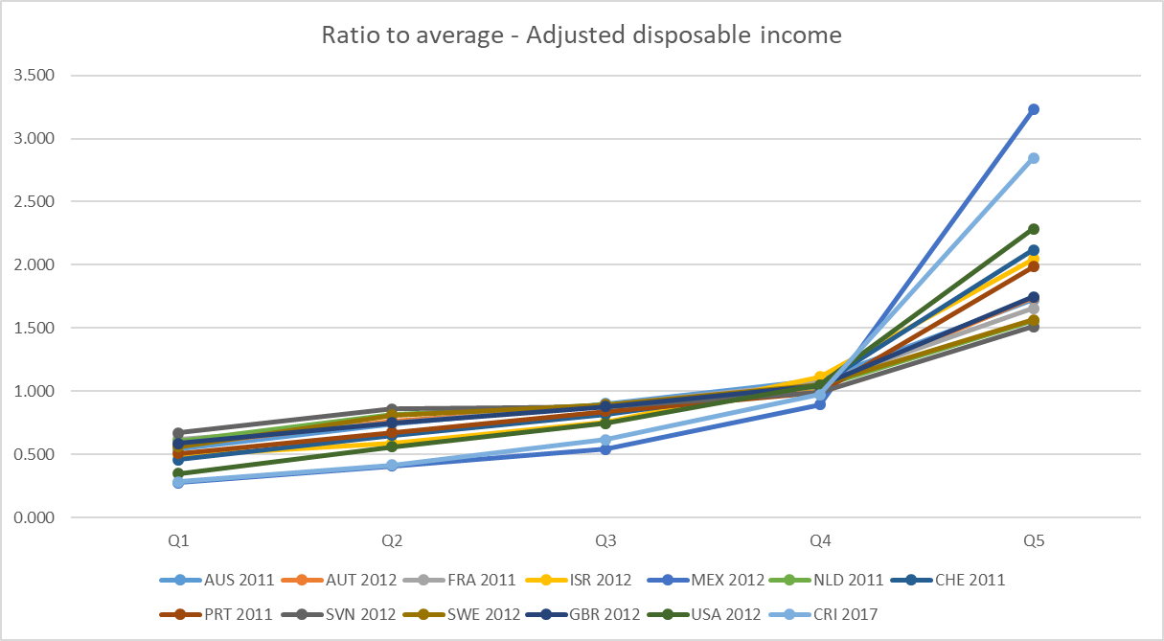
5. Main results

Slide 11
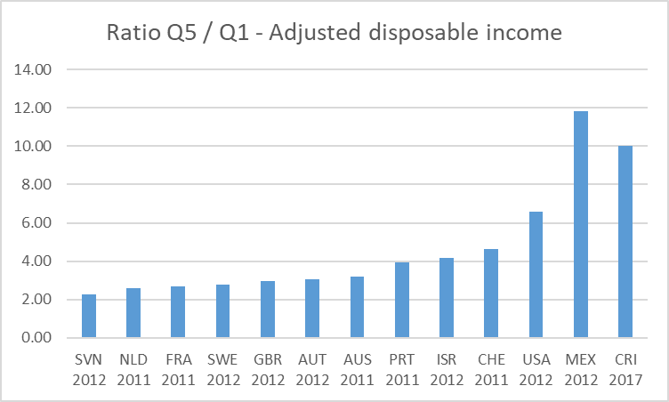
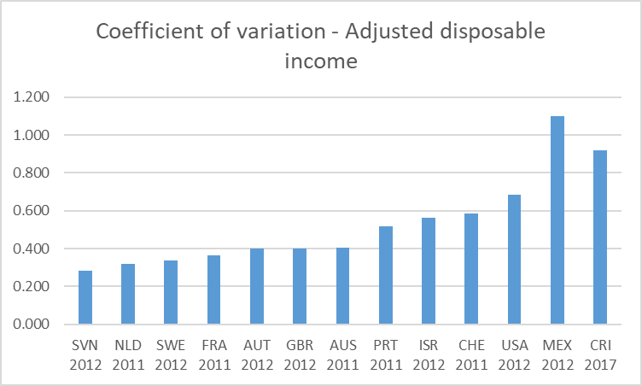
5. Main results

Slide 12
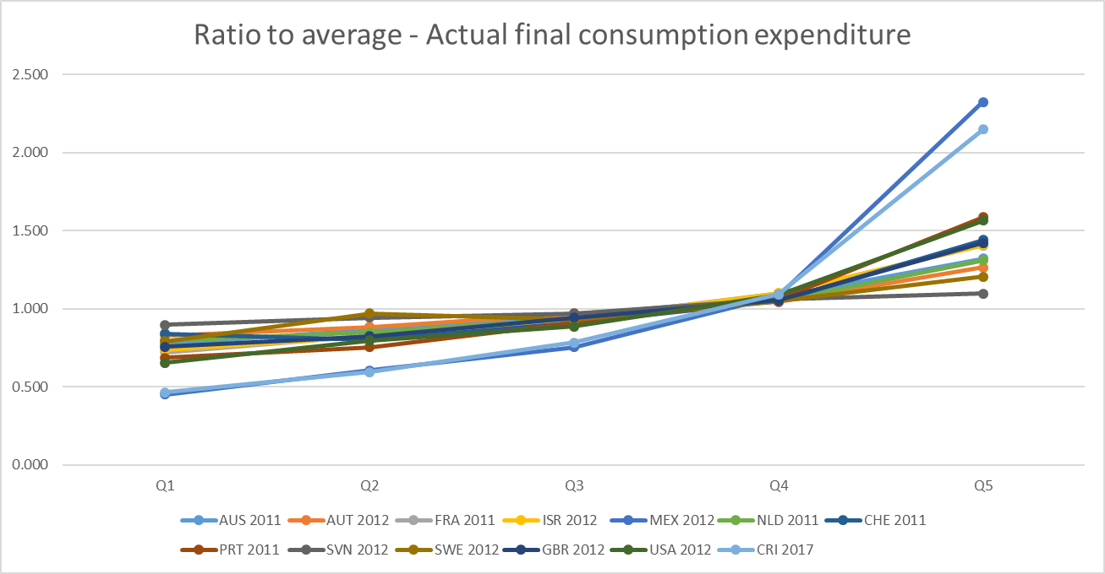
5. Main results

Slide 13
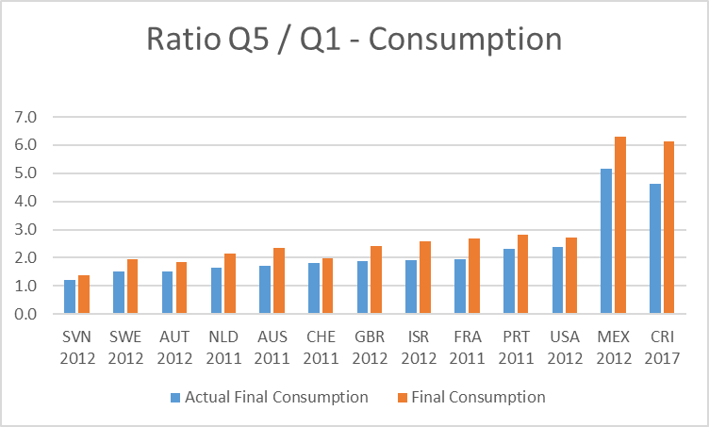
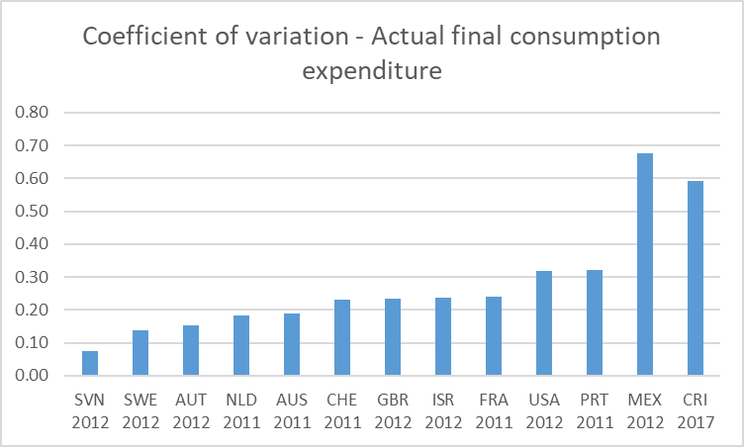
5. Main results

Slide 14
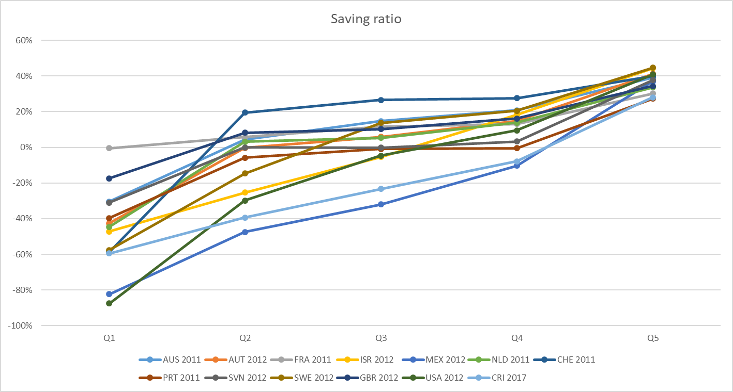
5. Main results

Slide 15
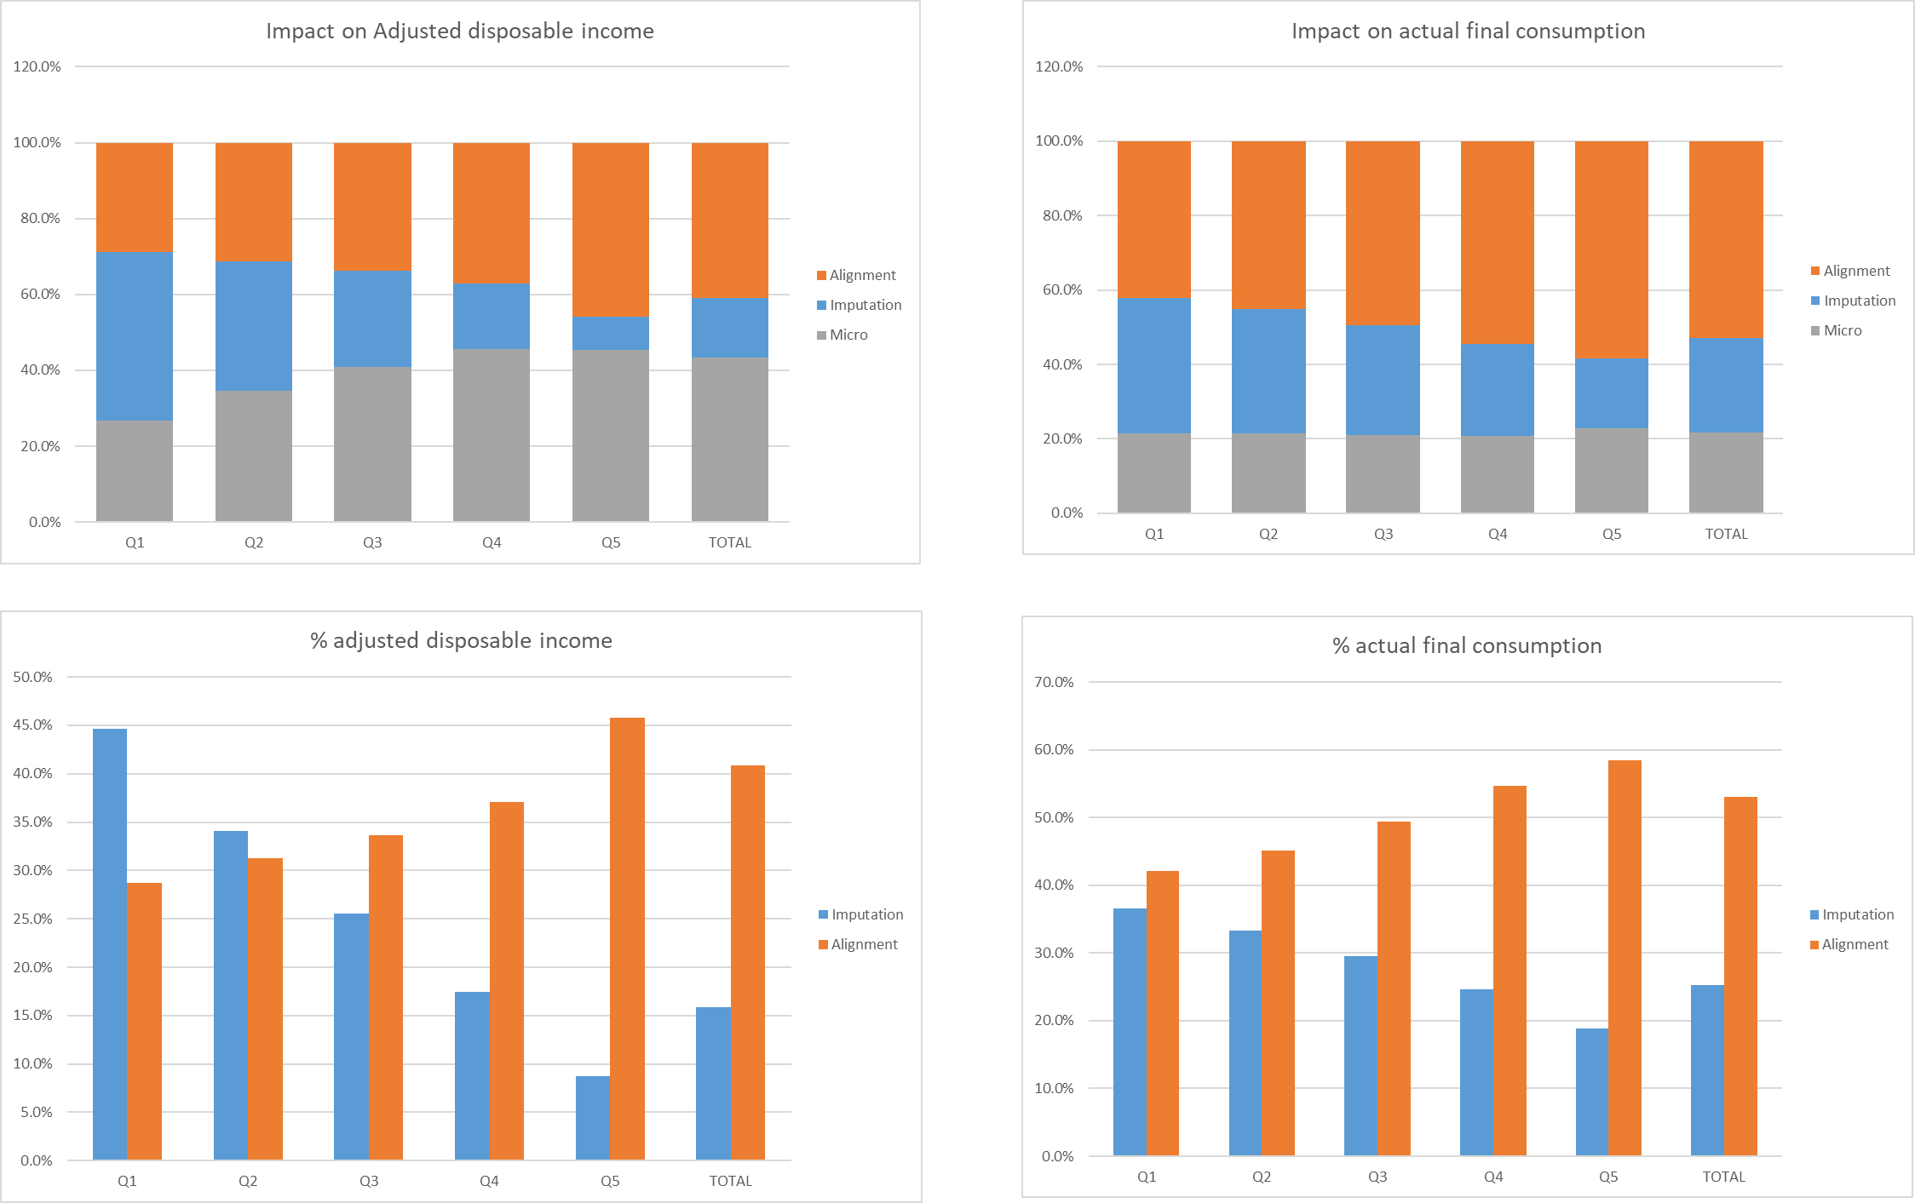
5. Main results

Slide 16
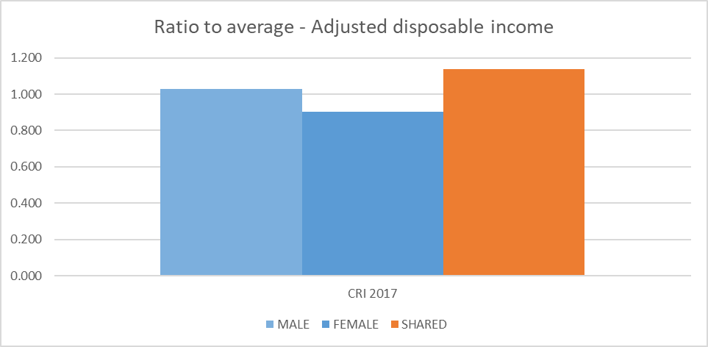
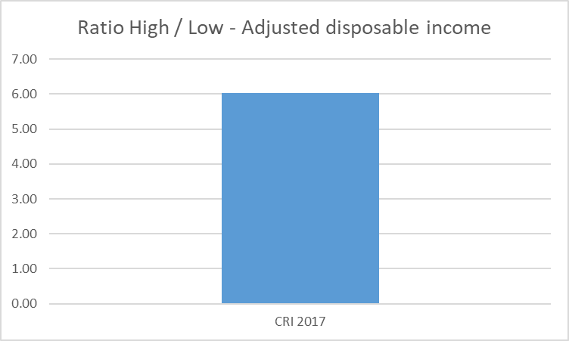
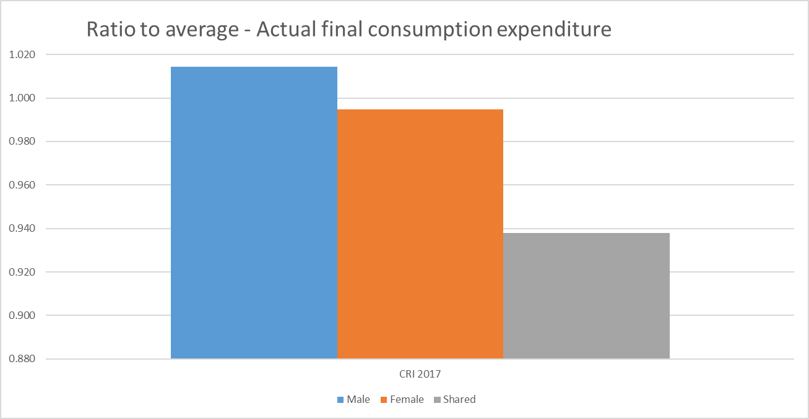
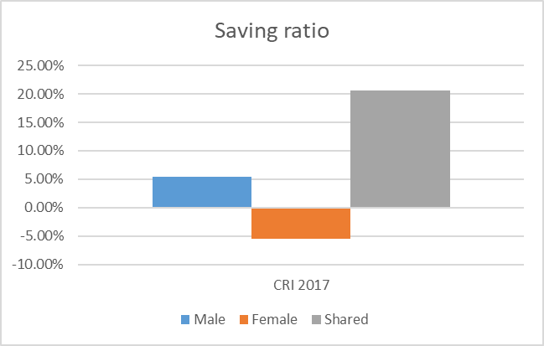
5. Main results

Slide 17
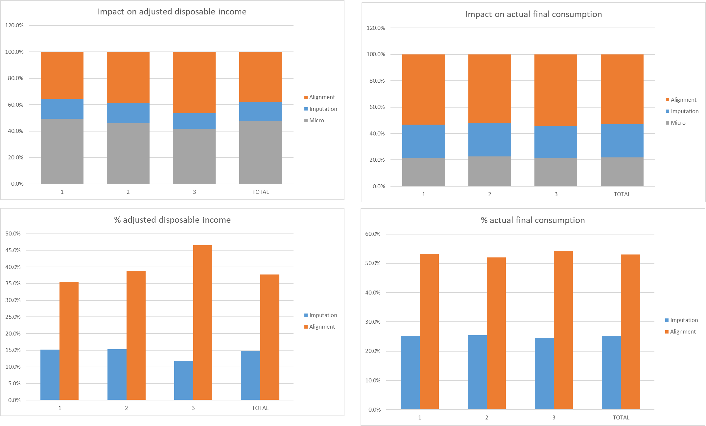
5. Main results

Slide 18
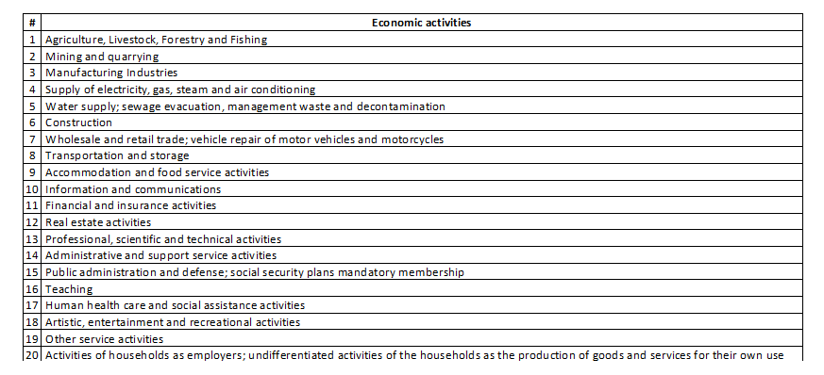
5. Main results

Slide 19
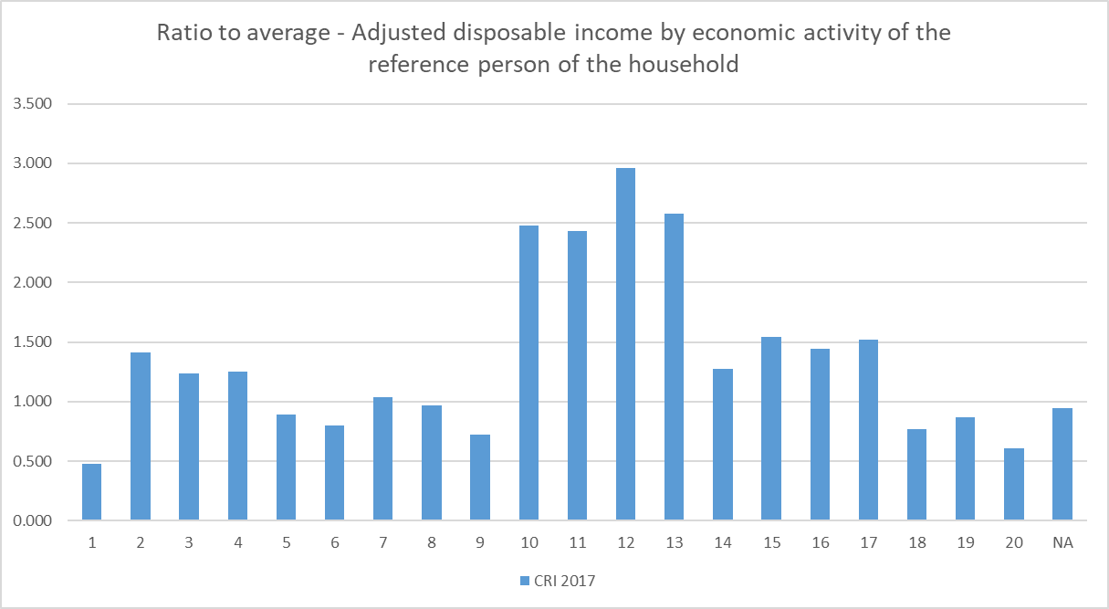
5. Main results

Slide 20
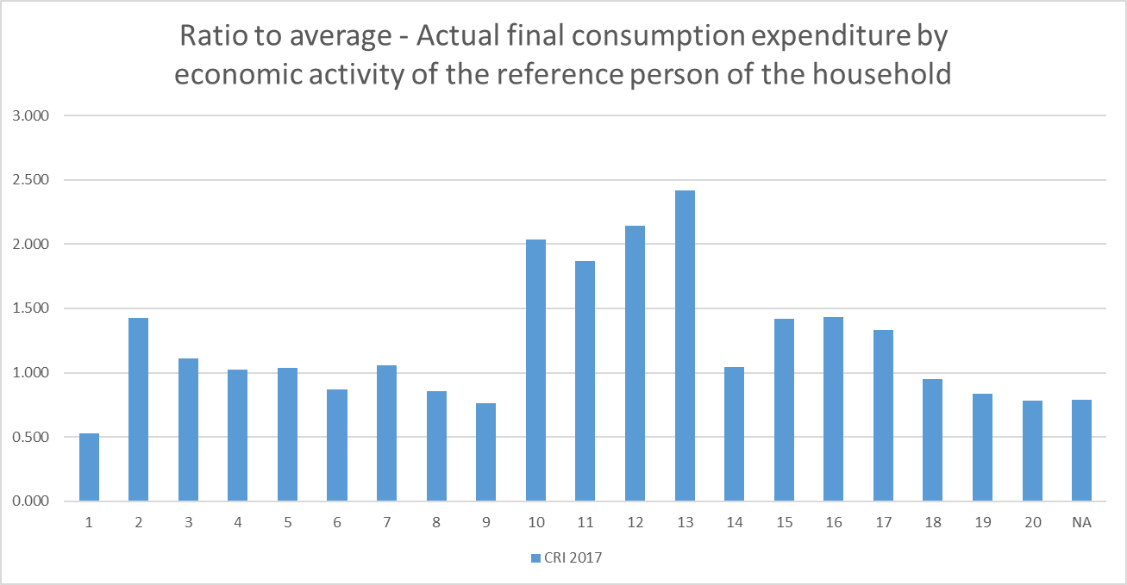
5. Main results

Slide 21
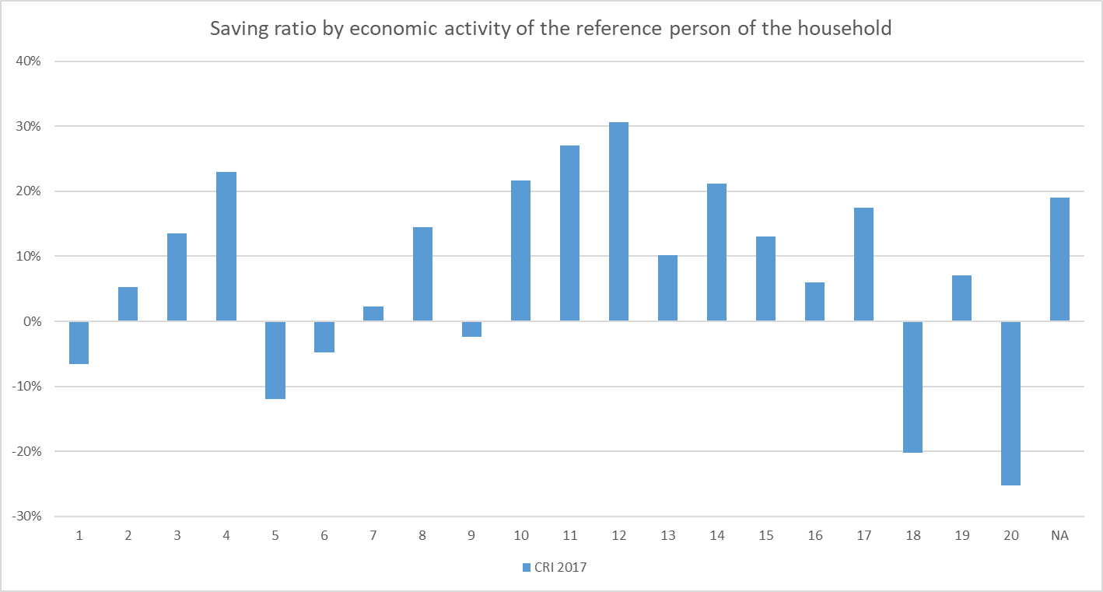
5. Main results

Slide 22
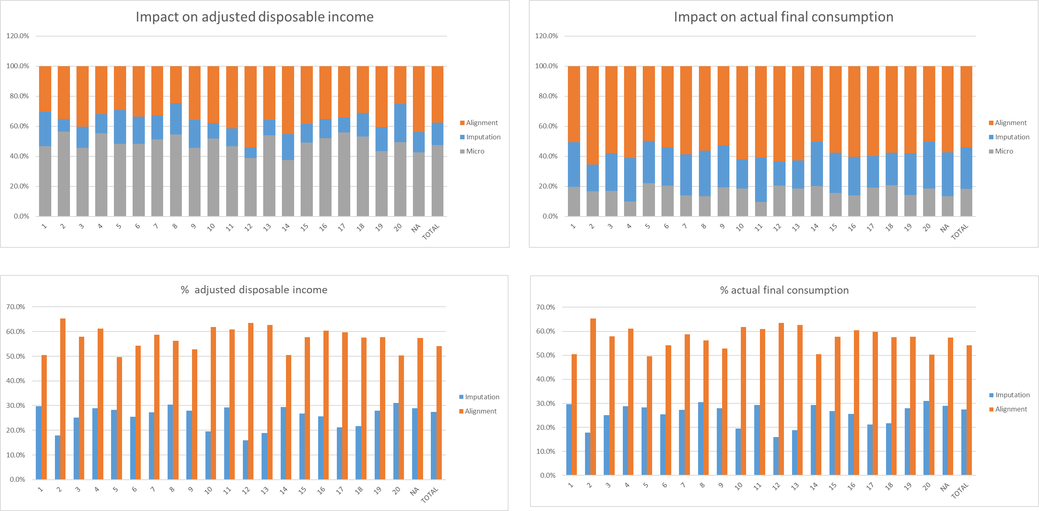
5. Main results

Slide 23
6. Difficulties found, lessons learned and next steps
Sectoral accounts and ENIGH refer to different year
  Reference year for the accounts was 2017 (latest available year) while ENIGH reference period was 2018
  We believed it was better to use data from 2018 rather than 2013
  Easy to update results once the accounts for 2018 are available
Tried to avoid using the structure of the aggregates when data on components is missing
  Favored the use of a combination of survey variables
  Better results in terms of micro-macro gaps
Adjustments needed on both micro and macro sides
  Outlier households were sistematically eliminated from the study (significant impact on final resutls)
  Additional adjustments needed at a distributional accounts level (income taxes, imputed rent)
Standardized working files will facilitate the compilation of distributional results in the future
  Collaboration from NSI and Central Bank’s side was critical
  Better results in terms of micro-macro gaps
Regional seminar conducted on December 1-3 as closing event
  Participants from CRI, GTM, SLV, HND, NIC, PAN, DOM, alongside OECD, IMF, ECLAC and WB
  Possibility to replicate this exercise at a regional level
SNA update
  Experience valid in terms of testing strategy for distributions

Slide 24
Thank you for your attention!

