Slide 2
SEEA and the National accounts: a perfect combination for policy use
Roel Delahaye, Niels Schoenaker and Vivian Tunn Statistics Netherlands
Environmental Accounts 21-05-2020

Slide 3
Outline
SEEA and its benefits
Recent Dutch policy applications:
Circular economy
Footprints
Carbon accounts

Slide 4
SEEA and its benefits
SEEA (System of Economic and Environmental accounts) is a satellite
account of National accounts.
Subsidies
Taxes
Environmental sector
SEEA modules extent the NA in different ways:
Specific monetary environmental data
Physical dimension to monetary data
Physical non-monetary data
Energy
Material flows (MFA)
Water
Assets
Waste
Emissions to environment Natural Capital
Benefits of SEEA/NA combination: Total is more than the sum of its
parts. Allows for policy relevant economic-environmental analysis.

Slide 5
Policy application 1: Circular economy

Slide 6
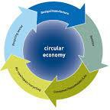
Policy questions regarding circular economy
Dutch Circular economy program:
Target: 50% reduction of abiotic resources in
2030.
EU action plan for the Circular Economy
& EU Green Deal
Focuses not only on energy but also on materials
Sustainable Development Goals (SDGs):
08 Decent Work and Economic Growth (resource efficiency; decoupling)
12 Responsible Consumption and Production
(use of resources; waste recycling)

Slide 7
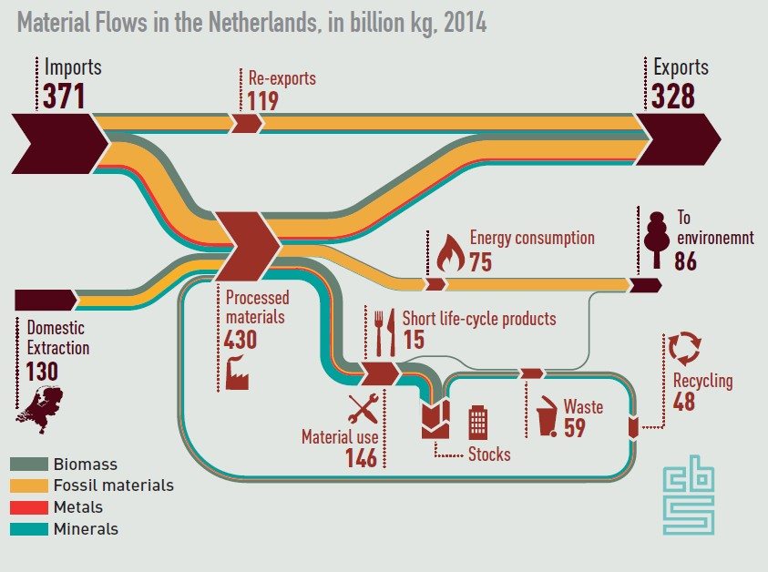
Material flows - Sankey
Material Flow Accounts
Waste accounts
Energy accounts
Air emission accounts
National accounts

Slide 8
CE monitoring framework EC
Eurostat monitors CE by a list of indicators including Sankey.
Recently Commission considers a new dimension:
Global sustainability and resilience.
To address the contribution of circularity to climate neutrality and zero pollution, to increase EU green and geopolitical resilience and accountability for the spill-overs of EU consumption (i.e. production outside the EU induced by final demand in the EU).
Carbon account and footprints address this new dimension.

Slide 9
Policy application 2: Footprints
Dutch politicians realize importance of environmental impact in the chain:
Circular economy program, Climate and energy outlook, Well being
Demand for footprints on: resources, GHG emissions, water, land and biodiversity
National account’s Input-output table in combination with SEEA modules on MFA,
GHG emissions and water.
SNAC methodology used to integrate Dutch IO table in MRIO
Challenge:
Need for harmonized methodology and consistent, up to date and detailed MRIO database.
To what extent does CE contribute to reduction in environmental impact?
9

Slide 10
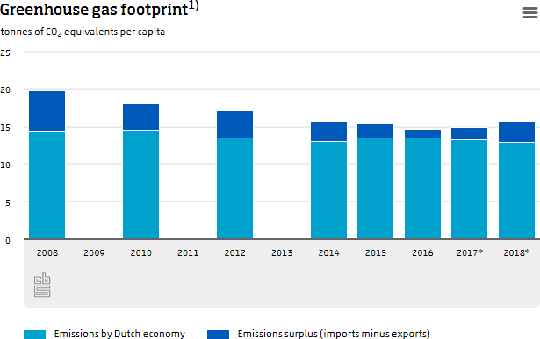
Footprint result
10

Slide 11
Policy application 3: Carbon accounts
Carbon accounts address policy for a low carbon economy.
Concept of carbon accounts are part of the eco-system accounts (SEEA EA) and combine SEEA modules:
Carbon flows and stocks within the economy (MFA, Circular economy)
Carbon emissions from economy (emissions)
Carbon sequestration and emissions from nature (Natural capital)
Monetary valuation of eco-system services is direct link to National accounts
11

Slide 12
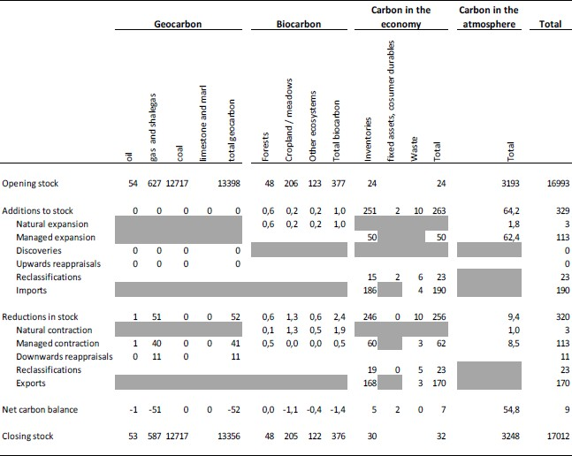
Carbon accounts results in Mtonne C
12

Slide 13
Conclusion
Combining information from multiple SEEA modules and the National accounts provides unique opportunities to support policymakers across different policy areas.
Good communication between SEEA-people and NA-people is paramount for alignment and, therefore, to assure future environmental-economic policy applications.
13

