Slide 1
A broader SNA Framework on WellBeing and Sustainability
State of Play
Jorrit Zwijnenburg, OECD
Catherine Van Rompaey, World Bank
Group of Experts in National Accounts

Slide 2
Outline
Background
Wellbeing and sustainability in the SNA
Progress of the task team
Status of SNA guidance
Highlights of guidance in each domain
Development of a broader framework

Slide 3
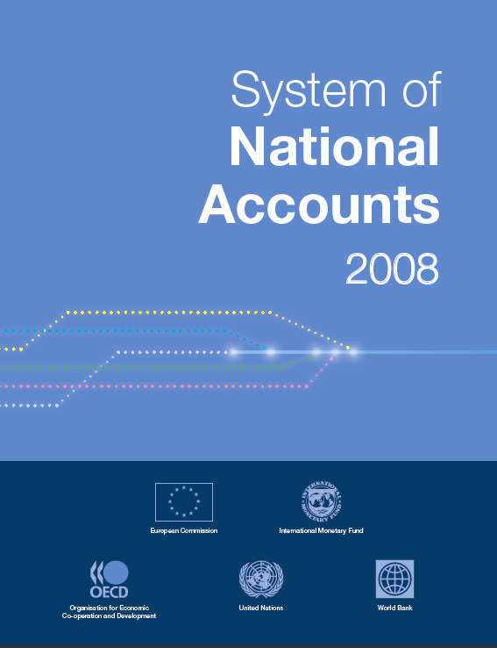
Well-being and sustainability in the SNA
As the overarching macroeconomic measurement framework, the boundaries of the System of National Accounts define what we know as the economy
This has real world impacts on decision making, shaping narrative on what's counted as progress
While not designed for this purpose, its headline indicator, the Gross Domestic Product, is often misused to represent societal progress
Proliferation of alternatives over decades modify/expand these measures to address wellbeing, sustainability and the negative externalities of economic activity
Recent discussions reflect widely-held view: wellbeing and sustainability are complex multidimensional phenomena
Measurement warrants a broader framework to analyze interrelations, tradeoffs and win-wins
Facing a new economic reality with globalization and digitalization
Production aggregates less indicative of the wellbeing of households
Increasing polarization of income, consumption and wealth, need for distributions consistent with national accounts

Slide 4
Existing material
Stiglitz-Sen-Fitoussi Recommendations
When evaluating wellbeing, look at income and consumption rather than production
Emphasize the household perspective
Consider income and consumption jointly with wealth
Give more prominence to the distribution of income, consumption and wealth
Broaden income measures to non-market activities
SNA Guidance on Satellite Accounts
Optional mechanisms to elaborate issues of social interest
Linked to, but distinct from, central framework
Expansion to relevant non-monetary units
Social Accounting Matrices (SAMs)
CES In-Depth Review of Satellite Accounts
Proliferation of specialized economic accounts prompted reexamination
Distinguish thematic accounts (eg Tourism) from those addressing wellbeing and sustainability
Recommendation to ISWGNA to prepare guidance on expanded SNA framework
Develop an online inventory of satellite accounts compiled by countries
https://statswiki.unece.org/display/SAOI/Satellite+Accounts+-+Online+Inventory+Home

Slide 5
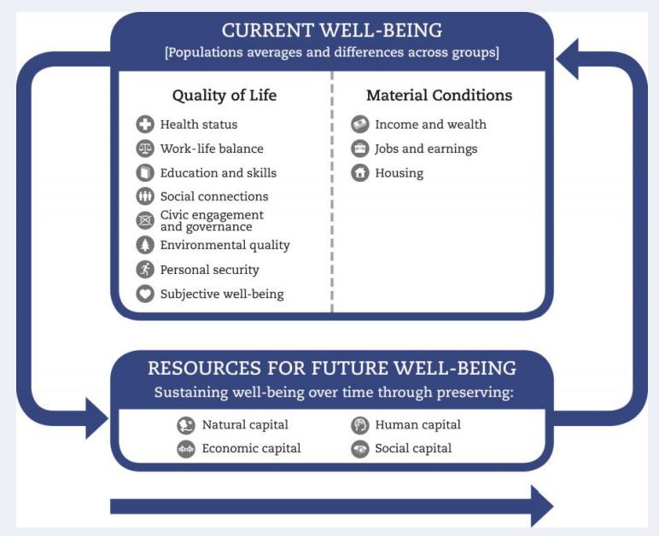
Wellbeing dashboards and indicator frameworks
Outside the macroeconomic statistics sphere, Stiglitz-Sen-Fitoussi gave impetus to the development of multidimensional wellbeing dashboards and indicator frameworks.
OECD How’s life? Indicator Framework

Slide 6
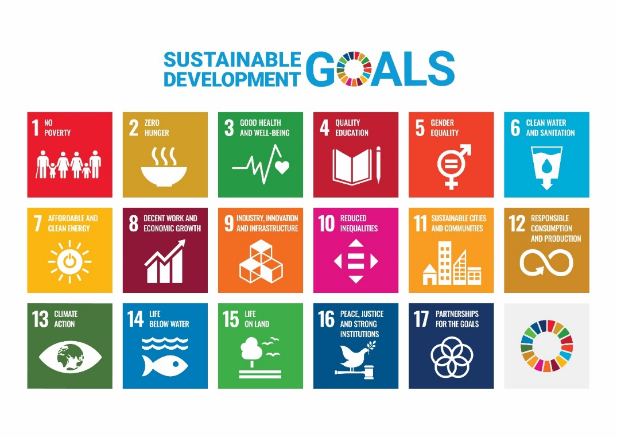
Sustainable Development Goals
17 interconnected goals, adopted by UN member states, along with their associated indicators coalesce local policy target setting in many areas of the world and warrant consideration in a broader SNA framework

Slide 7
Comprehensive or Inclusive Wealth
Gaining momentum as complement to economic indicators on current wellbeing, offering new insights on its sustainability over time
Augment traditional national wealth concepts of produced and financial capital to include natural and human capital
No attempt so far to monetize social capital (trust, cooperation, civic engagement)
Recent examples demonstrate feasibility of implementing concepts for a wide range of countries with differing levels of development
World Bank’s Changing Wealth of Nations 2018
United Nations Environmental Program (UNEP) 2018 Inclusive Wealth Report

Slide 8
Proposed guidance: A pragmatic way forward
Elaborate overarching framework with linkages to microdata would be desirable, but perhaps not achievable for next SNA update
More realistic goal is regular compilation of extended modules, drawing on body of guidance already available
Flexibility in frequency of compilation, integration of non-monetary measures as appropriate
Five areas of consideration
Distribution of household income, consumption saving and wealth
Unpaid household service work
Labour, education and human capital
Health and social conditions
Environmental-economic accounting

Slide 9
Wellbeing and sustainability task team
Co-chairs: Catherine Van Rompaey (World Bank) and Gabriela Saborio (Central bank of Costa Rica) Secretariat: Jorrit Zwijnenburg, Virginie Elgrably (OECD)
Six area groups:
A Broader SNA framework for Wellbeing and Sustainability
Catherine Van Rompaey, World Bank
Distributions of household income, consumption saving and wealth
Amanda Seneviratne, Australian Bureau of Statistics
Unpaid household service work
Chris Payne, UK Office for National Statistics
Labour, education and human capital
Michael Smedes, Australian Bureau of Statistics
Health and social conditions
Dylan Rassier, US Bureau of Economic Analysis
Environmental-economic accounting – multiple guidance notes on specific issues
Joe St-Lawrence, Statistics Canada

Slide 10
Status of SNA guidance
Targeted for public consultation
Distributions of household Income, consumption, saving and wealth
Households’ unpaid service work
Labour accounts, education and human capital
Health and social conditions
Environmental-economic accounting
Ownership and depletion of natural resources
Emissions in the national accounts

Slide 11
Status of SNA guidance
Remaining work
Environmental-economic accounting
In progress:
Accounting for biological resources
Provisions
Valuation methods
Renewable energy resources
Under consideration:
SEEA classifications
Recording of losses
Distinction between tax and service transaction
Broader framework

Slide 12
Highlights of proposed guidance
Distributions for the household sector
Increased granularity within the central framework; slightly adapted alternative concepts and classifications to facilitate micro-macro linkages.
Households’ unpaid service work
Extended alternative concepts as a complement to traditional measures; new granularity in time units and demographics.
Health and social conditions
Increased prominence of the health care sector, rethink of existing classifications and increased detail; minor conceptual adjustments; refinement of real measures.
Labour, education and human capital:
New labour accounts in physical units, new detail on education and training, extended alternative human capital assets.

Slide 13
Highlights of proposed guidance
Environmental-economic accounting:
Ownership and depletion of natural resources
Increased emphasis on new depletion-adjusted net measures, sectored according to SNA economic ownership principles.
Biological resources
Rethink of SNA production and asset concepts, for example for cultivated assets, to better align with the SEEA.
Treatment of emissions permits
Consideration of the atmosphere as an asset, with implications for both the SNA and the SEEA.

Slide 14
Development of a broader framework
Proposals may have various implications:
More granular product breakdowns, e.g. specific health care, education and environmental services
More granular industry breakdowns, e.g. health care providers
More granular asset breakdowns, e.g. health care related assets
More granular sector breakdowns, e.g. distributional information
Supplementary non-monetary information, e.g. hours worked, Co2 emissions
Further breakdowns into socio-demographic groups, e.g. age group, gender, education status, employment status
Extension of production boundary, e.g. unpaid household activities, ecosystem services
Extension of asset boundary, e.g. consumer durables, natural resources
Creation of new tables, e.g. full fledged labour accounts, tables on education and training, table on human capital, table on full time-use accounting

Slide 15
Development of a broader framework
Important links between areas that need to be considered
Health care and education may be provided in the form of unpaid household activities
Labour accounts and distributional information would benefit from extension to include unpaid household activities
Environmental-economic issues may affect health (care)
Changes in health (care) may affect human capital
All groups aim to have breakdowns by socio-demographic groups
...
These links need to be considered in developing the broader framework: how to best combine all this information?

Slide 16
Main challenges
How to align the various proposals?
Alignment is needed where area groups propose similar types of breakdowns, e.g. socio-demographic groups
How to combine the various proposals in core tables?
Combining all additional breakdowns would lead to very useful information, but is not considered feasible
Choices will need to be made what breakdowns to include in the core tables and what in supplementary tables
How to present information?
Creating new indicators on well-being and sustainability combining different types of information

Slide 17
Next steps
Specifying and integrating outputs from individual domains
Assessment of new classification breakdowns
More detailed information on proposed outputs and specific SNA impacts in discussion with task team leads
Assessment of links between 5 subdomains
Discussion note drafted to identify links
Working on visual diagram to summarize overall impacts
First draft is being discussed with task team leads
Drafting proposal on how to combine this information in core and supplementary tables and define new indicators
At the same time, working on terms/language in relation to impacts
Core accounts/central framework
Extended/alternative concepts
Supplementary tables

Slide 18
Thank you!
cvanrompaey@worldbank.org
jorrit.ZWIJNENBURG@OECD.org

