Slide 1
Task team on Digitalisation: overview of work on other topics
Nicola Massarelli, Eurostat, National Accounts methodology
on behalf of the Task Team
Group of Experts on National Accounts, 18 May 2021

Slide 2
Digitalization Task Team: research topics
Increasing the visibility of digitalization in NA (Digital SUTs)
Recording of data in the national accounts
Artificial Intelligence
‘New’ topics
‘Old’ topics
Cloud computing
Valuation of free assets and free services
Price and volume measurement of goods and services affected by digitalization
Digital intermediary platforms
Crypto assets
Notes:
[Possible Narrative]
This slide provides an overview of topics the Digitalization TT has been mandated to address.
The five topics on the left of the slide are ‘native’ for the TT, in the sense that they have been attributed to the TT since its setup.
The three topics on the right are new.
Of course, work on the ‘old’ topics is more advanced.

Slide 3
Many different types of crypto assets
Crypto currencies (intended as general medium of exchange)
Traditional cryptocurrencies (not backed by an asset)
Stablecoins (backed by asset or seignorage-based)
Crypto tokens
Asset tokens (represent debt or equity claim on the issuer)
Payment tokens (used as medium of exchange within a platform)
Utility tokens (provide holders future access to goods or services)
Hybrid tokens (combining aspects of other tokens)
A lot of different terminology, classifications and definitions are used
New crypto assets may easily emerge

Slide 4
Guidance on recording of crypto assets – state of play
Broad agreement for most types, except for cryptocurrencies without corresponding liability
How to account for their creation? (result of “mining” activities vs “appearance” like fiat currency)
Recording: financial assets vs valuables
What is the output of miners? (Cryptocurrencies vs validation services)
How should their output be valued?
Who is consuming the relevant output?

Slide 5
Artificial intelligence (AI)
Expected to have a relevant impact on the economy
There is no common definition, but one common element is emerging:
“Al reflects a machine’s ability to respond in a fashion consistent with human reactions”
Questions for macroeconomics accountants:
Do AI activity and its output fit within the current production and asset boundaries?
What is the nature of the product and how is it valued and recorded?
Do current classifications and set of accounts properly present the AI activities to users?

Slide 6
AI and National Accounts – initial reflections
AI is produced
AI falls within the production and asset boundaries
AI is not “visible” in the accounts (e.g. it is currently not distinguished from software, hardware)
It could be argued that AI is factor of production unique from either capital or labor (or that it combines elements of both)
There is a strong link between Data and AI

Slide 7
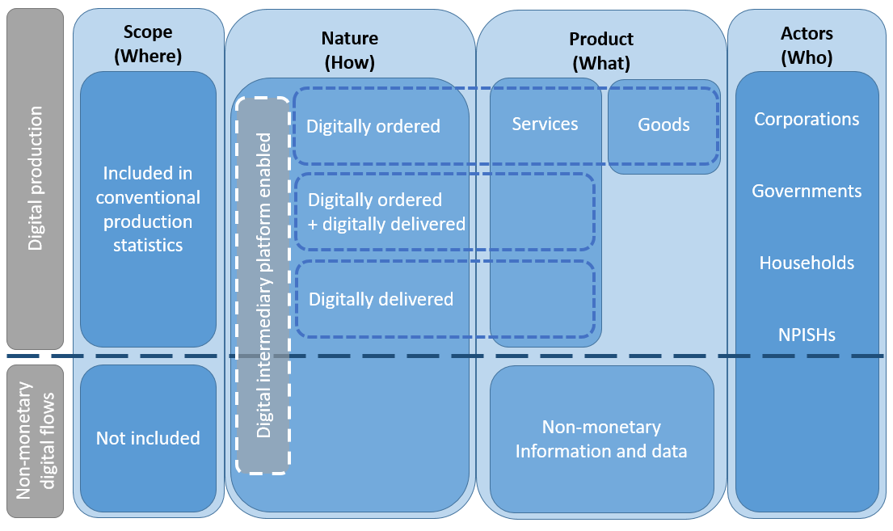
Conceptual Framework for Measurement of the Digital Economy
Source: OECD, adapted from OECD-WTO-IMF (2019).

Slide 8
Overall ambition and current situation
Digital SUTs will help to provide momentum for all countries in fostering the compilation of internationally comparable data on the digital economy
The Digital SUTs are partly designed to act as road maps that help to motivate the development of new data sources
Fully populating the framework is very challenging. Even partially completed tables will significantly help to fill the current information gaps
Several countries have started working on the framework, targeting some priority indicators
Output, Gross Value Added (GVA) and its components, of digital industries
Intermediate consumption of Digital Intermediary Services, Cloud Computing Services and total ICT goods and digital services
Expenditures split by nature of the transaction, including estimates of digital trade

Slide 9
Price and volume measurement of goods and services affected by digitalization: challenges
Traditional data sources need to be updated more frequently to capture rapid changes associated with digitalisation. Otherwise,
Nominal spending may not reflect the value of these goods in a timely fashion, and
Price and volume measures may not adequately represent:
New versions of existing goods (quality improvements in cars),
New types of outlets (UBER, Airbnb),
Entirely new goods (cloud services)

Slide 10
Guidance note on price and volume measurement of goods and services affected by digitalization
Draft GN structured in 5 chapters:
Chapter 1: Introduces Challenges for National Accountants
Chapter 2: Measuring the value of output in current prices
Chapter 3: Prices and volumes for existing goods and services (Computing machinery, telephones for cellular networks, Packaged software, Telecommunications)
Chapter 4: Prices and volumes for new goods and services (digital intermediaries, cloud computing)
Chapter 5: Methods to address fast-pace price change for evolving products
Practical recommendations on conceptual and practical issues

Slide 11
Price and volume measurement of goods and services affected by digitalization: open issues
Treatment of telecommunication services
Treatment of rooms rented out in an otherwise owner-occupied dwelling through Airbnb
Use of hedonic models for cloud computing services
Notes:
Most AEG members disagree with the proposal to treat telecommunication services like electricity. Telecommunication services are not homogenous and have a quality aspect (for example, data speed and network coverage) which should be reflected in prices and volumes. Additionally, it may be difficult to find source data for estimating unit values.
AEG members are not in agreement on the question of how to treat rooms rented out in an otherwise owner-occupied dwelling through Airbnb. Some AEG members prefer to exclude the rent of the room from the imputed rental price to avoid double-counting, while another stated that in experimental calculations, adjusting the imputed rental price made an insignificant difference.
AEG members argue that while hedonic models using quality-adjusted price indexes to deflate values are in principle suitable to capture the variety of attributes of cloud computing services, applying model prices will be complicated and expensive.

Slide 12
Credits
Slides 3-4: Jorrit Zwijnenburg (OECD)
Slides 5-6: Jim Tebrake (IMF)
Slides 7-8: John Mitchell (OECD)
Slides 9-11: Richard Heys (ONS) and Erich Strassner (BEA)
The Digitalization Task Team includes Andreas Dollt (Eurostat), Kevin Fox (UNSW), Ziad Ghanem (Stats Canada), Richard Heys (ONS), Stanimira Kosekova (ECB), Nicola Massarelli (Eurostat), John Mitchell (OECD), Dylan Rassier (BEA), Marshall Reinsdorf, Jennifer Ribarsky (IMF), Sebastián Rébora (Central Bank of Chile), Carol Robbins (NSF), Benson Sim (UN), Michael Smedes (ABS), Sri Soelistyowati (Statistics Indonesia), Teck-Wong Soon (Statistics Department Singapore), Erich Strassner (BEA), and Jorrit Zwijnenburg (OECD). Any omissions are accidental.

