Slide 1
Valuing the Data Economy
using Machine Learning and Online Job Postings
Christopher J. Blackburn NEA Research Group March 16th, 2021
The views expressed in this presentation are those of the author and not necessarily those of BEA or the Department of Commerce

Slide 2
Tackling Labor Costs Estimation for Data Activities
Time-use Labor Costs Estimation
𝐸෠_{𝜏} = ෍ 𝜏_{𝜔} 𝑊_{𝜔} 𝐻_{𝜔}
𝜔∈Ω
What occupations work with data?
How often do they engage with data?
Inclusion based on tasks performed
Time-use factors rarely observed
Ad-hoc rather than data-driven
50% estimate commonly assumed
We use machine learning techniques to estimate 𝛀 and 𝝉_{𝝎} from online job postings

Slide 3
Labor costs estimation using online job text
Online job postings from Burning Glass to estimate
𝑙_{𝜔}
𝑝 = ≡ Fraction of workers in 𝜔 engaged in data-related tasks
𝜔
𝐿_{𝜔}
𝐿_{𝜔}
෍ 𝕀 𝑦_{𝑖,𝜔} = 1
𝑖=1
≡ Data-related skills from Burning Glass
Proxy time-use using distance to “landmark” occupations
ℎ_{𝜔}/𝑙_{𝜔}
𝜏 = 𝑝 ≈ min 𝑑 , 𝑑 , … , 𝑑 𝑝
𝜔
𝐻_{𝜔} /𝐿_{𝜔}
𝜔 𝜔,1 𝜔,2 𝜔,𝐿 𝜔
Construct labor costs estimates for data activities
𝐸_{𝜏} ≈ ෍ 1 − 𝑑∗ 𝑝 𝑊 𝐻
𝜔 𝜔 𝜔 𝜔
𝜔∈Ω

Slide 4
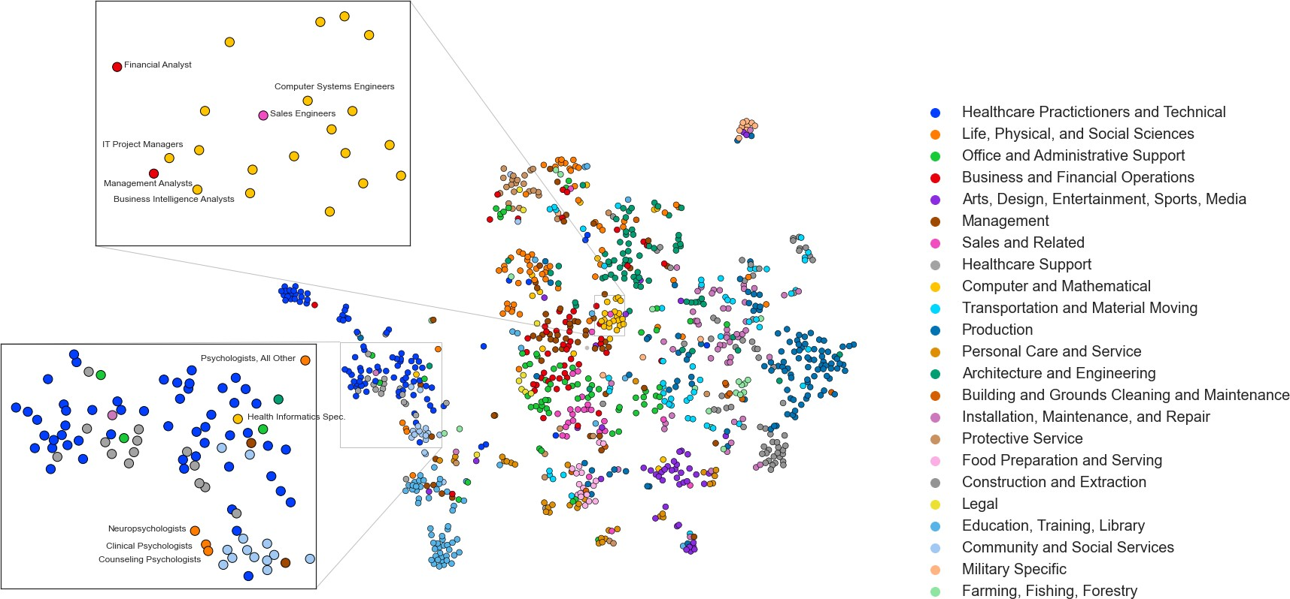
Landmark Occupation Vector Space

Slide 5
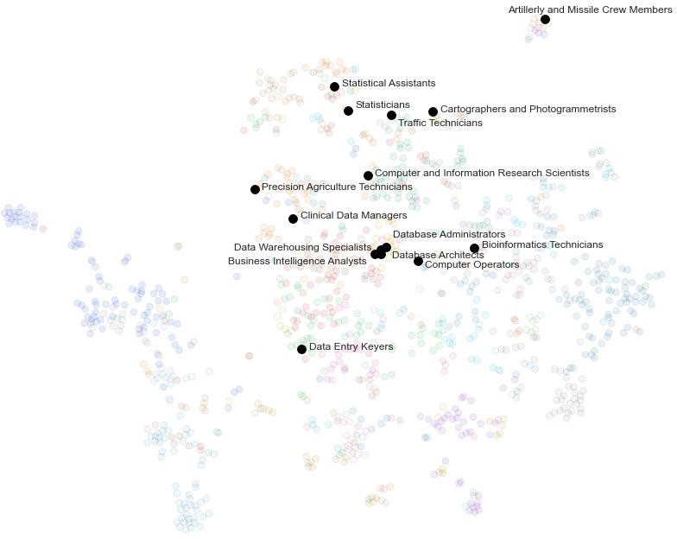
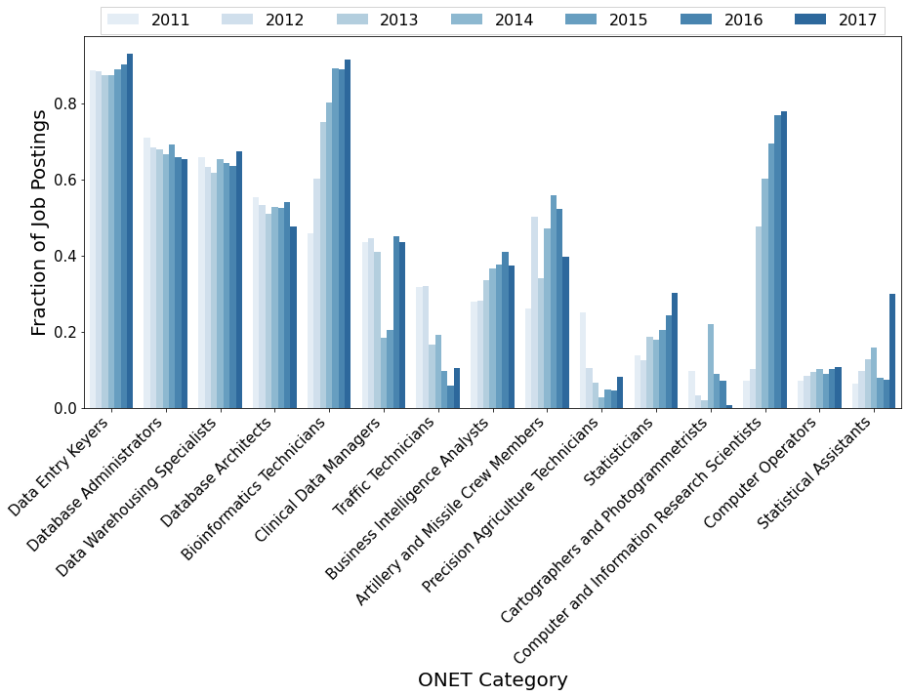
Distance to Landmark “Data” Occupations
Compute minimum distance to data landmark
Distance function
𝑑_{𝑖,𝑑} = 1 − cos 𝜃_{𝑖,𝑑} = 1 −
𝐀 ∙ 𝐁
𝐀 𝐁
𝐸_{𝜏} ≈ ෍ cos 𝜃∗ 𝑝 𝑊 𝐻
𝜔 𝜔 𝜔 𝜔
𝜔∈Ω
5
5/16/2021

Slide 6
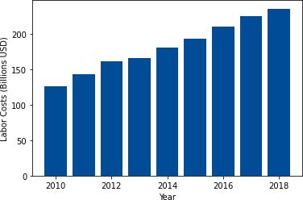
Labor Costs Estimates for Data-Related Activities
𝐸_{𝜏} ≈ ෍ 1 − 𝑑∗ 𝑝
𝑊 𝐻
𝜔 𝜔 𝜔 𝜔
𝜔∈Ω

Slide 7
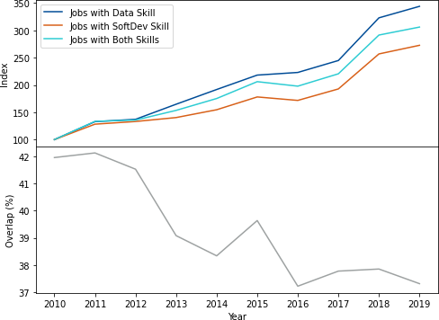
Assessing Overlap with Software Development
38% of data-interfacing jobs have software development skill

Slide 8
Conclusions and Future Work
Combine ML with online job postings to estimate labor costs of data activities
…Annual spending ranges depending on the technique
…Similarity adjusted spending estimates come in around $200 billion annually
Future work aims to address overlap between data, R&D, and software investment
…National accounts may already capture spending on data, but how much?
…Preliminary estimates suggest around 38% of SoftDev jobs overlap
Combining estimates using similar NLP techniques could yield more reliable estimate
…Many document embedding/similarity approaches exist, e.g. LDA, WMD
…Ensemble approaches usually yield more reliable estimators
Data is ubiquitous, but not nearly as exciting as popular anecdotes suggest
…Think data collected from oil changes, customer call records
…Data is everywhere, but will it show up in the productivity statistics?
8
5/16/2021

