Slide 1
An update on recording of Data as capital formation
Group of Experts on National Accounts 2021, 18 May, 2021
John Mitchell

Slide 2
Data as an asset
Preliminary guidance note in 2020 – presented at UNECE webinars last year.
Generated agreement on several key issues (Data can be an asset, it is distinct from the “OPs” that underpin it).
Updated issues paper presented to AEG in April 2021, provided options for several areas:
What costs associated with “acquiring” data should be included in the valuation of the data asset.
The exclusion of OPs from the SNA asset boundary.
If any component of the data asset should be considered non-produced.

Slide 3
Guiding principles for the recording of Data
Currently there is no final recommendations on a preferred treatment, however, there is support for certain principles:
A preference for a “prudent” estimation methodology for any produced data asset, no significant or open-ended changes to GFCF and GDP.
A preference for no extension of the production boundary, when it comes to the emergence of OPs, especially within the household sector.
A preference for a practically feasible methodology, when it comes to implementation.

Slide 4
Definition of Data
Current working definition for measurement
“Data is information content that is produced by accessing and observing phenomena; and recording, organizing and storing information elements from these phenomena in a digital format, which can be accessed electronically for reference or processing”
Everyone creates phenomena (people, economic units, nature)
Not considered production in the national accounts, now or in the future.
Some units produce data from this phenomena
Not considered production now, but likely in the future

Slide 5
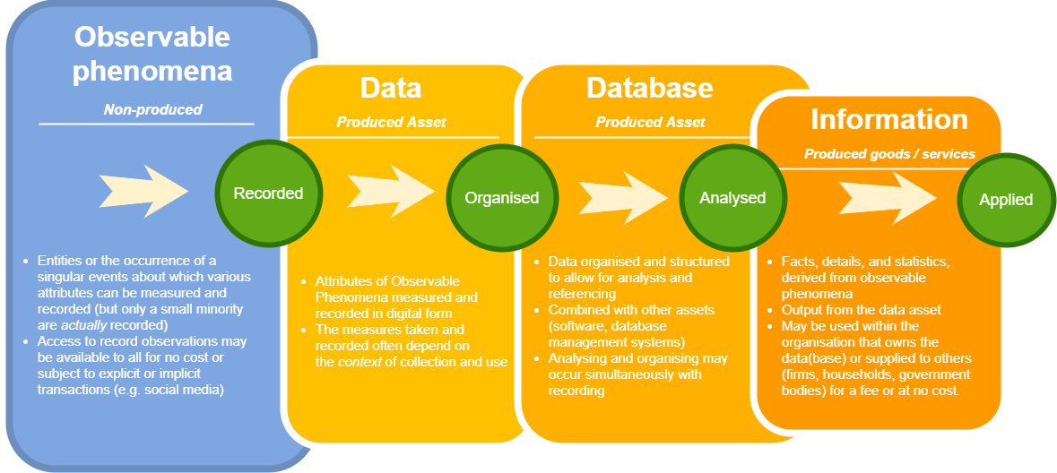
The OP – Data pathway

Slide 6
How to value data
Very limited information on market price of data or the value of accessing OPs.
Sum-of-cost seen as most likely valuation method (already in use for R & D and other IPP)
Preliminary sum-of-cost work using specific occupations and other intermediate costs to value data assets already exists (Canada, USA and others)
Conceptually, what costs should be included?

Slide 7
What costs to include

Slide 8
Delineating costs of producing data
“Data is information content that is produced by accessing & observing phenomena and recording, organizing and storing information elements from these observable phenomena in a digital format, which can be accessed electronically for reference or processing”
Recording and processing costs
appears consensus that these should be considered as an act of production.
OP procurement costs
Current SNA explicitly states to exclude “the cost of acquiring or producing the data”.
The previous TT GN stated that the value of own account data should include “the costs of collecting or acquiring observable phenomena”.
How do firms access the phenomena?
What does access costs actually mean?
Which is right choice?

Slide 9
Obtaining access to OP
Three basic ways in which firms acquire (access to) OPs:
In exchange for free services; (lots of access costs)
Social media, free phone apps
By explicitly purchasing them; (some access costs)
Coinout, Amazon, consumer research
As a by-product of the primary production process. (minimal or even no access costs)
Retail, financial services, logistics (this may include additional recording devices inserted on finished products)

Slide 10
OP procurement costs (Additional considerations)
Are all OP procurement costs created equal?
OP costs non existent, a by-product of conventional production. Does this make the data asset less valuable?
OPs accessed due to creation of new platforms, this involves complex research, as well as significant labor and capital required as input
OPs are purchased, minimal or no labor and capital involved, it is a simple transaction
Level of production and/or resources required
Value of data asset potentially unrelated to the level of production associated with gaining access.

Slide 11
OP procurement costs (Additional considerations)
The OP procurement costs often have a second benefit, on top of the access they provide.
Example
Is the main point of social media assets to:
produce data
produce advertising

Slide 12
OP procurement costs (Additional considerations)
Many of the costs are likely already captured
in other assets.
R & D,
Software
Databases
Data
Software
Databases
How to separate?
Which asset takes “priority”?

Slide 13
What costs to include?
Is it easier to leave OP procurement costs out?
If we do so, are we ignoring where the value comes from?
These costs are likely to become more fundamental to the creation of a data asset.
“access to capital is no longer the biggest problem for startups. It is access to data.”

Slide 14
Remaining points for resolution
As well as which costs to include, there remains additional considerations before any final guidance can take place.
How is data sold?
Provision of a service, sale of an asset, license
Is data entirely a produced asset?
Could the expenditure on OP procurement be considered a proxy amount for a non-produced component of the data asset
Confirmation of production and consumption of short-lived data.
Not all data is used for more than one year
Explicit transactions in OP?
Are these a purchase of asset/rent payment/other?

Slide 15
Thanks John.Mitchell@oecd.org

